Slide 1
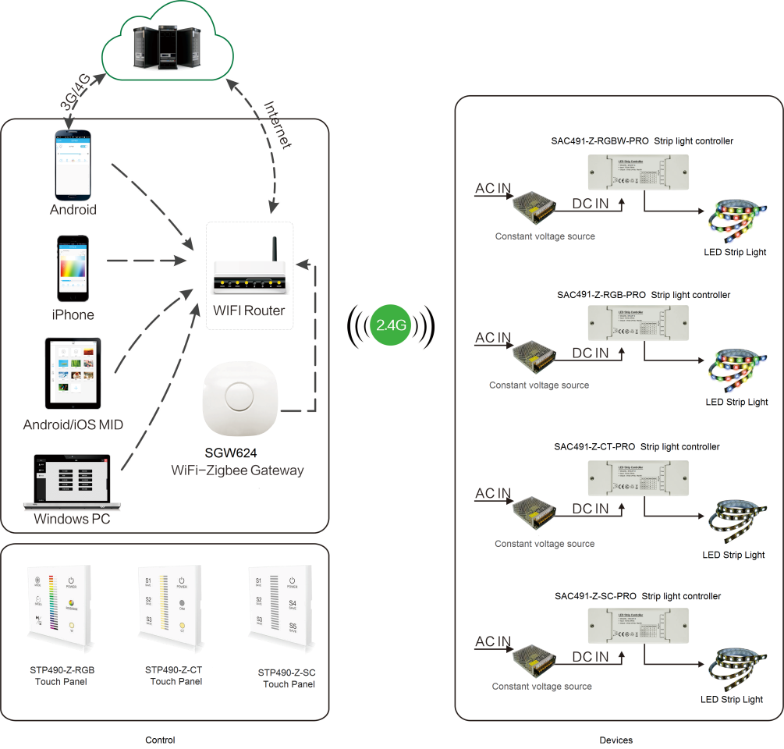
System Diagram

Slide 2
Features
Based on HA1.2 standard
Built-in Ethenet 2.0 controller.
Support 1 administrator account and 10 sub-account
Supports large number of 2,500 devices connection.
Support 100 ZigBee devices and 30 groups.
Each account supports 20 areas + 30 scenes + 20 timers
Each timer supports 20 devices or groups
Support multiple gateways in the LAN
Support Over-the-Air upgrade

Slide 3
Parameter
Parameter | SGW624-XX
Power Adapter | 100-240Vac
Gateway Input | 5V
Frequency | 2.4GHz
Operating Temperature | -20°C to 55°C
Control Range(To First Device) | 30m
OTA | Yes

Slide 4
Installation
For installation details, please contact us for spec. for your ref.

