Slide 1
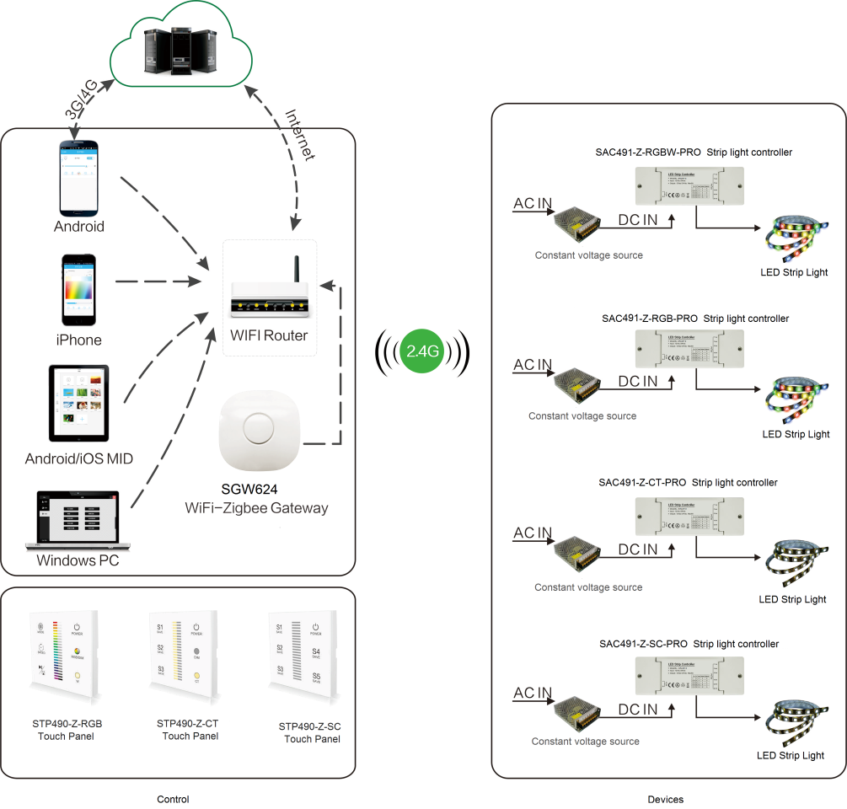
System Diagram

Slide 2
Features
Based on HA1.2 standard protocol
Built-in ZigBee 2.4G wireless transceiver module
Supports large number of 2,500 devices connection.
Remote controller work with ZigBee lighting system
Control up to 4 devices either at one time or individually

Slide 3
Parameter
Parameters | SRC-700
Battery Type | 2 x AAA batteries
Battery Voltage | 3V
Range outdoor/ indoor | 100m/30m

Slide 4
Installation
For installation details, please contact us for spec. for your ref.

