Slide 1
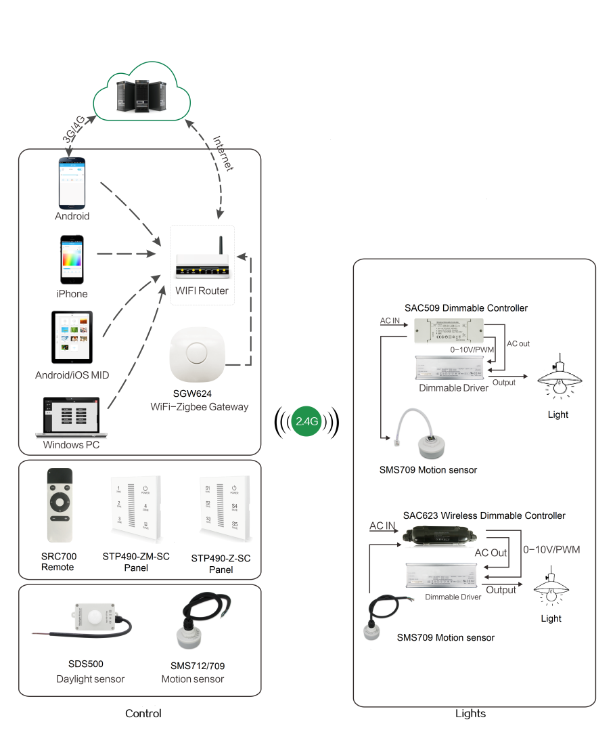
System Diagram

Slide 2
Features
Based on HA1.2 standard protocol
Built-in ZigBee 2.4G wireless transceiver module
Automatic induction of human motion
Built-in Motion sensor and daylight sensor

Slide 3
Parameter
Parameters | SMS709
Input Voltage | DC5V
Microwave frequency | 5.8 GHz +/- 75MHz
Transmitting power | <0.2mW
Detection range | 13-15m
Detection angle | 30°~ 150°
IP rating | IP65
Working temperature | -20℃ ~ +60℃

Slide 4
Installation
For installation details, please contact us for spec. for your ref.

