Slide 1
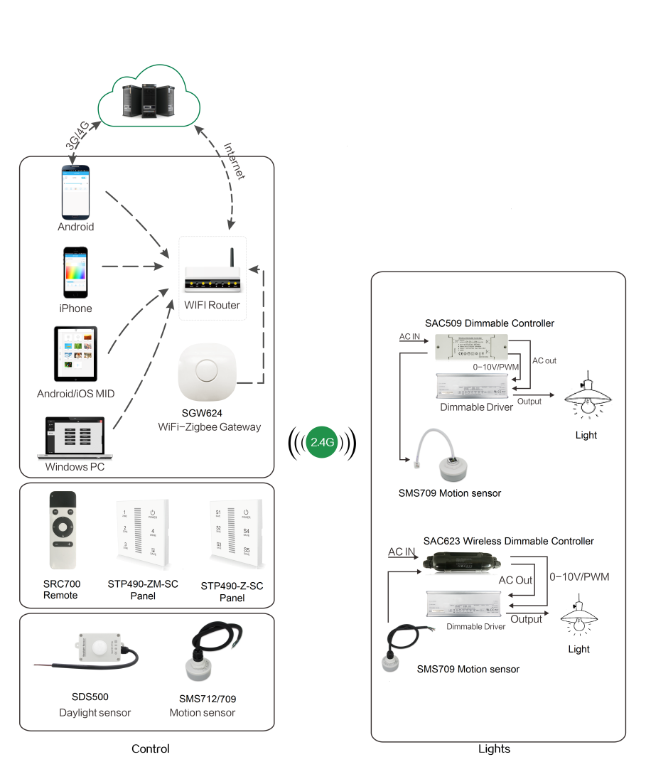
System Diagram

Slide 2
Features
Based on HA1.2 standard protocol
Built-in ZigBee 2.4G wireless transceiver module
Automatic induction of human motion
P65 waterproof
Support Over-the-Air upgrade

Slide 3
Parameter
Parameter | SMS712
Input Voltage | 100~277Vac 50/60Hz
Microwave Frequencies | 5.8 GHz +/- 75MHz
Microwave Power | <0.2mW
Detection Zone | 8-15m
Detection Angle | 30°~ 150°
Operation Temperature | -20℃ ~ +60℃

Slide 4
Installation
For installation details, please contact us for spec. for your ref.

