Slide 1
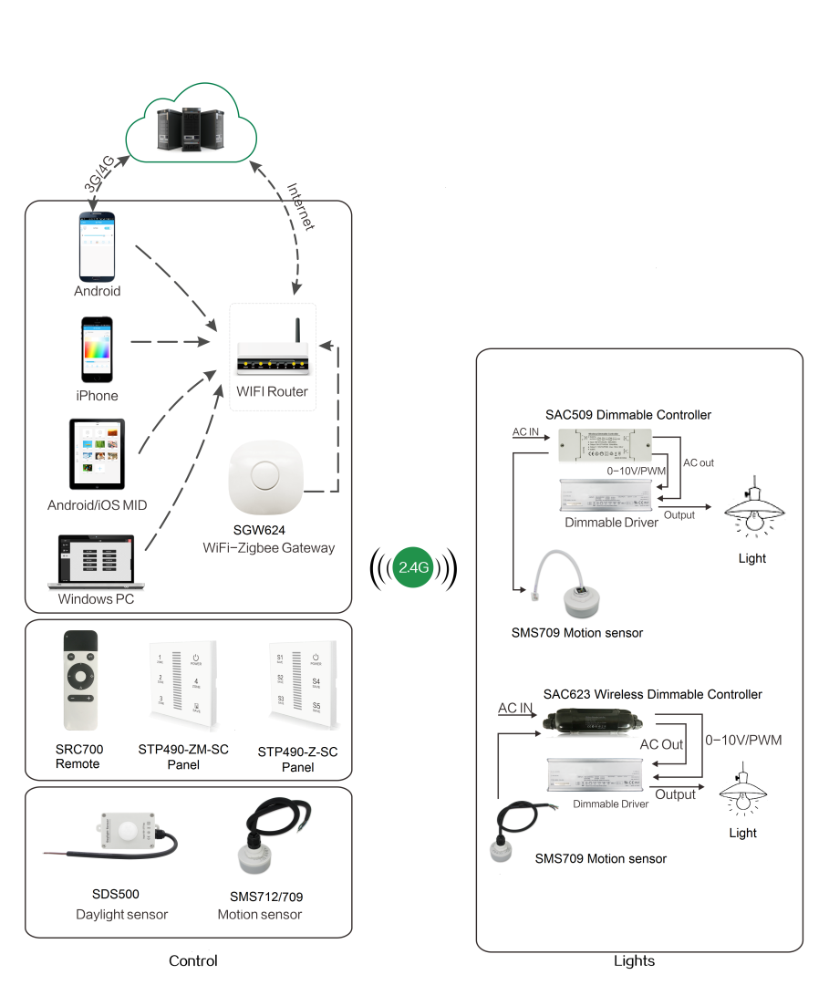
System Diagram

Slide 2
Features
Based on HA1.2 standard protocol
Built-in ZigBee 2.4G wireless transceiver module
Supports large number of 2,500 devices connection
Singel color and Change color temprature 2 versions.
Wireless control dimming, toning and setting scenarios
Different channels with different functions
Touch screen control
Work with -20-55℃ temperature

Slide 3
Parameter
Parameters | STP590-Z-XX
Input power | 100-277VAC
Wireless frequency | 2.4GHz
Operation temp. | -20°C to 55°C
Transmission Dist. | 30m
Standby power | <1W

Slide 4
Installation
For installation details, please contact us for spec. for your ref.

