Slide 1
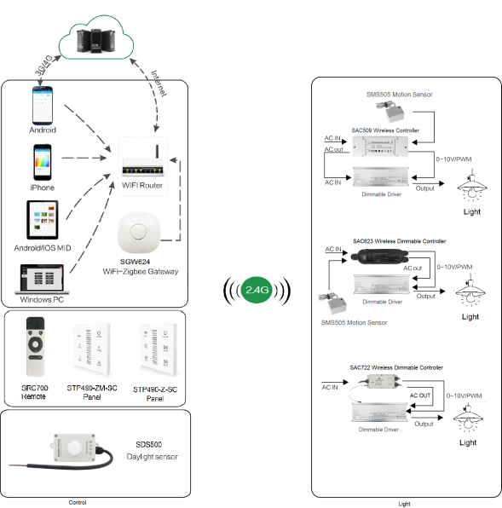
System Diagram

Slide 2
Features
Based on HA1.2 standard protocol
Built-in ZigBee 2.4G wireless transceiver module
Supports large number of 2,500 devices connection.
Able to achieve short & long distance controlling LED lights by
multi solutions
Work with 1-10V or 0-10V dimming drivers, daylight sensor
and motion sensor
Built-in lighting protector, 6KV
Internal antenna
Power metering
Support Over-the-Air upgrade

Slide 3
Parameter
SAC623-XX-PM-1C-IA-R-OTA
Patameter | SAC623-BS-PM-1C-IA-R-OTA | SAC623-MB-PM-1C-IA-R-OTA | SAC623-MD-PM-1C-IA-R-OTA | SAC623-3-PM-1C-IA-R-OTA
Performance | Dimming | Motion Binding | Motion+ Daylight | Dimming+Motion +Daylight
Input Power/ Voltage | AC 100-277Vac 50/60Hz 1-10V
0-10V Max Current | 15mA Max
Relay Max Current | 5A Max
Frequency | 2.4GHz
Control Distance | 20-30m
Operation Temp. | -40°C to 85°C
Waterproof | IP65
Note：a.The terminal of the product bears the maximum torque torque≦0.3N. m b.Shell lock screw bearing maximum torque torque≦0.2N.m

Slide 4
Installation
For installation details, please contact us for spec. for your ref.

