Slide 1
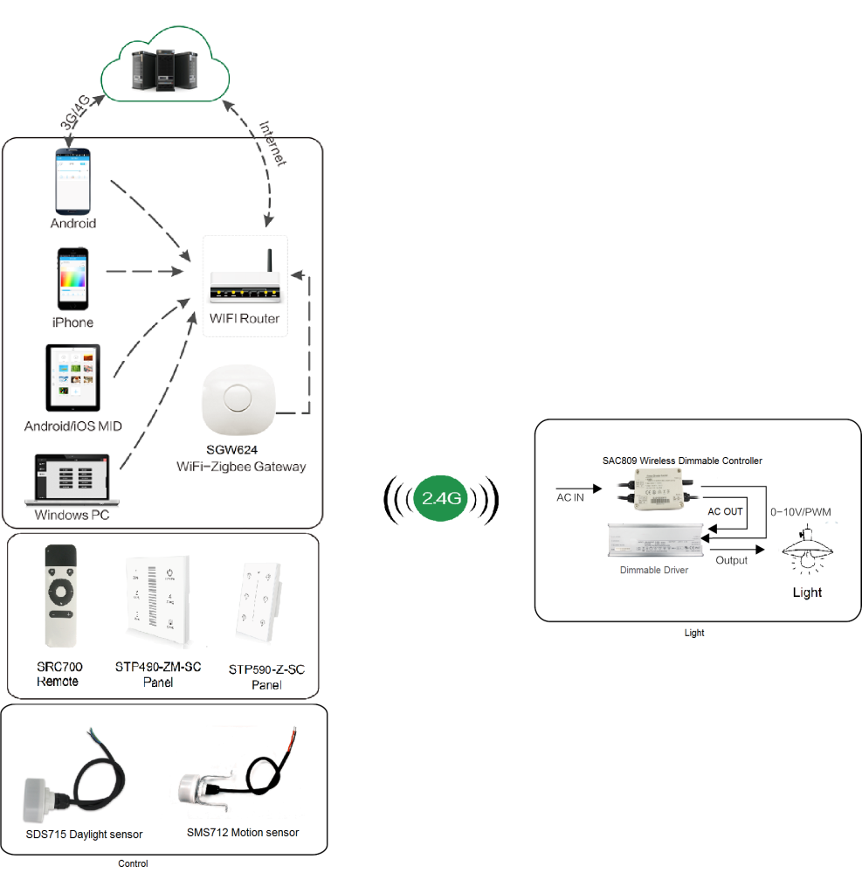
System Diagram

Slide 2
Features
Based on HA1.2 standard protocol
Built-in ZigBee 2.4G wireless transceiver module
Supports large number of 2,500 devices connection.
Able to achieve short & long distance controlling LED lights
by multi solutions
Work with 0-10V dimming drivers. Work with daylight sensor
and motion sensor
Built-in lighting protector, 6KV
IP65 waterproof
Power metering
Support Over-the-Air upgrade

Slide 3
Parameter
SAC801-PM-XX-OTA
Parameters | SAC801-PM-EA-OTA | SAC801-PM-EAC-OTA | SAC801-PM-BEAC-OTA
Input Power/ Voltage | AC 100-277Vac 50/60Hz 1-10V PWM (15mA Max)
Relay Max Current | 5A
PF | > 0.3 (MAX Load)
Frequency | 2.4GHz
Control Distance | 30m | 30m | 100m
Operation Temperature | -20°C to 70°C

Slide 4
Installation
For installation details, please contact us for spec. for your ref.

