Slide 1
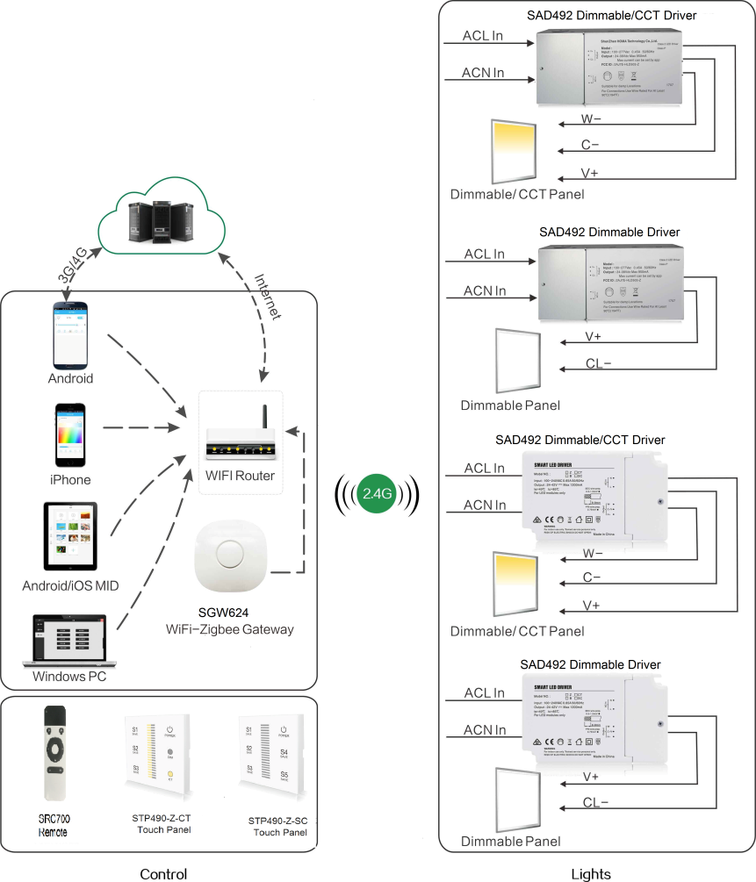
System Diagram

Slide 2
Features
Based on HA1.2 standard protocol
Built-in ZigBee 2.4G wireless transceiver module
Supports large number of 2,500 devices connection.
Able to achieve short and long distance controlling LED
lights by multi solutions
Monochromatic, bicolor is optional.
Work with motion sensor, daylight sensor.
Power metering. ( optional)
EU & US version.
Support Over-the-Air upgrade

Slide 3
Parameter
Model List | SAD492-SC/CT-MD/MB/BS(PM)/2-IA-EU/US-OTA
Parameters | SAD492-SC-XX-IA-XX-OTA | SAD492-CT-XX-IA-XX-OTA
Input Voltage | EU:100-240Vac US:100-277Vac
Output Channel (Optional) | 1 Channel | 2 Channels
Output Current | 1200mA Max | 1050mA Max
Output Voltage | 24-42VDC （46VDC MAX at No Load）
PF | > 0.9 (MAX Load)
Efficiency | 85% Max
Wireless Frequency | 2.4GHz
Transmission Dist. | 20-30m | 20-30m
Operation Temp. | -20℃ to 55℃

Slide 4
Installation
For installation details, please contact us for spec. for your ref.

