Slide 1
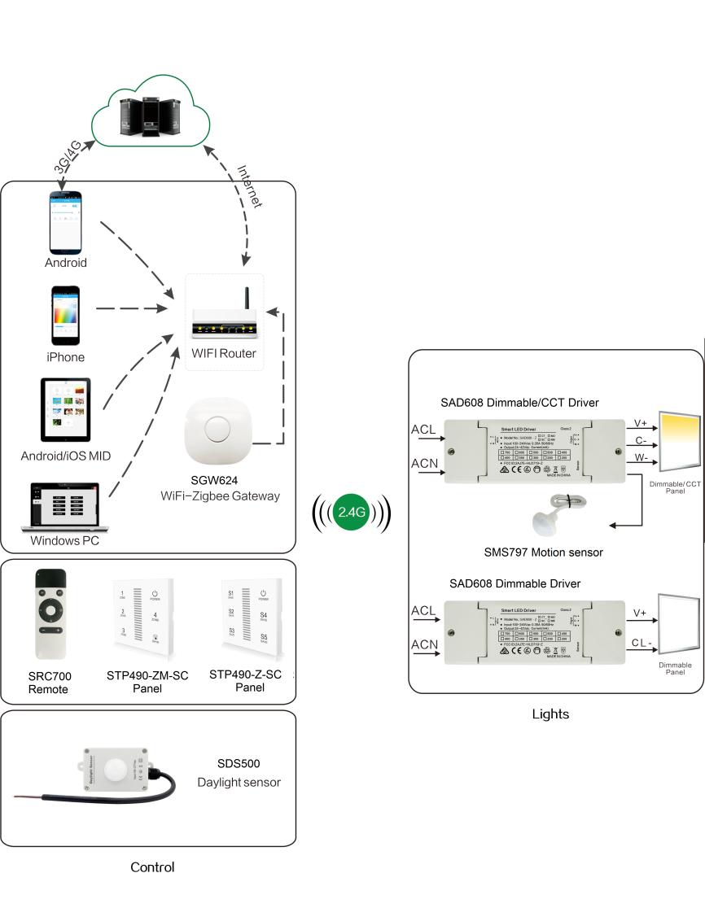
System Diagram

Slide 2
Features
Based on HA1.2 standard protocol
Built-in ZigBee 2.4G wireless transceiver module
Supports large number of 2,500 devices connection
Able to achieve short and long distance controlling LED
lights by multi solutions
Monochromatic, bicolor is optional.
Work with motion sensor, daylight sensor.
Support Over-the-Air upgrade

Slide 3
Parameter
Parameter | SAD608-XX
Input power | 100-240VAC
Channels | 2 Channels or 1 channel
Output Current | 700mA MAX (Can be set by Android APK)
Output DC | 24-42V
PF | > 0.9
Efficiency | Max 85%
Wireless frequency | 2.4GHz
Operation Temp | -20°C to 55°C
No land power | <0.75W

Slide 4
Part No.
SC: Single color CT: Change color temperature
MD : Motion + Daylight MB: Motion binding
Part Number | Dimmable Version | CCT Version | Sensor interface | Motion Function | Daylight Function
SAD608-SC | Y | - | - | - | -
SAD608-SC-MD | Y | - | Y | Y | Y
SAD608-SC-MB | Y | - | Y | Y | -
SAD608-CT | - | Y | - | - | -
SAD608-CT-MD | - | Y | Y | Y | Y
SAD608-CT-MB | - | Y | Y | Y | -

Slide 5
Installation
For installation details, please contact us for spec. for your ref.

