Slide 1
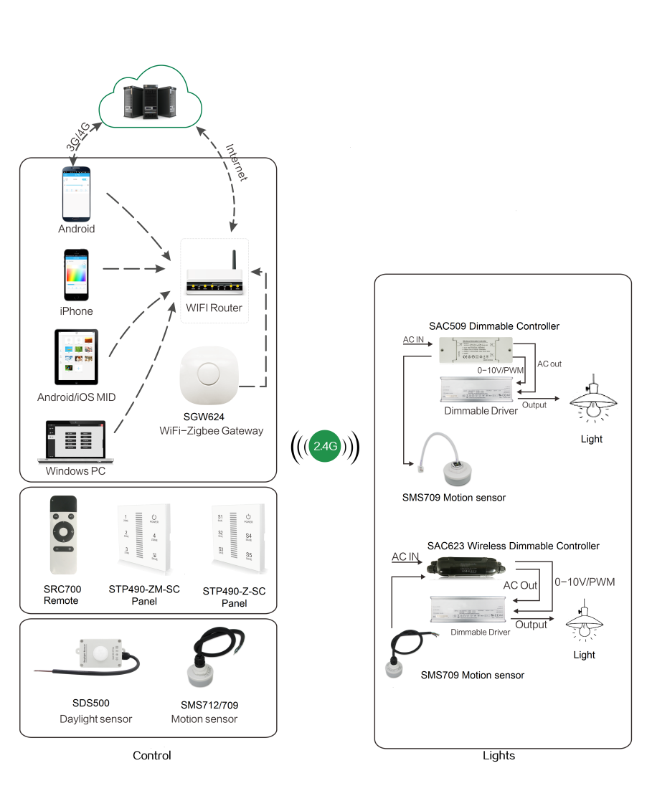
System Diagram

Slide 2
Features
Based on HA1.2 standard protocol
Built-in ZigBee 2.4G wireless transceiver module
Supports large number of 2,500 devices connection
The parameter could be set by application.
The daylight sensor will change light brightness based on
current lux and target lux.
IP65 waterproof
Support Over-the-Air upgrade

Slide 3
Parameter
Parameter | SDS500-Z-AC-PRO | SDS500-Z-DC-PRO
Input | AC100-277V | DC12V
Frequency | 2.4GHz | 2.4GHz
Operating Temperature | -40°C to 85°C | -40°C to 85°C
Lux Range | 0-8000lux | 0-8000lux
Sensitivity | 10lux | 10lux
Waterproof | IP65 | IP65
OTA | Yes | Yes

Slide 4
Installation
For installation details, please contact us for spec. for your ref.

