Slide 1
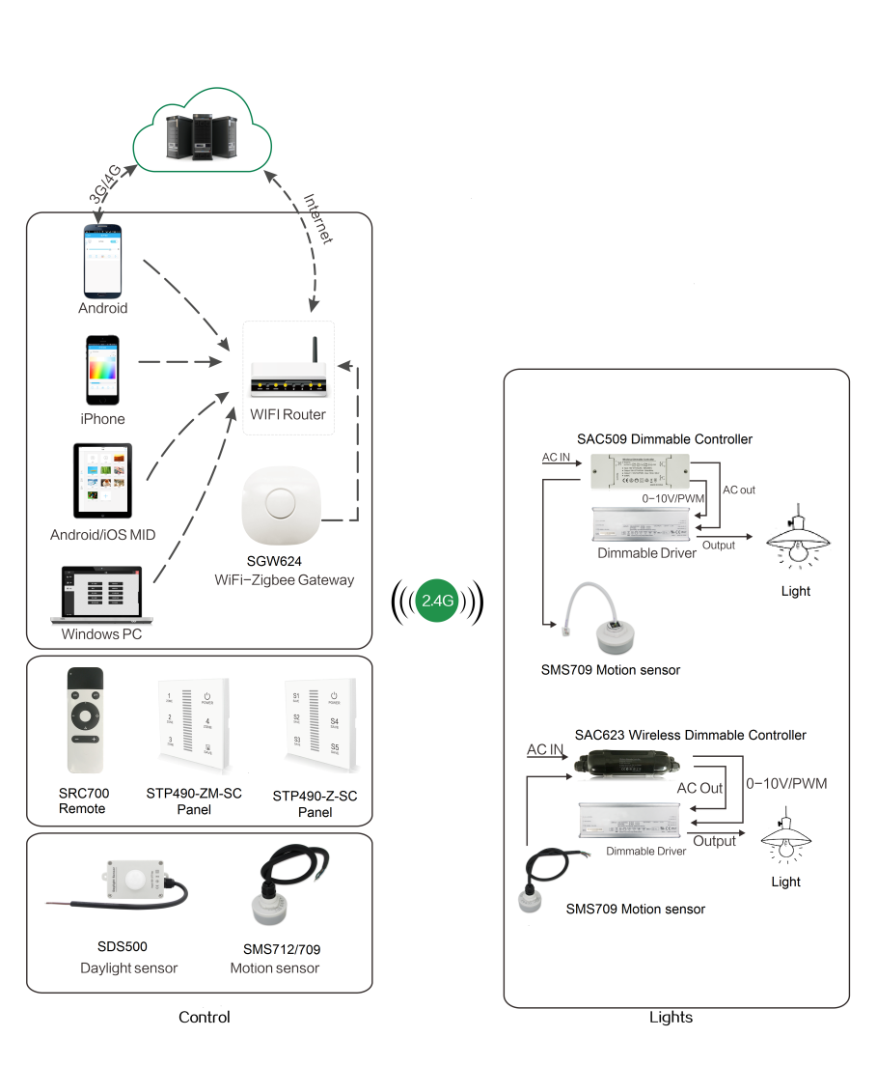
System Diagram

Slide 2
Features
Based on HA1.2 standard protocol
Built-in ZigBee 2.4G wireless transceiver module
Supports large number of 2,500 devices connection
Single color (SC) and change color temp.(CCT) are
optional.
Communication distance is more than 30 meters
The parameter could be set by application.
Light brightness would be adjusted according to your
setting.
P65 waterproof
Support Over-the-Air upgrade

Slide 3
Parameter
SDS715-XX-WP-OTA
Parameter | SDS715-SC-WP-OTA | SDS715-CT-WP-OTA
Input Voltage | AC 100-277Vac 50/60Hz
Wireless Frequency | 2.4GHz
Control Distance | 20-30m
Operation Temperature | -40°C to 85°C
Lux Detection Range | 0-65528lux
Detection Accuracy | ±10lux

Slide 4
Installation
For installation details, please contact us for spec. for your ref.

