Slide 1

A Case For Rust
Oxidize your stack!

Slide 2
What is Rust?
High level systems programming language
  No, this is not an oxymoron
High performance and highly productive
Moves run time errors into compile time errors
  More on this later
Expressive type system
Haskell in C++’s clothing
Compiler enforces memory safety and disallows dataraces
  The compiler literally will refuse to compile code that has a datarace condition or potential memory corruption

Slide 3
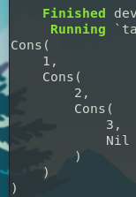

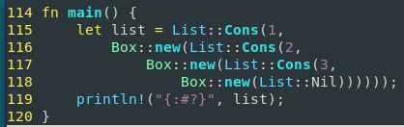
Basic Language Features
Of course, int, float, string…
Also enum, but better!
  Rust enums are actually tagged unions

Slide 4
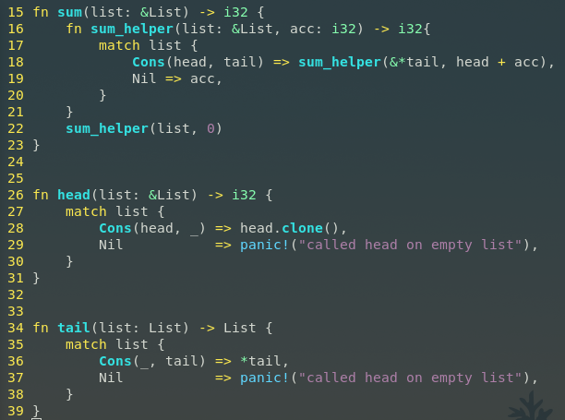
Enum and Pattern Matching
Pattern matching on enums must be exhaustive, i.e., the compiler requires that you handle every case.
Pattern matching allows you to access the fields of an enum

Slide 5
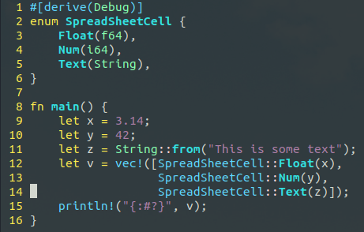
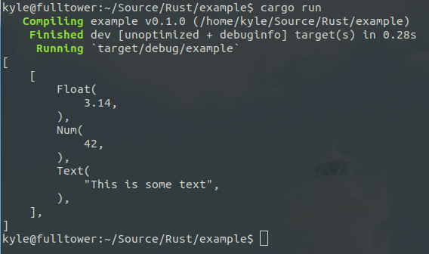
Instead of Dynamic Typing...
Rust is a strongly and staticly typed language
One can however utilize enums in places where dynamic typing is useful, such as putting items into an array or vector
One can then pattern match over the data to do the correct operation with the correct type

Slide 6
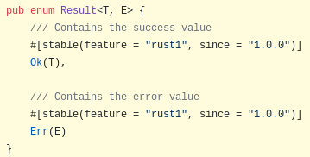
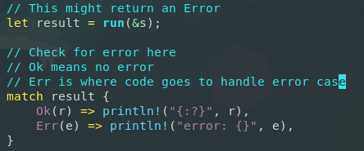
Error Handling
No Exceptions!
Exceptions do not exist in the language, and neither does Null
  This means it is not possible to dereference a Null pointer!
Errors must be handled explicitly, or returned to the caller by using a Result type

Slide 7
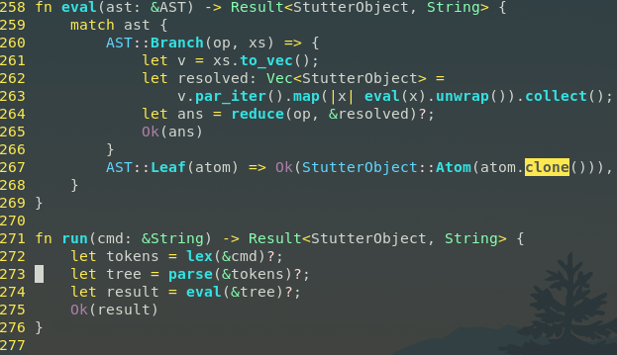
Error handling and Patern Matching in Action!
Error handling as a part of the type system
Exhaustive Pattern Matching
Closures (AKA Anonymous functions, AKA Lambda functions)
Either handle errors as they come, or pass them down the line as a Result::Err type

Slide 8
No Segfaults
The Rust compiler checks for any potential memory issues such as
  Dangling pointers
  Use after free
  Buffer overflows
  Race conditions while multithreading
The Rust compiler checks for these conditions and will not compile your code if any of them are present

Slide 9
Easier Multithreading
Even if you don’t write close to the metal code and use a GC’d language, everyone has to worry about race conditions in multithreading
Rust will ensure that your code has no race conditions at compile time
This eliminates an entire class of errors that can be very hard to detect and even harder to fix

Slide 10
Easier Multithreading
How does Rust ensure no race conditions?
Rust uses something called a “Borrow Checker” to ensure that there is no more than 1 mutable reference to an object at any given time
Rust supports message passing to communicate between threads
Rust also supports shared memory, and requires that you uphold that no 2 threads can mutate the memory at once
You can do this by wrapping a shared object in a Arc smart pointer, and using a mutex lock
  Arc is an Atomic Reference Count smart pointer that uses hardware provided atomic primitives to ensure that only one thread can alter the reference count at a time

Slide 11
RAII Instead of GC
RAII
  Resource
  Acquisition
  Is
  Initialization
This is a concept borrowed from C++, which means
  Allocate memory for an object when it comes in scope
  Deallocate memory when the object goes out of scope

Slide 12
RAII Instead of GC
Rust favors stack allocation over heap allocation, which cleans up memory for free
Heap allocations are done using smart pointers, which free the memory when it goes out of scope
Smart pointers mean you can `new` whatever you want without having to worry about calling `delete` later
You also can call obj.drop() if you want to manage memory manually

Slide 13
RAII Instead of GC
Remember this code?
  Box<List> means this is a smart pointer
  Box::new heap allocates an object within a smart pointer
  Memory Allocated here
  Memory Deallocated here

Slide 14
RAII Instead of GC
This means you get all the benefits of manual memory managed systems without having to actually manage memory yourself!
Rust has NO Garbage Collector, meaning you get performance on par with C

Slide 15
Performance
Move by default
  No copy constructor
  Instead, if you want to copy, then you must explicitly .clone() your object
  Pass by reference is encouraged by the compiler
Most checks for safety are done at compile time, so there is a minimal runtime environment (on par with C)
Generics are done in a similar fashion to C++, i.e. through templates that are resolved at compile time
  This is in contrast to many high level languages such as Java and C# which use runtime indirection through pointers to achieve generics

Slide 16
Ecosystem
Helpful compiler with easy to understand error messages
  Anyone who has made an error with C++ templates can understand how helpful good and concise error messages can be
Companies already using it
  Mozilla (Sponsor and largest contributor) – Firefox
  Dropbox
  Cloudflare
  Sensirion – Embedded Sensors
  Amazon – Firecracker
  Google – Fuchsia
  Facebook – Libra, Mononoke
  Microsoft – IoT Edge

Slide 17
Ecosystem
Rust has existing frameworks and packages to support many use cases, including…
  Web Frameworks
    Rocket – (my favorite and similar to Flask)
    Iron
    Nickle
    Warp
    H2
    Hyper
    Tiny-http
  Front end Web through WASM
    smithy
  Game Engines
    Amethyst
    Piston
    SDL bindings
  Embedded
    STM32 (ARM)
    AVR

Slide 18
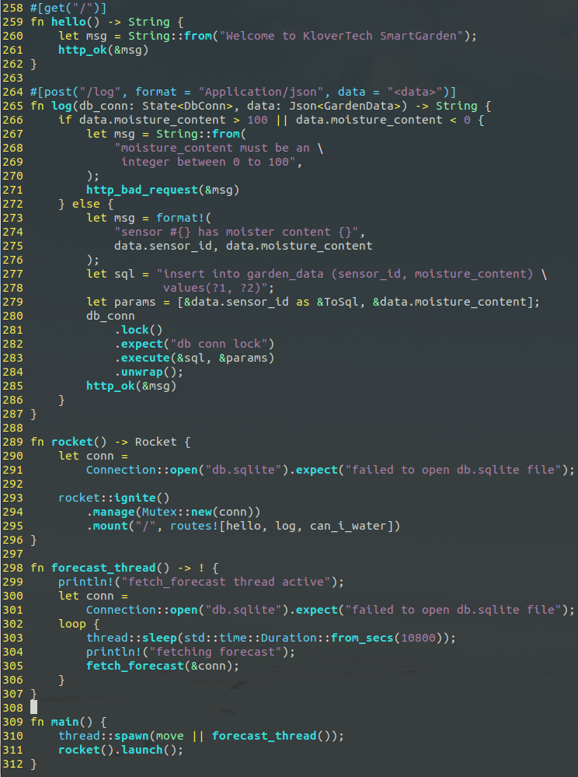
Web –
Rocket Framework

Slide 19
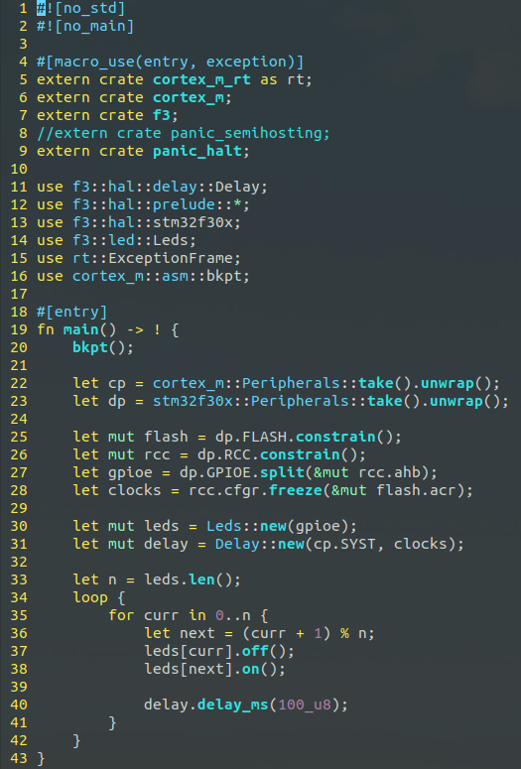
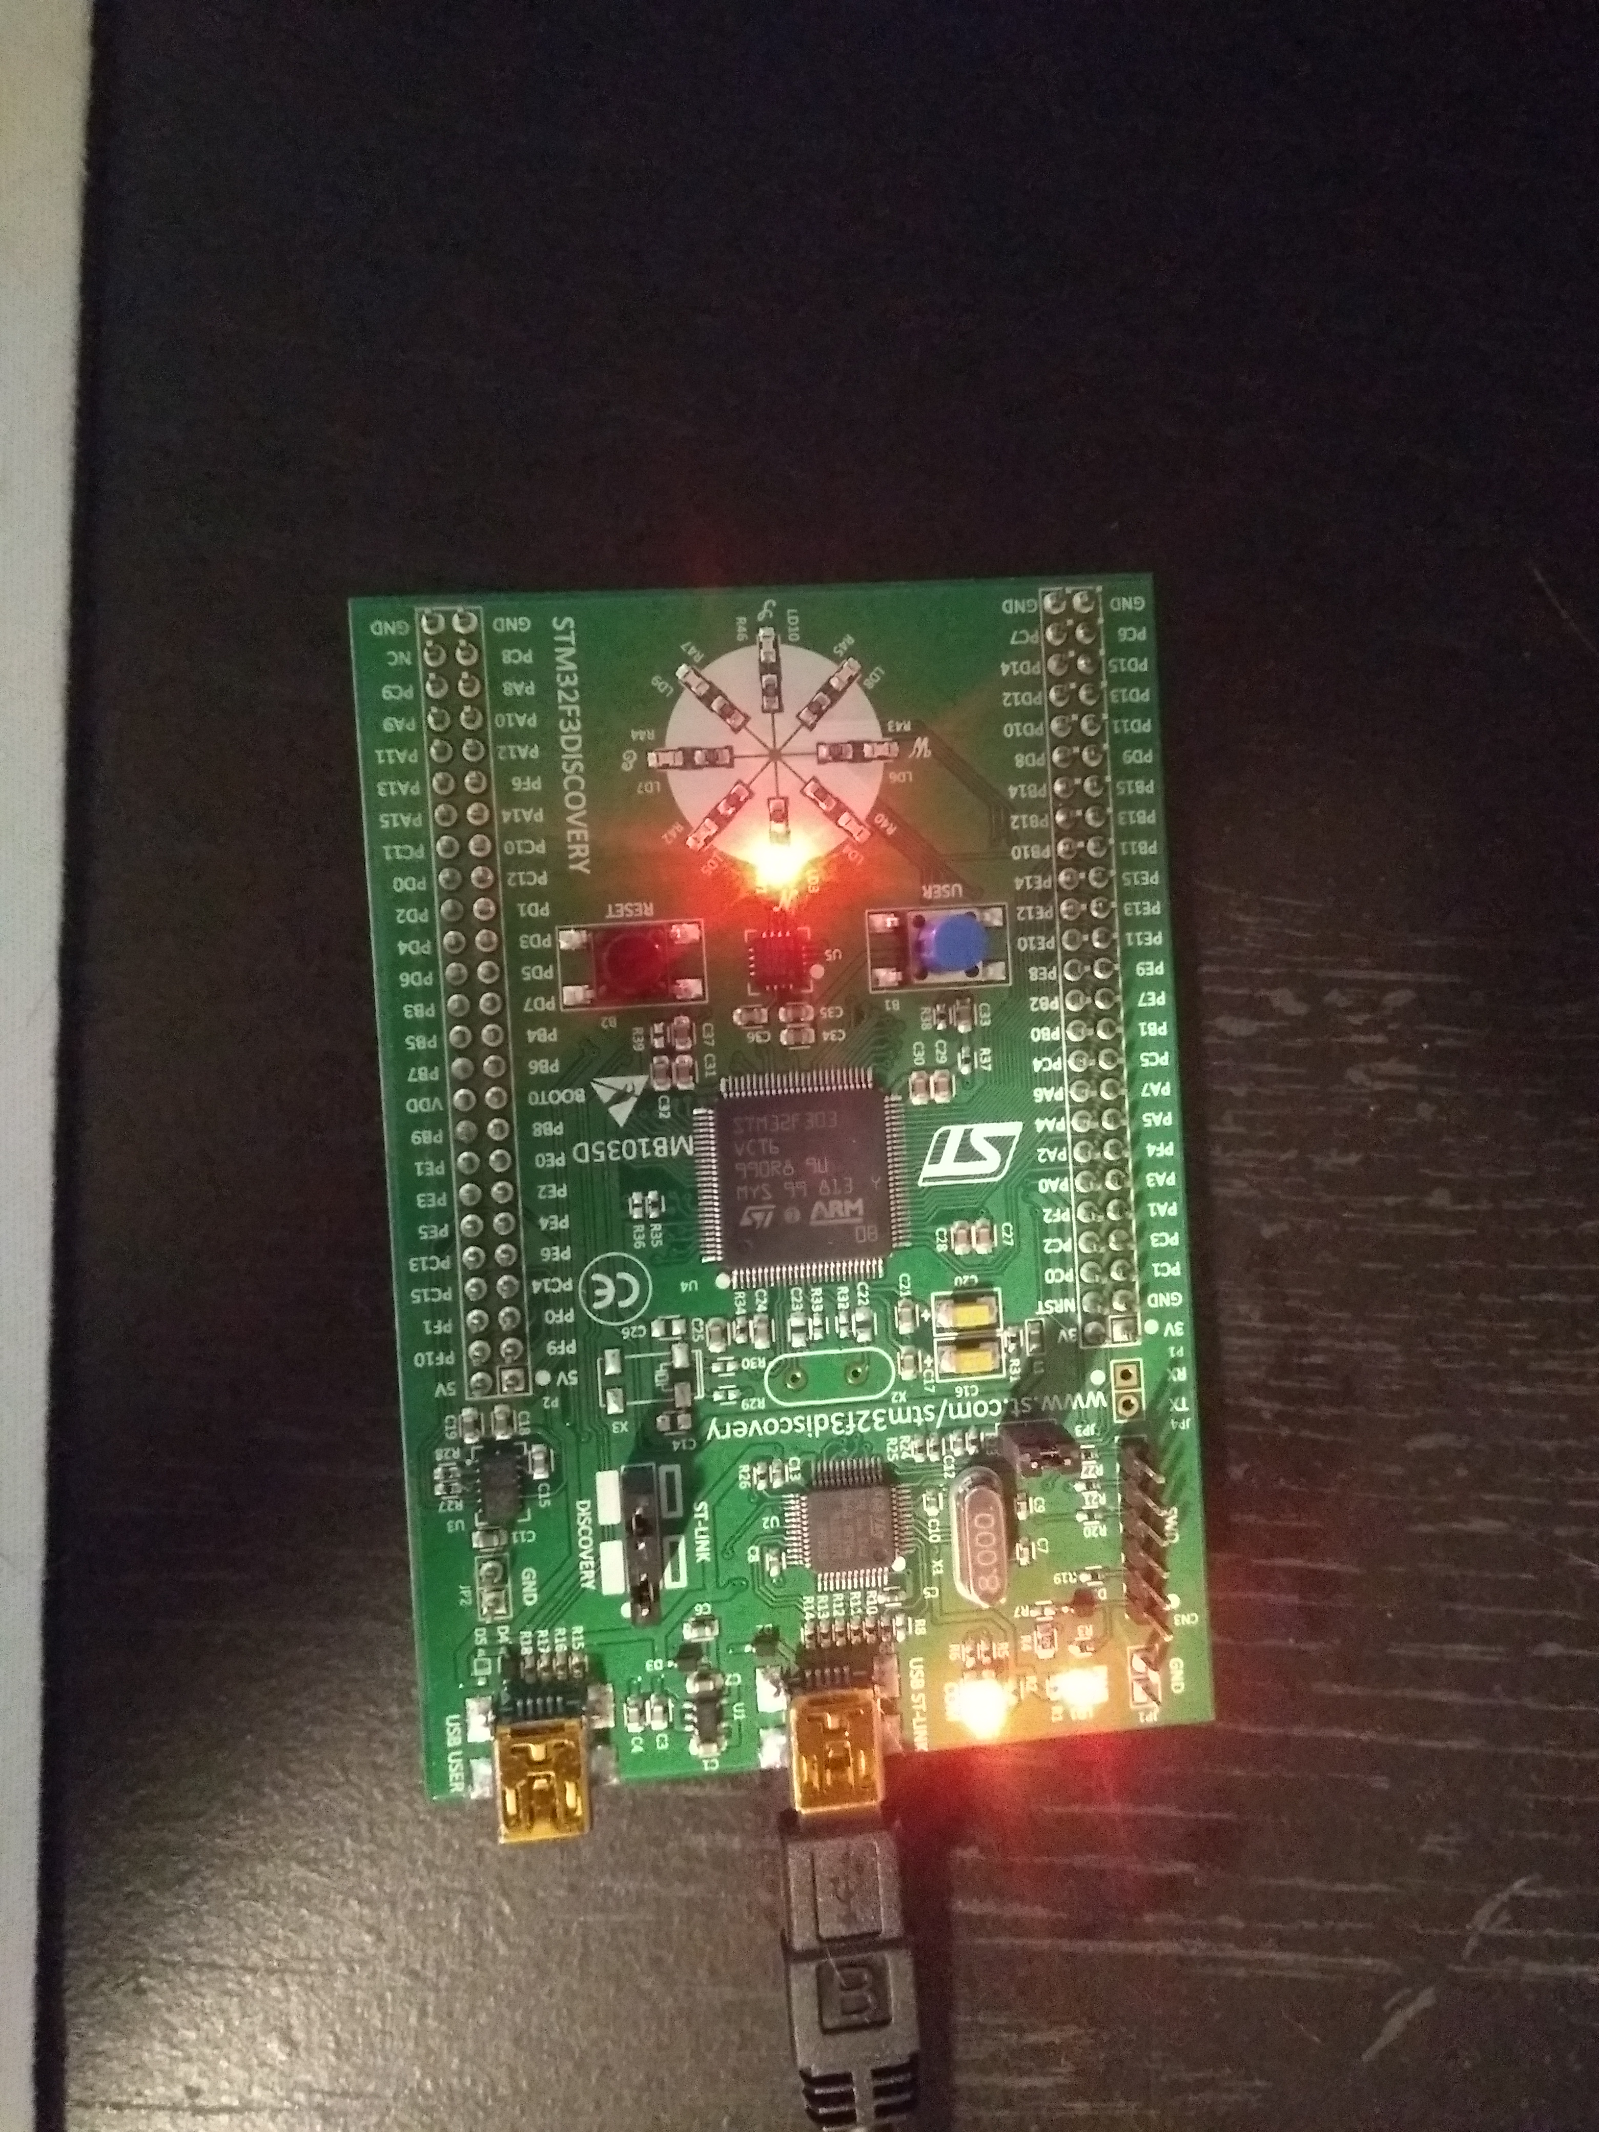
Embedded
This code runs on a microcontroller with no OS or runtime environment
  40 KB RAM
  32 bit
  72 MHz Clock

Slide 20
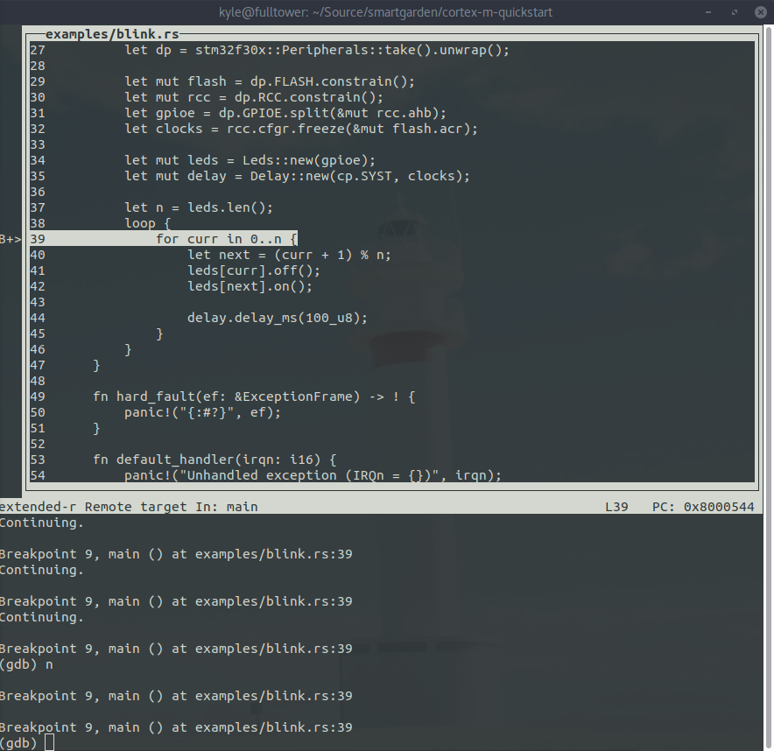
Full GDB Support

Slide 21
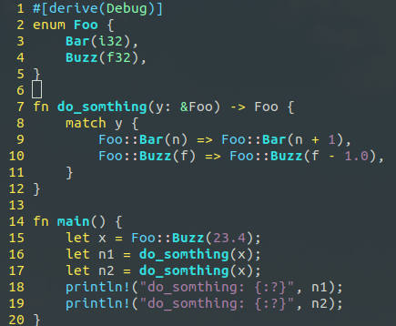
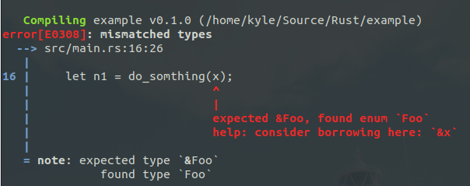
Helpful Compiler
The Rust compiler produces very helpful error messages and often will tell you what code to copy and paste to make your program compile properly

Slide 22
Build System and Package Management
Cargo is the build system and package manager
All dependencies are pinned in the Cargo.toml file
To build, you simply type `cargo build` and cargo will fetch the dependencies from Cargo.toml, compile them, then compile your project with just one command
To build and run, simply type `cargo run`
Builds are automatically done in parallel with however many cores you have available

Slide 23
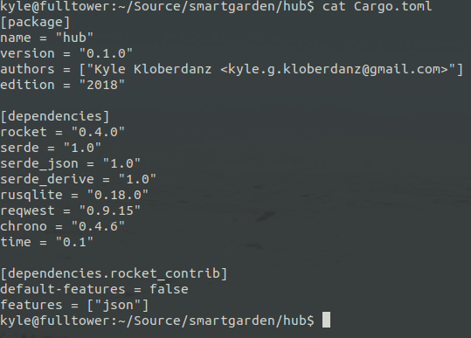
Build System and Package Management

Slide 24
Build System and Package Management
kyle@fulltower:~/Source/smartgarden/hub$ cargo run
Compiling autocfg v0.1.2
Compiling libc v0.2.53
Compiling semver-parser v0.7.0
Compiling rand_core v0.4.0
Compiling version_check v0.1.5
Compiling proc-macro2 v0.4.29
...
Compiling rocket_contrib v0.4.0
Compiling hub v0.1.0 (/home/kyle/Source/smartgarden/hub)
Finished dev [unoptimized + debuginfo] target(s) in 42.01s
Running `target/debug/hub`
fetch_forecast thread active
🔧 Configured for development.
=> address: 0.0.0.0
=> port: 8080
=> log: debug
=> workers: 32
=> secret key: provided
=> limits: forms = 32KiB
=> keep-alive: 5s
=> tls: disabled
=> [extra] databases: { sqlite_db = { url = "db.sqlite" } }
🛰 Mounting /:
=> GET / (hello)
=> POST /log Application/json (log)
=> GET /can-i-water/<sensor_id> (can_i_water)
🚀 Rocket has launched from http://0.0.0.0:8080

Slide 25
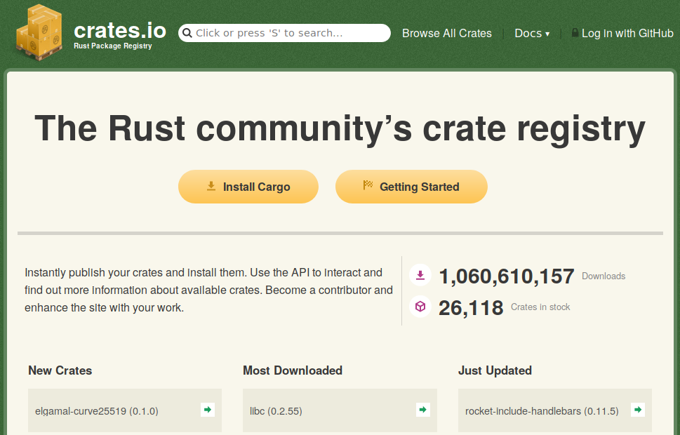
Build System and Package Management

Slide 26
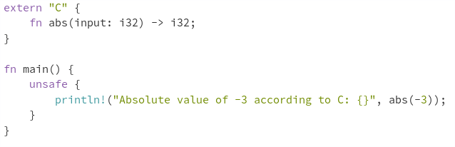

C Compatible Application Binary Interface
Rust can support the C ABI
  To use C in Rust:
  To use Rust in C:
    #[no_mangle] will ensure that the machine code is C ABI compatible
    Build a .h header
    Compile as if it was C
  Tools like bindgen can generate boiler plate for you

Slide 27
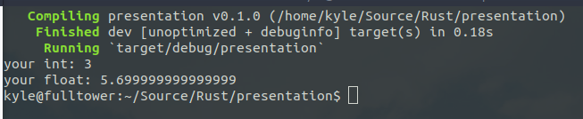
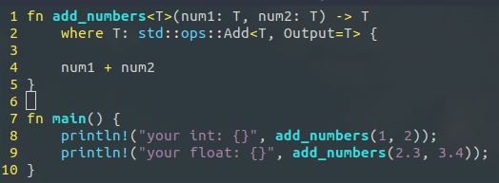
Generics
Compile time templates
Unlike C++, templates are type checked before expanding
  Operations that can be performed on objects are a part of its type, so in order to pass something to the `add_numbers` function, the type signature must match what operations are done on the object within the function.

Slide 28
Generics
What if we want to make our own type work with the `+` operator?

Slide 29
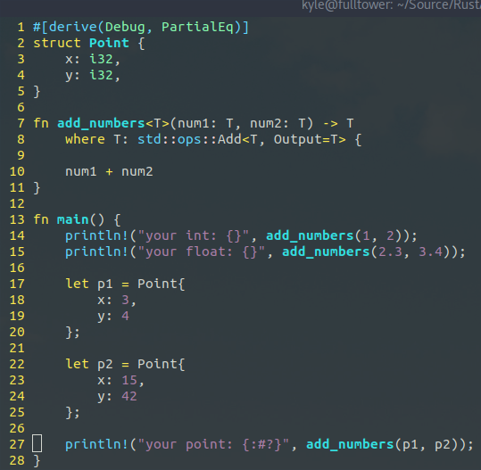
Generics - Naive Approach

Slide 30
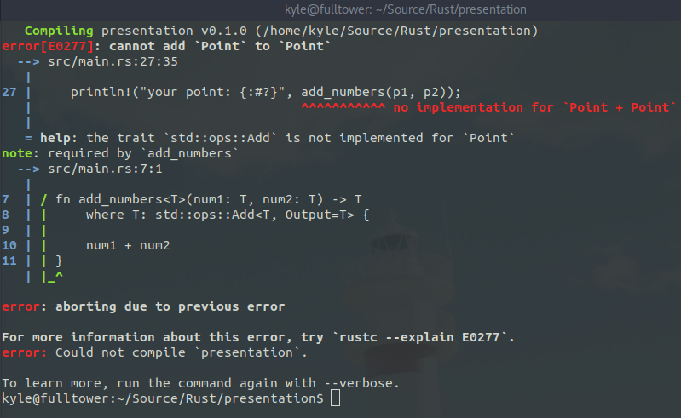
Generics - Naive Approach

Slide 31
Traits (Type Classes)
If you want to pass a custom object to add_numbers, then you must implement the trait std::ops::Add

Slide 32
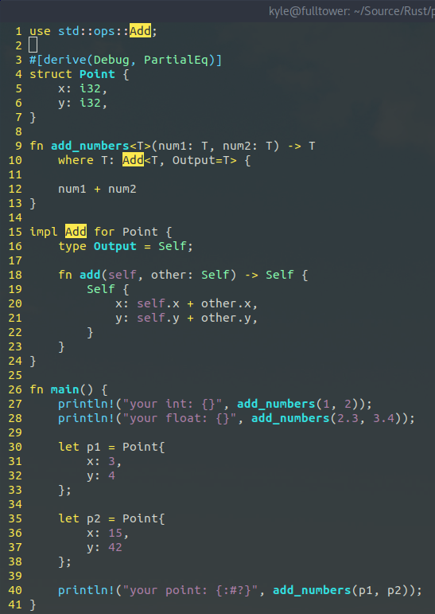
Generics - Fixed

Slide 33
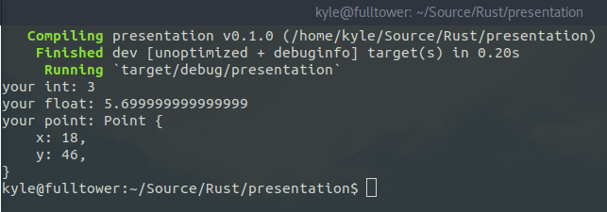
Generics - Fixed

Slide 34
How do I get Rust?
curl https://sh.rustup.rs -sSf | sh

Slide 35
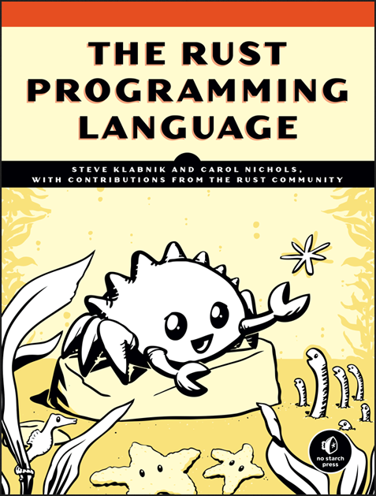
How can I learn more?
The Rust Programming Language is freely available in online form and in print edition from No Starch Press
  https://nostarch.com/Rust
  https://doc.rust-lang.org/book/

