Slide 1
Your Own Search Engine: Especially in Emergency

Slide 2
Introduction
Now a day everything is online. But still sometimes in some area with poor network connection we might not reach at what we want.
Some part of India or any other region in world facing network issue due to some terrorist activity or protest. So at this time using this script we can get what we want in a map.
Just after entering your address you can get hospitals surrounds you. Actually, we can search for anything on entire globe!

Slide 3
Data
I am planning to use folium library of python which will provide the Map function that generates the map. Foe searching the hospitals in nearby area I will use Foursquare API. So everything is simple and handy. Especially these are easily accessible by anyone.
URL = 'https://api.foursquare.com/v2/venues/search?&client_id={}&client_secret={}&v={}&ll={},{}&query={}'.format(CLIENT_ID, CLIENT_SECRET, VERSION, latitude, longitude, Query )
venues is used when we are looking for something like coffee shop or hospital anything.
Search? is a regular end point.
query is what we are looking for, in our case Query = ‘Hospital’

Slide 4
Methodology
First of all we will enter the location for which we are looking for and then pandas Nominatim function from Geopy library. This will convert any address into latitude and longitude.
Now we will run the URL which mentioned in Data section. After running results = requests.get(url).json() this code we will get data in Jason file.
We will extract the data that we want like response and venue. Now we will convert into Pandas Dataframe using jaon_normalise.
Now we filter column that is required, like in our case, Hospital’s name, address, latitude, longitude, and distance

Slide 5
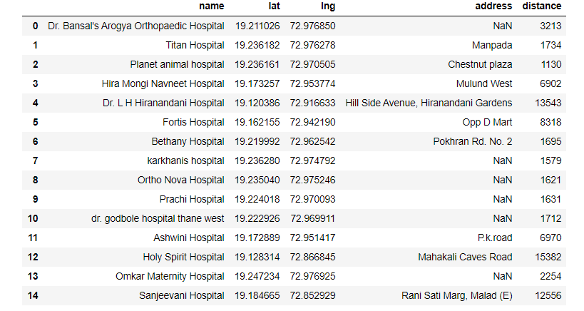
Methodology
Figure 1 Hospitals nearby Thane, Maharashtra, India

Slide 6
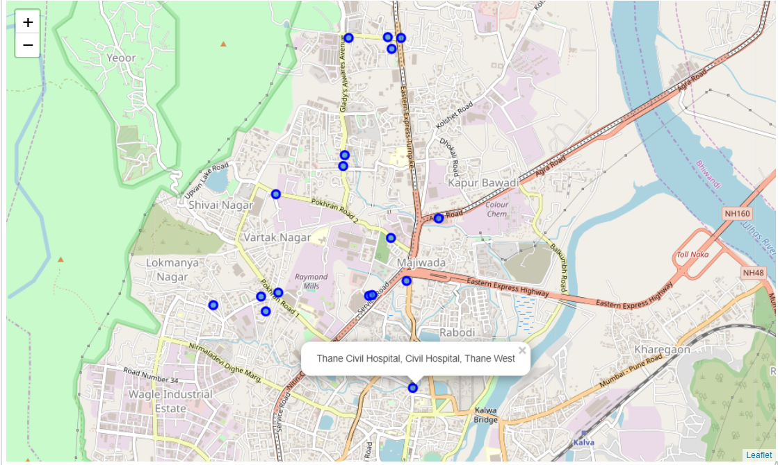
Methodology
Figure 2 Map of hospital near Thane, Maharashtra, India

Slide 7
Results and Discussion:
Results are mentioned in figures 1 and 2. We can get any information like what we want like restaurant, medical shops in this time of Corona pandemic especially, or cinema anything.
It also get distance so we can get idea how far any location is.

Slide 8
Conclusion
It is very helpful when we are out of network. If is there any critical situation where we are no reach of network, we might use this script to get what we are looking for. It increases its value drastically.

