Slide 1
INTELLI TOLLGATE
An Industrial Training Project by:
Keshav Kumar Mishra
Kumar Vivek
Krishnkant Jaiswal
Kumar Vaibhav
Fariya Tamkeen

Slide 2
PROBLEM STATEMENT
The main problem faced with the manual tollgates in today's busy world is the wastage of precious time. People have to wait in long queues in the scorching heat which lead to the detoriation in health of them. Because of this, people are getting mentally frustrated which make them less concentrated in their day-to-day jobs. As every development is leading towards a digital future, it is necessary for the toll-gates to be more feasible and digital to the users using them.

Slide 3
ABSTRACT
Intelli Tollgate is a I0T project that is developed to provide the users with a platform through which they can pay for the tollgates they will cross during their journey from their home. The interface of the application will be very simple and user friendly, the user just have to click on the button through which they can pay the amount of the tollgate through which they will pass during the journey. The balance remaining in their wallet will be displayed after they have done each payment. The application is divided mainly into two parts, one for the user and other for the admin. The admin needs to provide an authentication password to view the current users which has done the payment and allow them to pass without any delay, when they reach the toll-gate. They just have to show their RFID card through which they have done the registration and the database which stores the registered card numbers will do the comparing of both the numbers which will allow the user to pass through the toll-gate without any waiting.

Slide 4
WORKING MODULES
The Intelli Tollgate App is basically divided into two working modules:
Android Application
Hardware Module
The Android application part is an user friendly interface which contains two buttons, user and admin through which the user can login and register and do all the payments of the toll-gates that they want to pass through when they travel. For the admin, it provides to see the users who have registered and add all the toll-gates of the particular area.
The Hardware module, detects the card and then verifies with the database if the user is registered or not. If the user is registered with the verified card number, it lets the user to pass through to the toll gate and after a sufficient amount of delay closes the gate for the next user to verify the card.

Slide 5
ANDROID APPLICATION
The first section of the android application consists of two buttons seperately for the users and the admin
When someone clicks on the USER button, the interface will take them to the login page of the user ,
The login interface will ask the user to log-in the app using their credentials. New user can register in the app using their RFID card number.
After logging in they will be directed towards the home page which consists of the different toll-gates near their location. Clicking on the pay button, the current amount in their pay wallet will be deducted by the amount they have to pay for the particular toll.
The application also provides the users to add balance and to make payments for all the tolls at once they will pass during their journey.

Slide 6
HARDWARE MODULE
The Hardware Module will be situated near the toll-gate where the user just have to bring their RFID card in contact with the RFID reader.
The RFID reader which is connected to the Node MCU will then compare this card number with the numbers that have been registered in Firebase.
On finding the match, the LCD will show the status “Access Granted” and will let the user go pass the toll-gate.
On finding no-match, the user will not be granted access and they have to pay for the toll in order to go through it.
The LCD will also display the user if they have make the payment or not, by showing “Paid” or “Not Paid”.

Slide 7
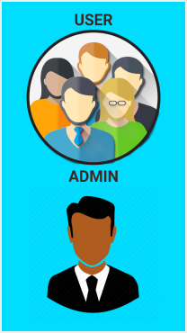

SCREENSHOTS
The Splash Screen of the App
The two sections of the App

Slide 8
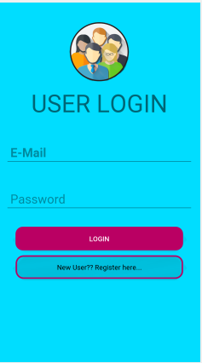
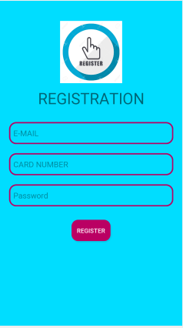
Existing User Login
New User Registration

Slide 9
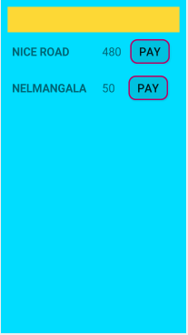
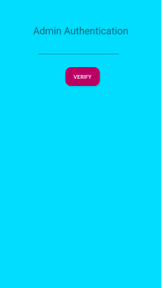
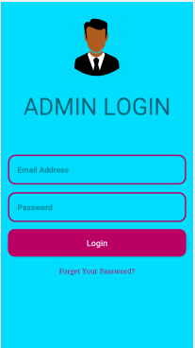
Available Toll Gates List
Admin Authentication
Admin Login

Slide 10
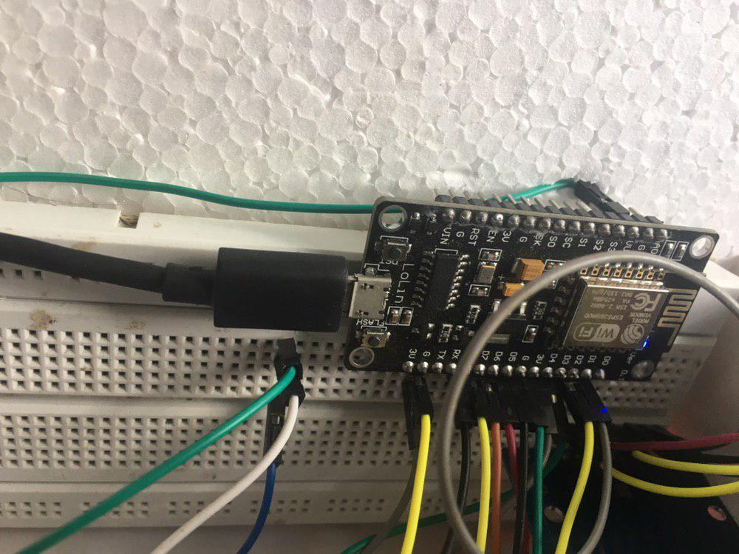
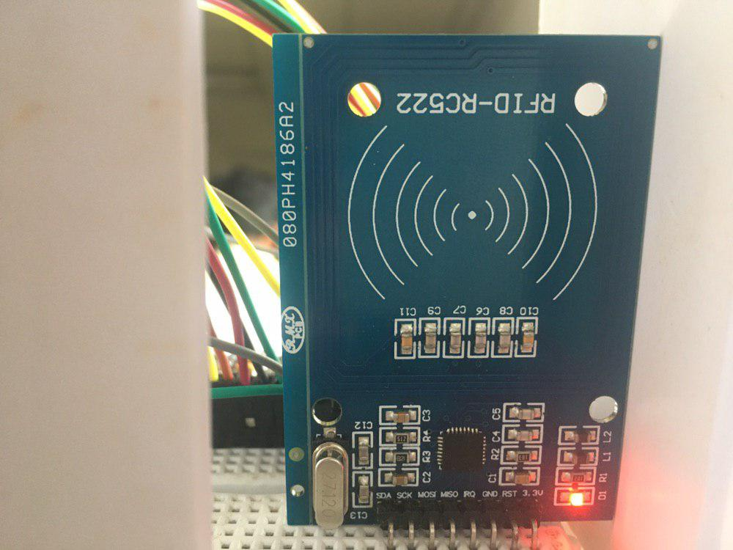
WORKING MODEL

Slide 11
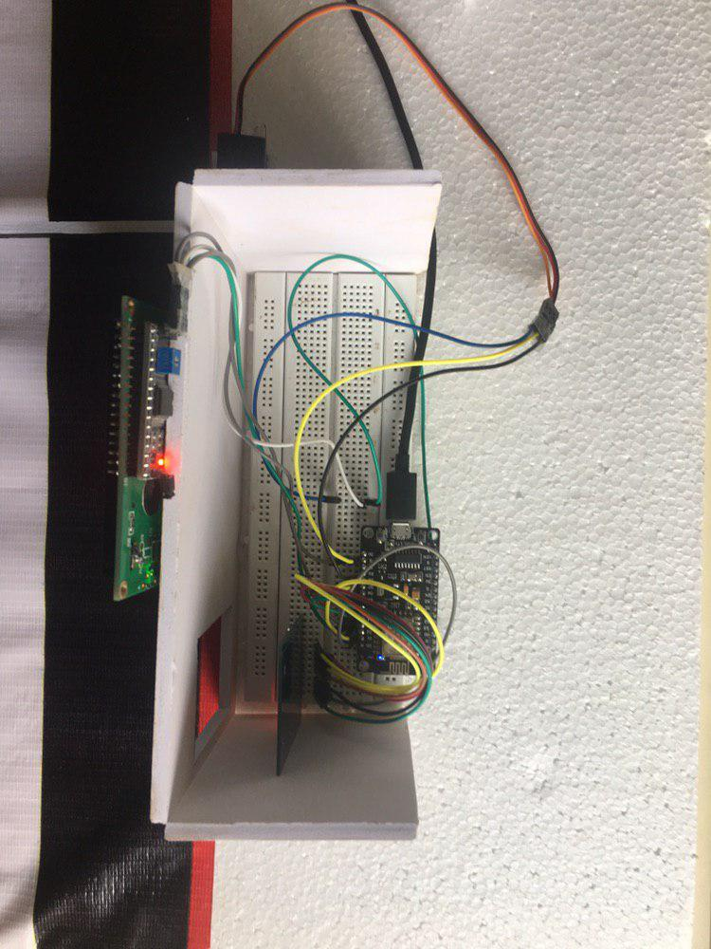
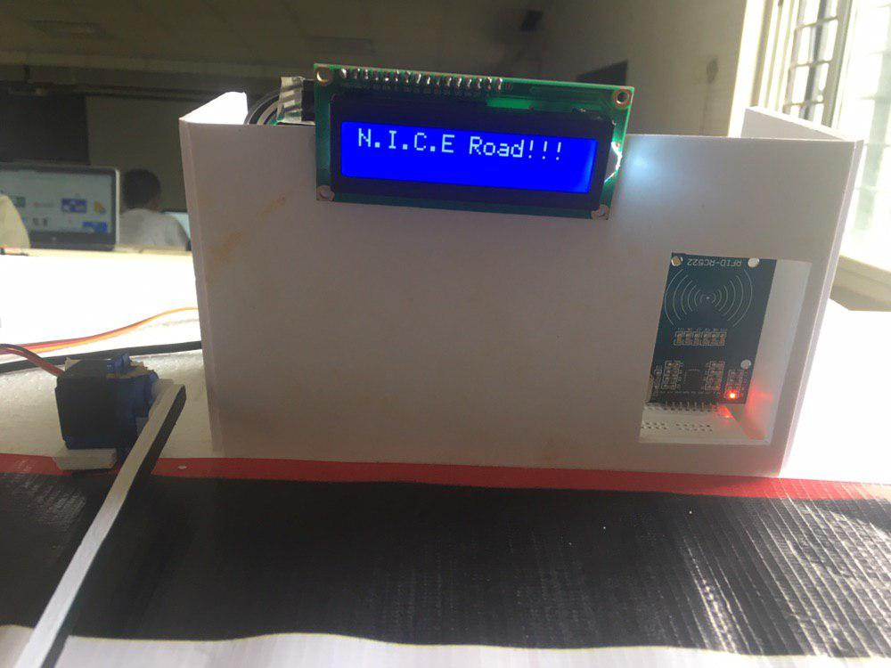

Slide 12
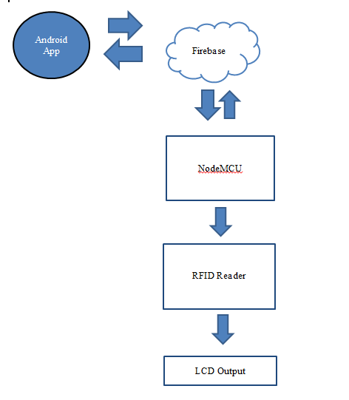
BLOCK DIAGRAM

Slide 13
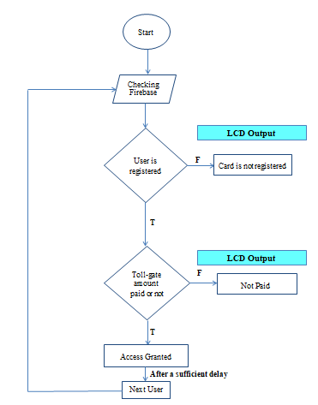
FLOW CHART

Slide 14
THANK YOU!!

