Slide 1

Medical Insurance Cost Prediction
Predicting insurance costs using demographics and health data.

Slide 2
Team Details
Om Prakash Mahato — 10800222098
Rahul Kumar Lal — 10800222100
Md Ebad — 10800222120
Karan Kumar Nonia — 10800222101
Guided By : Dr. Arnab Chakraborty Sir

Slide 3
Introduction
What is the project about?
Predicting medical insurance costs based on features like age, BMI, smoking status, and region using a machine learning model.
Why is this important?
Helps insurance companies set premiums fairly.
Enables customers to understand their expected costs.
Key tools and technologies: Python, Pandas, Scikit-learn, Matplotlib, and Seaborn.

Slide 4
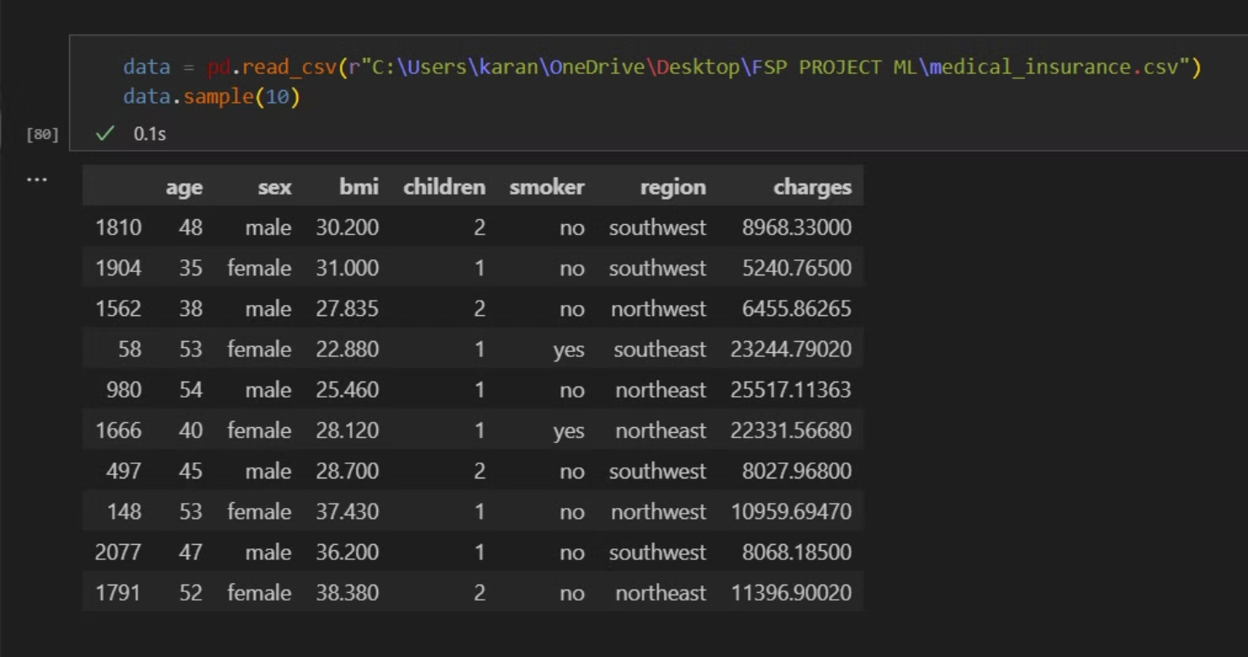
Dataset Overview

Slide 5
Data Distribution
Age
Most between 20-40, with a tail towards older ages.
BMI
Normally distributed with a slight right skew, with a few outliers.
Charges
Right skewed, indicating a few individuals with high costs.

Slide 6
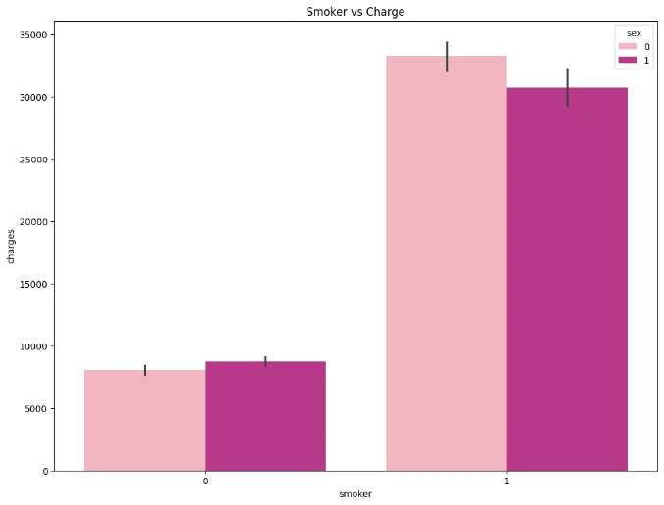
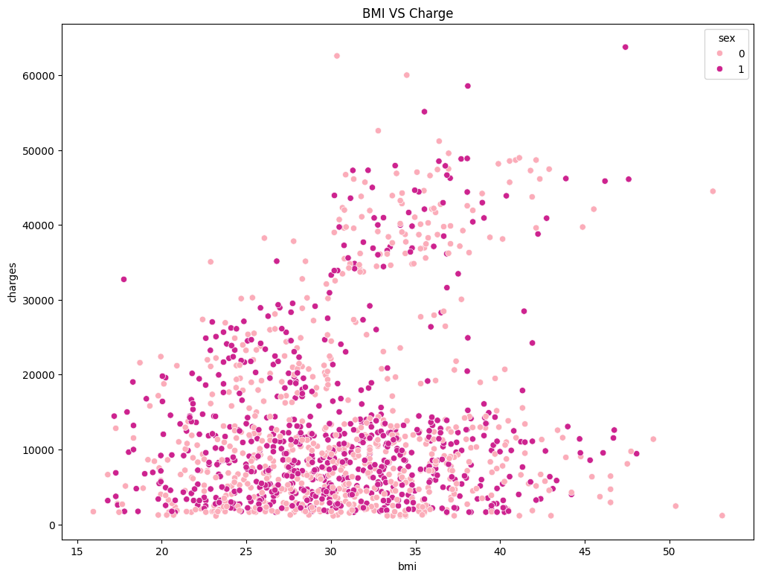
Feature Relationships
1
1. Charges vs Smoker
2
2. Charges vs BMI
Strongest positive correlation, smokers pay significantly more.
Moderate positive correlation, higher BMI, higher costs.

Slide 7
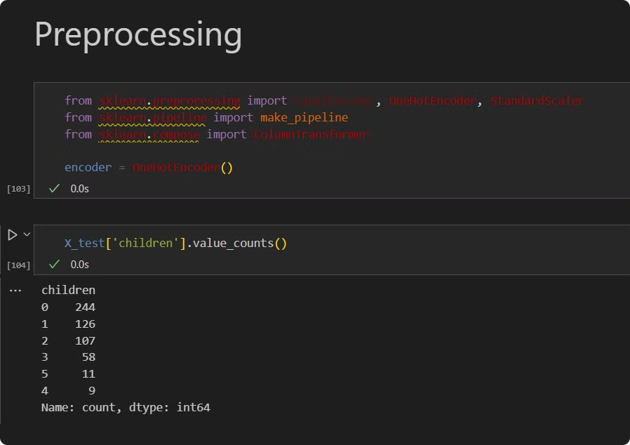
Data Preprocessing
Encoding
Convert categorical features to numerical using one-hot encoding.
Splitting
Divide dataset into training (80%) and testing (20%) sets.
Normalization
Scale features to a similar range for model training.

Slide 8
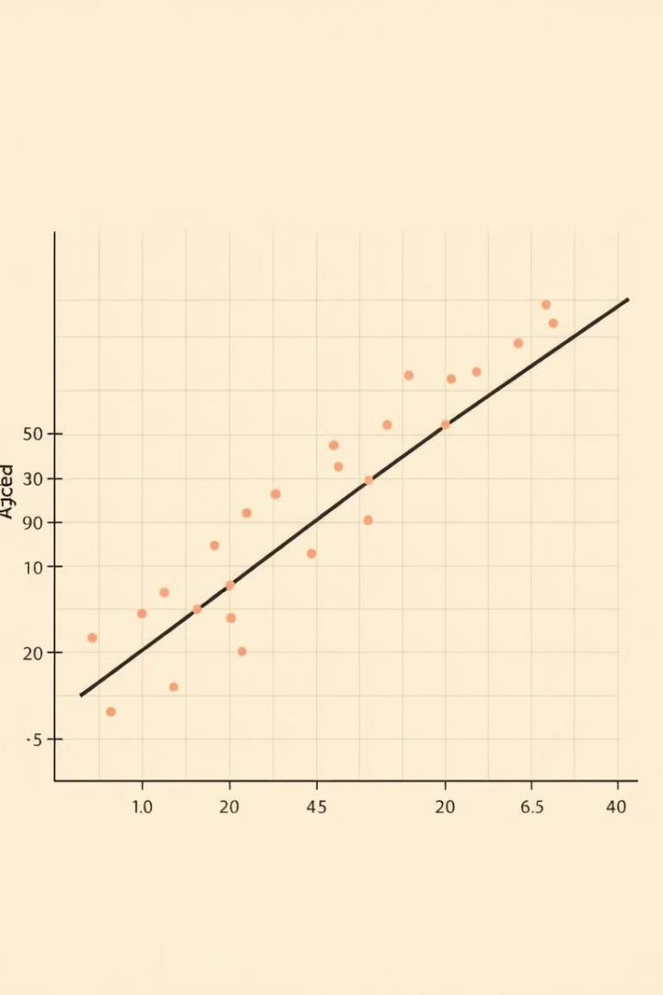



Model Selection
Linear Regression
Simple, interpretable, and widely used.
Train/Test Split
80% train, 20% test, to assess model generalization.
R² Score
Metric for evaluating model performance (higher is better).

Slide 9
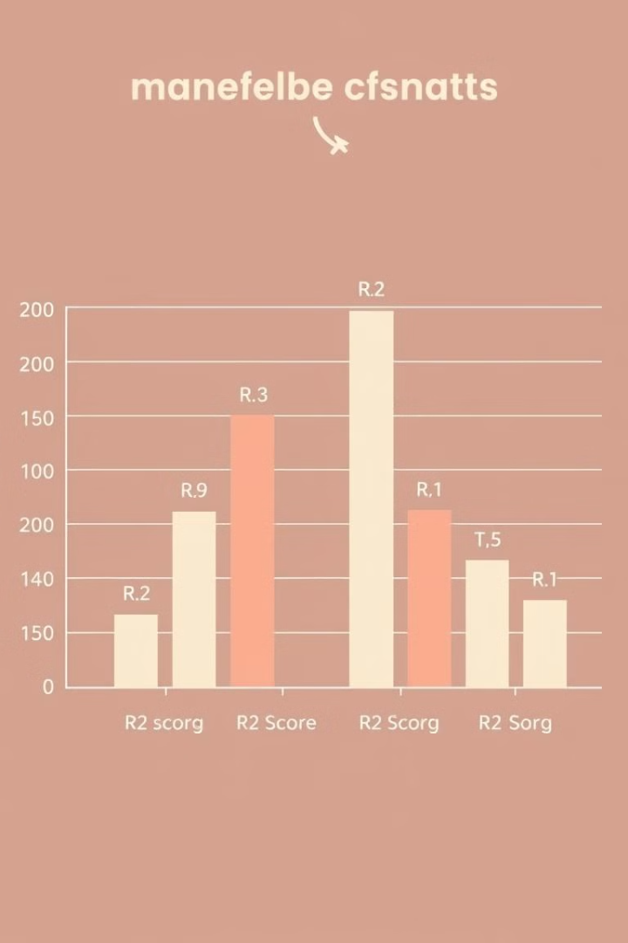
Model Performance
1
Training R²: 0.75
2
Testing R²: 0.74
3
Consistent performance, reliable model.

Slide 10
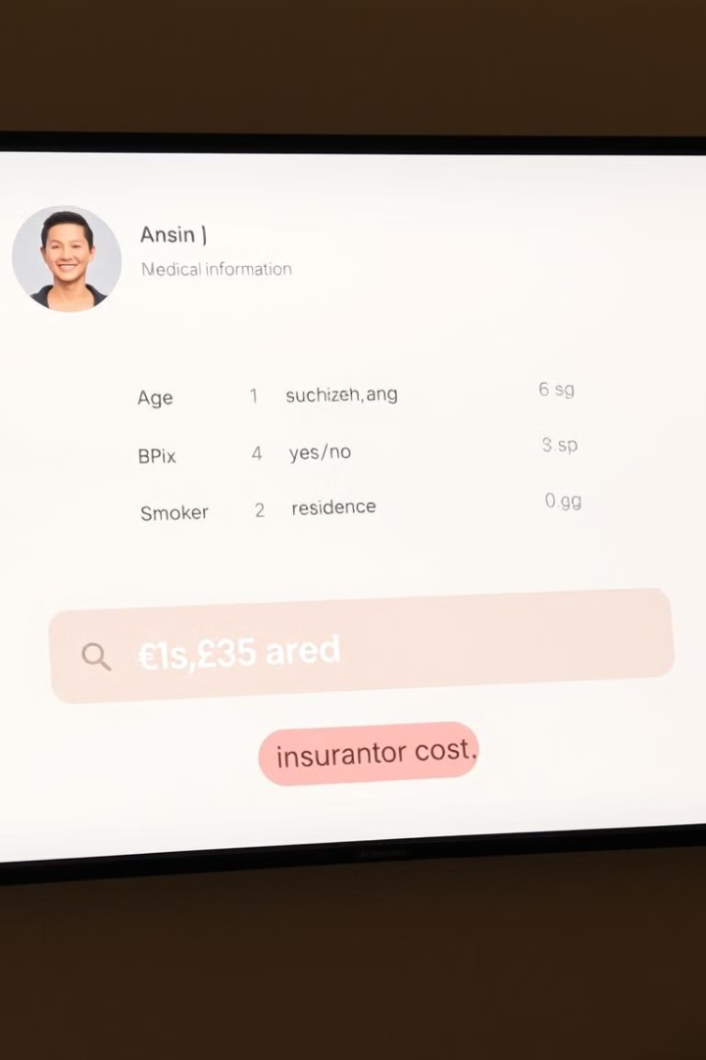


Prediction Example
Input
Age: 37, Sex: Female, BMI: 30.8, Children: 2, Smoker: No, Region: Southeast
Output
Estimated insurance cost: $8102.13

Slide 11
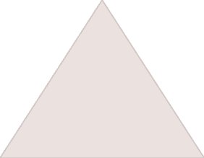


Conclusion
Prediction
1
Model accurately predicts insurance costs using relevant features.
Applications
2
Assists insurance companies in risk assessment and pricing.
Future Work
3
Explore more complex models, improve accuracy, and incorporate new features.

