Slide 1

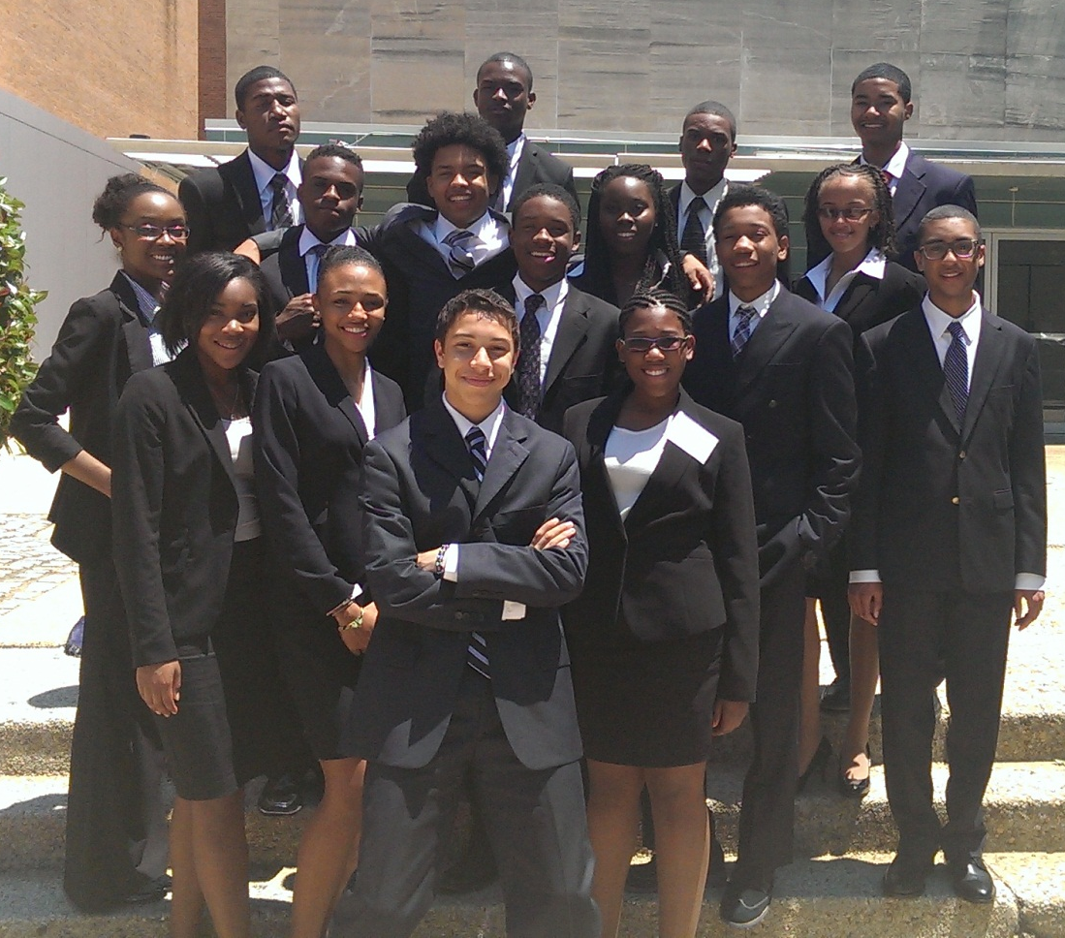
School of business summer enrichment programs
2013 George S. Willie Accounting Career Awareness Program

Slide 2
George S. Willie Accounting Career awareness program
The Accounting Career Awareness Program was established in 1980 by the National Association of Black Accountants (NABA) to increase the understanding of accounting and business career opportunities among high school students from underrepresented ethnic groups. The program has since been adopted by the Howard University School of Business. During the week students will explore accounting career opportunities, learn practical industry skills, and participate in sessions geared toward their soft skill development.
This program’s agenda includes site visits and sessions on Accounting Careers, Introductory Accounting Skills, Financial Literacy, ACT/SAT Preparation, Leadership Development, and Educational/Professional Development.
This is a 1 week residential program.

Slide 3
Computer information systems career awareness program
CISCAP is an intensive one-week residential program for rising high school seniors who have an interest in computers, business, or STEM (Science, Technology, Engineering and Math) discipline. This enriching week provides exposure to the possible range of careers in Information Systems, as well as an opportunity to attend college preparatory classes. The goal of CISCAP is to encourage and assist high school students from under-represented minority ethnic groups to attend college and consider selecting Computer Information Systems as a possible major. The program introduces students to Howard University and to careers and opportunities available in the field of Information Systems. CISCAP provides students with an opportunity to do activities which include attending modules in web design, software applications and cyber-security awareness; work on team projects; tour the Howard University Campus as well as visit a local technology firm.
This program’s agenda includes site visits and sessions on IT/IT Management Careers, Introductory IT Skills, Financial Literacy, ACT/SAT Preparation, Leadership Development, and Educational/Professional Development.
This is a 1 week residential program.

Slide 4
Hospitality career awareness program
The primary objective of the Hospitality Career Awareness Program is to increase the number of high school students from under-represented ethnic groups who attend college and major in hospitality management – particularly at Howard University’s School of Business, by introducing them to careers and opportunities available in this field. It is a one week, intensive, residential program where rising high school juniors and seniors with an interest and aptitude for hospitality management and business attend college preparatory and basic management skills classes, networking seminars with industry professionals, go on field trips and undertake group projects.
This program’s agenda includes site visits and sessions on Hospitality Careers, Introductory to Hospitality Skills, Financial Literacy, ACT/SAT Preparation, Leadership Development, and Educational/Professional Development
This is a 1 week residential program.

Slide 5
Summer actuarial program
The Summer Actuarial Program is an educational enrichment experience in mathematics, statistics, computers, business, and actuarial careers for exceptional mathematics high school juniors. The program is funded by the Joint CAS/SOA Committee on Minority Recruiting, insurance companies, actuarial consulting firms, and Howard’s Center for Insurance Education. It is devoted to helping strong mathematics students improve their skills and providing information about business and actuarial careers.
The curriculum for the Summer Actuarial Program is built around these topics: Statistics and Probability Matrices Life Contingencies
Each of these topics is important in actuarial mathematics. These topics are coordinated with instruction in the use of personal computer systems. This is an intensive program of studies but within the grasp of a talented student with a good command of high school algebra. For computer instruction, students will be grouped by computer ability. No prior computer knowledge is assumed.
This a 2 week residential program.

Slide 6
Minority Male Empowerment Program
The Minority Male Empowerment Program was offered for the first time in the Summer of 2014. The purpose of the program is to equip students with the tools needed to get into and succeed at their preferred Universities. This will operate as a day program focused on increasing students scores on college entrance exams, as well as develop a mastery of the fundamental English and math skills needed to matriculate in college.
This program’s agenda includes sessions on SAT/ACT Prep Sessions, English Grammar/Writing Workshops, and Math Workshops
Eligibility: High School Sophomore or Junior at the time of Application SAT Score between 900 and 1100 (Combined Math and Verbal) or ACT of 19+ Unweighted H.S. GPA of 2.7+
This is a 3 week Day Program. Students will not be provided housing.

Slide 7
activities
Career/ Industry Counseling
Career Workshops
Site Visits
Leadership/Professional Development
Leadership Workshops
College Prep./Educational Development
SAT/ACT Workshops
Writing Workshops
Industry Skills Workshops
Team Building Projects
Networking & Cultural Exploration
Students have the opportunity to develop relationships with professionals and with students from around the world
Introduction to Case Analysis
Financial Literacy Workshops
Personal Branding Workshops
Time Management Workshops
Cultural Excursions Throughout Washington DC
Workshops Facilitated by Industry Professionals and School of Business Professors

Slide 8
Case Competition
Most programs feature a case competition. The students are broken into teams and are assigned a business case based on their program. They have time set aside daily for them to work on their project and presentation. The program counselors double as team mentors to help them develop their case presentation.
Students present on the last day of the program. The winning team is announced and awarded a books scholarship during the closing luncheon.
2013 Case Projects Included:
CISCAP - Design a website and discuss the impact it would have on a business or industry.
ACAP – Create a small business and create financial statements showing potential profits for the first year of business
Book scholarships are applicable to
only to Howard University.

Slide 9
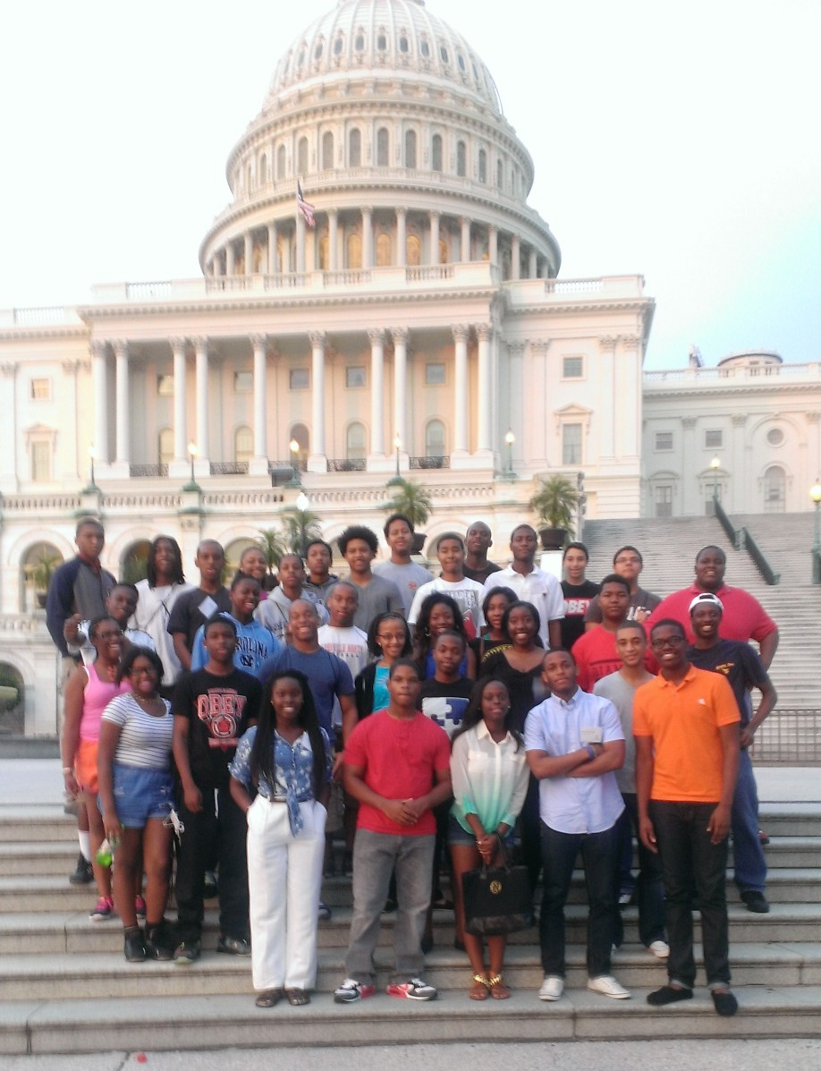
Food, Lodging, Supervision & Other Expenses
Participants will be housed in dormitory facilities on Howard University’s campus. Six to nine tutor/counselors are assigned to each program and will reside in the dormitory with the participants. The counselors will assist the students in both academic and personal concerns. In addition, staff members of the Dean of Residence Life will be present in the dormitory at all times.
With the exception of scheduled cookouts, picnics and other sight-seeing activities, all meals for participants will be provided by University Food Services in the Blackburn Student Center. Housing, food and transportation during the program will be provided for the students. All other costs including unscheduled meals are the student’s responsibility.

Slide 10
Eligibility & Application Information
High school students in their sophomore or junior year at the time of application.
Program seeks students with PSAT or SAT scores of at least 1000 (math and verbal only). Note the SAP program requires that a mathematics PSAT scores of approximately 60 (SAT 600) or higher.
Have excellent high school grades.
Strong recommendations from the math chairperson or teacher.
Please note the University Readiness Program, please see pg. 9
Applications are available online now. Please follow the link below.
http://goo.gl/Vd9Z6v

