Slide 1
Introduction to Databases with Python
Simeon Kakpovi

Slide 2
What is a database?
A database is a structured collection of data
Provide data persistence
Relation Databases
MySQL
Postgresql
SQLite
Non-relational databases
Mongo DB

Slide 3
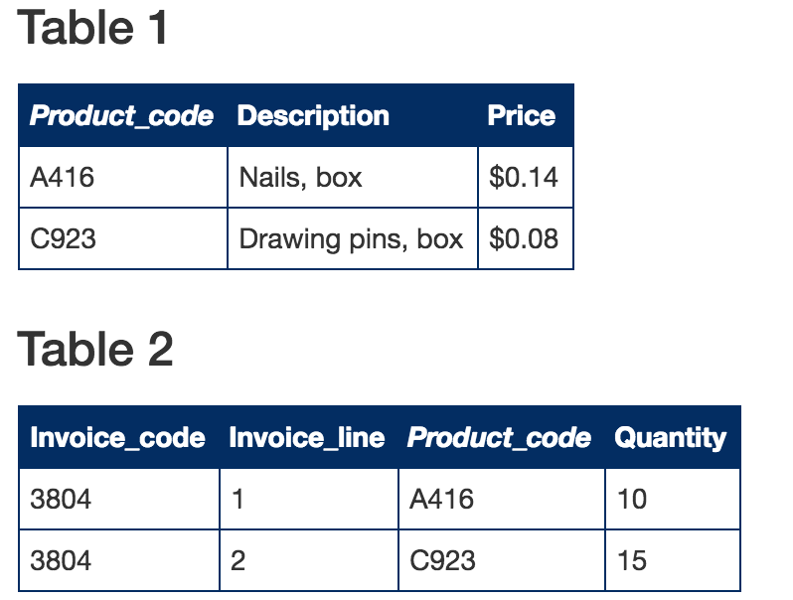
Relational Databases
Data is split into tables
Rows are entities or records
Columns are tuples or attributes

Slide 4
Structured Query Language
SQL is a standard language for storing, manipulating and retrieving data in databases.
SELECT column1, column2, ... FROM table_name;

