Slide 1
SQL-Alchemy – A Python ORM

Slide 2
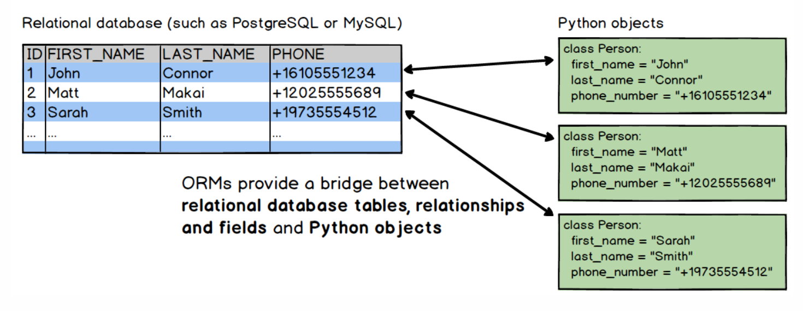
ORM (Object Relational Mappers)
Code library that automates the transfer of data stored in relational databases tables into objects that are more commonly used in application code.

Slide 3
Why ORM?
Developers can use the programming language they are comfortable with to work with a database instead of writing SQL statements or stored procedures.

Slide 4
Examples
SQLAlchemy
Peewee
The Django ORM
PonyORM
SQLObject

Slide 5
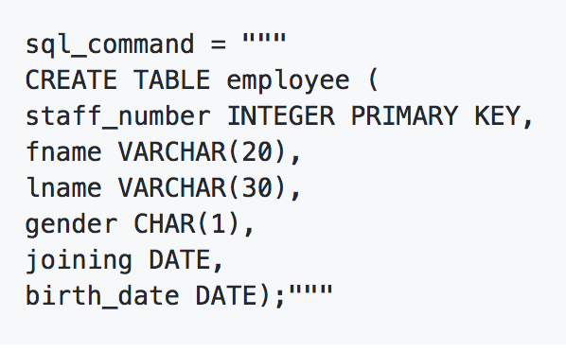
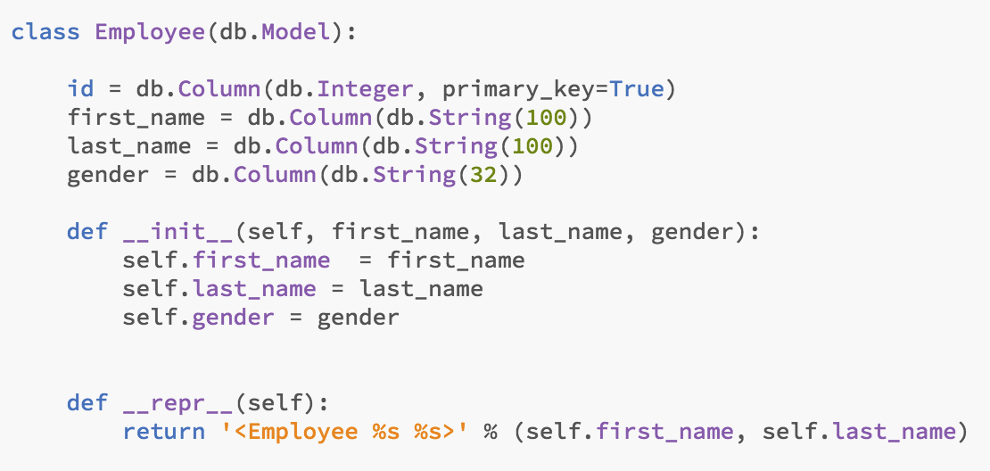
Example

