Slide 1
Python: Unit Testing
Simeon Kakpovi

Slide 2
Why test?
Catch Syntax errors
Catch logical errors
Make sure module components are working as expacted
Having tests does not mean your code is perfect

Slide 3
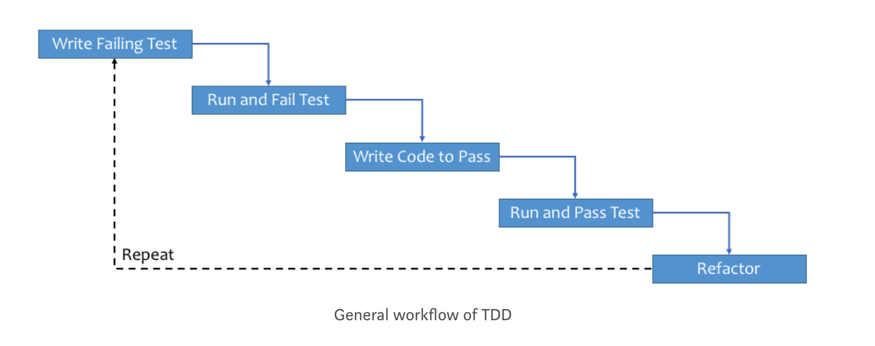
General Workflow

Slide 4
Getting started
You define your own class derived from unittest.TestCase.
Then you fill it with functions that start with ‘test_’.
You run the tests by placing unittest.main() in your file, usually at the bottom

Slide 5
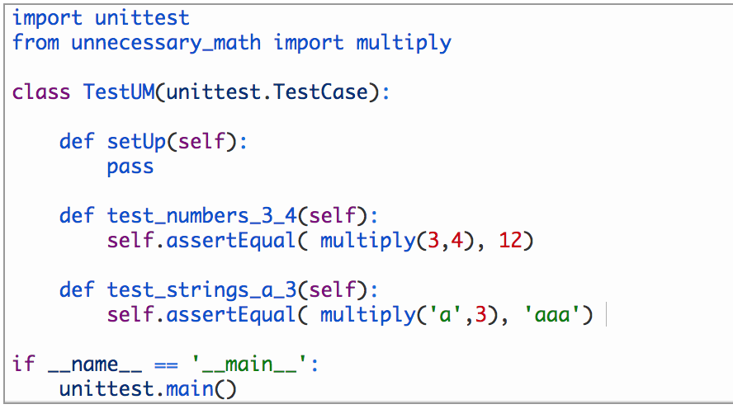
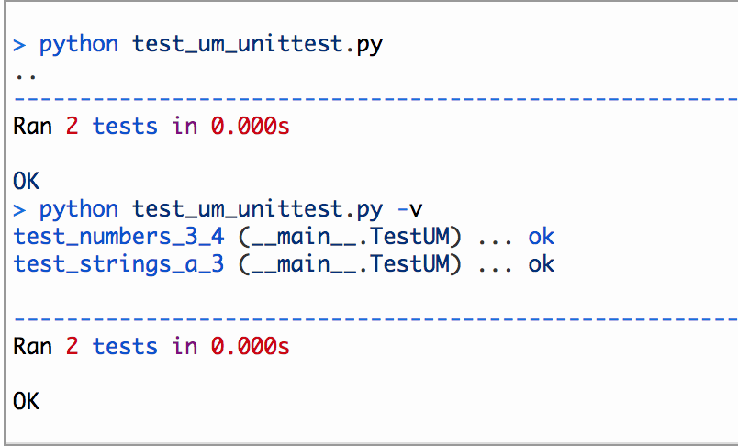
Example

Slide 6
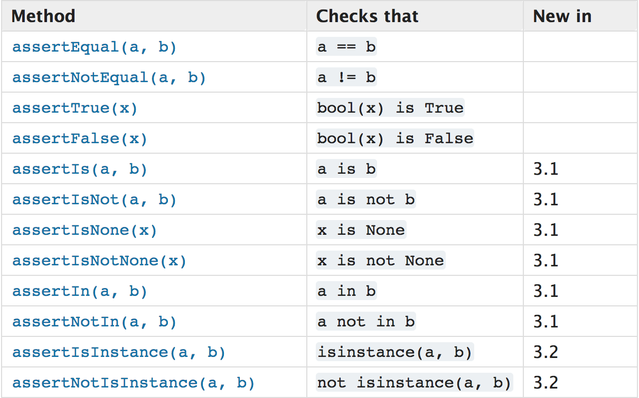
Assert Methods

