Slide 1
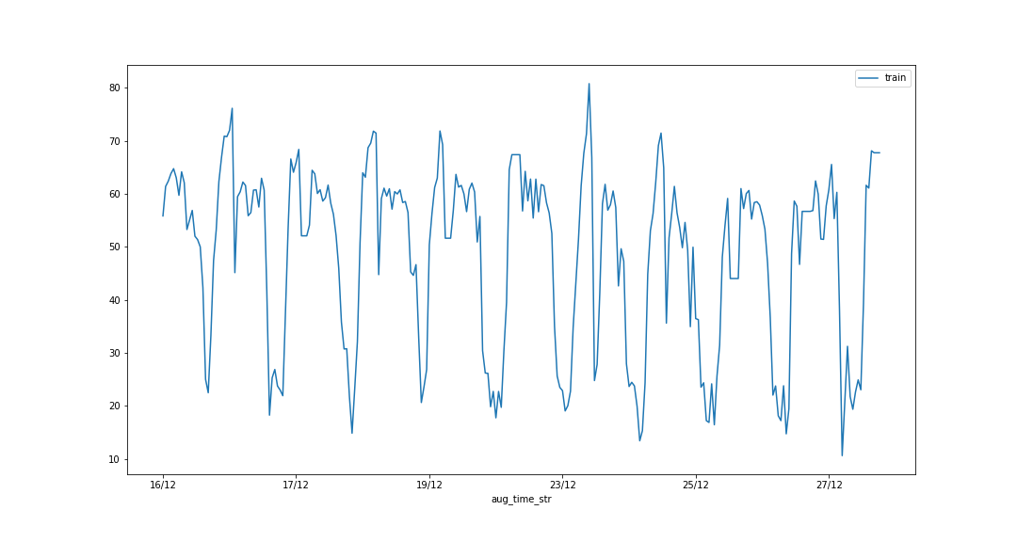
FOR X LABEL

Slide 2
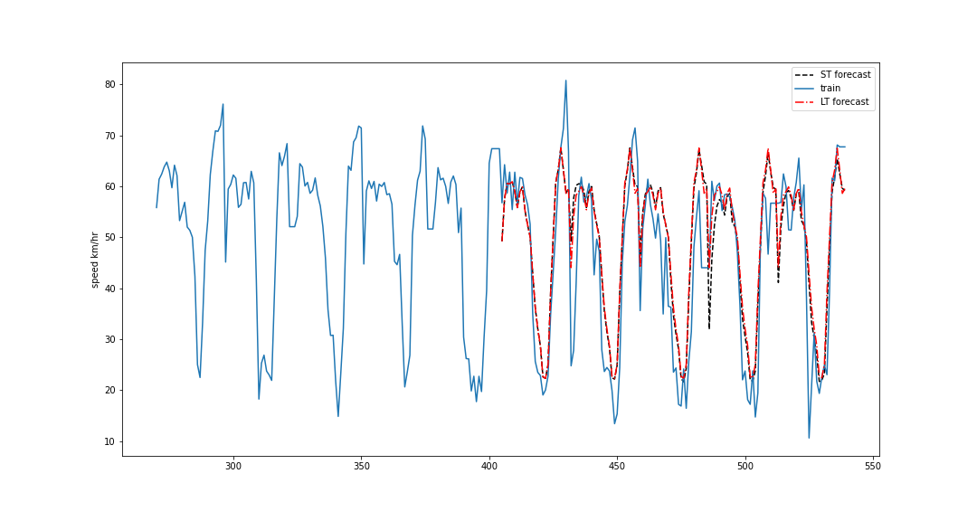
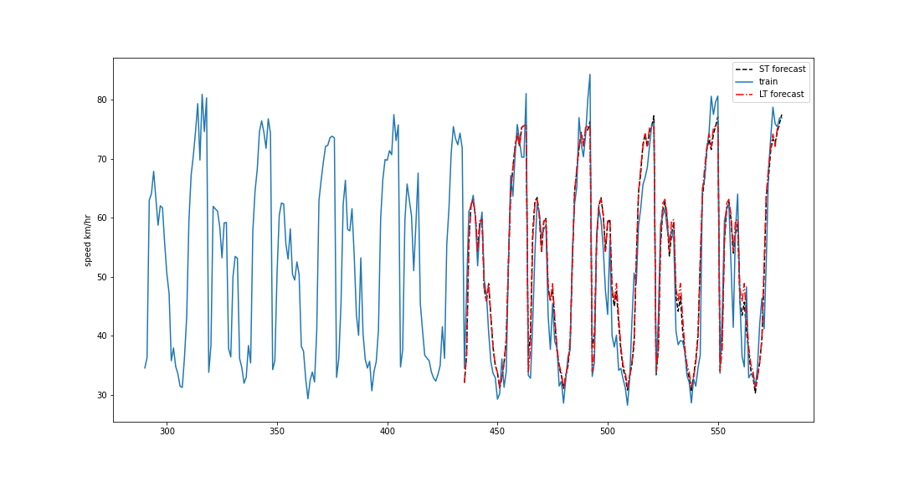
Sc-A
Segment 14
Sc-b
Segment 51

Slide 3
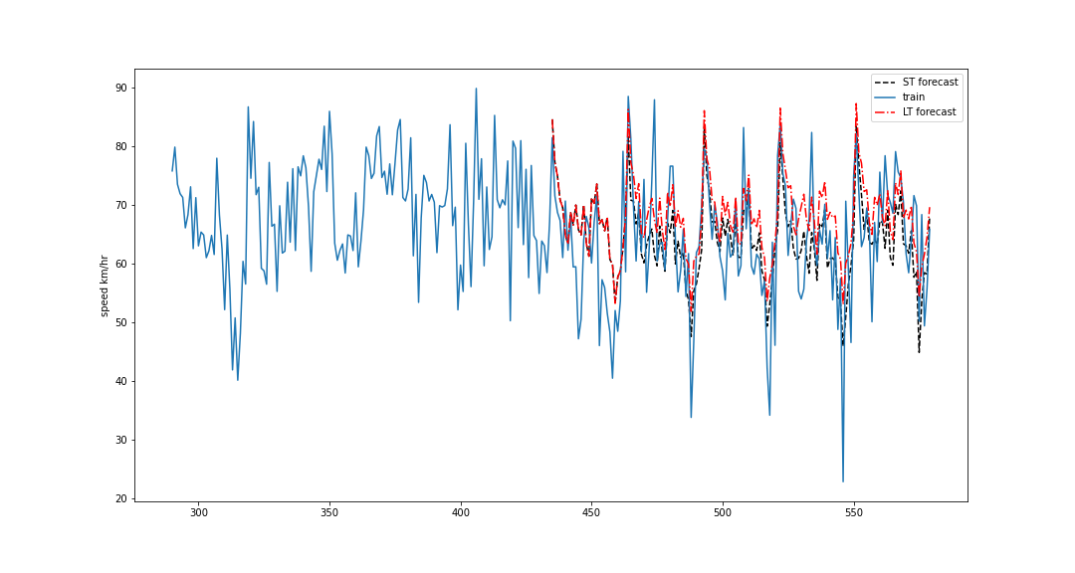
Sc-c
Segment 189

