Slide 1
reddit_nosleep_analysis
File created on: 11/18/19 7:08:08 PM EST

Slide 2
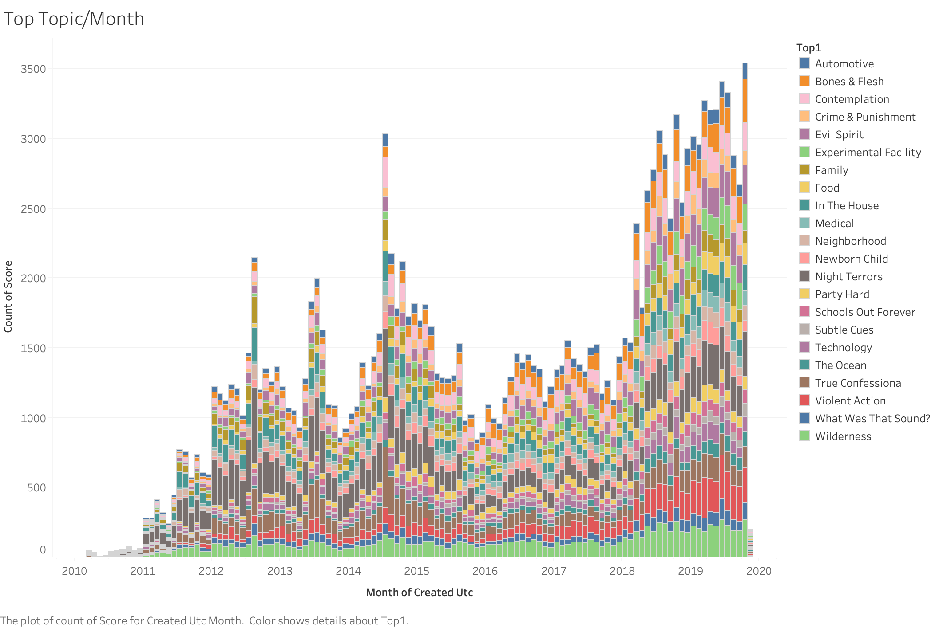

Slide 3
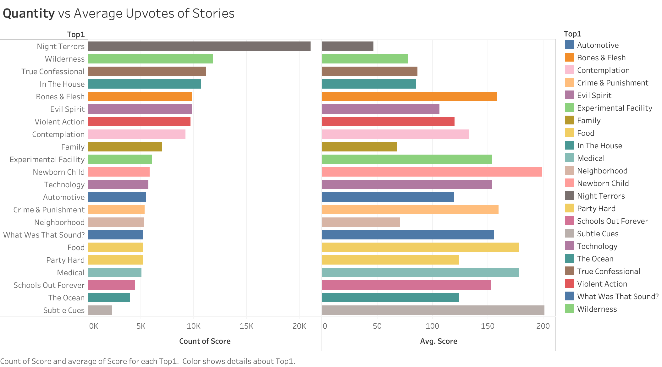

Slide 4
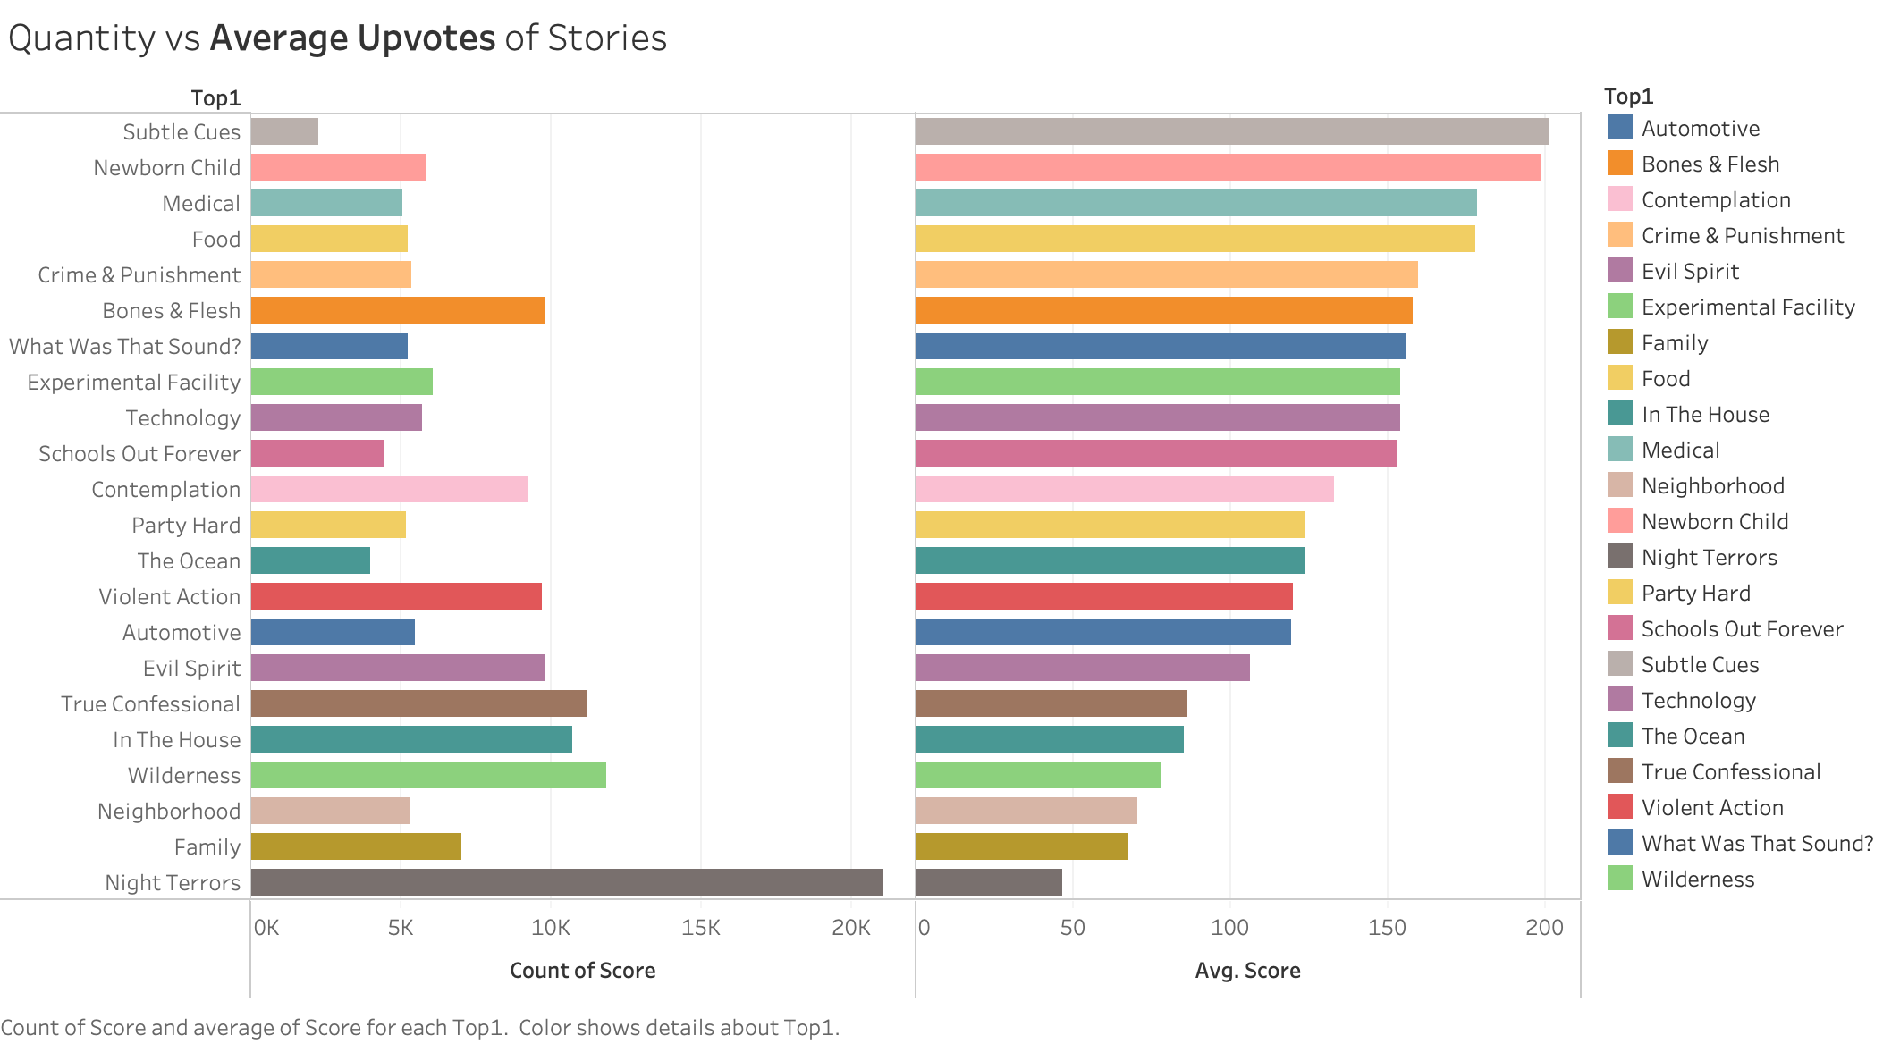

Slide 5
