Slide 1
Can’t Spell Anime Without AI
Kiran Kokilepersaud
Brighton Ancelin
Max Xu

Slide 2
Outline
Intro
Computer Vision
Natural Language Processing
Miscellaneous

Slide 3
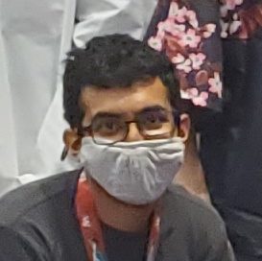
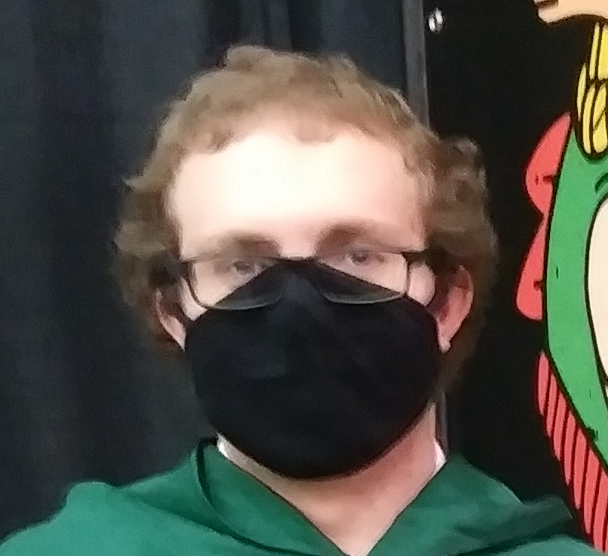
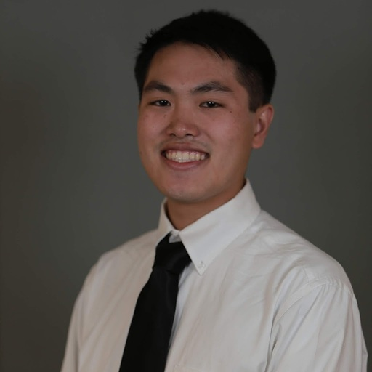
Introductions
Kiran Kokilepersaud
PhD Student, Georgia Tech, Electrical & Computer Engineering Program
Favorite Anime: Grimgar of Fantasy and Ash
Brighton Ancelin
PhD Student, Georgia Tech, Machine Learning Program
Favorite Anime: Attack on Titan
Max Xu
PhD Student, Georgia Tech, Machine Learning Program
Favorite Anime: A Silent Voice

Slide 4
Audience
We think this presentation is most useful for…
Artists
Computer Geeks
TODO: More
Everyone interested in SoTA AI

Slide 5
(FOSS)
This presentation was developed using free-and-open-source (FOSS) software; our code is freely available at github.com/kkokilep/Cant-Spell-Anime-Without-AI

Slide 6
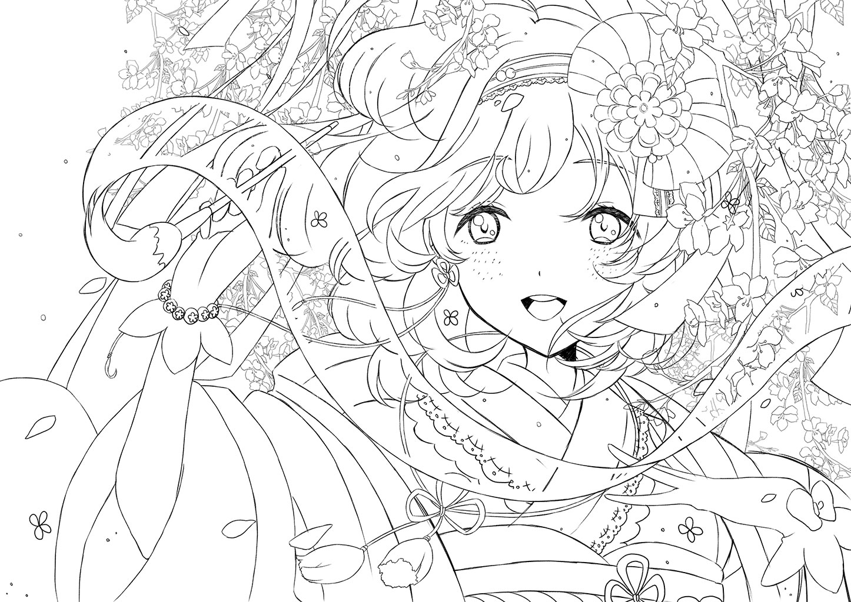
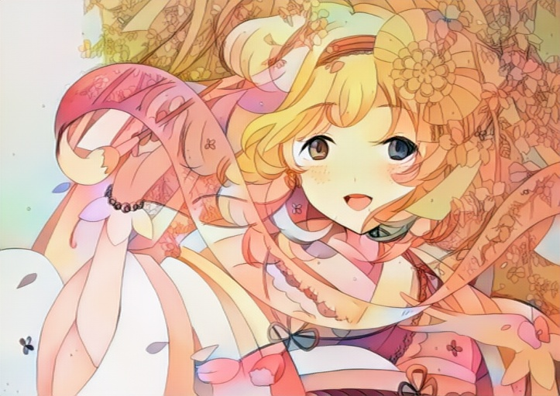
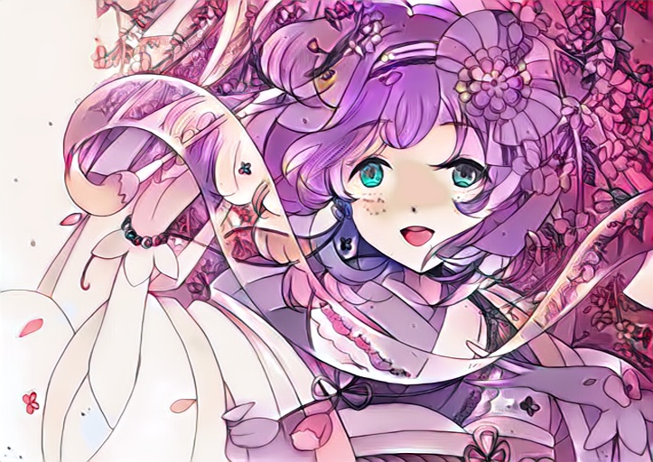
Auto-Coloring
Given a black-and-white sketch, color it in a reasonable manner, optionally with color information specified.
Original B&W Sketch
Random colorization
Purple hair, Cyan eyes

Slide 7
Auto-Coloring
Freely available tools:
petalica-paint.pixiv.dev
github.com/kvfrans/deepcolor
github.com/DwangoMediaVillage/Comicolorization
github.com/blandocs/Tag2Pix

Slide 8
[DEMO]
[Auto-color some default characters. Have some funny recolorings.]
[Let audience choose character (anything from internet will work), and color-scheme (any should work), and generate it. Could have some funny recoloring’s of existing characters from various manga]
[Ask if anyone in audience is an artist, and if so if they’d be willing to share a B&W sketch for us to autocolor]
[Mention the use for artists, seeing what their sketches could look like with varying color schemes for inspiration]

Slide 9
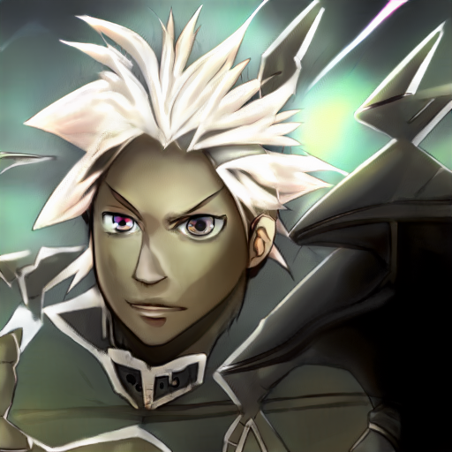

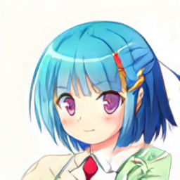
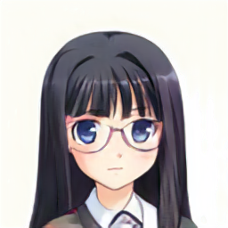
Character Generation
Generate a drawing of an anime character, either completely randomly or with some details defined.
Random
Random
Pink eyes, Blue hair
Long hair, Glasses, No smile

Slide 10
Character Generation
Freely available tools:
thisanimedoesnotexist.ai
make.girls.moe
waifulabs.com
www.thiswaifudoesnotexist.net

Slide 11
[DEMO]
[Generate some random characters]
[Let audience choose details, generate those characters]
[Mention how this can be useful for artists, e.g. get inspiration from these random characters]

Slide 12
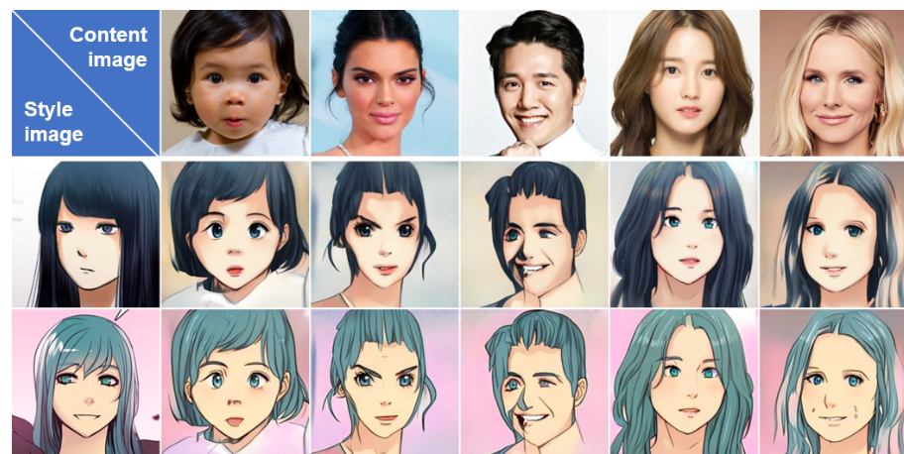
Style Transfer
Given an image of a person, then redraw it in another anime style.

Slide 13
Style Transfer
Freely available tools:
waifu.lofiu.com
huggingface.co/spaces/akhaliq/AnimeGANv2
animefilter.com
github.com/CherylHuang/Faces2Anime

Slide 14
[DEMO]
[Style-transfer some default characters. Do some funny ones.]
[Let audience choose style (from a predefined list), choose character (anything from internet will work), do the style-transfer]
[Show how you can even use style-transfer on real-world pictures of people]
[Get someone in audience to take a photo, and we’ll generate their anime character in a variety of styles]
[Mention the use for artists, seeing what their existing characters might look like in another style]

Slide 15
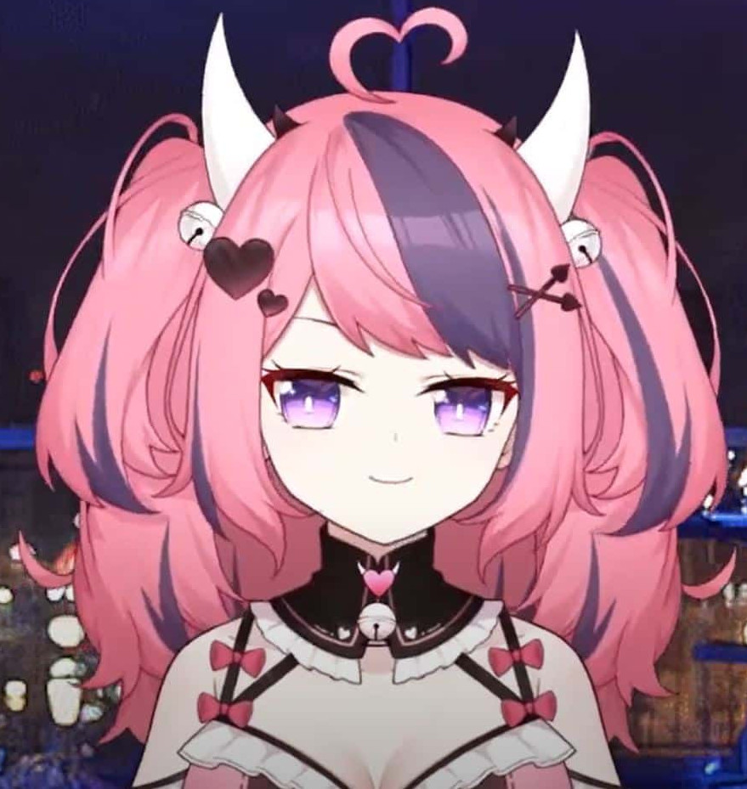

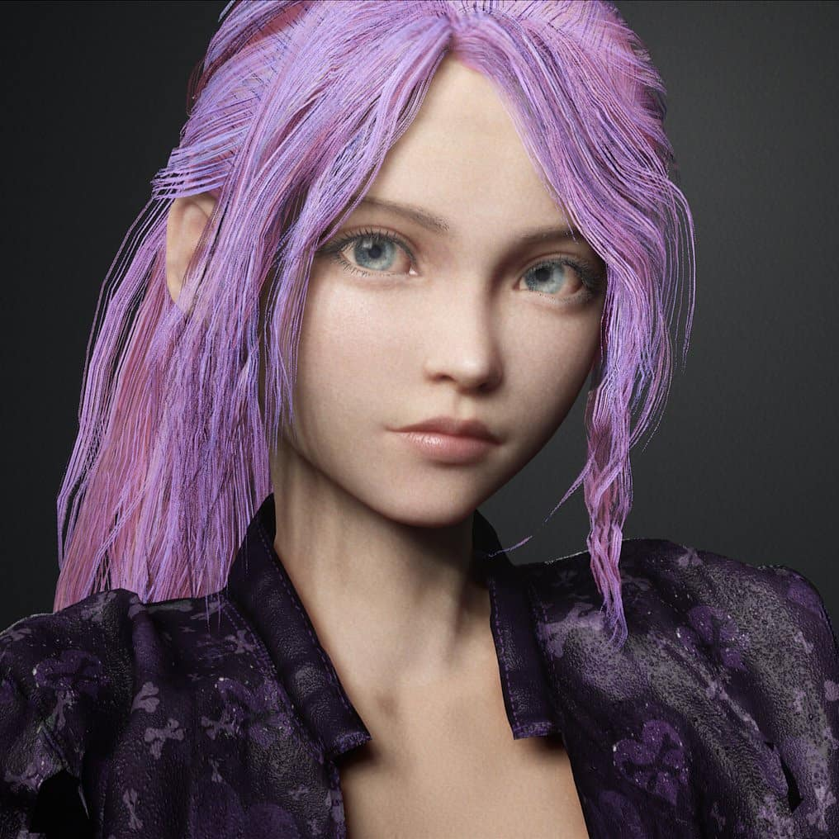
Face Translation
Given a video of a human face, render a digital avatar face with the same expression and details.
Commonly used by Vtubers

Slide 16
Face Translation
Freely available tools:
Vtube Studio (denchisoft.com)
PrprLive

Slide 17
[DEMO]
[Live face-translate one of us onto some avatar]
[Ask for an audience member to come up and try it out]

Slide 18
In-Place Manga Translation
Replace the japanese in a manga panel with the corresponding english in the same location.
TODO: Add three-wide row, left being the original manga panel, middle being the auto-translated panel, and right being the human translation.

Slide 19
In-Place Manga Translation
Freely available tools:
TODO: list these

Slide 20
[DEMO, non-interactive]
[Auto-translate some default manga panels.]
[Mention the use for fans, being able to read their favorite obscure manga before translators get around to it]

Slide 21
Manga Auto-Captioning
Given a series of manga panels, generate feasible captions for each panel.
TODO: Add image of a manga with auto-generated captions.

Slide 22
Manga Auto-Captioning
Freely available tools:
TODO: list these

Slide 23
[DEMO, non-interactive]
[Auto-caption some default manga panels.]

Slide 24
(FOSS Reminder)
This presentation was developed using free-and-open-source (FOSS) software; our code is freely available at github.com/kkokilep/Cant-Spell-Anime-Without-AI

