Slide 1
Ai-healthcare chatbot
Arvind sisodiya
Durgesh barde
Amit porwal

Slide 2
Objectives of ai-healthcare chatbot
Early diagnosis.
Prediction of outcome of the disease as well as treatment.
Feedback on treatment .
Reinforce non pharmacological management.
Reduce diagnostic and therapeutic errors.
Increased patient safety and Huge cost savings associated with use of AI.
AI system extracts useful information from a large patient population.
Assist making real-time inferences for health risk alert and health outcome prediction.
Learning and self-correcting abilities to improve its accuracy based on feedback.

Slide 3
Learnings from ai-healthcare chatbot
we will learn to use artificial intelligence applications in real life scenario.
We will be able to use NLP(natural language processing) algorithm for building a conversational chatbot.
AI technologies used in healthcare:
Machine learning
Machine vision
Natural Language Processing
We will be familiar with web framework of python and how make make an web application.

Slide 4
Problem domain
Increasing individual healthcare expenses.
Larger Geometric population.
Imbalance between health workforce and patients.
Real time health monitoring.
Human errors in medical diagnosis.
unnecessary and excessive diagnostic tests.
continuous shortage of medical personnel

Slide 5
Existing solutions
SafedrugBot: is a virtual assistant designed to help healthcare professionals in providing valuable guidance and monitoring.
Babylon Health:offers A.I. consultation based on personal medical history and common medical knowledge as well as live video consultation with a real doctor
Your.Md: It is a symptom checker free platform offers actionable health information based on highly accurate sources and lets the user make the best choices for his health.
Ada Health: which can assess the user’s health based on the indicated symptoms using its vast, A.I.-based database.
Buoy Health: The chatbot thoroughly asks you about the details of your medical state and offers you various solutions and actionable steps to take.

Slide 6
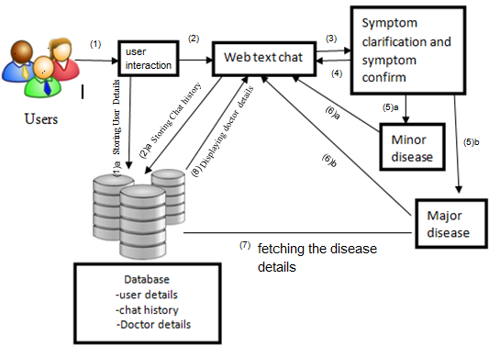
Proposed solution

Slide 7
implementation
User Interaction:It will take user input from web interface and natural language processing will be used to understand the input(syntax) given by the user for automatic analysis and representation of human language that machine can understand.
Symptoms clarification:The chatbot will clarify the users symptoms with serious of questions and the symptom conformation will be done. Artificial intelligence markup language will be used define rules for pattern matching and determine responses.
Symptoms confirmation:In this step it will determine the disease type and will provide possible treatements.

Slide 8
Algorithms used:
Natural language processing: Natural Language Processing (NLP) is the study of computer programs to understand human Language. The ultimate goal of NLP is to read, translate, understand and make sense of the human languages. NLP will be used to understand the input(syntax) given by the user for automatic analysis and representation of human language that machine can understand. We will use datasets to train the model. It will perform the sentimental analysis of trained datasets and will diagnose the diseases based on input symptoms.
ChatterBot: ChatterBot is a conversational dialog engine based on machine-learning algorithms. chatterbot is build in Python which generates responses based on collections of already known conversations. The language independent design of ChatterBot be trained to speak any language. It is simple and easy to use for building a customized chatbot

Slide 9
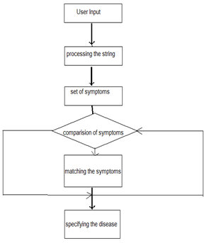
Flow diagram

Slide 10
USE CASE DIAGRAMS

Slide 11
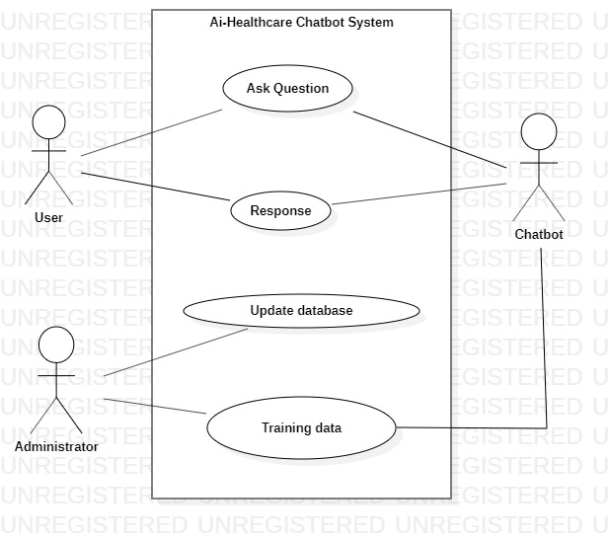

Slide 12
SEQUENCE DIAGRAM

Slide 13
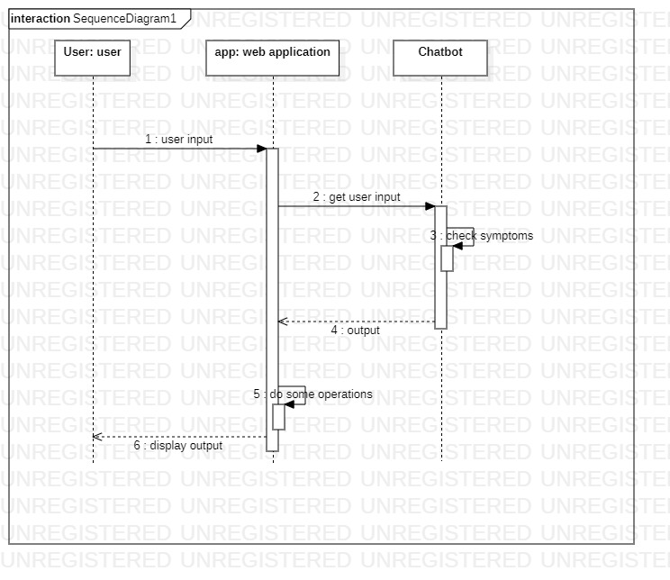

Slide 14
Project demo

Slide 15
