Slide 1
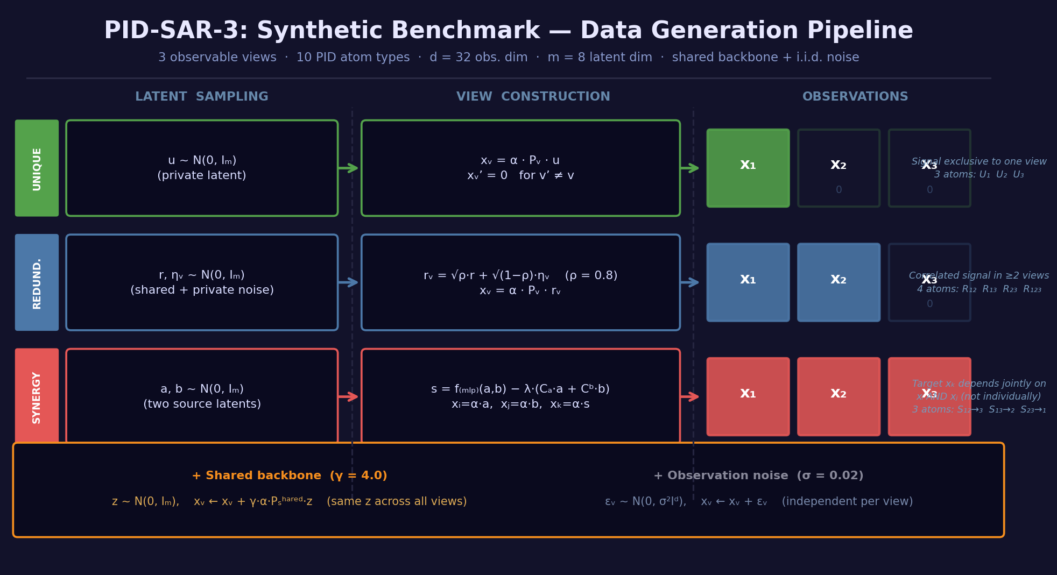

Slide 2
PID-SAR-3: Mathematical Formulation
d=32 obs. dim | m=8 latent dim | σ=0.02 noise | ρ=0.8 | α~U[0.8,1.2] | hop=1 | λ=0.25 de-leakage | γ=4.0 backbone gain | K=5 atoms (multi-atom mode)
① Unique atom Uᵥ (v ∈ {1, 2, 3})
② Redundancy atoms R_{ij} / R_{123}
u ~ N(0, I_m)
x_v = α · P_v^{U_v} · u
x_{v'} = 0 for all v' ≠ v
• u is a private m-dim latent, visible only in view v
• P_v^{U_v} ∈ ℝ^{d×m} is a fixed col-normalised random projection
• α ~ U[α_min, α_max] scales the signal amplitude
r, η_i, η_j ~ N(0, I_m) independently
r_i = √ρ · r + √(1−ρ) · η_i
r_j = √ρ · r + √(1−ρ) · η_j
x_i = α · P_i^{R_{ij}} · r_i , x_j = α · P_j^{R_{ij}} · r_j
x_k = 0 (k ≠ i, j)
• r is the shared factor; ρ controls correlation strength
• R_{123}: same formula extended to all three views
③ Directional Synergy S_{ij→k}
④ Shared backbone, noise & composition
a, b ~ N(0, I_m) (independent source latents)
x_i = α · P_i^{A_{ij}} · a
x_j = α · P_j^{B_{ij}} · b
s₀ = f_MLP(a, b ; hop) [fixed random residual MLP, tanh]
δ = a · C_a[hop] + b · C_b[hop] [linear de-leakage]
(C_a, C_b fitted by ridge regression to predict s₀ from a, b)
s = s₀ − λ · δ [de-leaked synergy signal]
x_k = α · P_k^{SYN_{ij}} · s
• x_k depends non-linearly on BOTH x_i and x_j but not individually
• de-leakage removes the component of s₀ predictable from a or b alone
Shared backbone (applied after atom construction):
z ~ N(0, I_m) [per-sample random latent]
x_v ← x_v + γ · α · P^{shared}_v · z
Same z and same P^{shared}_v across all views
P^{shared} is tied (identical) across views when tied=True
Observation noise (independent per view):
ε_v ~ N(0, σ² I_d)
x_v ← x_v + ε_v
Multi-atom composition (K atoms, K ≥ 2):
x_v^{total} = Σ_{k=1}^{K} x_v^{atom_k}
Primary atom label retained; K−1 atoms sampled w/o replacement
Fixed projections: P[view][comp] ∈ ℝ^{d×m}, cols normalised to unit ℓ₂
Synergy MLP: residual blocks with tanh; weights fixed at init
Projections: P_v^{comp} ~ N(0, 1/√d), col-normalised | α ~ U[0.8, 1.2] | ρ ∈ {0.2, 0.5, 0.8} | hop ∈ {1,2,3,4} | σ = 0.02 | λ = 0.25 (de-leakage) | γ = 4.0 (backbone) | K = 1 (single-atom) or 5 (multi-atom) | Balanced over 10 PID atoms

Slide 3
