Slide 1
The Battle of Neighbourhoods
Bar Venues in Toronto
Kristian Koschany

Slide 2
Opening a bar in Toronto, with the use of Foursquare’s API
This study displays and demonstrates how Foursquare’s API can be used to pull venue data, model it for consulting purposes, and present it in an understandable and useful manner
In this particular case, we are determining which neighbourhoods in Toronto proper are the best option for a client to open a new bar in the city
  In particular, they are looking for the Toronto neighbourhoods that currently have the least bars

Slide 3
Data acquisition and processing
List of neighbourhoods in Toronto containing postal code, borough, and neighbourhood name; 2019 data scraped from https://en.wikipedia.org/wiki/List_of_postal_codes_of_Canada:_M
  Neighbourhoods sharing the same postal code were combined
  Neighbourhoods not in Toronto proper were dropped
Latitude and longitude of each of Toronto’s postal codes; obtained from https://cocl.us/Geospatial_data
  This data was combined with the previous data, to add information to our dataset
  Neighbourhood boundaries were assigned using specific radii from their individual latitude and longitude
List of venues in each neighbourhood in Toronto, containing venue name, venue category, latitude, and longitude; pulled from Foursquare’s API
  The top 100 venues within a specified radius of each individual neighbourhood were pulled, then all non-bar venues were dropped

Slide 4
Neighbourhoods with the most and least bars
Neighbourhood | Number of bars
CN Tower, Bathurst Quay, Island airport, Harbourfront West, King and Spadina, Railway Lands, South Niagara | 1
Forest Hill North, Forest Hill West | 1
Moore Park, Summerhill East | 1
. . .
Berczy Park | 14
Design Exchange, Toronto Dominion Centre | 14
First Canadian Place, Underground city | 14
Little Portugal, Trinity | 18

Slide 5
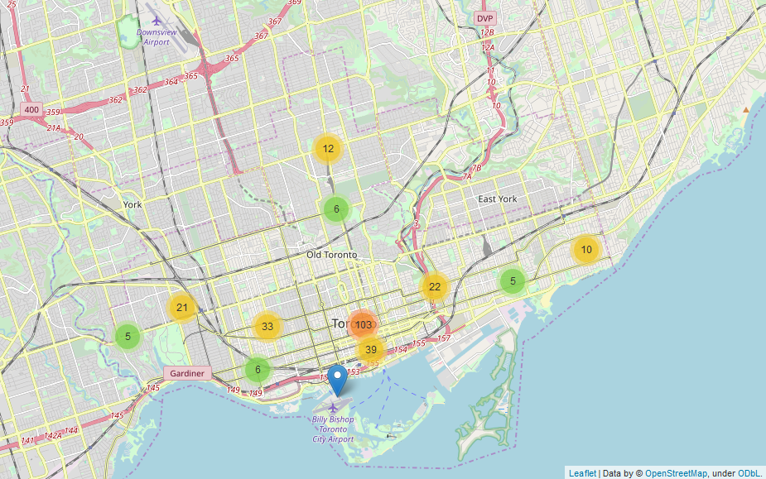
Map of bar venues in Toronto

Slide 6
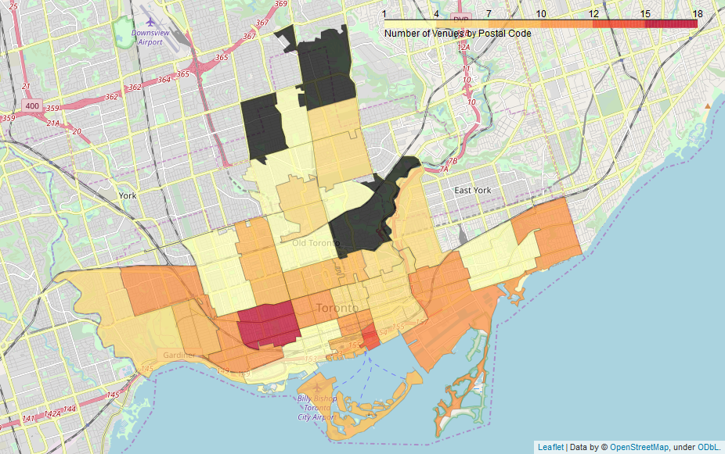
Choropleth map of bar venues per neighbourhood
These black-shaded neighbourhoods do not have any bars, which does not interest our client
Note that one of the one-bar neighbourhoods, CN Tower [etc], is directly next to the neighbourhood with the most bars, Little Portugal [etc]

Slide 7
Conclusion
The neighbourhoods with the least-number of bars are the best options for our client to open a new bar in Toronto
We shall exclude CN Tower, Bathurst Quay, Island airport, Harbourfront West, King and Spadina, Railway Lands, South Niagara, as it is directly next to the most-bar heavy neighbourhood, Little Portugal, Trinity
Thus, our two recommended neighbourhoods are Forest Hill North, Forest Hill West and Moore Park, Summerhill East
This has been a useful study in how to use Foursquare’s API data to pull venue data, model it for consulting purposes, and present it in an understandable and useful manner

