Slide 1
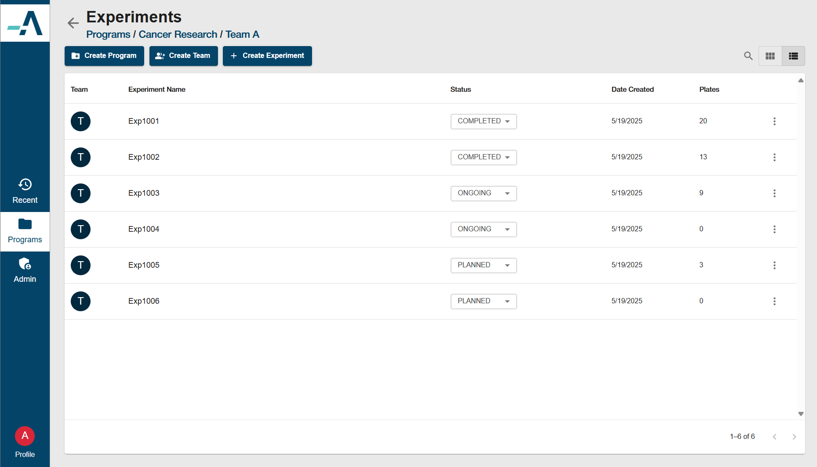

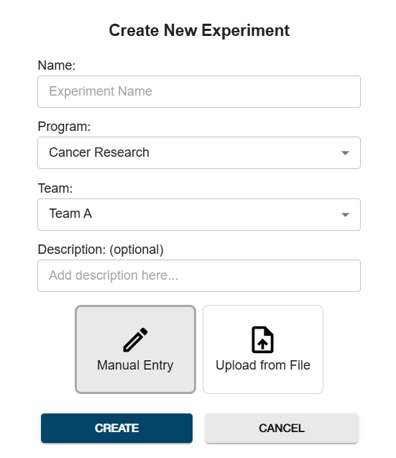
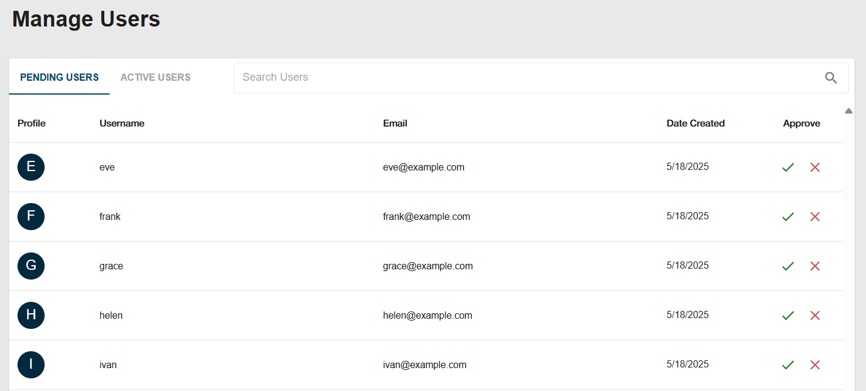
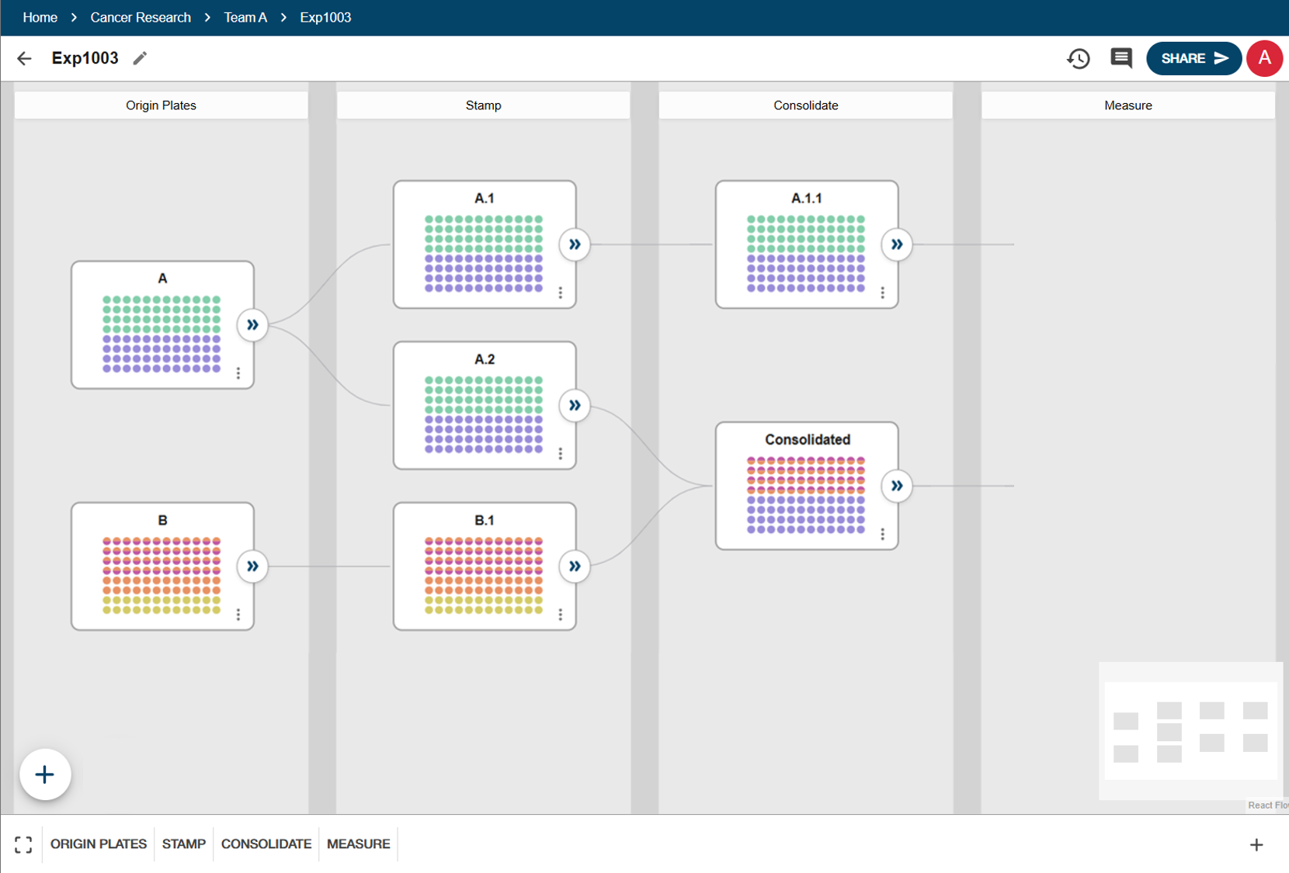
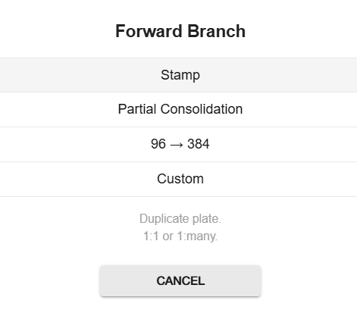


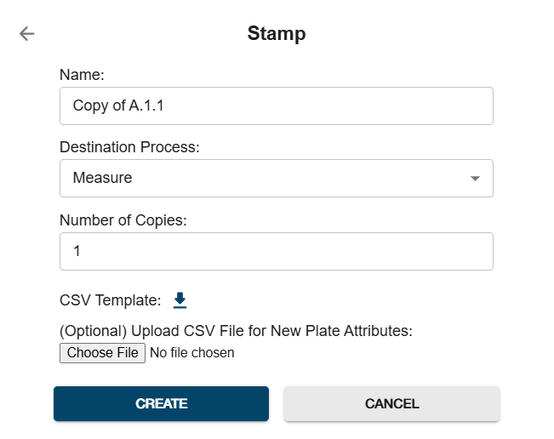

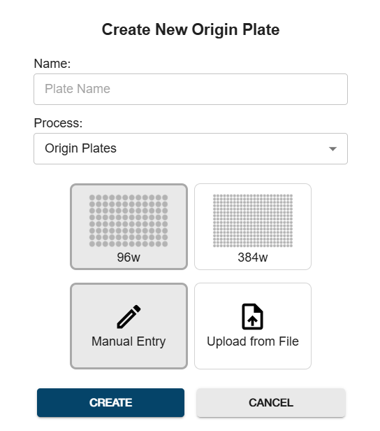









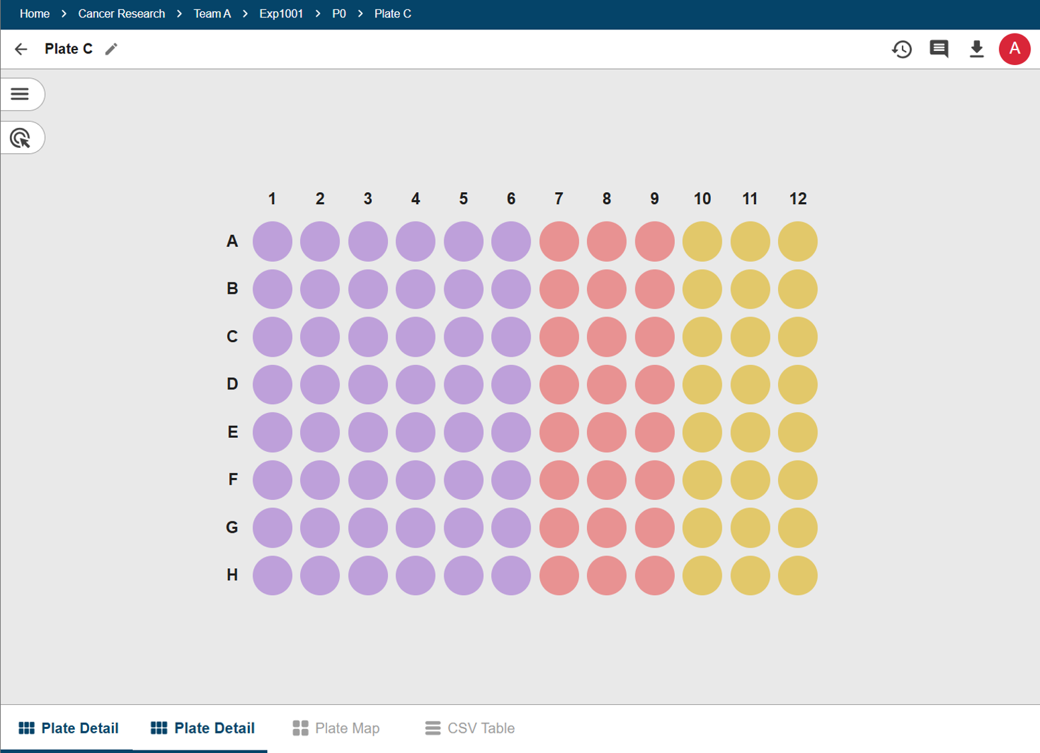
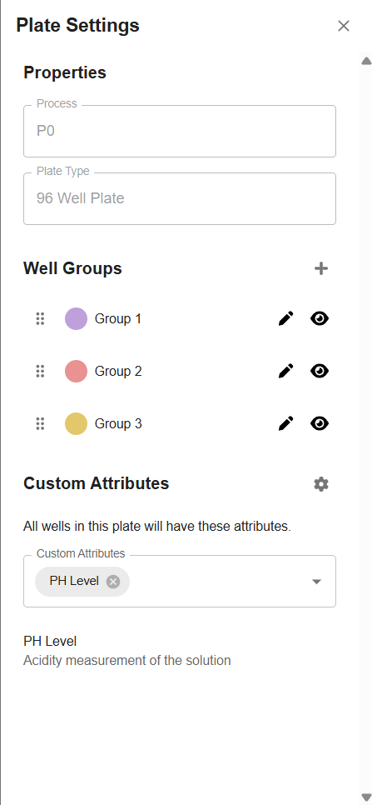

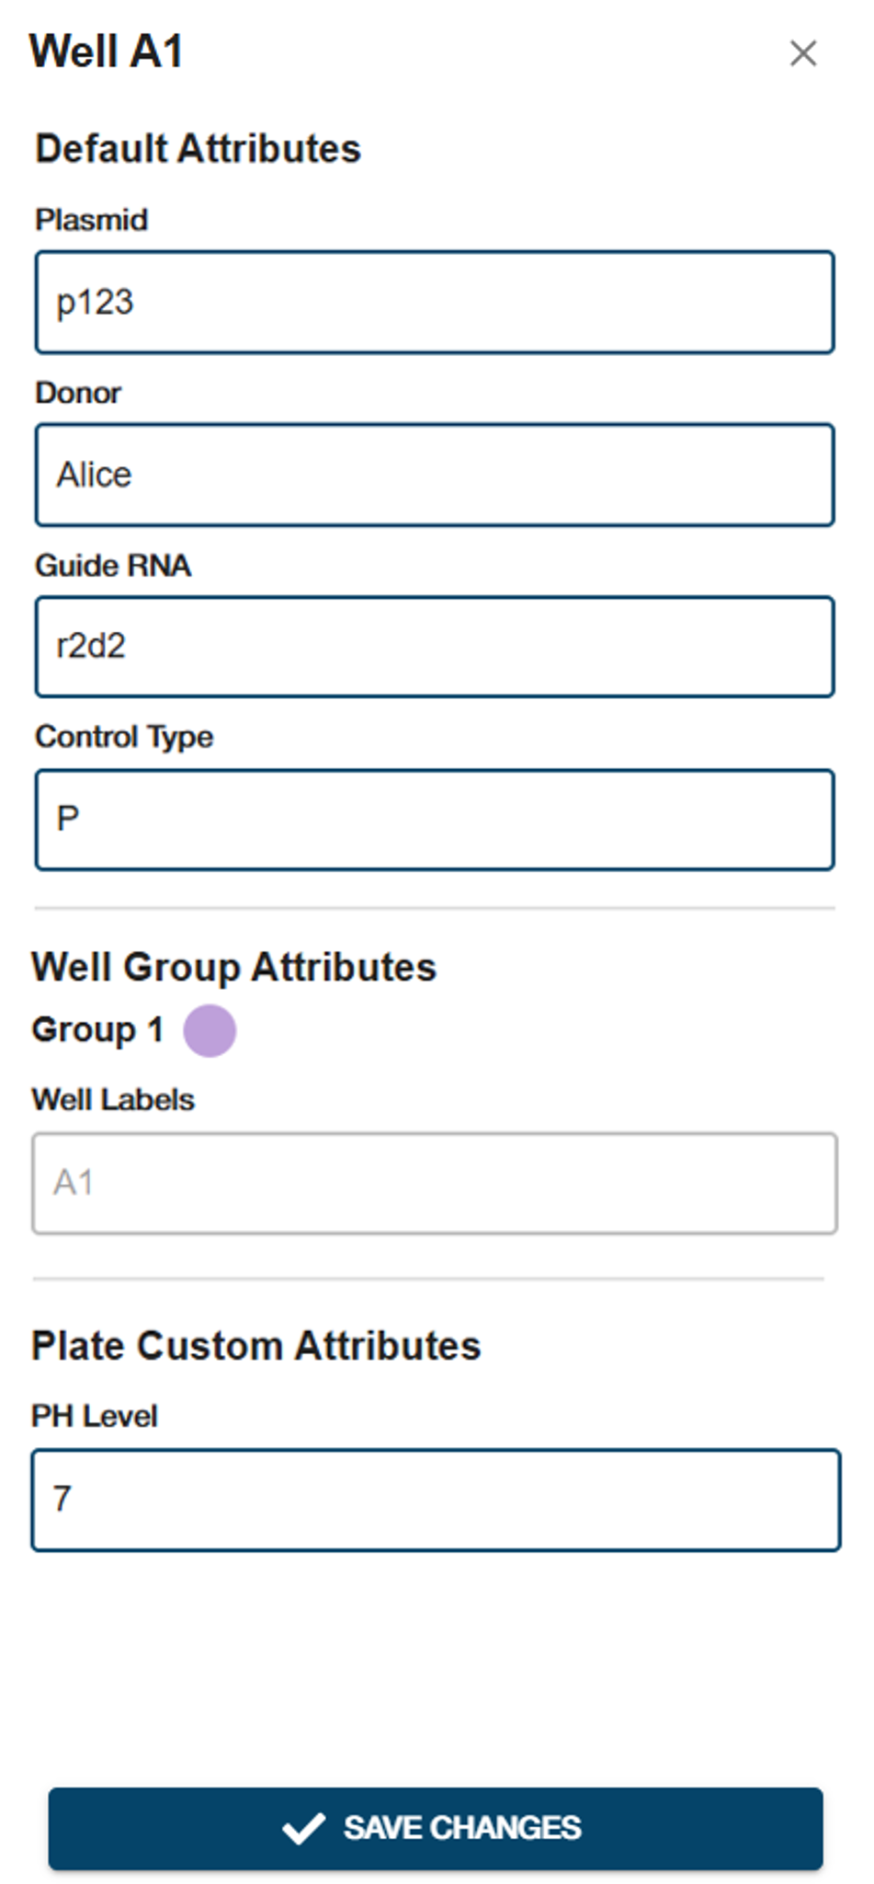

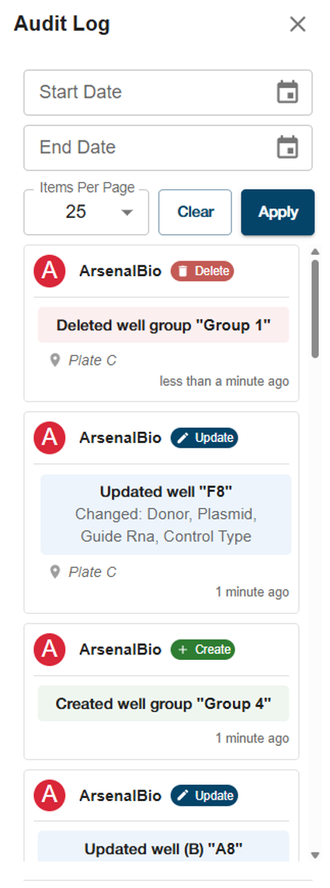

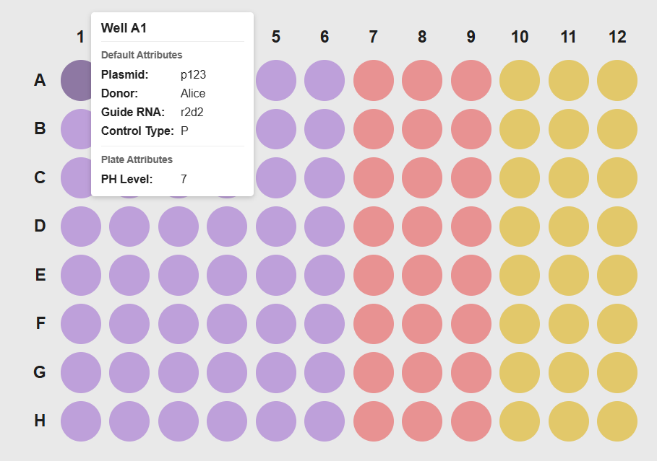







CSE 115C - Capstone Project
Experiment Visualization Tool
Arnav Nepal, Diego Yanez,
Eric Phuong, Sakshi Konnur,
Navaneeth Srinivasan
Jia Cheng Liu, Kat Kosolapova, Maggie Heathcote, Simon Zhao, Violet Solorio Gaitan
Abstract
Overview
Results
Our team developed an interactive tool to support scientists in planning, visualizing, and managing biological experiments. This tool is designed to replace time consuming and error prone manual visualization methods using Google Sheets or Lucidchart.
Plate Visualization
Dashboard
1
Interface to visualize 96/384-well plates of test tubes
1
View a list of experiments organized by program and team
2
Condition Tracking
Track attributes and properties of wells
2
Users can create a new experiment from scratch or from an existing CSV file
3
Lineage Tracking
Approach
Only admins can approve new users
Visualize plate relationships through different processes
Team Management
Formed 2 sub-teams (Experiment / Plate) to each focus on a portion of the tool
Experiment View
View plate nodes in columns for each timestamped process
Graph structure displays connections between parent and child plates
Option to add a child plate branching off of an existing plate
Plate View
Click into a plate to view well grid
Color coded by well groups defined by scientists
View and edit well attributes in sidebar or alternate table views
3
Automation
Automate repetitive tasks to reduce
manual entry errors and save time
4
7
Experiment View
Data Import / Export
4
View plates in an experiment organized vertically by process - arrows represent parent-child relationships
CSV and PDF
Management & Collaboration
Create new ‘origin’ plates without parents - user can fill out attribute data manually or via CSV upload
Organize by programs and teams, sharing features, and an audit log
5
Add new processes with associated names and dates
Conclusion
5
6
Our experiment visualization platform empowers cancer researchers by providing a graphical interface to visualize and manage their experimental workflows. It streamlines experiment management and transforms complex processes into an organized, intuitive system. Looking ahead, there is still potential for more features, and our goal is to hand off this platform to ArsenalBio to continue development to meet their research needs.
7
The forward branch menu walks users through the key use cases for creating child plates (see examples below)
6
Stamp
Consolidation
96 → 384
Architecture
Plate View
9
8
Visualize a plate with color coded well groups and selectable wells
10
8
12
Plate settings menu allows the user to manage well groups and custom attributes
Acknowledgements
Web Server
9
The Software Team:
Fabio Ingrao
Mary Chua
10
View and edit the attributes of selected wells
User
Alternatively, view plate data in a table format
Load Balancer
11
The Staff:
Instructor Richard Jullig
TA Pranay Mundra
API Server
Database
12
Track edits in an audit log
11

