Slide 1
Why are we here?
Why Are We Here?
Problem:
Most Sudoku apps use fixed difficulty levels that don’t adapt to individual skill levels, leading to boredom or frustration.
Our Idea:
Develop a Smart Adaptive Sudoku app that adjusts puzzle difficulty based on user performance and learning progress.

Slide 2
Elevator Pitch
Sudo is a personalized brain-training app that dynamically adjusts puzzle difficulty based on each user’s performance.
Unlike traditional Sudoku apps with fixed levels, our app analyzes solving time, mistakes, and hint usage to deliver the right level of challenge, helping users continuously improve their logical thinking while staying motivated and engaged.

Slide 3
Product Box
Key Features:
Adaptive difficulty system
Smart hints and mistake detection
Progress tracking dashboard
Daily challenges and leaderboards
Key Benefits:
Personalized learning experience
Improved logical reasoning
Higher engagement and motivation
Continuous skill development

Slide 4
  In scope
  Core gameplay
  Adaptive difficulty
  Hints system
  User profiles
  Session management
  Out of scope
  Multiplayer modes
  Social features
  Cloud sync
  Monetization system
  Unresolved
  Adaptation strategy
  Target platform
  Offline support

Slide 5
Key stakeholders
End users
Supporting stakeholders
Development team

Slide 6
Front end
React
Component-based UI
Sudoku grid with interactions
Application logic
Puzzle generator
Adaptive difficulty engine
Hing engine
Firebase
Game state, progress, difficulty history
Firebase Auth
Firebase Hosting
Web application
  React, HTML, CSS
  Firebase
  Jest

Slide 7
Risks
Main risks:
Complexity of Sudoku generator
Difficulty balancing (adaptive system)
Team coordination problems
React + firebase integration issues
Ways to solve them:
Weekly Scrum meetings
Early and continious testing
Build core version first
Focus on in-scope features

Slide 8
Project size and timeline
Duration: 12 weeks (12 sprints)
Plan:
Weeks 1-2: Planning & setup
Weeks 3-8: Core development
Weeks 9-10: Advanced features development
Weeks 11-12: Testing and deployment

Slide 9
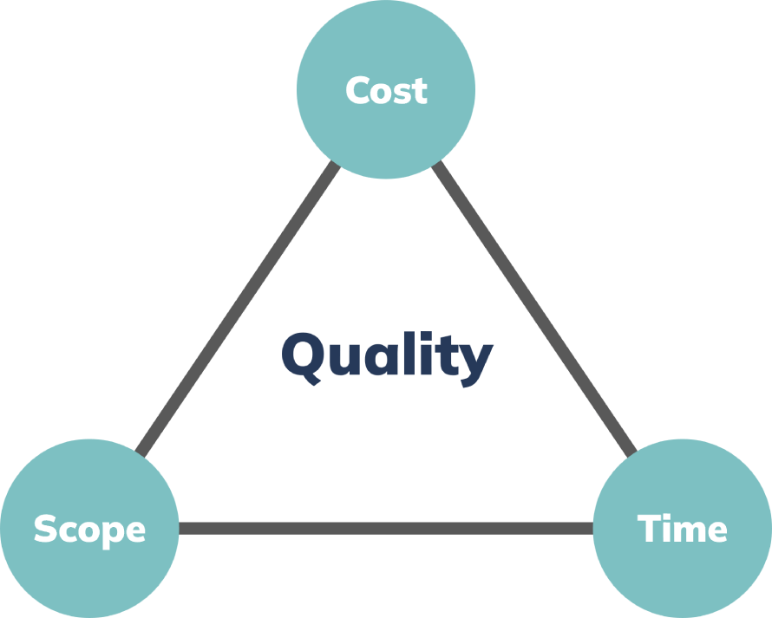
Project Trade-Offs
Time → Fixed
Cost(Team) → Fixed
Scope → Flexible

Slide 10

Resources & Plan
12 Weeks → 12 Sprints
Team of 4
Agile Scrum
Free Tools

