Slide 1
AIRPLANE SAFETY
Cody Alliston | Collin Fernandez
Kareena Kothari | Zack Nakasone

Slide 2

PROBLEM STATEMENT
Produce a shiny web application to determine hotspots for accidents using data from the National Traffic Safety Board. The application will allow for filtering of data to easily show factors contributing to accidents in certain areas. The application will focus on smaller aircraft, with airline accidents being filtered out due to their frequency being lower and fatalities being higher.

Slide 3
OBJECTIVES
Identify Hotspots
Where are severe accidents occurring?
Identify Trends
Why are those accidents occurring?
Present Data
Effective and dynamic visualizations

Slide 4
REQUIREMENTS
Data Cleaning
Filter out unwanted data
Format to make data usable
Geolocations
Latitude and longitude of accidents
Airport locations
Interactive Visualizations
Effective and customizable visuals

Slide 5
DATA SOURCES
National Traffic Safety Board
Accident Information
The Global Airport Database
Airport Locations, codes, and names

Slide 6
DATA CLEANING
FILTER OUT IRRELEVANT DATA
MISSING VALUES & CONSISTENT FORMATTING
CALCULATE SEVERITY INDEX
USABLE DATA
BRING IN AIRPORT INFORMATION
RAW DATA FROM NTSB

Slide 7
SEVERITY INDEX
SI = 3.0 * X₁ + 1.8 * X₂ + 1.3 * X₃ + X₄
Where:
X₁ = Fatalities
X₂ = Serious injuries
X₃ = Minor injuries
X₄ = Uninjured
Yafei Li, Chen Liang, "The Analysis of Spatial Pattern and Hotspots of Aviation Accident and Ranking the Potential Risk Airports Based on GIS Platform", Journal of Advanced Transportation, vol. 2018, Article ID 4027498, 12 pages, 2018. https://doi.org/10.1155/2018/4027498

Slide 8
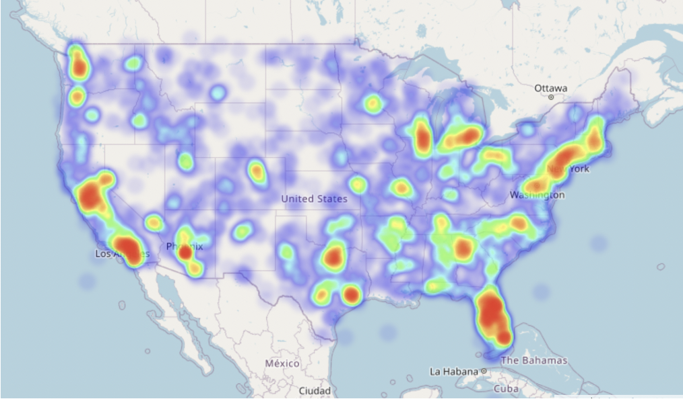
VISUAL EXAMPLE: HEAT MAP Accident hotspots based on severity magnitude

Slide 9
METHODOLOGIES
Association Rules Mining
Time Series Analysis
Text Analysis
Cluster analysis

Slide 10
METHODOLOGY: ASSOCIATION RULES MINING
What is ARM?
Association rules are if-then statements
How does it help solve the business problem?
How was it applied?
Filter by injury severity, then use Apriori algorithm to find frequent item sets
Find patterns in fatal and non-fatal accidents

Slide 11
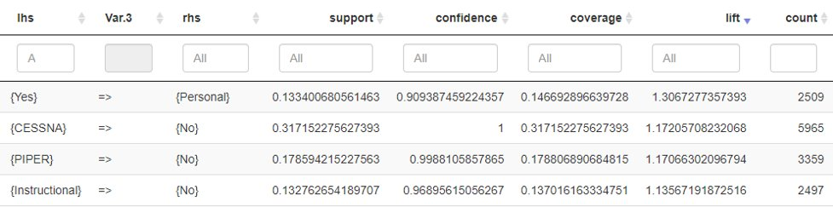
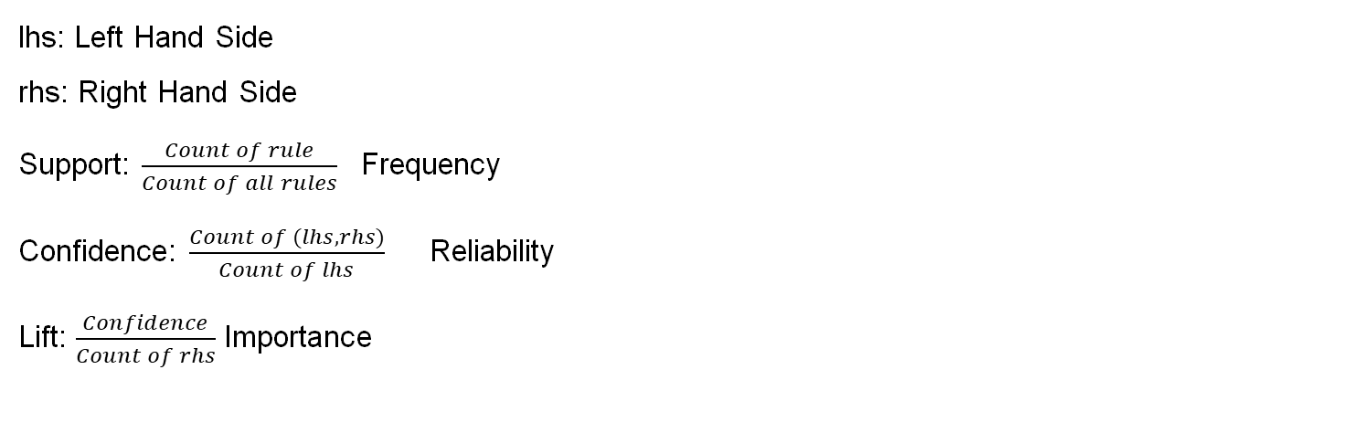
METHODOLOGY: ASSOCIATION RULES
lhs: Left Hand Side
rhs: Right Hand Side
Support: $\frac{Count of rule}{Count of all rules}$ Frequency
Confidence: $\frac{Count of (lhs, rhs)}{Count of lhs}$ Reliability
Lift: $\frac{Confidence}{Count of rhs}$ Importance

Slide 12
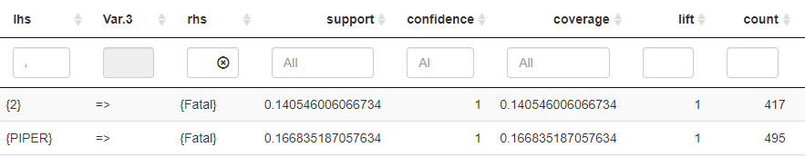
METHODOLOGY: ASSOCIATION RULES

Slide 13
METHODOLOGY: CLUSTER ANALYSIS
What is cluster analysis?
Finds similar observations and places them into groups
Find similarities between accidents and explore the groupings
How does it help solve the business problem?
Split the data into fatal and non-fatal sets, then calculate similarity using the Gower method and cluster
How was it applied?

Slide 14
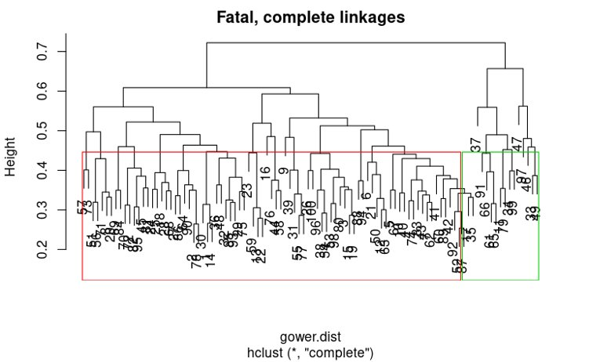
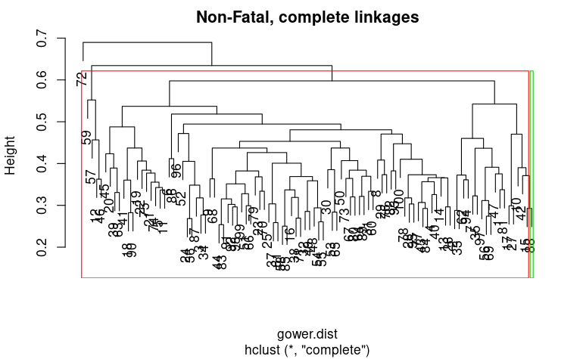
METHODOLOGY: CLUSTERING
Left low severity, right higher severity >3
72, 33 uninjured, high severity

Slide 15
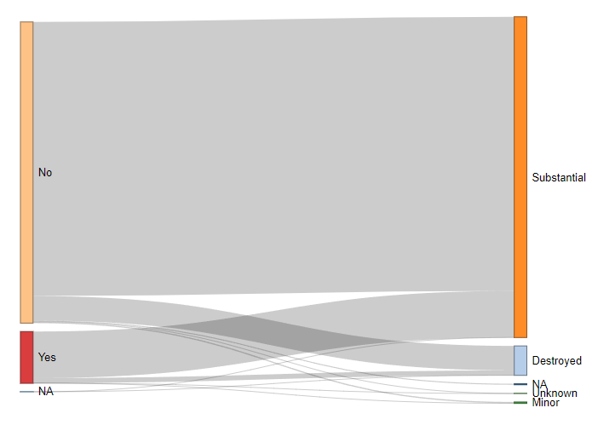
VISUAL EXAMPLE: SANKEY PLOT
Amateur Built
Aircraft Damage

Slide 16
METHODOLOGY: TIME SERIES ANALYSIS
What is time series analysis?
Method of observing a sequence of data over an interval of time
Identifying trends/patterns of accidents
How does it help solve the business problem?
Cumulative Distribution
How was it applied?

Slide 17
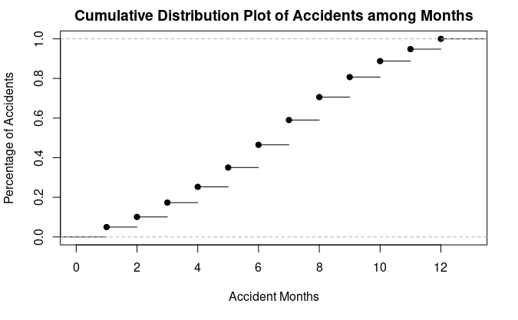
METHODOLOGY: TIME SERIES ANALYSIS

Slide 18
METHODOLOGY: TEXT ANALYSIS
What is text analysis?
Explores word frequency in categorical data
Identifies repeated words in selected category
How does it help solve the business problem?
How was it applied?
Interactive filtering options in application

Slide 19
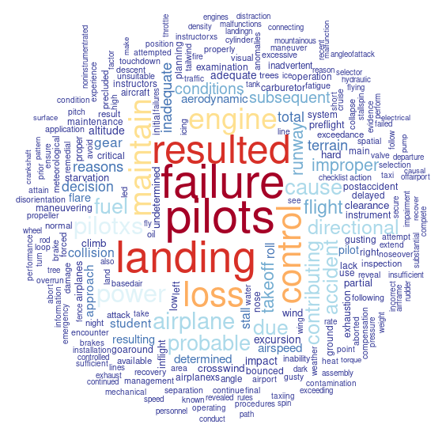
METHODOLOGY: TEXT ANALYSIS REPORT STATUS

Slide 20






PRODUCT FLOW
USER
FILTERS
FILTERED DATA
DATA MODELS
USER INTERACTION
DESIRED MODEL
selects
formats
applied
displays

Slide 21
DEMO

Slide 22
CONCLUSION
Identify Hotspots
Heat map
Identify Trends
Time series
Sankey
Association Rules
Severity index

Slide 23
CAPSTONE OUTCOMES
Establish question and objectives
Critically review relevant literature
Organize, clean, and pre-process data
Exploratory Data Analysis (EDA)
Analysis-based inference or explanation of phenomenon
Data summarization and visualization
Communicate key insights

Slide 24
QUESTIONS

