Slide 1
Flattened circadian glucocorticoid oscillations cause obesity due to increased lipid turnover and lipid uptake
Stefan Tholen, Kyle Kovary, Atefeh Rabiee, Ewa Bielczyk-Maczyńska, Wenting Yang, and Mary N. Teruel

Slide 2
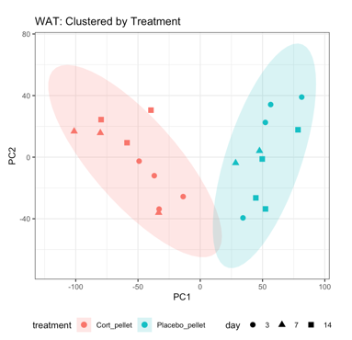
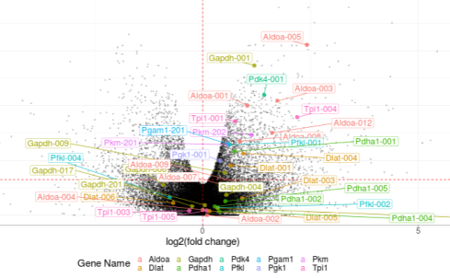
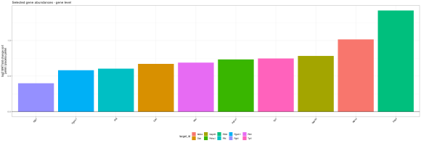
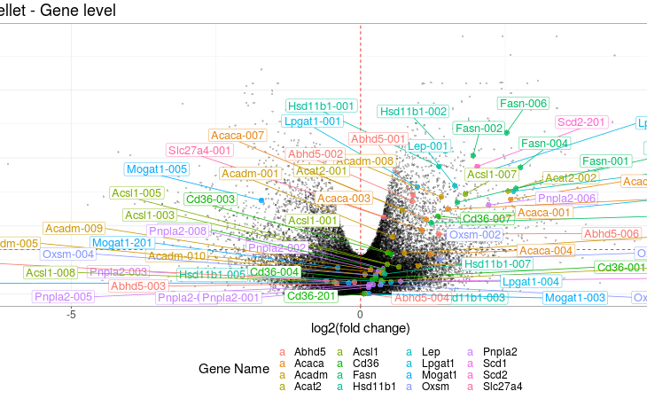
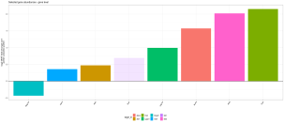




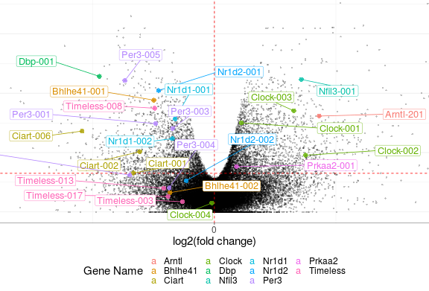
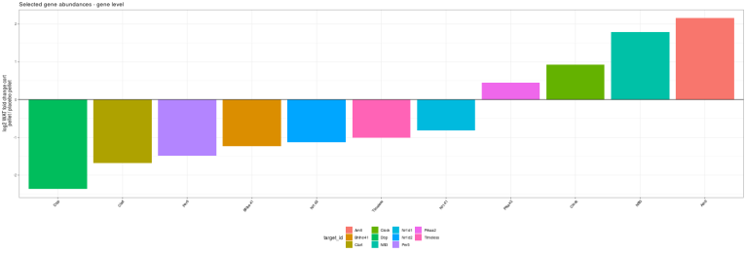
Fig. 6
Tholen et al.
A
B
C
Glycolysis
Gene bar plot of highlighted genes in B
Write „vWAT“ and „sham“
All bars same color (use color from dots in B)
Write vWAT and sham pellet
Write „vWAT“ and „sham“
remove protein names, all dots same color
D
Lipid metabolism
E
Fatty acid
transport
TG synthesis
TG degradation
Other
Genes: Abhd5, Pnpla2, Acadm, Acat2
Genes: Cd36, Slc27a4
Genes: Lep, Hsd11b1
Write „vWAT“ and „sham“
Please use this order of genes
Use the same colors for each category as in D
Write „vWAT“ and „sham“
remove protein names, color dots (4 different colors for 4 differetn categories: a) TG synthesis, b) TG degradation, c) lipid transport, d) Other)
F
Circadian Rhythm
G
Write „vWAT“ and „sham“
All bars same color (use color from dots in F)
Write „vWAT“ and „sham“
remove protein names, all dots same color

Slide 3
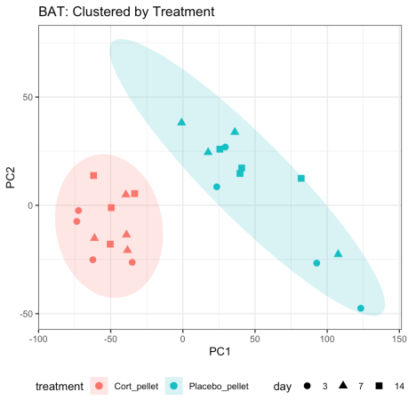
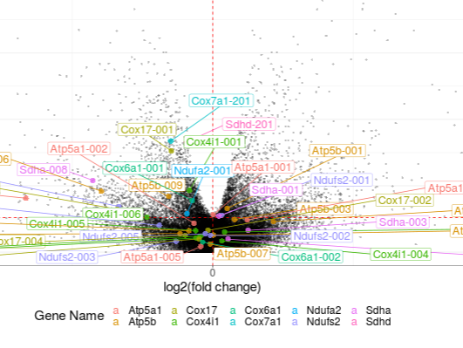
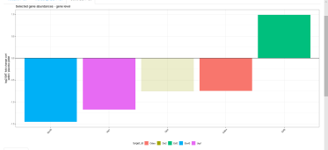
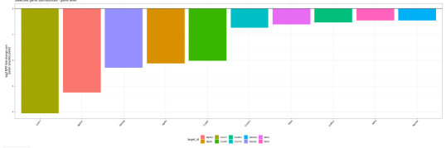
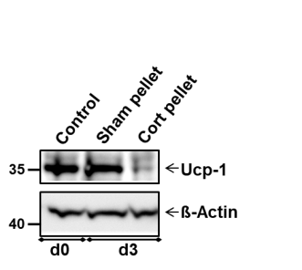
Fig. 7
Tholen et al.
A
B
Thermogenesis / oxidat. phosphorylation
C
Gene bar plot of highlighted genes in B related to thermogensis
Write „sham“
All bars same color as used for thermogensis-related genes in B
Write sham pellet
Write „sham“
remove protein names, use 2 different colors for dots (color 1: thermogenesis-related genes; color 2: oxidat Phos.-related genes)
D
E
Write „sham“
All bars same color as used for oxid. Phos.-related genes in B
F
G

Slide 4
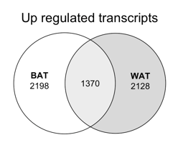
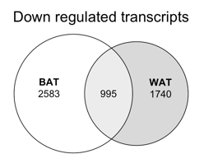
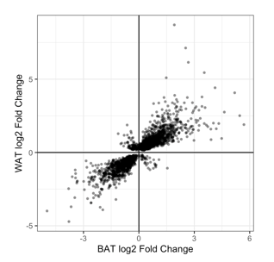
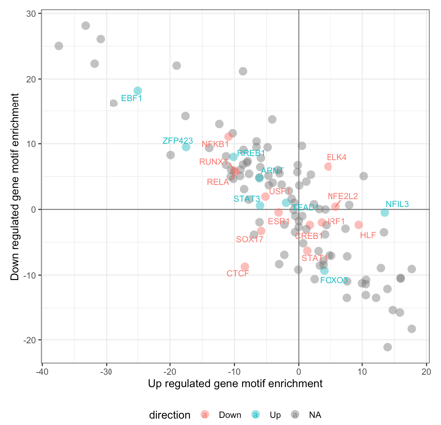
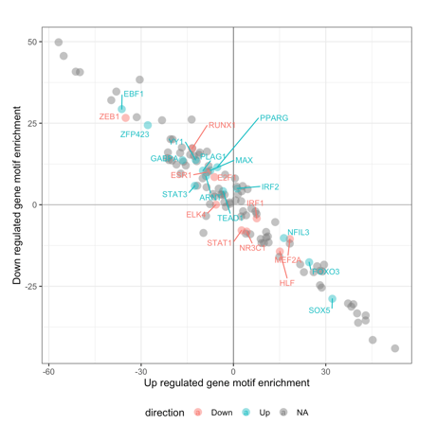
Fig. 8
Tholen et al.
A
B
C
Please write „vWAT“
Please write „vWAT“
Please write „vWAT“
D
E
F
Go terms related to lipid metab. and positively correlated in WAT and BAT
Gene bar plot of lipid metab genes in BAT and vWAT (genes in excel file)
Gene bar plot of circadian genes in BAT and vWAT (genes in excel file)
G
vWAT
H
BAT

Slide 5
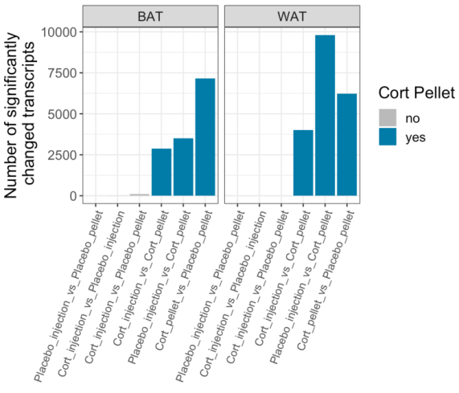
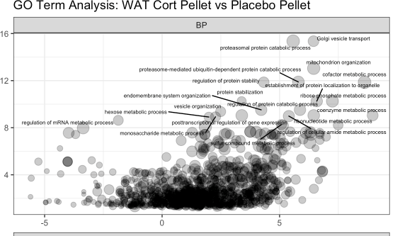
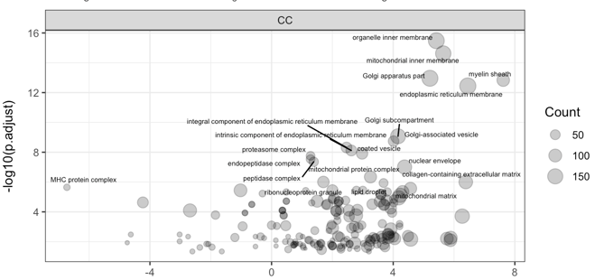
Sup. Fig. 2 (WAT)
Tholen et al.
A
B
PCA analysis as in fig 6A for WAT sham inj vs cort inj
Remove „Cort pellet“ yes no
Maybe different color for bar only for sham pellet vs cort pellet and sham inj vs cort inj
remove BAT , only show vWAT (Always in all figures write vWAT)
Do not use placebo, write sham
Highlight not top 20:
Instead highlight:
acetyl-CoA metabolic process
carbohydrate catabolic process
lipid localization
cellular response to lipid
lipid homeostasis
phospholipid metabolic process
fatty acid metabolic process
fat cell differentiation
fatty acid biosynthetic process
fatty acid transport
fatty acid oxidation
glucose metabolic process
glucose 6-phosphate metabolic process
glycolytic process
pyruvate metabolic process
regulation of cellular component size
mitochondrion organization
mitochondrial transport
circadian rhythm
rhythmic process
C
Biological process
D
Cellular Component

Slide 6
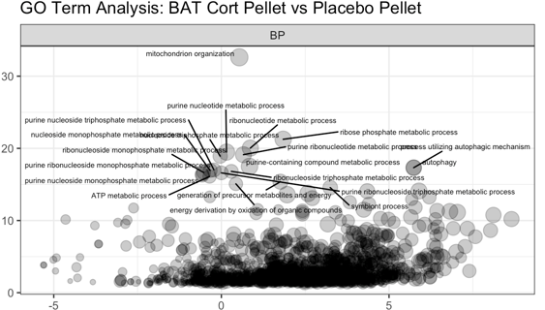
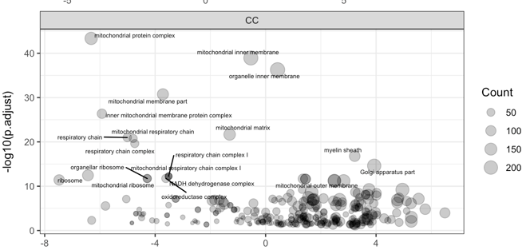
Sup. Fig. 3 (BAT)
Tholen et al.
A
B
PCA analysis as in fig 7A for BAT sham inj vs cort inj
Remove „Cort pellet“ yes no
Maybe different color for bar only for sham pellet vs cort pellet and sham inj vs cort inj
remove WAT , only show BAT (Always in all figures write vWAT)
Do not use placebo, write sham
C
Highlight not top 20:
Instead highlight:
cold-induced thermogenesis
regulation of cold-induced thermogenesis
adaptive thermogenesis
mitochondrial transport
mitochondrial membrane organization
mitochondrial respiratory chain complex assembly
mitochondrial ATP synthesis coupled electron transport
respiratory electron transport chain
Circadian rhythm
Rhythmic process
regulation of lipid metabolic process
lipid oxidation
lipid storage
lipid localization
fatty acid metabolic process
brown fat cell differentiation
fatty acid beta-oxidation
fatty acid oxidation
Cellular response to lipid
Temperature homeostasis
Biological process
D
Cellular Component

Slide 7
Tables:
Table S2: vWAT: Differntially expressed genes sham pellet vs cort pellet
Table S3: vWAT: GO terms sham pellet vs. Cort pellet
Table S4: BAT: Differntially expressed genes sham pellet vs cort pellet
Table S5: BAT: Differntially expressed genes sham inj vs cort inj
Table S6: BAT: GO terms sham pellet vs. Cort pellet
Table S7: Differntially expressed genes sham pellet vs cort pellet in vWAT and BAT

