Slide 1
#
®
Mobile Everything

Slide 2


What is Mobilizer
Mobilizer

Slide 3
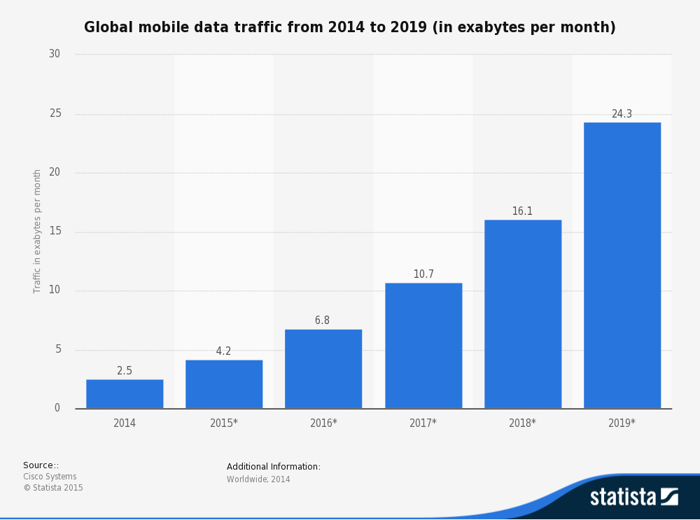

Slide 4
The Start

Slide 5
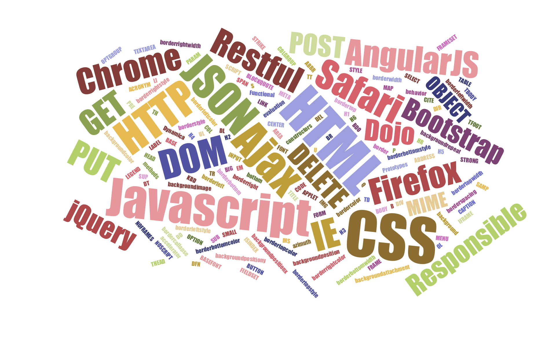

Slide 6
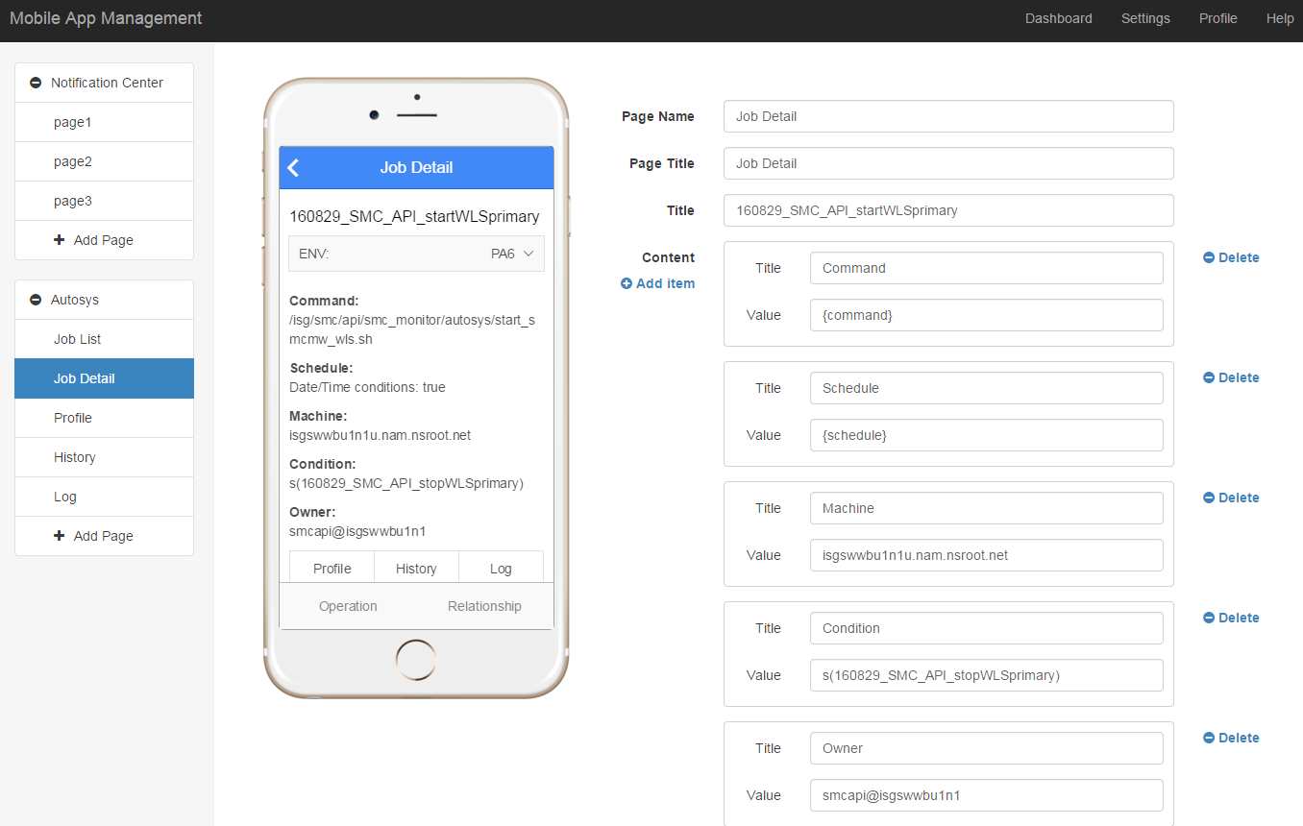

Slide 7

Page A
Page C
Page B
Page D
GET/POST/PUT/DELETE
Service A
Service B
Service C

Slide 8

Service
GET
/service/modelname/:id
POST
/service/modelname
PUT
/service/modelname/:id
DELETE
/service/modelname/:id

Slide 9
Page
Parameter
Label Control
Name:
modelId
Label:
Name
Type:
Integer
Value:
${modelName.name}
Model
Label Control
Name:
modelName
Label:
Amount
Service:
/service/model
Value:
${modelName.amount}
Route Control
Text:
Owner
target:
ownerView?id=${id}

Slide 11

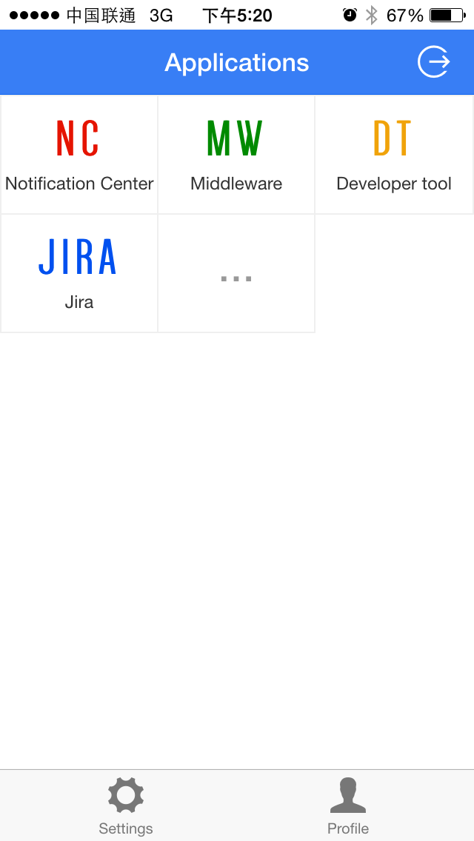
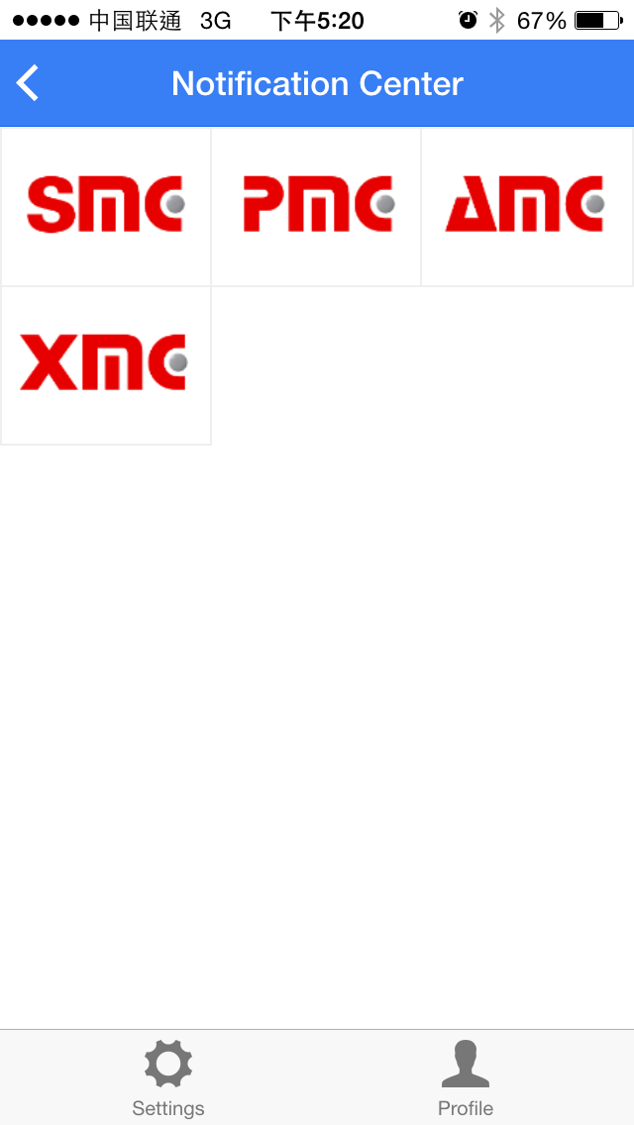

Slide 12
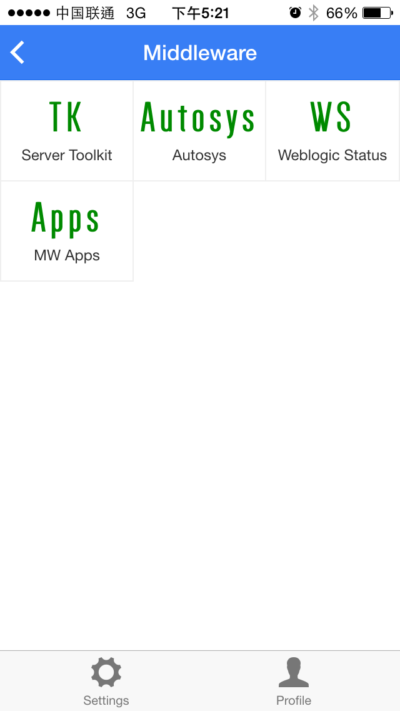
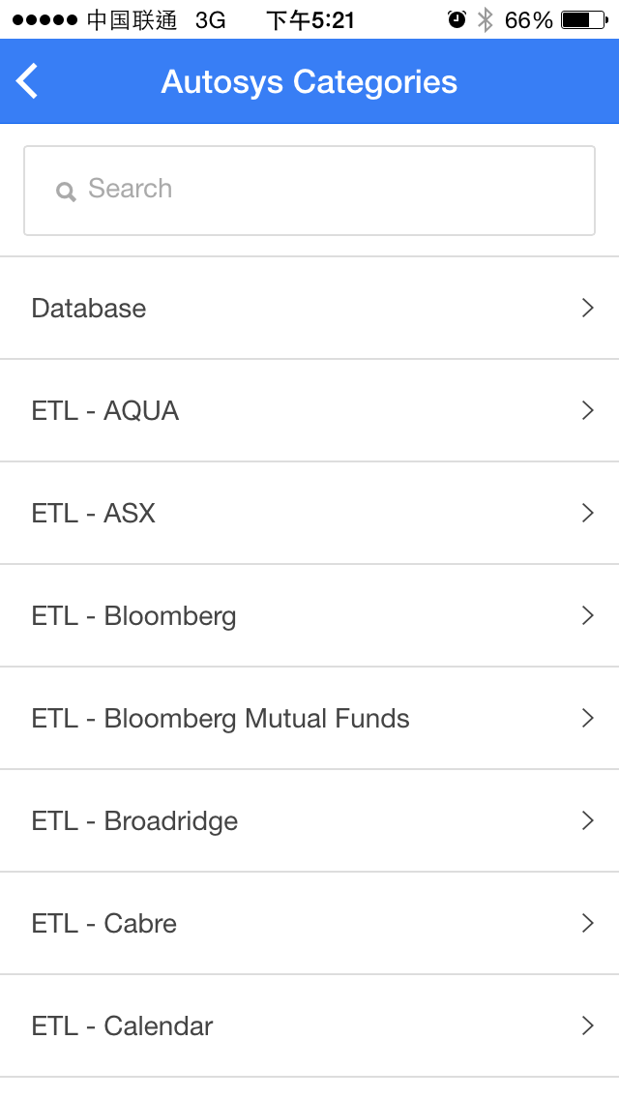

Slide 13
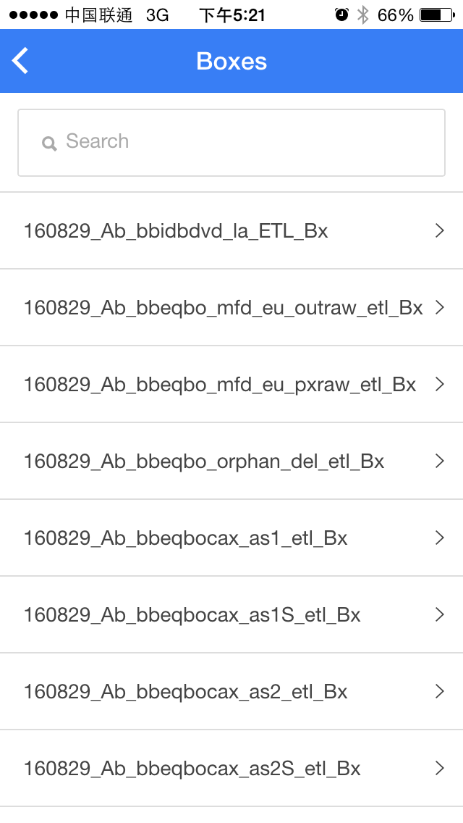
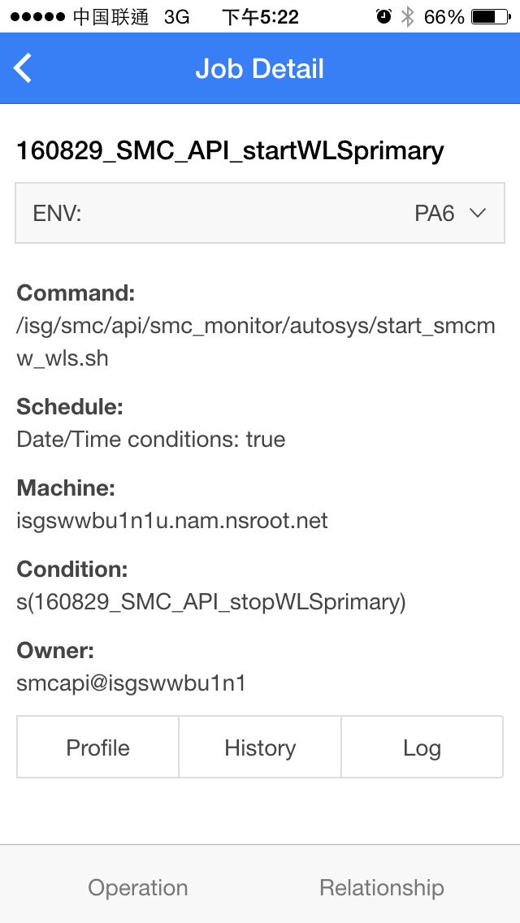

Slide 14
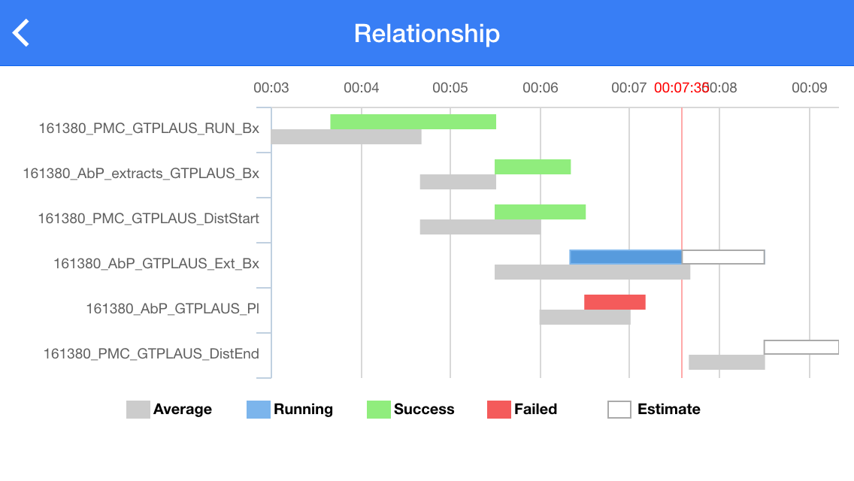

Slide 17
Thank you

