Slide 1
Bosch Production Line Performance
Final Deliverables: Predictive Quality, Process Intelligence, Copilot, and Executive Dashboard

Slide 2
Project Objective
Build a reusable manufacturing analytics reference architecture.
Predict product failure risk from raw numeric, categorical, and date data.
Explain risk through SHAP, station evidence, process bottlenecks, and graph analytics.
Deliver usable interfaces: Manufacturing Copilot and Executive Dashboard.

Slide 3
Data and Scope
Labeled train products: 1,183,747; failures: 6,879.
Historical failure rate: 0.581%.
Test products scored: 1,183,748; predicted alerts: 6,998.
Raw Bosch CSVs remain the source. Processed outputs are reproducible phase artifacts.

Slide 4
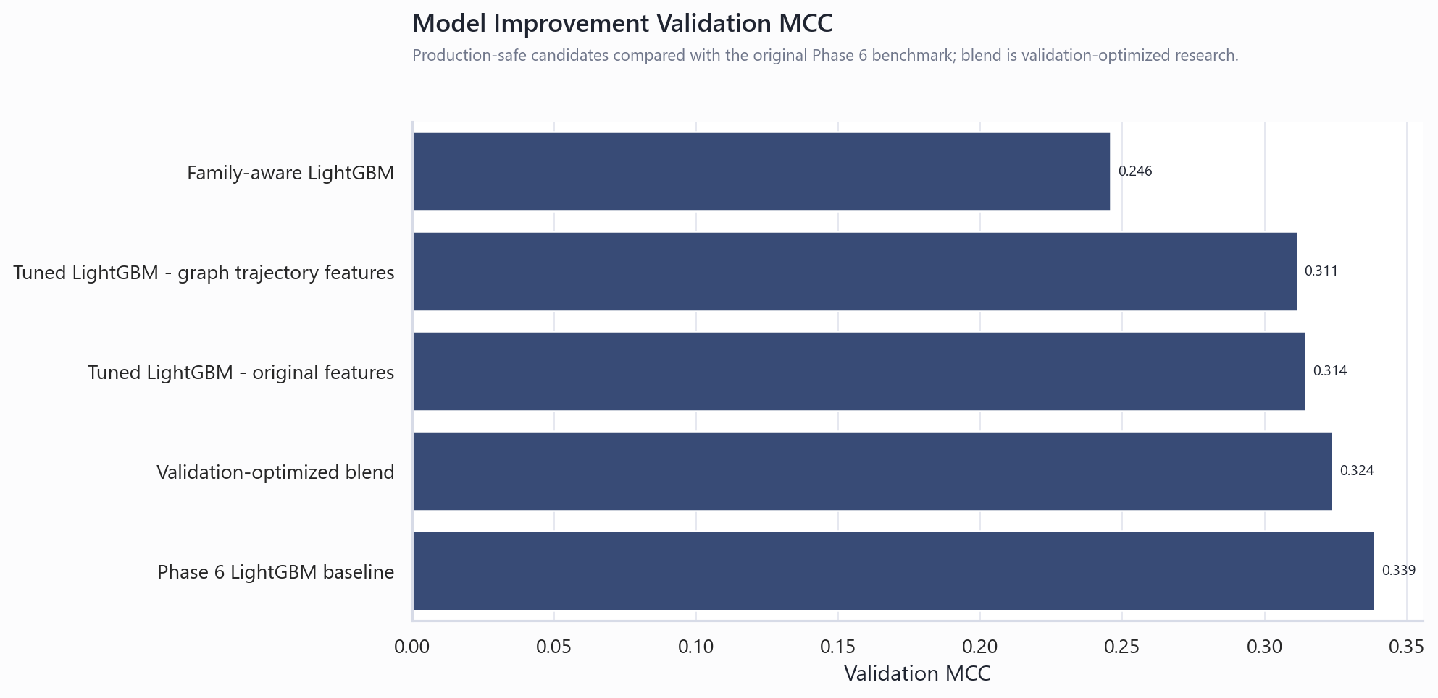
Production Failure Prediction Model
Selected model: LightGBM.
Validation MCC 0.339; precision 0.574; recall 0.213.
Improvement experiments did not beat the Phase 6 LightGBM baseline.
Leaderboard leakage model remains research-only and excluded from production deliverables.

Slide 5
Product Family Segmentation
Final segmentation contains 8 product families.
Highest-risk family: 4 at 0.737% failure rate.
Families are based on station-presence and flow-path structure.
Segmentation supports targeted monitoring by route and product mix.

Slide 6
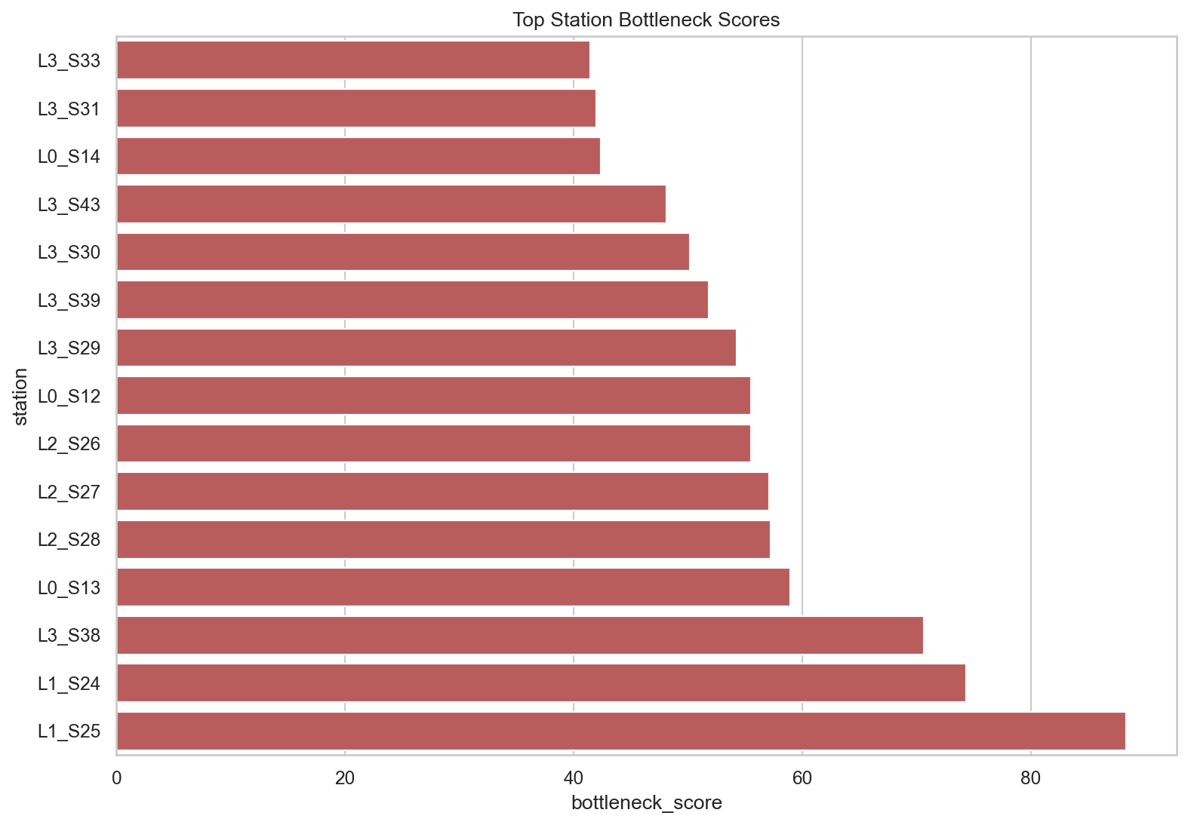
Process Mining Engine
Top bottleneck: L1_S25 with score 88.34.
Outputs include process-map edges, station waiting times, bottleneck scores, and critical paths.
Throughput efficiency is a relative timestamp proxy, not formal OEE.

Slide 7
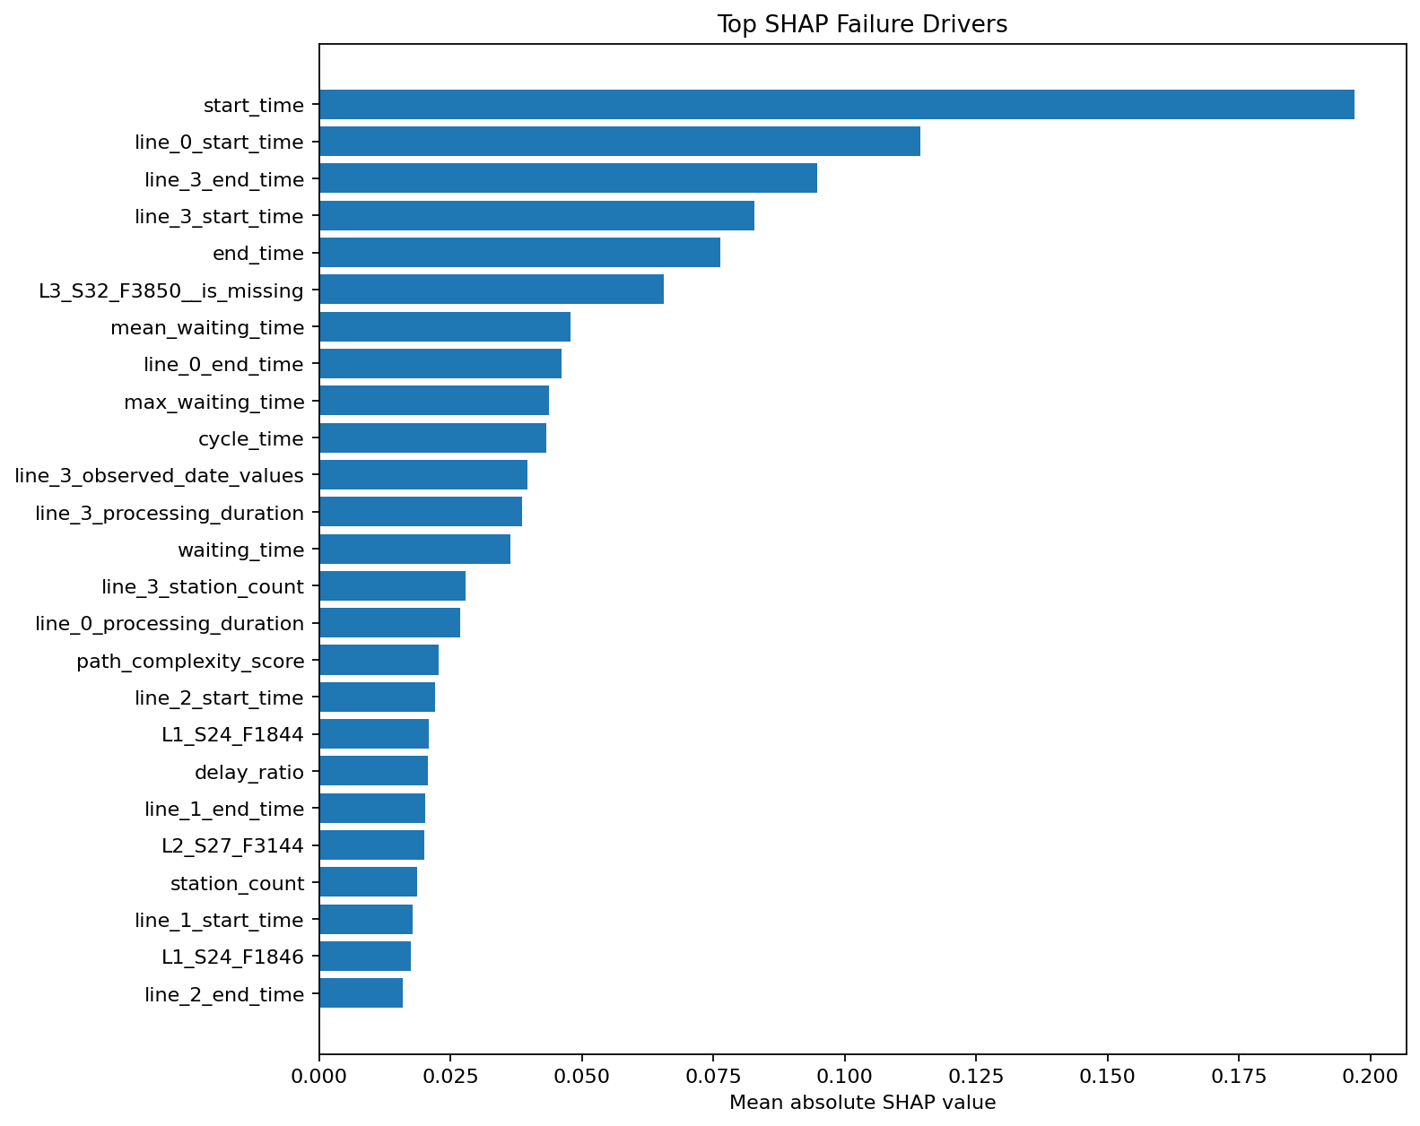
Root Cause Analysis Engine
SHAP identifies timing, line-level, missingness, and station-measurement drivers.
Highest observed station risk: L3_S32 at 4.506%.
Recommendations are engineering investigation priorities, not causal proof.

Slide 8
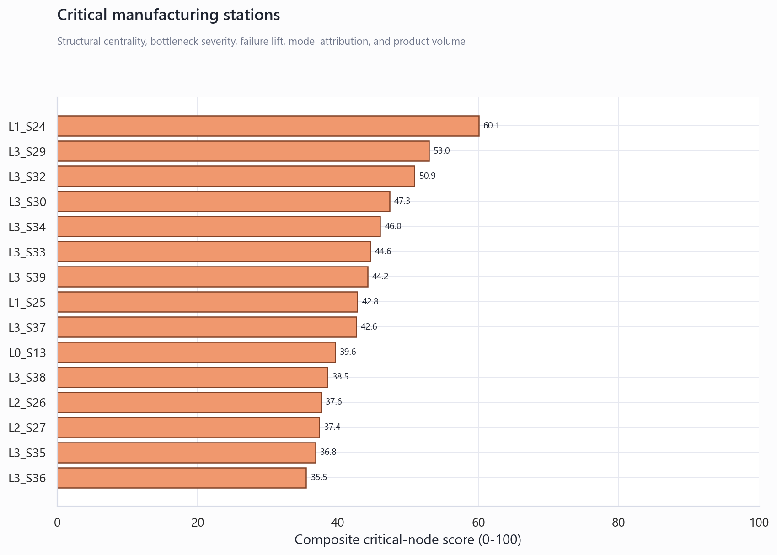
Knowledge Graph
Graph size: 4,321 nodes and 4,923 edges.
Top critical node: L1_S24.
Relationships connect production lines, stations, features, transitions, and failure evidence.
Failure propagation routes are monitoring hypotheses.

Slide 9
Manufacturing Copilot
SQLite-backed copilot database contains 1,240,468 prediction rows.
Streamlit app supports risk review, root-cause Q&A, bottlenecks, graph insights, and summaries.
Natural-language answers use deterministic reviewed intents and parameterized SQL.

Slide 10
Executive Dashboard
Dashboard includes KPI scorecard, relative failure trends, station heatmaps, bottlenecks, SHAP drivers, and business impact.
Business impact is assumption-driven and explicitly labeled as a scenario.
Dashboard is suitable for demos and future client adaptation after data-source replacement.

Slide 11
Deployment Boundary
Current system is a validated use-case prototype on Kaggle Bosch data.
Future production use requires live plant data contracts, forward-time validation, access control, and monitoring.
Model alerts should prioritize engineering review, not automate quality disposition without governance.

Slide 12
Final Deliverable Map
68 Model: models/phase6_best_model.joblib
69 Segmentation: src/data/phase5_product_family_discovery.py
70 Process mining: src/data/phase8_process_mining_bottleneck_analysis.py
71 Root cause: src/data/phase7_root_cause_analysis.py
72 Knowledge graph: reports/phase9_manufacturing_knowledge_graph.graphml
73 Copilot: app/phase11_manufacturing_copilot.py
74 Dashboard: app/phase12_executive_dashboard.py
75 Documentation and presentation: docs/final_deliverables/

