Slide 1
Barzilai-Borwein Step Size for Stochastic Gradient Descent
Computational Methods Course Project
Kamal Patel
Notes:
Hello everyone, My Name is Kamal, and I will be presenting course project, implementing algorithms from (Barzilai-Borwein Step Size for Stochastic Gradient Descent) paper.

Slide 2
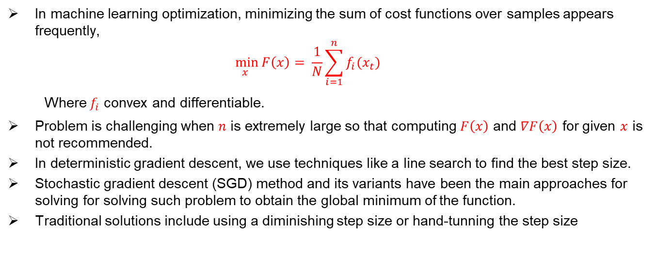
Motivation
In machine learning optimization, minimizing the sum of cost functions over samples appears frequently,
$$\min_{x }{F\left(x\right)= \frac{1}{N}\sum_{i=1}^{n}{f_{i}(x_{t})} }$$
Where $f_{i}$ convex and differentiable.
Problem is challenging when $n$ is extremely large so that computing $F\left(x\right)$ and $∇F\left(x\right)$ for given $x$ is not recommended.
In deterministic gradient descent, we use techniques like a line search to find the best step size.
Stochastic gradient descent (SGD) method and its variants have been the main approaches for solving for solving such problem to obtain the global minimum of the function.
Traditional solutions include using a diminishing step size or hand-tunning the step size
Notes:
First the slide. And then the below
This paper addresses a major issue in stochastic gradient, that is how to choose an appropriate step size while running the algorithm. The common practice is SGD is either use a diminishing step size or tune a stepsize by hand, which is time consuming. So this paper proposes to use the Barzilai-Bowein Method to automatically compute step size for SGD and its variant.

Slide 3
Paper Contributions
They propose to use Barzilai-Borwein(BB) method to compute step size for SGD and SVRG.
They prove linear convergence for SVRG-BB for strongly convex function.
They conducted numerical experiment for SGD-BB and SVRG-BB on solving logistics regression and SVM problem
Notes:
They Propose to use Barzilai-Borwein(BB) method to compute step size for SGD and SVRG and prove linear convergence for SVRG-BB for strongly convex function.
we learnt that they are important in optimization because they guarantee a unique global minimum and allow for faster convergence of optimization algorithms like gradient descent. This faster convergence is particularly beneficial for problems where computational time is a constraint.
3. They conducted numerical experiment for SGD-BB and SVRG-BB on solving logistics regression and SVM problem

Slide 4
Project Scope
Implement the 3 algorithm – Stochastic Gradient Descent and its variant, SVRG(Stochastic Variant Reduced Gradient) and SVRG-BB.
Compare the performance of all three algorithm.
Experiment with the learning rate parameter.
Notes:
For this project I have limited my scope to tackle classification problem on MNIST data and apply the proposed algorithm from the paper.
I implemented three algorithm.
Stochastic Gradient Descent, our baseline.
SVRG is a variant of SGD method which injects a variance-reduction correction to standard SGD.
SVRG-BB, which layers on a Barzilai–Borwein rule to adapt the learning-rate automatically.
I then compared accuracy of these algorithms and convergence speed.
Finally, experiment across a range of step-sizes (η=0.01, 0.1, 0.5) to see how sensitive each algorithm is to learning-rate choice—
and to demonstrate how SVRG-BB can largely eliminate that tuning pain point.”

Slide 5
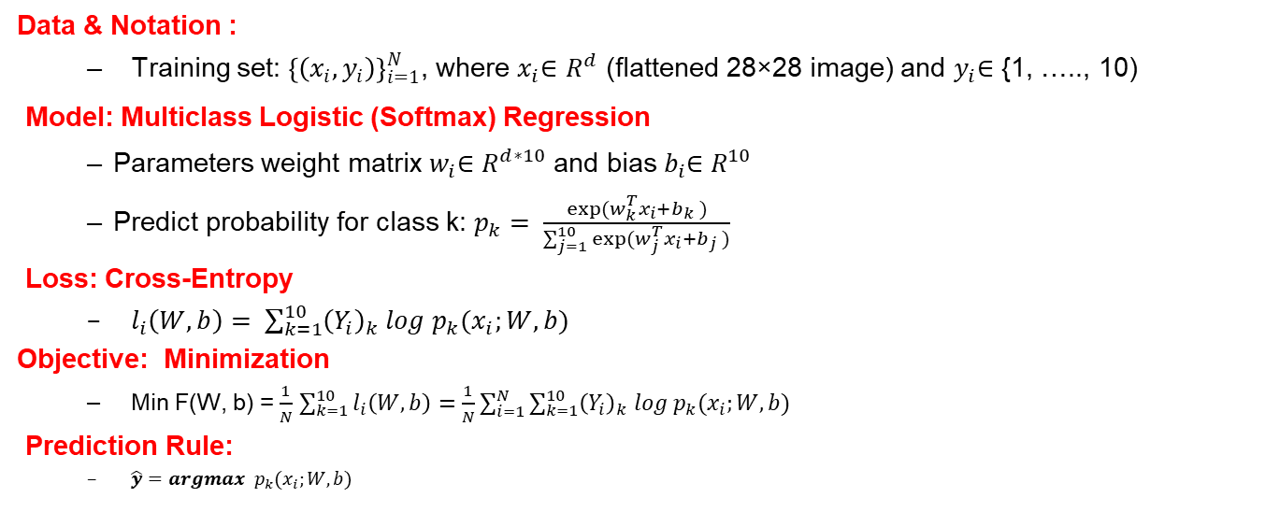
Problem Statement: Classification of MNIST Data
Data & Notation :
Training set: ${\left\{\left(x_{i},y_{i}\right)\right\}}_{i=1}^{N}$, where $x_{i}$∈ $R^{d}$ (flattened 28×28 image) and $y_{i}$∈ {1, ….., 10)
Model: Multiclass Logistic (Softmax) Regression
Parameters weight matrix $w_{i}$∈ $R^{d∗10}$ and bias $b_{i}$∈ $R^{10}$
Predict probability for class k: $p_{k}= \frac{exp⁡(w_{k}^{T}x_{i}+b_{k} )}{\sum_{j=1}^{10}{exp⁡(w_{j}^{T}x_{i}+b_{j} )}}$
Loss: Cross-Entropy
$l_{i}\left(W, b\right)= \sum_{k=1}^{10}{{\left(Y_{i}\right)}_{k} log p_{k}(x_{i};W, b)}$
Objective: Minimization
Min F(W, b) = $\frac{1}{N}$ $\sum_{k=1}^{10}{l_{i}\left(W, b\right)}=\frac{1}{N}\sum_{i=1}^{N}{\sum_{k=1}^{10}{{\left(Y_{i}\right)}_{k} log p_{k}(x_{i};W, b)}}$
Prediction Rule:
$\hat{y}=argmax p_{k}(x_{i};W, b)$
Notes:
Softmax Regression for MNIST Classification (Detailed Explanation)
1. Problem Setup: MNIST Dataset
We have 60,000 training examples, where each example consists of:
An input image (xᵢ) of size 28×28 pixels, flattened into a 784-dimensional vector (since 28×28 = 784).
A true label (yᵢ), which is a digit from 0 to 9.
The label is converted into a one-hot encoded vector (Yᵢ) of size 10 (e.g., if yᵢ = 3, then Yᵢ = [0, 0, 0, 1, 0, 0, 0, 0, 0, 0]).
2. Model: Softmax Regression
Softmax Regression (also called Multinomial Logistic Regression) is a generalization of logistic regression for multi-class classification. Here’s how it works:
Weights (W) & Biases (b):
We learn a weight matrix W of size 784×10 (since input dimension = 784, output classes = 10).
We also learn a bias vector b of size 10 (one per class).
Score Calculation: For each input image xᵢ, we compute a score vector:
scores=Wxi+bscores=Wxi​+b
This gives 10 scores, one for each digit (0–9).
Higher scores mean the model thinks the input is more likely to belong to that class.
Softmax Activation: The scores are converted into probabilities using the softmax function:
P(y=k∣xi)=e(Wkxi+bk)∑j=09e(Wjxi+bj)P(y=k∣xi​)=∑j=09​e(Wj​xi​+bj​)e(Wk​xi​+bk​)​
This ensures all probabilities sum to 1.
The model predicts the class with the highest probability.
3. Loss Function: Cross-Entropy
We use cross-entropy loss because:
It measures how well the predicted probabilities (P) match the true one-hot labels (Y).
For a single example, the loss is:
Li=−∑k=09Yi,klog⁡(Pi,k)Li​=−k=0∑9​Yi,k​log(Pi,k​)
Since Yᵢ is one-hot, only the true class contributes to the loss.
If the model assigns high probability to the correct class, loss is low; if wrong, loss is high.
Average Loss Over Dataset: The total training objective is to minimize the average cross-entropy over all examples:
L=160000∑i=160000LiL=600001​i=1∑60000​Li​
4. Optimization Goal
We adjust W and b using gradient descent (or variants like SGD, Adam) to minimize the average cross-entropy loss. This makes the model:
Increase the probability of the correct class.
Decrease the probability of incorrect classes.
5. Prediction Rule
For a new test image x, the model:
Computes scores: Wx + b
Applies softmax to get probabilities.
Predicts the class with the highest probability:
y^=arg max⁡kP(y=k∣x)y^​=kargmax​P(y=k∣x)
Why This Works for MNIST
Softmax regression is a linear classifier (decision boundaries are hyperplanes in pixel space).
It works well when classes are roughly linearly separable (MNIST digits are somewhat separable by pixel patterns).
Cross-entropy is a natural choice for classification because it directly penalizes incorrect probabilistic predictions.
Limitations
Since it’s linear, it may struggle with complex, non-linear boundaries (better performance can be achieved with neural networks).
Assumes each pixel contributes independently, which is not always true (CNNs handle spatial structure better).

Slide 6
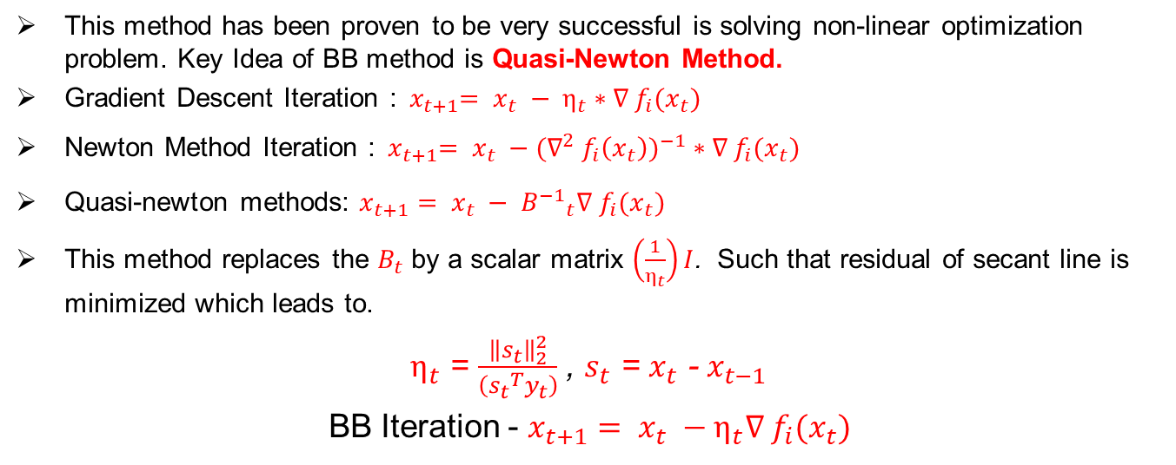
Barzilai-Borwein (BB) Method
This method has been proven to be very successful is solving non-linear optimization problem. Key Idea of BB method is Quasi-Newton Method.
Gradient Descent Iteration :${ x}_{t+1}= x_{t} − η_{t}∗∇ f_{i}(x_{t})$
Newton Method Iteration :${ x}_{t+1}= x_{t} −({∇^{2} f_{i}\left(x_{t}\right))}^{−1}∗∇ f_{i}(x_{t})$
Quasi-newton methods: $x_{t+1}= x_{t} − {B^{−1}}_{t}∇ f_{i}(x_{t})$
This method replaces the $B_{t}$ by a scalar matrix $\left(\frac{1}{η_{t}}\right)I$. Such that residual of secant line is minimized which leads to.
$η_{t}$ = $\frac{{\left\|s_{t}\right\|}_{2}^{2}}{\left({s_{t}}^{T}y_{t}\right)}$ , $s_{t}$ = $x_{t}$ - $x_{t−1}$
BB Iteration - $x_{t+1}= x_{t} −η_{t}∇ f_{i}(x_{t})$
Notes:
New that we have the problem statement we can move on to what the paper proposes.
This paper discusses the use of this method to automatically compute the step size for SGD and its variant.
We know from basics that that Gradient Descent finds the minimum of a function and its Iteration looks like this, in Newton Method finds the roots of function rather than maxima or minima. Iteration differes by using inverse hessian, its have much faster convergene that GD but at cost of computing the hessian.
In Quasi-newton methods, instead of using identity matrix, it used other matrix B_t. if B_k = I its same as GD, if H_t = Inv Hessian its Newton. so want some B_t that will give better convergence and less expensive. B that is usefull than I and less expensive to compute than inv of hessian. Since B is approx. of Hessian matrix of at current iterate x, solving the above linear system may be time consuming when 𝐵_𝑡 is large
From the equation we can see that BB method does not require any parameter and step size is compute while the algorithm is running
SGD Choose an initial vector of parameters w and learning rate η.
Repeat until an approximate minimum is obtained:
Randomly shuffle samples in the training set.
For i=1,2,...,n, do:
w:=w−η∇Qi(w).

Slide 7
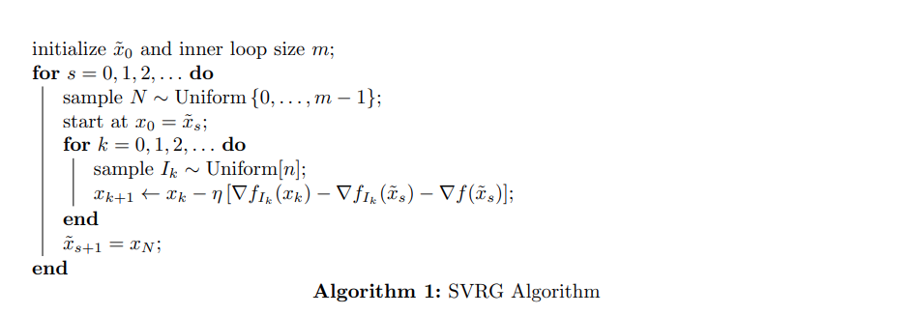
SVRG Algorithm
Notes:
Imagine you’re trekking down a hilly landscape toward the very lowest point (the minimum of your cost function), but you can only take noisy “stochastic” compass readings (gradients on one data point at a time). Plain SGD is like following those jittery compass needles—it eventually gets you down, but you zig-zag and stall a lot.
SVRG fixes this by introducing a “control variate” (a more accurate compass reading) every so often:
Take a Snapshot
Pause at your current position and compute the exact slope of the hill by looking at every data point (i.e. compute the full gradient).
Store that true direction.
Inner Stochastic Steps
From this snapshot point, take a series of cheap, one-point gradient steps—
but each time you adjust your noisy reading by subtracting the noise you would have gotten at the snapshot and then adding back the true full-gradient you stored.
Concretely, you measure the gradient on one random example (noisy),
correct it by removing the same example’s gradient at the snapshot (subtracting off the bias), and then re-anchor with the true full gradient.
Why That Helps
By anchoring every stochastic step to the recent full-gradient, you cancel out most of the random jitter and hence its variance is dramatically lower.
Repeat
After a fixed number of these corrected steps, you choose one of the new points as your next snapshot, recompute the full gradient there, and repeat.

Slide 8
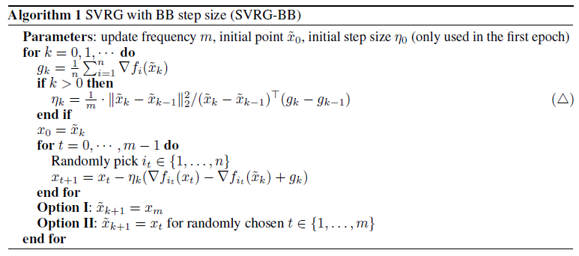
SVRG-BB Algorithm
Notes:
SVRG‐BB is just SVRG with one extra trick: instead of picking and holding a fixed learning rate, it automatically computes a “best‐guess” rate at the start of each inner loop by looking at how your two most recent reference points moved and how their full gradients changed.
Intuitively, it uses how far your last two snapshots moved versus how much their gradients changed to pick an adaptive learning rate that often gives near‐optimal progress without any manual tuning.

Slide 9
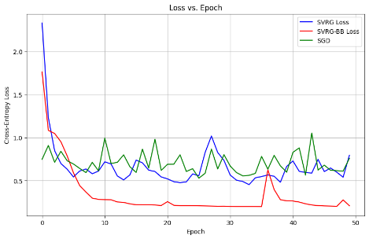
Results
Rapid Initial Descent
All methods start by dropping loss quickly in the first few epochs.
SVRG-BB (red) falls fastest, reaching a much lower loss by epoch 10.
Noise & Stability
SGD (green) shows large oscillations lead to erratic loss spikes.
SVRG (blue) is smoother than SGD but still exhibits periodic spikes whenever the reference point is reset.
SVRG-BB (red) remains the most stable, with minimal variance once it reaches near a good step size.
Notes:
If we look at the plot we can see that, All methods start by dropping loss quickly in the first few epochs.
SVRG-BB (red) falls fastest, reaching a much lower loss by epoch 10.
Also SGD (green) shows large oscillations lead to erratic loss spikes.
Where as SVRG (blue) is smoother than SGD but still exhibits periodic “humps” whenever the reference point is reset.
However, SVRG-BB (red) remains the most stable, with minimal variance once it homes in on a good step size.

Slide 10
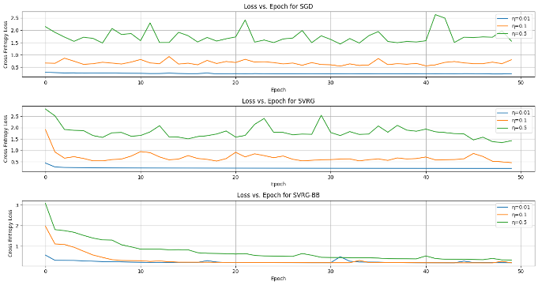
Learning-Rate Sensitivity
(η=0.01, 0.1, 0.5)
SGD
SVRG
SVRG-BB
New algorithm
Notes:
Slide 1: Learning‐Rate Sensitivity
From the plot we can see that SGD and SVRG show similar pattern in the losses at different eta values.
SVRG-BB: The drop is sudden at all eta and then there is gradual decrease as epoch increases. Showing the effectiveness of the algorithm and that algorithm converges quickly.

Slide 11
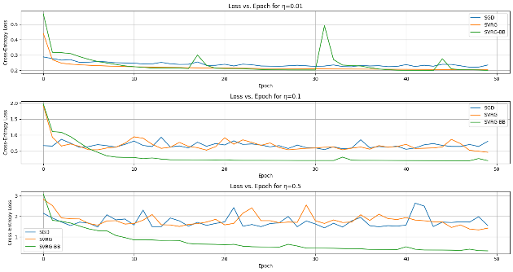
Effect of Step‐Size on Cross‐Entropy Loss
SVRG-BB is robust enough to work well even at η is large as well.
Notes:
Superimposing the plots for different eta values we can see that
SVRG-BB is robust enough to work well even at η=0.5, but you’ll still see best results when η₀ is in the 0.1–0.3 range.

Slide 12
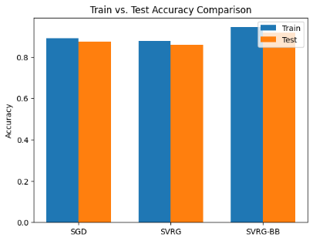
Accuracy Comparison
Model | Accuracy
SGD | 0.8738
SVRG | 0.8576
SVRG-BB | 0.9167
SVRG-BB outperforms all the other gradient descent method.
SVRG-BB achieves the highest training and test accuracy.
Notes:
Because you used a huge inner‐loop length (m = 2n) and a constant η = 0.1, SVRG’s “anchor” gradient was stale for 2 full passes before each refresh, so its variance‐reduction term no longer matched the current iterates—and with no decay on η it either overshot or under‐stepped late in training. Which would require more experimentation.
In contrast, SGD’s per‐sample updates (and any implicit or explicit η decay) stayed in sync with the evolving loss surface, giving it better convergence and generalization under those settings.

Slide 13
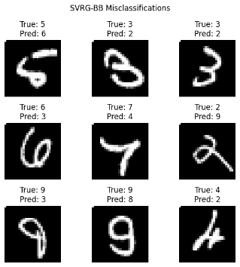
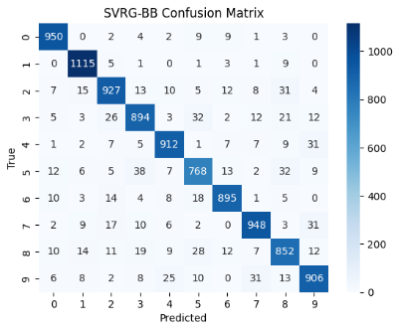
Confusion matrix & Misclassifications
Notes:
Understanding the misclassification and how the model performed and what classes it predicted well vs misclassified. we can try new ideas to improve the accuracy,
SVRG-BB get most digits right - dark diagonal but the few errors tend to be between visually similar pairs (e.g. 5↔3, 4↔9).
we would need more data with similar feature for each digit for model to learn or do some data augmentation for those particular digits for which classification are wrong.
Labels like “True: 5 Pred: 6” highlight how similar strokes can fool the classifier.

Slide 14
Conclusion
Automatic step‐size adaptation via the Barzilai–Borwein rule achieves better result then manual tunning η.
SVRG-BB converges the fastest, combines best of both world, low-variance update and adaptive step size which delivers fast, stable tuning free convergence.
For future work, Instead of updating single input, I would like to try small batches and try different problem such as logistic regression and SVM.

Slide 15
Thank You

