Slide 1
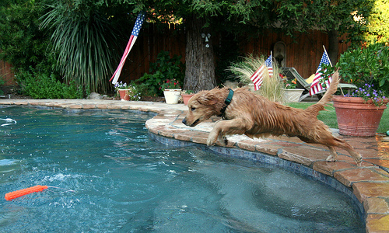
Multilingual Image Captioning with Voice Assistance
a brown dog jumps into a pool
ఒక గోధుమ కుక్క ఒక కొలనులోకి దూకుతుంది
Krishna Kumari Ravuri
M22AI567

Slide 2
Problem Statement
The visually impaired population in India faces significant barriers to education and employment due to limited access to Braille and other costly assistive technologies. Less than 10 percent of blind individuals in India have the opportunity to learn Braille, resulting in a critical literacy gap. To address this issue, there is a need for an affordable and accessible solution that assists the visually impaired to navigating in their surroundings. The project aims to develop Model that uses computer vision, object recognition, and speech synthesis technologies to read text aloud and provide real-time information about the user's environment, ultimately improving the quality of life and opportunities for the visually impaired in India. Use of regional languages is important, as India is a linguistically diverse country. Ensuring that the model can convert the image to text and read out text in multiple languages is essential for its widespread usability. use of regional languages is important, as India is a linguistically diverse country. Ensuring that the model can read out text in multiple languages is essential for its widespread usability.

Slide 3
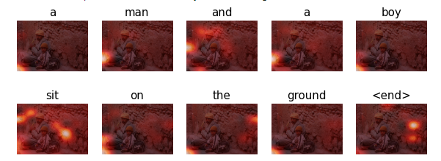
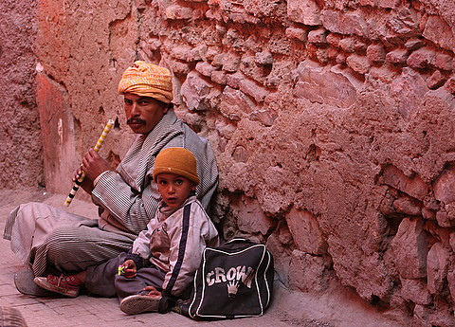

My Approach:
Input Image
Convolutional Feature Extraction
RNN with attention over the image
Word by
word generation
Converting text to speech using gTTS
Prediction Caption: a man and a boy sit on the ground

Slide 4
Dataset:
COCO dataset : Contains 123,000 caption-annotated images.
Flickr30k : Consists of 31,000 caption-annotated images, with each image labeled with 5 different descriptions.
Flickr8k : Comprises 8,000 caption-annotated images.
I've chosen to use the Flickr8k dataset as the primary data source due to limitations in storage and computational power, despite it having the least number of images among the three datasets.

Slide 5
Feature extraction: InceptionV3
InceptionV3 is part of the Inception architecture family developed by Google. It uses a deep neural network with a complex structure that includes various convolutional and pooling layers. It is designed to capture features at different scales and resolutions simultaneously.
InceptionV3 is often used for image classification and object detection tasks. It has been successful in various competitions and benchmarks.
extracted the features of the images using the last layer of pre-trained model. The shape of the output of this layer is 8x8x2048
storing the features using a dictionary with the path as the key and values as the feature extracted by the inception net v3
Create the train-test split using 80-20 ratio

Slide 6
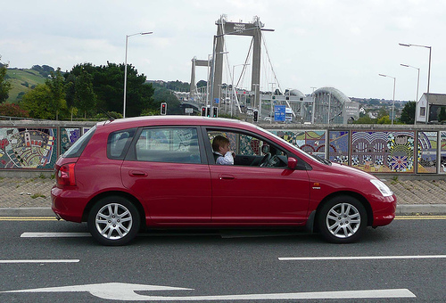
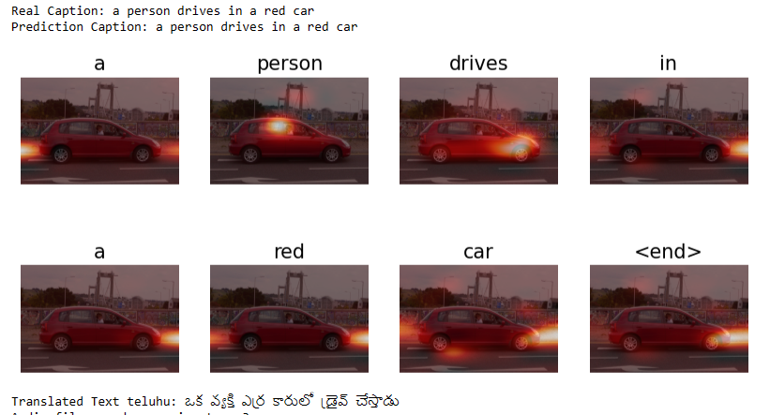
Methodology:
Encoder
Attention Mechanism
Decoder
Convert predicted caption into different languages
Text to voice conversion

Slide 7
Model Building
Encoder
Role: Processes input images (e.g., using InceptionV3) and extracts meaningful features.
Architecture: Typically a convolutional neural network (CNN).
Output: Produces a tensor representing extracted features, often with dimensions (batch_size, spatial_size, embed_dim).
Purpose: Transforms visual information into a format suitable for language processing.

Slide 8
Attention Mechanism:
Role: Dynamically focuses on different parts of the input features during caption generation.
Inputs: Receives features from the Encoder (features), hidden state from the Decoder (hidden), and sometimes the input sequence from the Decoder.
Output: Provides a context vector and attention weights, allowing the model to selectively attend to relevant image regions.

Slide 9
Decoder:
Role: Generates captions for images based on visual features and contextual information.
Architecture: Typically involves recurrent neural network (RNN) cells (LSTM).
Inputs: Receives initial input sequence, features from the Encoder (features), and an initial hidden state.
Output: Produces predicted word probabilities at each step, updated hidden state, and sometimes attention weights.

Slide 10
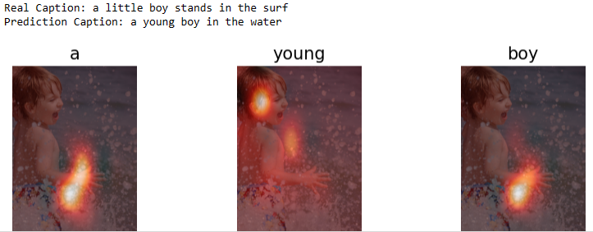

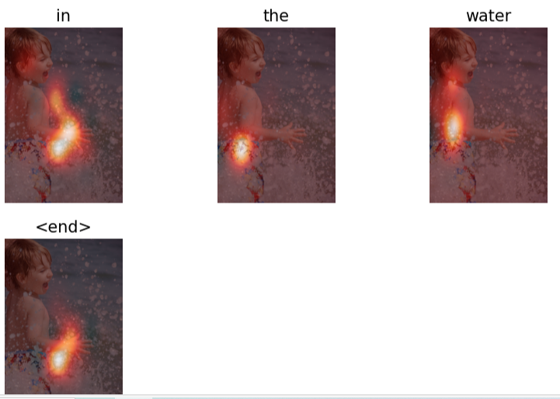


DEMO
Telugu
English

Slide 11
References:
Xu, Ke et al. “Show, Attend and Tell: Neural Image Caption Generation with Visual Attention.” International Conference on Machine Learning (2015).
M. P. Arakeri, N. S. Keerthana, M. Madhura, A. Sankar and T. Munnavar, "Assistive Technology for the Visually Impaired Using Computer Vision," 2018 International Conference on Advances in Computing, Communications and Informatics (ICACCI), Bangalore, India, 2018, pp. 1725-1730, doi: 10.1109/ICACCI.2018.8554625.
M. Sailaja, K. Harika, B. Sridhar, R. Singh, V. Charitha and K. S. Rao, "Image Caption Generator using Deep Learning," 2022 International Conference on Advancements in Smart, Secure and Intelligent Computing (ASSIC), Bhubaneswar, India, 2022, pp. 1-5, doi: 10.1109/ASSIC55218.2022.10088345.
M. P. R, M. Anu and D. S, "Building A Voice Based Image Caption Generator with Deep Learning," 2021 5th International Conference on Intelligent Computing and Control Systems (ICICCS), Madurai, India, 2021, pp. 943-948, doi: 10.1109/ICICCS51141.2021.9432091.
S. V. Patnaik, R. Mukka, R. Devpreyo and A. Wadhawan, "Image Caption Generator using EfficientNet," 2022 10th International Conference on Reliability, Infocom Technologies and Optimization (Trends and Future Directions) (ICRITO), Noida, India, 2022, pp. 1-5, doi: 10.1109/ICRITO56286.2022.9964637.

