Slide 1
Multilingual Image Captioning with Voice Assistance
Krishna Kumari Ravuri
M22AI567

Slide 2
Previous Status
Collected 1000, 2000 images from fliker dataset along with captions into different folder.
Splitting them into train , test and validation
Created feature vector of images and tokenizer for captions
Feature extraction using Encoder
Text conversion based on encoder feature vector
Caption creation with relevant text
Convert predicted caption into two languages
Text to voice conversion

Slide 3
Current Status
Considered filker8k , which contains 8000 images.
Used JarvisLab for development environment
Splitting them into train , test and validation
Created feature vector of images and tokenizer for captions
Implemented Encoder for 8000 images
Implemented Decoder for 8000 images
Attention Mechanism to create complete caption
Saving the encoder and decoder model
Convert predicted caption into all possible Indian regional languages
Text to voice conversion into all possible Indian regional languages
Reload the model and tested with other images
Create another Dataset with 16 classes , trained and validated the model with that dataset.

Slide 4
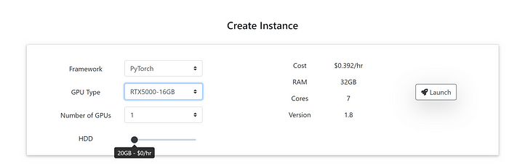
JarvisLab
JarvisLab is an advanced research environment specializing in artificial intelligence (AI) and machine learning (ML) development. It offers a suite of tools, libraries, and computing resources tailored for AI projects, including deep learning models, natural language processing (NLP) algorithms, computer vision applications, and more.
URL:https://jarvislabs.ai/.
Jarvis comes with three types of GPU. RTX5000 ,RTX6000 and AT100 .
basic RTX5000. It's less than a half of dollar for an hour.

Slide 5
Implementation Steps
Data Reading and Pre-processing
Splitting them into train , test and validation
Applying the methodology
Encoder
Decoder
Attention Mechanism
Convert predicted caption into different languages
Text to voice conversion into different languages

Slide 6
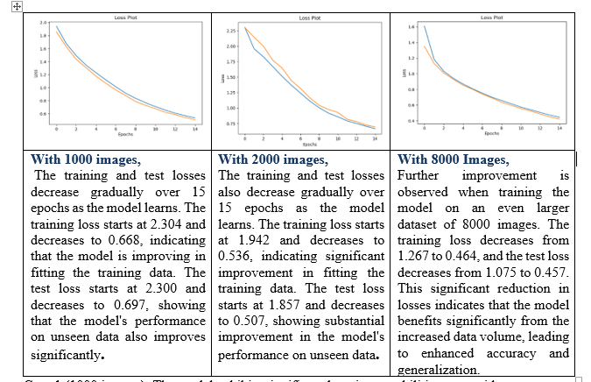
Results

Slide 7
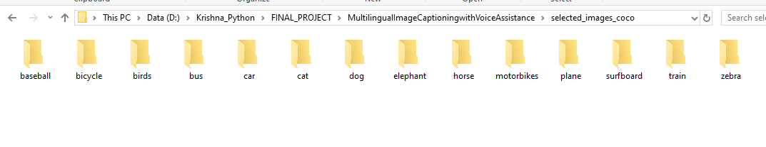
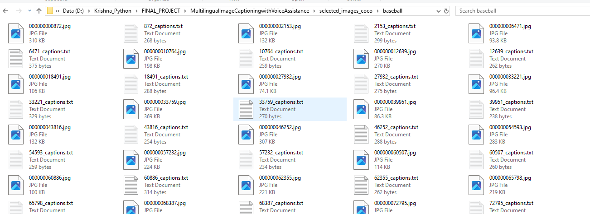
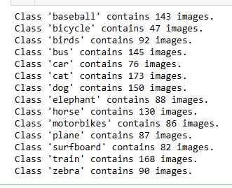
Collection of Images and categorizing them into classes

Slide 8
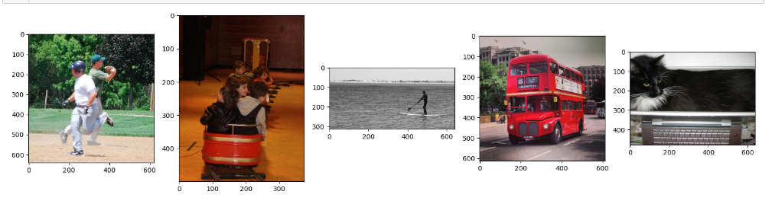
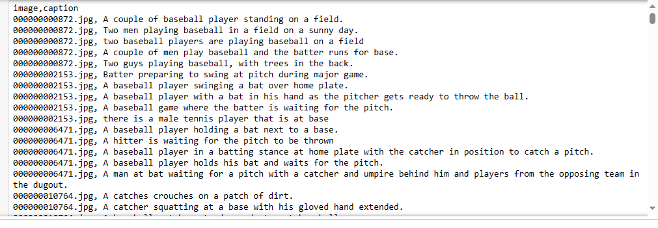
Data set Sample View

Slide 9
Multilingual Image Captioning with Voice Assistance
Extracted the feature of the uploaded images and leveraging the saved models to predict the caption
Developed a simple user interface (UI), ensuring a smooth and intuitive user experience
Integrating image upload option to upload image
seamlessly integrating more regional languages dynamically using dropdown selection
Displaying the text and audio file on the UI based on the selected language
Developed Mobile application to capture image using camera

