Slide 1
CLV
9,134
0.9112
Prediction
CUSTOMERS
R² SCORE
Customer Lifetime Value · Auto Insurance · IBM Watson Dataset
5
$1,389
ML MODELS
MEAN ABS ERROR
Kriday Kallalathil · Anusha Bellavara Mallikarjuna · MSA 8200 · Georgia State University · Spring 2025

Slide 2
01 · PROBLEM STATEMENT
What Is CLV & Why Does It Matter in Insurance?
Customer Lifetime Value - total net revenue an insurer expects from a customer over their entire relationship
What Is CLV?
Business Risk Without a CLV Model
CLV = the present value of all future premiums a customer will pay, minus claims and servicing costs over the entire relationship
It is a forward-looking, per-customer metric - it answers: how much can the insurer afford to spend to win and keep this customer?
In auto insurance, CLV is driven by premium tier, number of policies held, tenure, claims history, and customer financial stability
Over-investing in low-value customers
Marketing budgets allocated by volume, not value - profitable spend wasted on customers who churn after their first renewal.
Under-investing in high-value customers
The most profitable policyholders receive the same service as low-value ones, raising churn risk in the highest-margin segment.
Blind acquisition decisions
Why It Matters
Introductory discounts and onboarding spend set uniformly - not calibrated to each customer's predicted lifetime ROI.
Acquisition spend: sets how much to offer a new customer without eroding margin
Retention targeting: identifies who to reach out to proactively before their next renewal
Resource allocation: sizes service teams proportionally to customer value
Reactive retention - too late
Without CLV decline signals, churn interventions trigger only after the customer has already decided to leave.

Slide 3
01 · DATASET OVERVIEW
IBM Watson Auto Insurance Dataset
9,134 records · 24 raw features · 5 regression models evaluated
9,134
24
0
56
CUSTOMER RECORDS
RAW FEATURES
MISSING VALUES
FEATURES AFTER OHE
Policy: Coverage, Policy Type, Monthly Premium Auto
Claims: Total Claim Amount, Open Complaints
Demographics: State, Gender, Education, Employment, Income
Relationship: # Policies, Sales Channel, Renew Offer Type
Target: Customer Lifetime Value → log1p transformed
CLV range: $1,898 - $83,325 (strong right skew)
Skewness raw: 3.03 → after log1p: 0.58
25.4% zero income - retained as valid observations
Customer ID dropped before modelling - no leakage
80/20 train-test split - random_state=42
Feature Categories
Key Observations

Slide 4
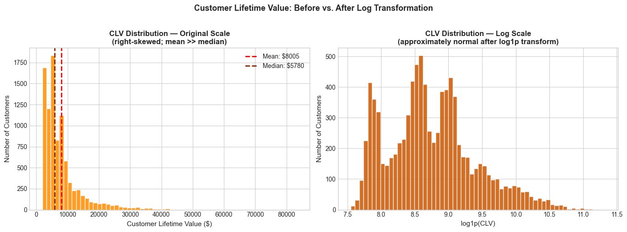
02 · EXPLORATORY DATA ANALYSIS
CLV Distribution - Before & After Log Transform
Original CLV skewness = 3.03 → log1p reduces to 0.58 - near-normal for regression
Key Takeaways
Raw CLV: strongly skewed
Skewness = 3.03. Mean ($8,005) far exceeds Median ($5,780). Violates normality assumption for regression.
log1p transform fixes it
Skewness drops to 0.58 — near-normal. All 5 models train on log_CLV as the target variable.
Back-transform for reporting
expm1() exactly inverts log1p(). Final RMSE and MAE reported in original $ for interpretability.
Why this matters
Without the transform, extreme high-CLV outliers dominate the loss function and degrade model fit for typical customers.

Slide 5
03 · FEATURE ENGINEERING
Engineered Features - 5 Domain-Driven Additions
OHE (drop_first=True) → 56 total features · StandardScaler fit on training data only
01
Premium_to_Income_Ratio
Monthly premium ÷ (Income+1). Measures financial burden. +1 guard handles zero-income customers (25.4% of dataset). Appears in top-8 feature importances.
02
Claim_per_Policy
Total claim amount ÷ number of policies. Normalises claim exposure across portfolio sizes. Validated by appearing in top-8 importances.
03
High_Complaint_Flag
Binary — 1 if any open complaints. Captures dissatisfaction signal beyond raw count. Simple but predictive for churn risk.
04
Policy_Tenure_Bucket
Months since inception binned Early / Mid / Long-term via equal-frequency quantiles (q=3). Captures non-linear tenure effects.
05
Renewal_Month
Calendar month extracted from Effective To Date (1–12). Captures seasonal renewal patterns and weather-related claims cycles.
15 categorical columns → OHE (drop_first=True) → 56 total features · StandardScaler fit on training data only (no leakage)

Slide 6
04 · MODEL DEVELOPMENT
Five Models - Training & Validation Setup
80/20 split · StandardScaler on training only · GridSearchCV 5-fold within training set
# | Model | Type | Key Param | Role
1 | Linear Regression | Linear baseline | — | Performance floor — measures non-linear uplift
2 | Decision Tree | Tree-based | max_depth=10 | Interpretable single tree; prone to overfitting without pruning
3 | Random Forest | Ensemble - bagging | n_estimators=100 | Reduces variance via bootstrap aggregation; robust baseline
4 | XGBoost | Ensemble - boosting | n_estimators=100 | Sequentially corrects residuals; often best single model
5 | KNN | Instance-based | k=5 | Non-parametric; sensitive to scale — requires StandardScaler
★ Random Forest and XGBoost highlighted — selected for GridSearchCV hyperparameter tuning in Section 6
Validation: 80/20 split · StandardScaler fit on training data only · CV Pipelines refit scaler on each fold independently
Notes:
we ran 5 models on an 80/20 split. The table shows the setup — Linear Regression is the baseline, Decision Tree and KNN are the simpler models, and Random Forest and XGBoost highlighted are the ones we expected to win and took forward for tuning. One technical point worth noting — StandardScaler was fit on training data only, inside a Pipeline, so there's zero data leakage into the test set.

Slide 7
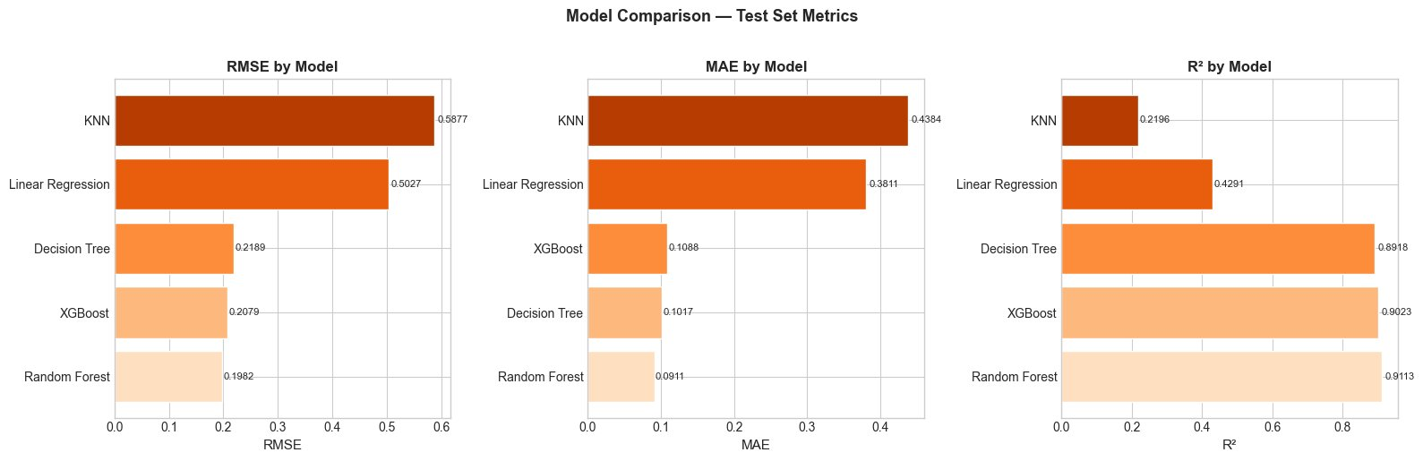
05 · RESULTS
Model Comparison - Test Set Performance
Random Forest wins: R² = 0.9113, RMSE = 0.1982, MAE = 0.0911 on log scale
Key Takeaways
Random Forest wins
R² = 0.9113, RMSE = 0.1982, MAE = 0.0911. Narrowly outperforms XGBoost on all three metrics.
Tree ensembles dominate
RF and XGBoost (R² > 0.90) are dramatically better than KNN (0.22) and Linear Regression (0.43).
Linear model: R² = 0.43 only
The gap to non-linear models confirms CLV has complex structure that linear regression cannot capture.
Both top models tuned next
RF and XGBoost selected for GridSearchCV tuning in Section 6 to extract maximum performance.
Notes:
Looking at the three bar charts — RMSE, MAE, and R². Random Forest is the lightest bar on all three, meaning lowest error and highest accuracy. R² of 0.9113. XGBoost is right behind at 0.9023. Now look at the other end — KNN is 0.22 and Linear Regression is 0.43. That's less than half the R² of Random Forest. That gap is the proof that CLV is non-linear — a straight line model simply cannot capture it.

Slide 8
06 · MODEL OPTIMISATION
GridSearchCV Tuning - Tuned Random Forest Wins
Exhaustive grid search within training set only; test set reserved for final evaluation
Random Forest - 60 fits (12 combos × 5-fold)
XGBoost - 90 fits (18 combos × 5-fold)
Grid Parameters:
Grid Parameters:
n_estimators: [100, 200]
max_depth: [None, 10, 20]
min_samples_split: [2, 5]
n_estimators: [100, 200]
max_depth: [3, 5, 7]
learning_rate: [0.05, 0.1, 0.2]
Best: max_depth=None, split=5, n=200
Best: lr=0.1, max_depth=5, n=200
CV R² (train): 0.8901
CV R² (train): 0.8856
Test RMSE: 0.1983
Test RMSE: 0.2007
Test R²: 0.9112
Test R²: 0.9097
WINNER: Tuned Random Forest - Test R² = 0.9112 - RMSE (log) = 0.1983 - MAE ($) = $1,389
Notes:
we ran GridSearchCV on both top models. Random Forest tested 12 parameter combinations across 5 folds — 60 total fits. The winning config was max_depth=None, min_samples_split=5, n_estimators which is number of trees =200. CV R² on training was 0.8901, and on the unseen test set it held at 0.9112 — meaning the model generalised well, it didn't overfit. XGBoost got 0.9097 — close, but Random Forest wins on every metric so that's our final model.

Slide 9
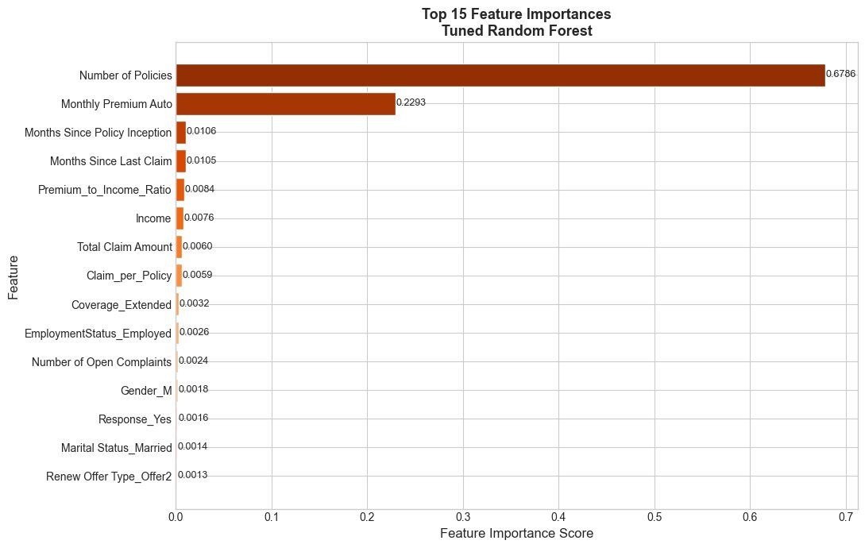
07 · INTERPRETATION
Top 15 Feature Importances - Tuned Random Forest
Number of Policies dominates at 0.6786 — accounts for 68% of all predictive power
Key Takeaways
Number of Policies = 0.6786
Accounts for 68% of all predictive power. Multi-policy customers have structurally higher CLV and lower churn.
Monthly Premium = 0.2293
Second most important. Together policies + premium explain ~91% of all predictive signal in the model.
Engineered features validated
Premium_to_Income_Ratio and Claim_per_Policy appear in top 8. Domain engineering added real signal.
Business implication
Cross-sell campaigns (adding a second policy) are the highest-ROI retention lever an insurer can pull.
Notes:
Look at that first bar — Number of Policies at 0.6786. That one feature alone is responsible for 68% of everything the model learned. The second bar, Monthly Premium Auto, is 0.2293. So just these two features together explain 91% of all predictive signal. Now look at positions 5 and 8 — Premium_to_Income_Ratio and Claim_per_Policy. Those are two of our engineered features sitting in the top 8, which directly validates that the feature engineering step added real signal

Slide 10
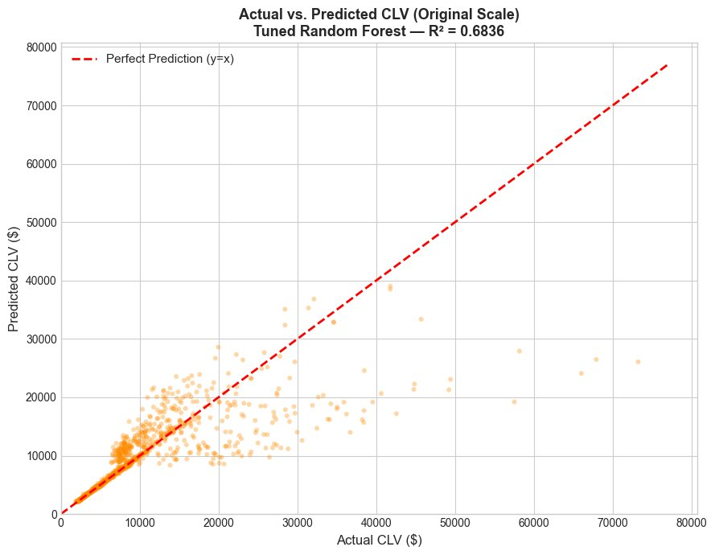
07 · INTERPRETATION
Actual vs. Predicted CLV - Original Dollar Scale
Tuned Random Forest — R² = 0.6836 on dollar scale after back-transformation via expm1()
Key Takeaways
R² = 0.6836 on dollar scale
Lower than log-scale R² (0.91) because back-transformation amplifies errors on extreme high-CLV outliers.
Low/Mid CLV: tight cluster
Points cluster closely around the y=x perfect prediction line for customers under $20,000 CLV.
High CLV: systematically low
Customers above $30,000 are underestimated. Sparse in training data causes regression toward the mean.
No systematic over-prediction
The model does not inflate predictions - critical for CRM budget allocation decisions.
Notes:
"The scatter plot tells the story clearly. The dashed red line is perfect prediction. Everything in the bottom-left cluster — customers under $20,000 CLV — sits tight around that line, that's the 99% of your customer base. The points spreading away from the line at the top-right are the high-CLV outliers above $30,000 — the model underestimates them because there aren't enough of them in training data. R² on log scale is 0.91, but when you back-transform to actual dollars it drops to 0.68 — that drop is entirely caused by those few extreme outliers getting amplified."

Slide 11
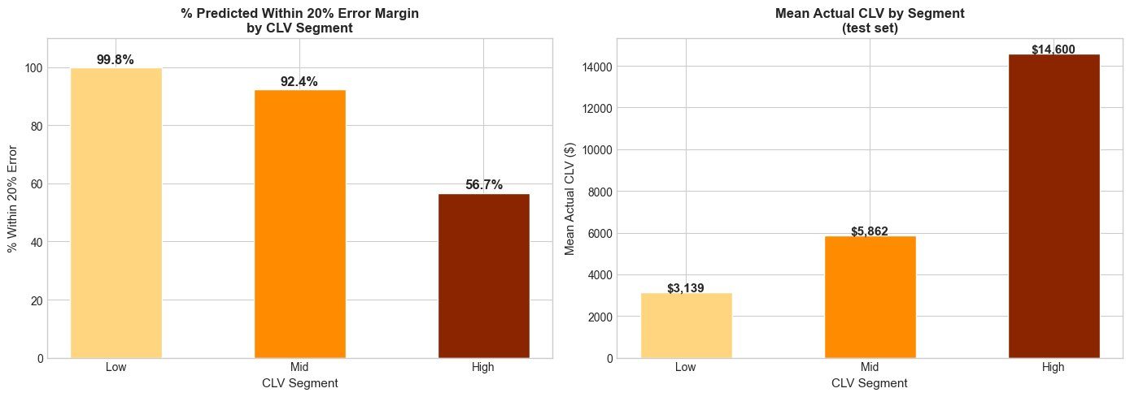
07 · INTERPRETATION
Customer Segment Accuracy - Low / Mid / High CLV
Segmented at 33rd/66th percentiles · within 20% error = |predicted − actual| / actual ≤ 0.20
Key Takeaways
Low CLV: 99.8% accuracy
Mean actual $3,139. Near-perfect - customers are homogeneous. Low-touch automated service is appropriate.
Mid CLV: 92.4% accuracy
Mean actual $5,862. Strong accuracy makes this the best target for cross-sell campaigns.
High CLV: 56.7% accuracy
Mean actual $14,600. Lower accuracy due to sparse extremes. Use as directional signal, not precise estimate.
Still highly actionable
Even at 56.7%, the model identifies High-CLV customers far better than random selection.
Notes:
The left chart shows prediction accuracy by segment within a 20% error margin. Low CLV — 99.8%. Essentially perfect. Mid CLV — 92.4%. High CLV — 56.7%. Now look at the right chart showing the actual mean CLV values — Low is $3,139, Mid is $5,862, High is $14,600. The practical takeaway is this: for 92% of your customer base — the Low and Mid segments — the model is highly reliable. The High segment at 56.7% is still useful to identify who your premium customers are.

Slide 12
08 · BUSINESS APPLICATION
Key Business Insights & Applications
01
Premium Tier Drives CLV
04
Segment-Aware Service Strategy
Monthly Premium Auto is the #2 predictor. Pricing teams should design tiered products to attract high-premium customers - lifetime revenue quickly recoups the upfront acquisition incentive cost.
Low CLV → automated self-service. Mid CLV → targeted email campaigns. High CLV → dedicated agent outreach. Model enables cost-proportional service allocation.
02
Multi-Policy = Retention Moat
05
Deploy as CRM Scoring Engine
A single cross-sell event can shift a customer from Mid to High CLV tier. The model identifies which customers have the right profile, making campaigns directly ROI-measurable.
Run the model quarterly on the full active customer book. Customers whose predicted CLV has declined are flagged as churn risks — triggering proactive interventions before renewal.
03
Channel is a Long-Term Investment
Sales Channel correlates with CLV tier. Channels attracting High-CLV customers justify higher per-acquisition spend - lifetime ROI must guide budget allocation, not short-term CPA.

Slide 13
09 · CONCLUSION
Summary & Final Results
End-to-end ML pipeline on 9,134 auto insurance records
5 engineered domain features (OHE → 56 total features)
5 models: Linear Reg., Decision Tree, RF, XGBoost, KNN
Per-fold Pipeline scaling - zero CV data leakage
GridSearchCV tuning: RF (60 fits) + XGBoost (90 fits)
Segment analysis - Low / Mid / High CLV tiers
Feature importance - top driver: Number of Policies
Deployable as real-time CRM scoring engine
What Was Built
Final Results - Tuned Random Forest
0.9112
0.6836
R² - LOG SCALE
R² - DOLLAR SCALE
Tuned Random Forest
After expm1() back-transform
$4,038
$1,389
RMSE - DOLLAR
MAE - DOLLAR
Root Mean Squared Error
Mean Absolute Error
Log-transform reduced CLV skewness 3.03 → 0.58 · Pipeline scaling prevented all data leakage · Deployable as real-time CRM scoring engine

