Slide 1
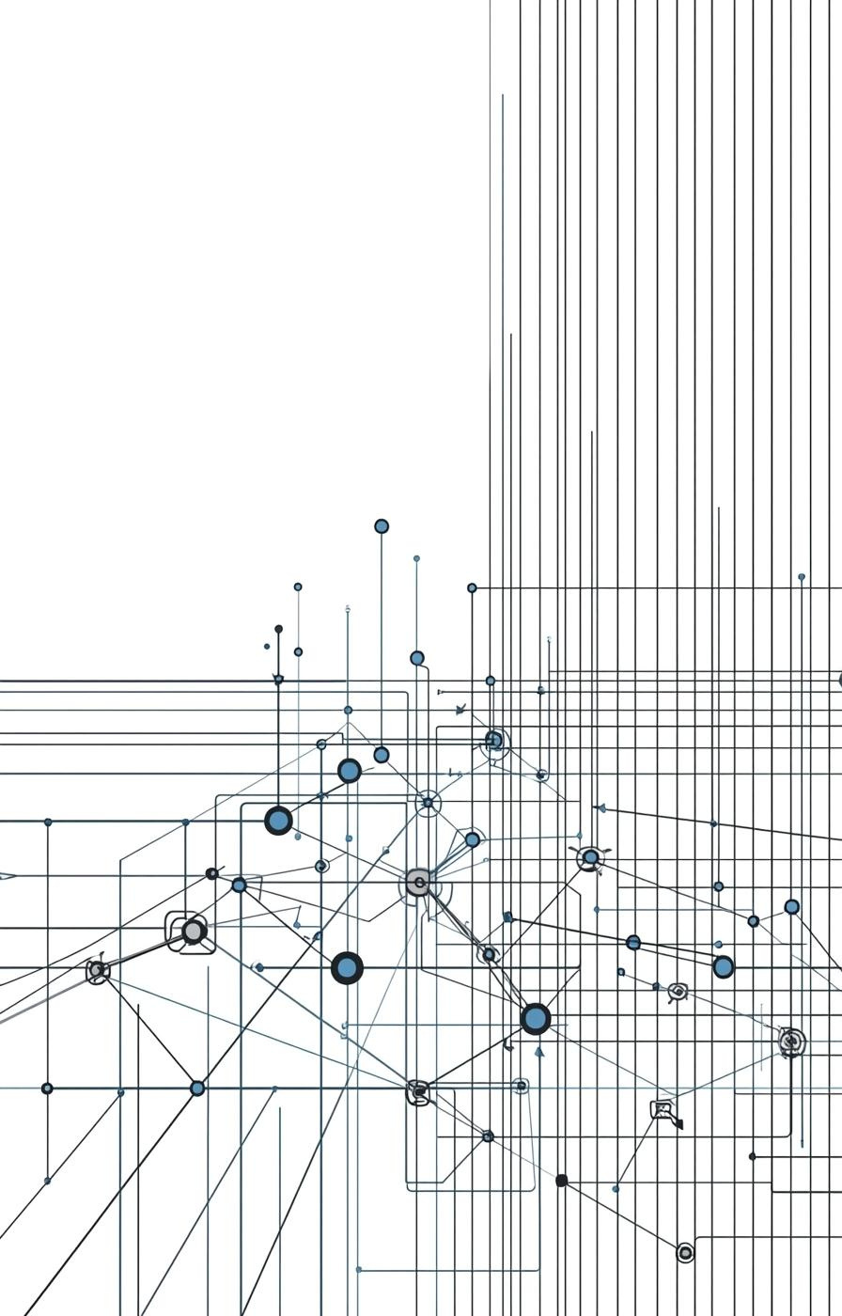
Telco Customer Churn Analysis
Predictive Modeling for Customer Retention
Team Members:
Tejas Sanjeev Vaidya (Team Manager)
Anusha Bellavara Mallikarjuna, Gouri Sharma
Kriday Kallalathil, Tejaswini Waghmare
Data Programming - Fall 2025

Slide 2
Problem Statement & Business Context
This project analyzes customer churn in the telecom industry, where retention is far cheaper than acquisition. The goal is to predict who is likely to leave and identify the key factors driving churn to support targeted retention efforts.

Slide 3
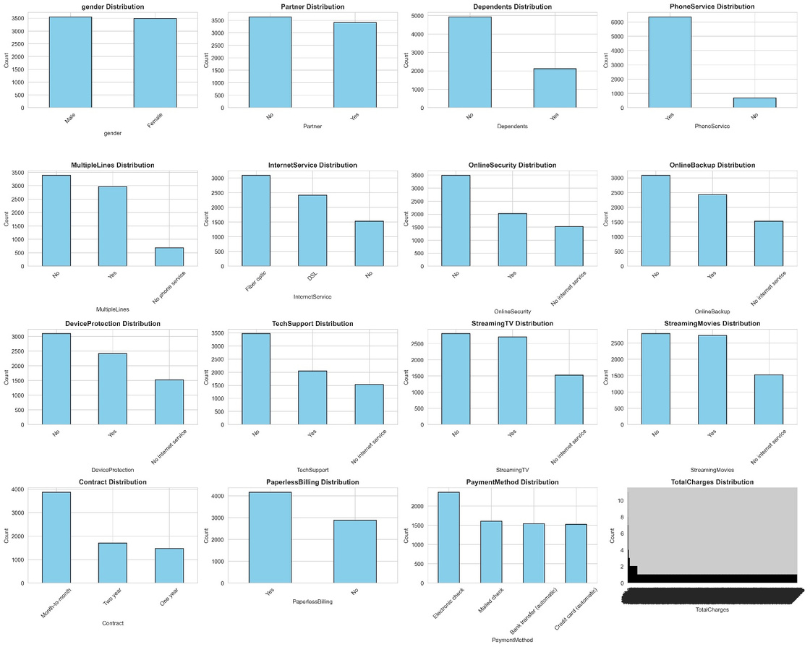
Dataset Overview & Descriptive Statistics
  Dataset Size: The Telco Customer Churn dataset contains 7,042 customers and 21 features.
  Numerical Features (4): Includes tenure, MonthlyCharges, TotalCharges, and SeniorCitizen, which capture customer tenure, billing behavior, and demographic information.
  Categorical Features (17): Represent demographics, subscribed services, and billing/contract types, covering gender, internet services, phone services, payment method, and more.
  Target Variable: Churn (Yes/No) — 26.5% of customers churn, showing a 2.7:1 imbalance.
  Key Insights:
    Dataset is gender balanced.
    16% are senior citizens, meaning churn is mostly driven by younger customers.
    Month-to-month contracts dominate, and these customers exhibit the highest churn.

Slide 4
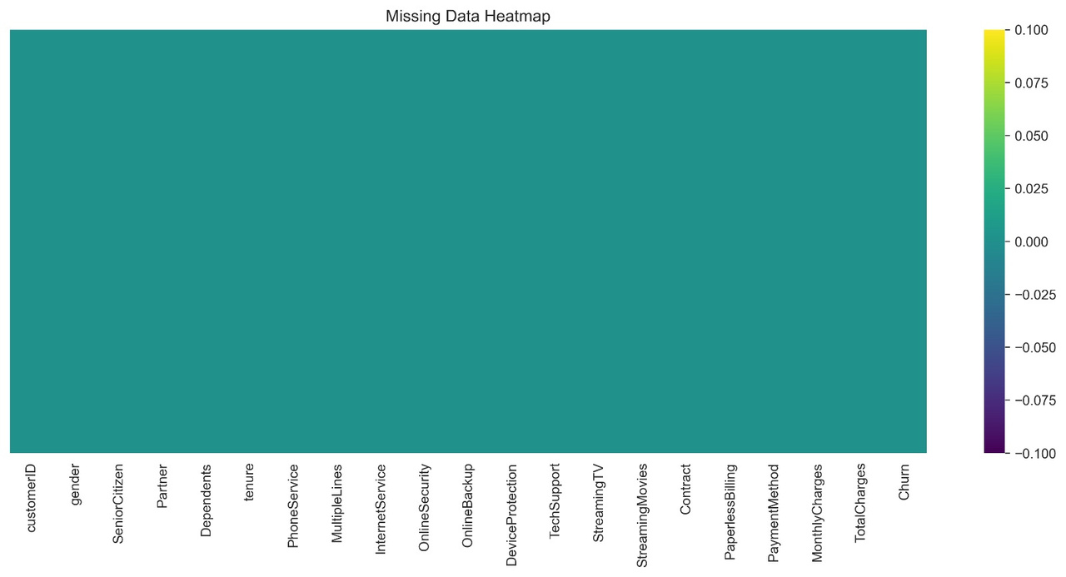
Missing Data Analysis
  Finding: The only missing data in the dataset appeared in TotalCharges, with 11 records (0.16%) showing blanks.
  Root Cause: All missing values belonged to customers with tenure = 0, indicating they had just joined and had not generated any billing yet.
  Solution Applied:
    A conditional imputation was used by assigning TotalCharges = 0 for all tenure-0 customers, reflecting their lack of prior charges.
    For the few remaining gaps, median imputation ensured consistency without distorting the distribution.
  Result: After these steps, the dataset had no missing values, making it ready for modeling and analysis.

Slide 5
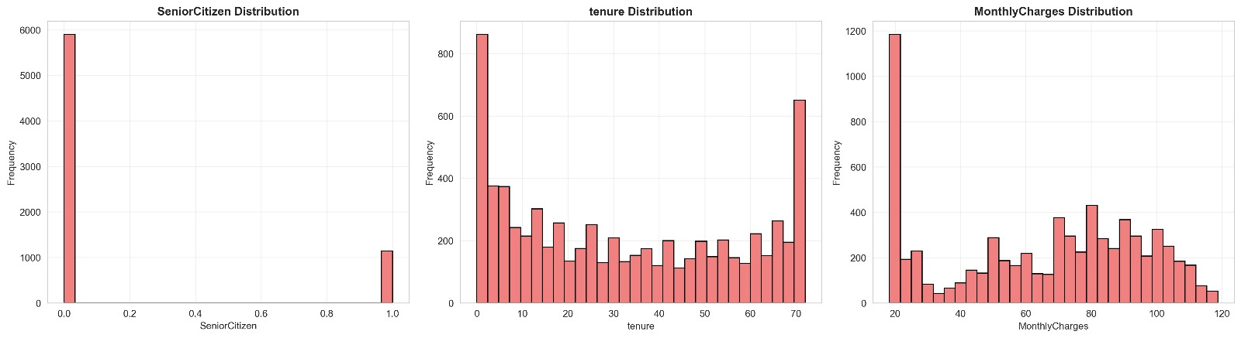
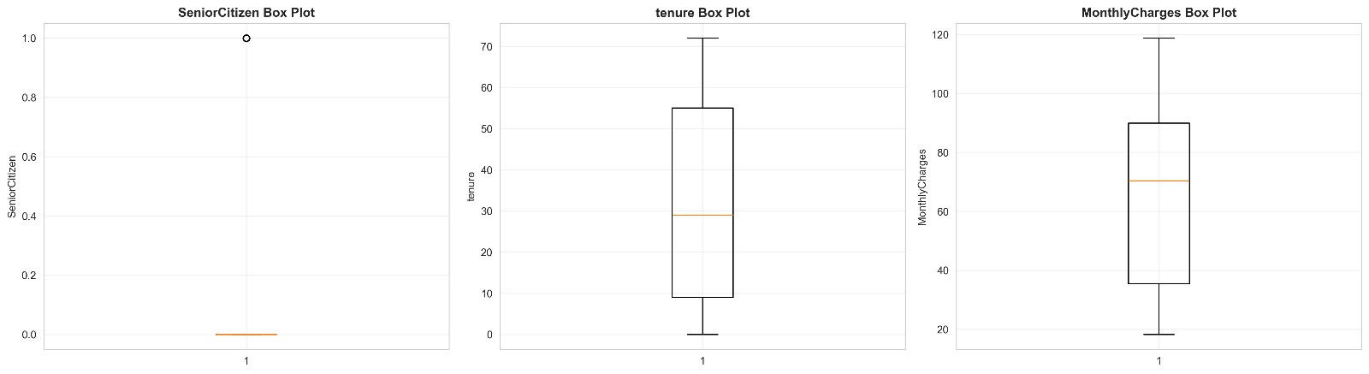
Exploratory Data Analysis - Feature Distributions

Slide 6
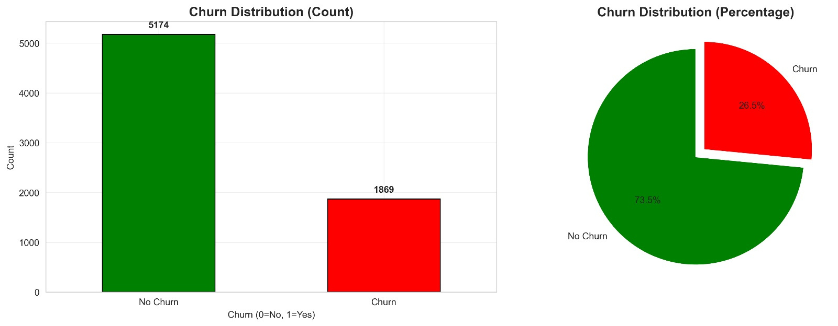
Target Variable Analysis - Class Imbalance
  Distribution: The dataset is moderately imbalanced, with 5,174 customers who did not churn (73.5%) and 1,869 who did churn (26.5%).
  Imbalance Ratio: This creates a 2.7:1 imbalance, meaning churners are significantly under-represented compared to non-churners.
  Solution Applied:
    Used class_weight=‘balanced’ to ensure the model pays equal attention to minority churn cases.
    Prioritized F1-score and Recall, since identifying churners is more important than overall accuracy.
    Employed a stratified train–test split to preserve the original churn proportions in both sets.

Slide 7
Data Preprocessing Pipeline
Step 1: Remove non-predictive features: The customerID column was dropped since it does not contribute to churn prediction and only serves as an identifier.
Step 2: Encode target variable: The churn outcome was converted into numerical form (No = 0, Yes = 1) to make it compatible with machine learning models.
Step 3: Feature Encoding:
Binary features (e.g., gender, partner, phone service) were transformed using Label Encoding.
Multi-class features (such as contract type, internet service, payment method) were expanded using
One-Hot Encoding to capture each category properly.
Step 4: Feature Scaling: Applied StandardScaler to numerical features—tenure, MonthlyCharges, TotalCharges, and SeniorCitizen—to normalize their ranges and improve model performance.
Result: After preprocessing, the dataset expanded to 7,042 samples and 49 features, ready for modeling.

Slide 8
Machine Learning Approach & Model Selection
  A supervised binary classification framework was used to predict whether a customer would churn or stay.
  An 80–20 stratified Train–Test split was used so the churn ratio stays consistent, resulting in 5,633 training samples and 1,409 testing samples.
Models Selected:
  Logistic Regression – A clear, interpretable baseline to understand directional effects of features.
  Decision Tree – Captures simple non-linear relationships and is easy to explain (max_depth = 5).
  Random Forest – A more stable ensemble approach using 100 trees for better generalization.
  Gradient Boosting – Powerful ensemble that improves by learning from errors.
  SVM – Useful for modeling complex decision boundaries in higher-dimensional space.
Imbalance Handling: All models were trained with class_weight=‘balanced’ to counter the 2.7:1 ratio and ensure churn cases are properly learned.

Slide 9
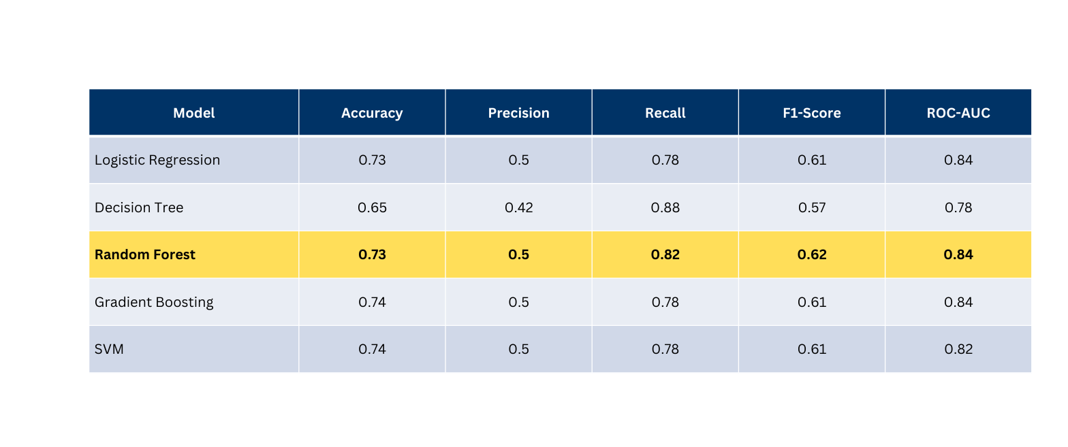
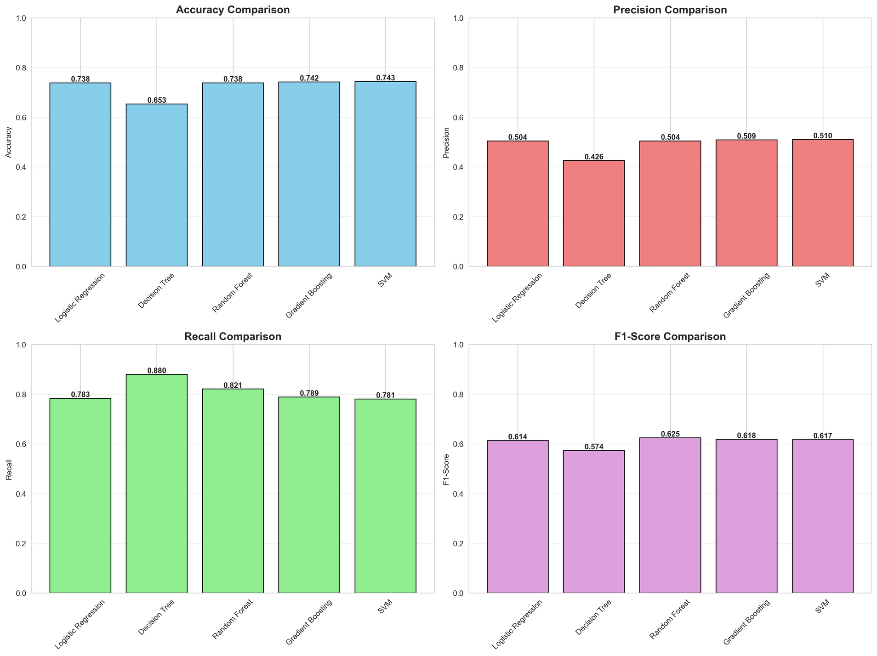
Model Performance Comparison

Slide 10
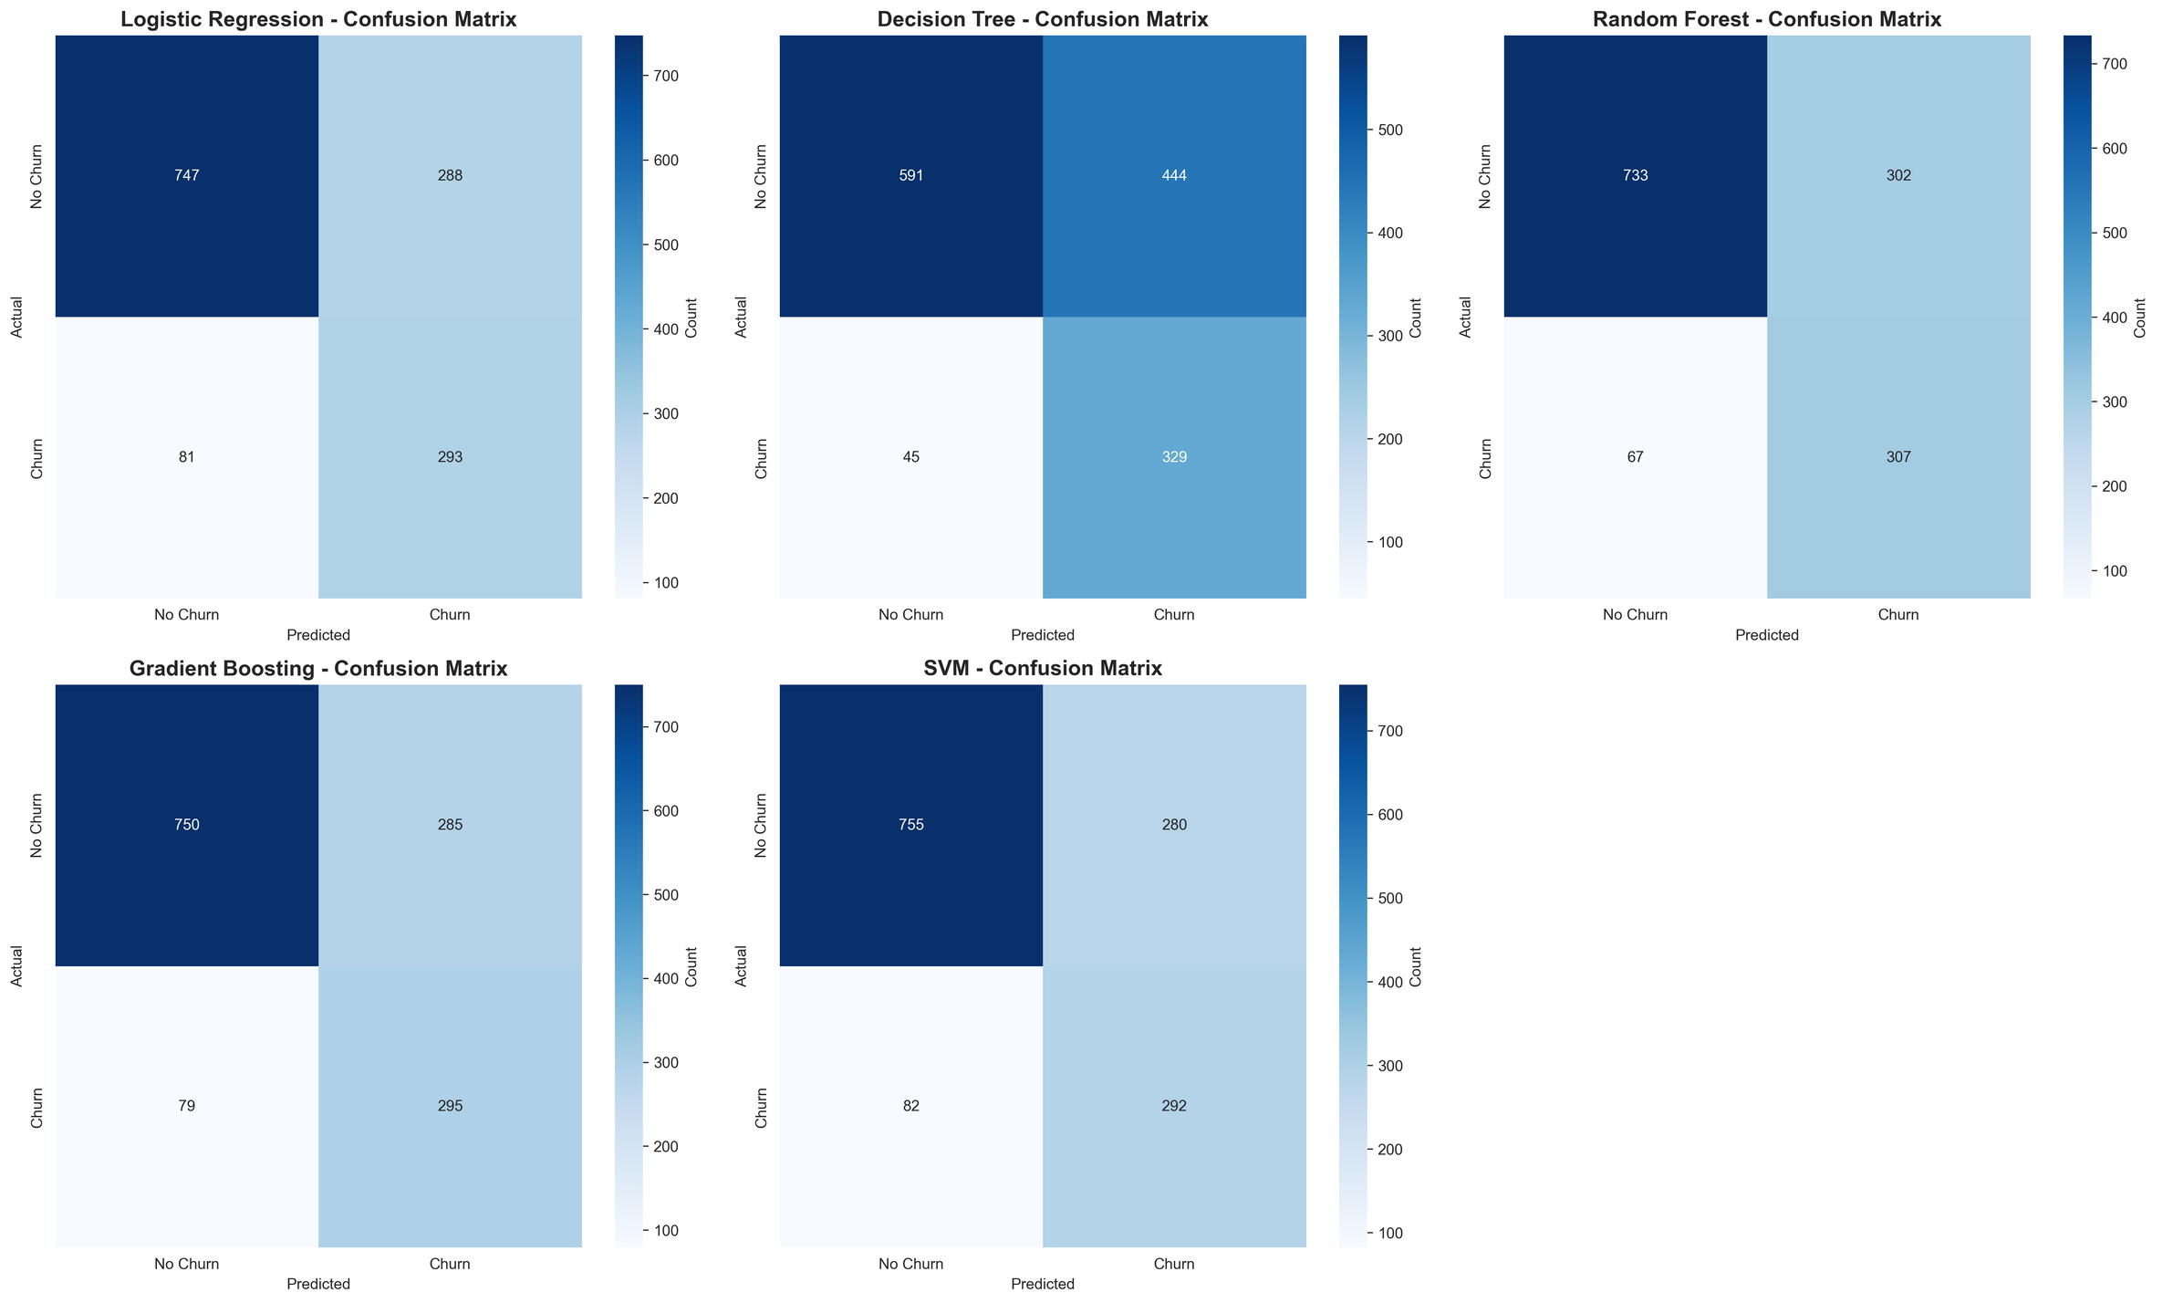
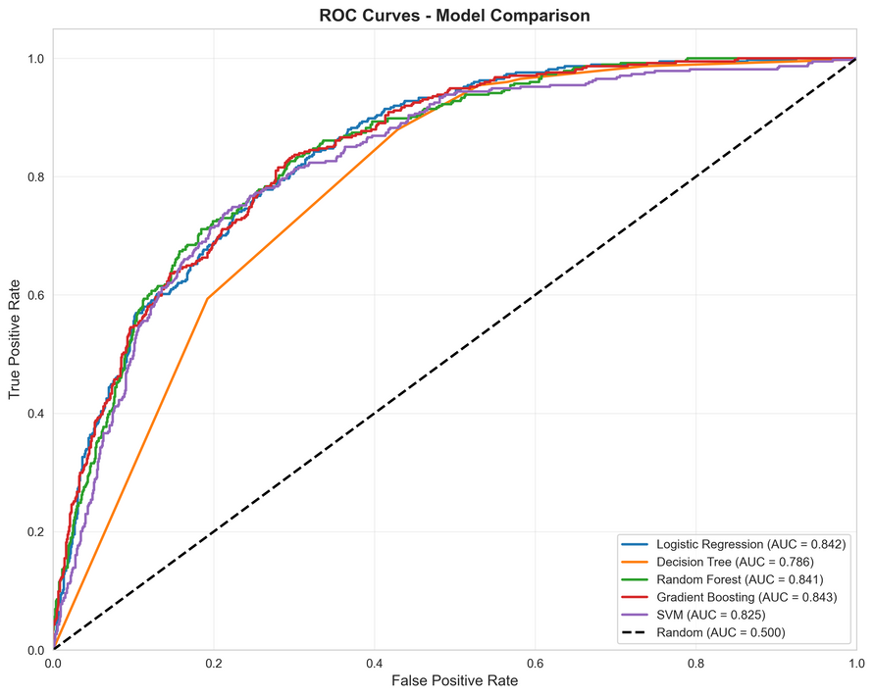
Detailed Model Evaluation

Slide 11
Key Insights & Business Recommendations
Critical Churn Drivers:
  Tenure: Highest churn in the first 12 months.
  Contract Type: Month-to-month customers churn ~3× more.
  Service Type: Fiber Optic users show the most churn.
  Pricing: Higher MonthlyCharges strongly linked to churn.
  Payment Method: Electronic Check users churn at higher rates.
Business Recommendations
  Early Intervention: Focus retention on 0–12 month customers.
  Contract Incentives: Push 1–2 year contracts using discounts.
  Pricing Review: Reevaluate Fiber Optic pricing & performance.
  Payment Optimization: Reduce friction for Electronic Check users; promote autopay.
  Model Deployment: Use Random Forest for real-time churn prediction.

Slide 12
Conclusions
  Comprehensive EDA: The analysis uncovered clear churn patterns, such as tenure, contract type, and pricing, providing strong direction for targeted retention strategies.
  Robust Preprocessing: A complete pipeline was built to clean the data, encode features, scale numerical fields, and handle class imbalance, ensuring models received high-quality inputs.
  82% Recall: The model successfully identified the majority of churners, making it highly effective for proactive retention efforts where catching at-risk customers is critical.
  Business-Driven Metrics: Evaluation focused on recall rather than accuracy, aligning the modeling approach with real business needs where missing a churner is more costly than a false alarm.

Slide 13
Future Enhancements
  Explore advanced ensemble methods like XGBoost and LightGBM for stronger predictive power.
  Enhance features through interaction terms, tenure groups, and CLV-based metrics.
  Incorporate cost-sensitive learning to directly optimize retention ROI.
  Use k-fold cross-validation for more reliable model evaluation.
  Perform threshold optimization to find the best balance between recall and precision.

Slide 14
THANK YOU

