Slide 1
Retail Sales Analytics
Where does the business make money, and where does it lose it?
Final Capstone: Week 6 | Python, Power BI, GitHub

Slide 2
The question and the data
Sales grew every year, but is every sale a good sale?
Superstore retail orders, 2015 to 2018
9,994 order lines, 793 customers, 49 states
Cleaned: 806 stray rows removed, 11 postal codes fixed, dates converted
$2.30M
Sales
$286K
Profit
12.5%
Margin

Slide 3
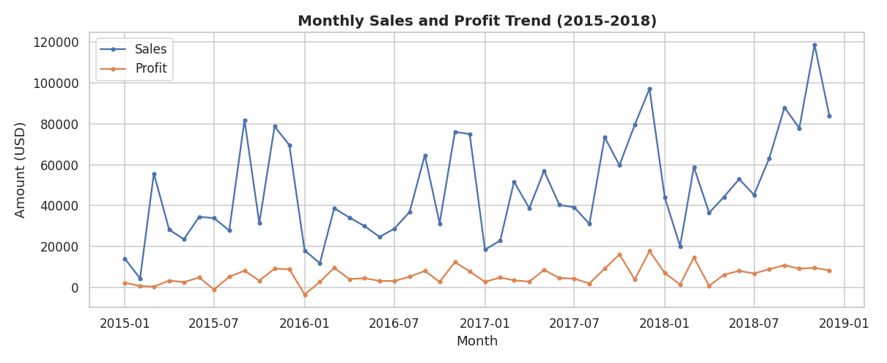
Growth is real
Sales up 51%, 2015 to 2018
Profit nearly doubled: $49K to $93K
Peaks every Sep, Nov and Dec

Slide 4
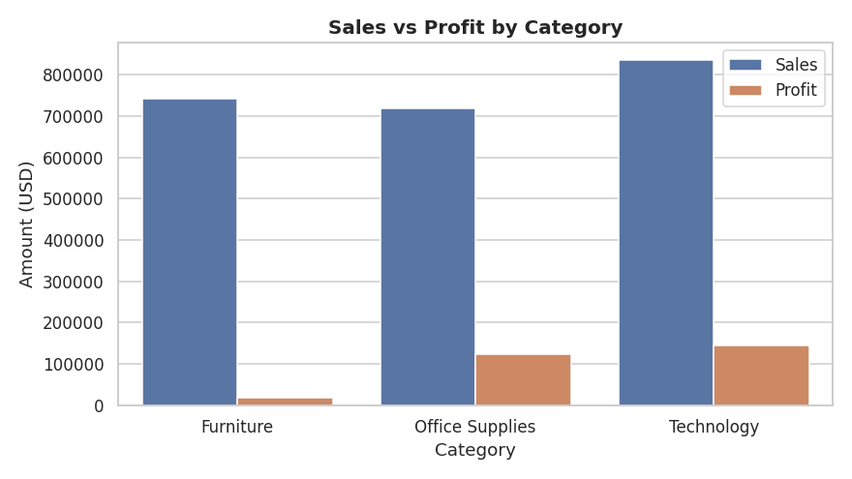
Furniture sells, but barely earns
Furniture: 32% of sales, 2.5% margin
Technology and Office Supplies: about 17%

Slide 5
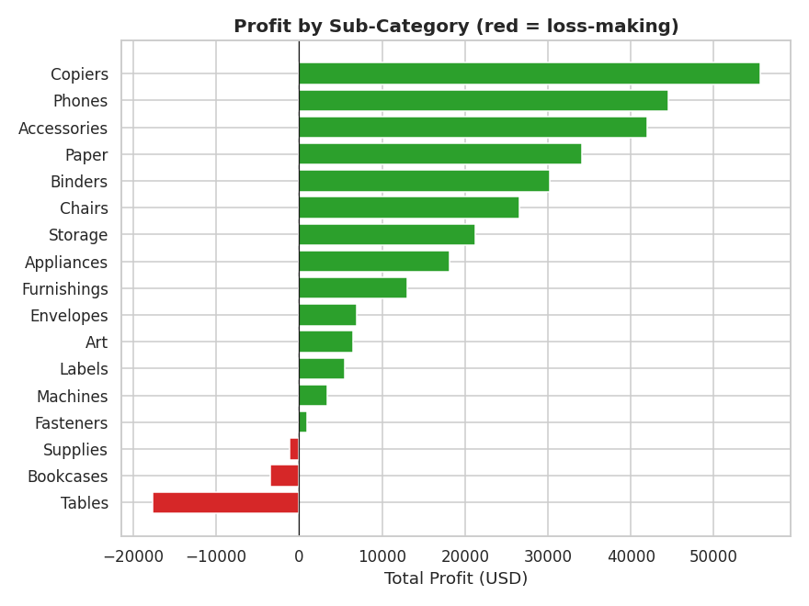
Three sub-categories lose money
Tables: -$17.7K
Bookcases: -$3.5K
Supplies: -$1.2K
Copiers lead profit at $55.6K

Slide 6
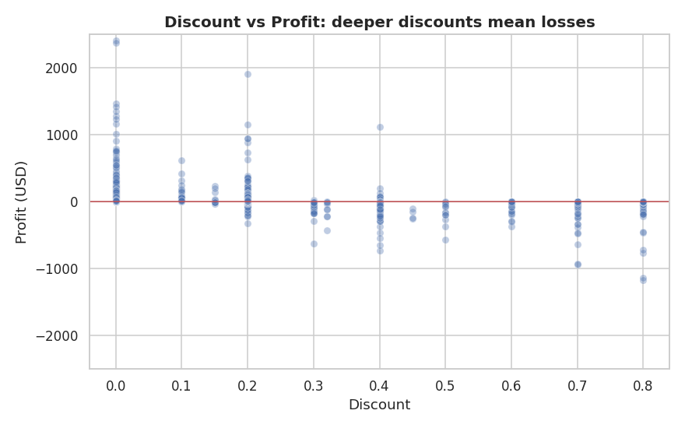
Discounts are the profit leak
40%+ discounts: -$99.6K across 933 orders
No discount: +$321K
Discount vs margin correlation: -0.86

Slide 7
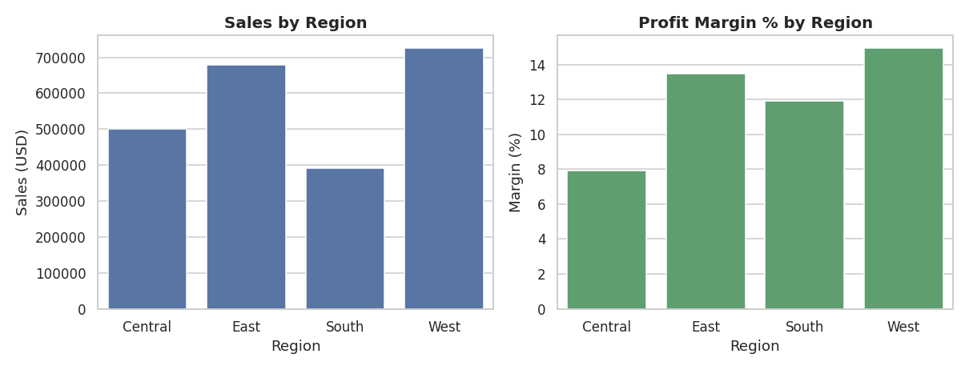
Central region lags
Margin: West 14.9%, Central 7.9%
Loss-making states: TX, OH, PA, IL

Slide 8
What we should do
Cap discounts at 20-30%
Fix Tables and Bookcases
Lines at 30%+ lost $135K. Breaking even would lift profit about 47%.
Review supplier cost and pricing, or trim the range.
Central turnaround
Push high-margin lines
Start with Texas, Ohio, Pennsylvania, Illinois.
Copiers, Accessories, Paper, Labels, Envelopes.

Slide 9
Growth is real. Discount discipline is the biggest lever.
Code, dashboard and full write-up are in the GitHub repo.

