Slide 1
Fraud Claim Detection Analysis, Insights and Predictive Modelling By Kriti Kashyap(C-72)

Slide 2
How can we analyse historical claim data to detect patterns that indicate fraudulent claims?
In our project, we analyzed historical insurance claim data by exploring and visualizing it to find patterns that could point to fraud. We first cleaned the data, handled missing values, removed irrelevant columns like IDs, and converted categorical variables using dummy encoding. Then, we created new, which helped us spot unusual behaviors.
We visualized relationships using bar plots, histograms, and heatmaps to find important trends. For example, we noticed that higher claim amounts, fewer witnesses, or no police reports were more common in fraudulent claims. We also looked at incident time, collision types, and customer professions, which gave us more insight.
After preparing the data, we used two models — Logistic Regression and Random Forest — to predict fraud. Logistic Regression helped us understand the statistical importance of each feature (like age, number of vehicles involved, and incident severity), while Random Forest gave us a list of the most important features for fraud prediction.
We also tested different cutoff values for classifying fraud based on model probabilities. For example, using a cutoff of 0.2 gave us higher sensitivity, which means we were better at catching actual frauds, even if it meant a few false positives.
Overall, by using EDA, feature creation, and machine learning models, we were able to detect strong patterns in the data that point to potential fraud — making it easier to predict and prevent it in future claims.

Slide 3
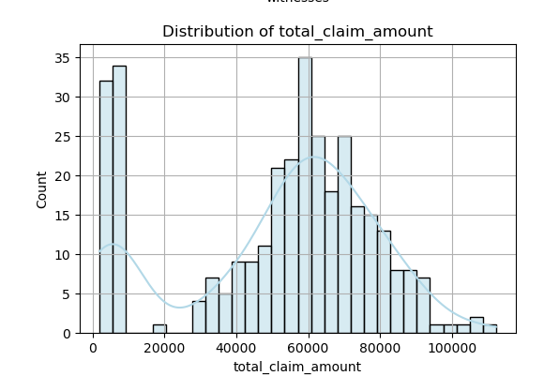
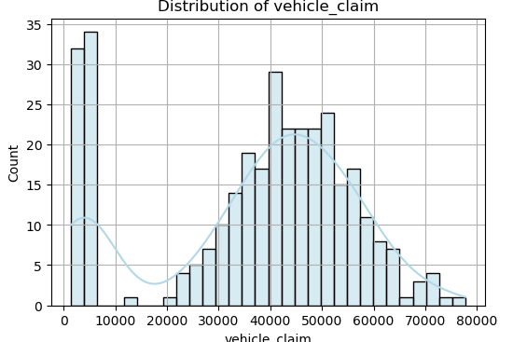
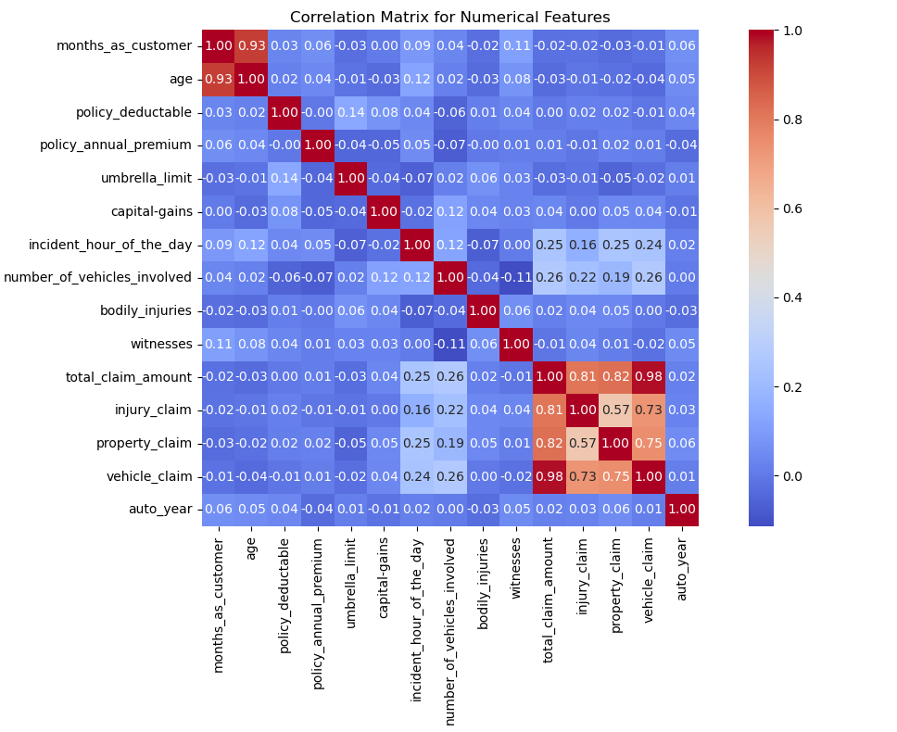

Slide 4
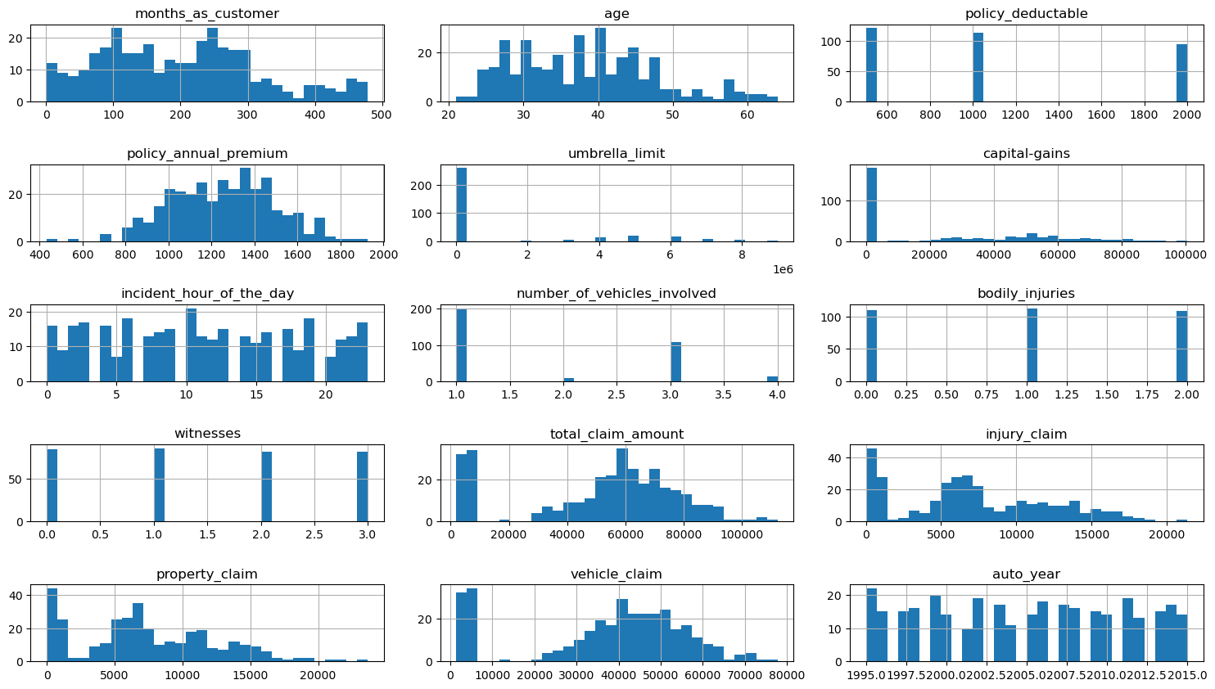
Visualize the distribution of selected numerical features using appropriate plots to understand their characteristics.

Slide 5
Which features are most predictive of fraudulent behaviour?
In our analysis, we found that certain features were strongly linked to fraud based on the results from both Logistic Regression and Random Forest models.
Here are the most predictive features we identified:
Claim Severity Ratio This was one of the most important features. It shows how high the claim amount is compared to the policy premium. A very high ratio may signal fraud.
Incident Severity We observed that fraud was more likely in cases labeled as “Minor Damage” or “Total Loss.” Fraudsters may try to exaggerate the damage.
Number of Vehicles Involved Fraud was more common when only one vehicle was involved, possibly due to staged accidents.
Incident Hour of the Day Odd hours (like very early morning or late at night) were linked with a higher chance of fraud.
We confirmed these features through feature importance scores from Random Forest and statistical

Slide 6
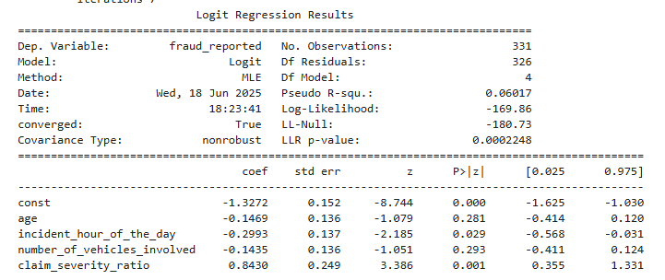
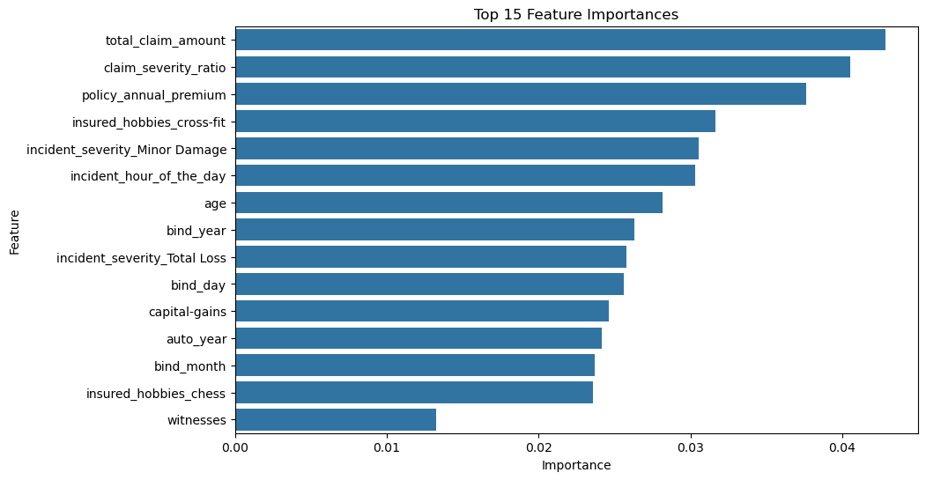

Slide 7
Can we predict the likelihood of fraud for an incoming claim, based on past data?
We used historical insurance claim data and applied machine learning models—
Logistic Regression and Random Forest—to detect fraud patterns effectively. The process started with data cleaning and preprocessing, where we removed irrelevant columns (like date fields) and grouped low-frequency categories to reduce noise.
In the feature engineering phase, we created new variables such as
claim_severity_ratio and incident_hour_daytype to improve model accuracy.
We trained our models on 70% of the data: Logistic Regression was used for its interpretability, and Random Forest for its performance. Once trained, these models could assess any new claim by assigning it a fraud probability score—for example, a claim with high severity, no police report, and filed at odd hours might receive a fraud probability of 0.78. Since this exceeds the chosen cutoff of 0.3, the model would flag the claim for further investigation.
In conclusion, our trained models can predict the likelihood of fraud with good accuracy. This helps insurance companies quickly identify suspicious claims, reduce financial losses, and improve the efficiency of the claims review process.

Slide 8
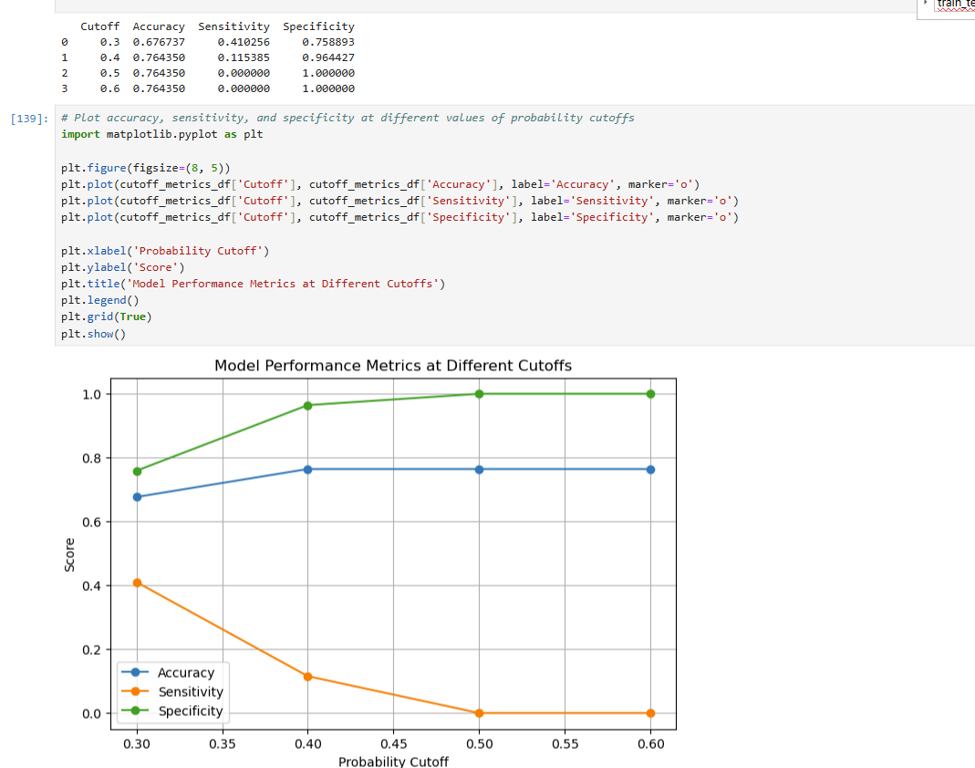

Slide 9
What insights can be drawn from the model that can help in improving the fraud detection process?
Our model has revealed several valuable insights that can enhance the fraud detection process. For example, features like incident severity, number of vehicles involved, claim severity ratio, and incident time were found to be highly predictive of fraud.
We also observed that fraudulent claims are more likely to occur late at night or when there are no witnesses or police reports. Using these insights, insurers can create smarter rules—such as flagging claims with high severity and missing documentation—to prioritize manual reviews.
Additionally, the model can assign a fraud probability score to each new claim, helping reduce manual effort while ensuring that risky claims are reviewed more thoroughly, ultimately improving accuracy and saving costs.

Slide 10
