Slide 1

Minjae Lee

Slide 2
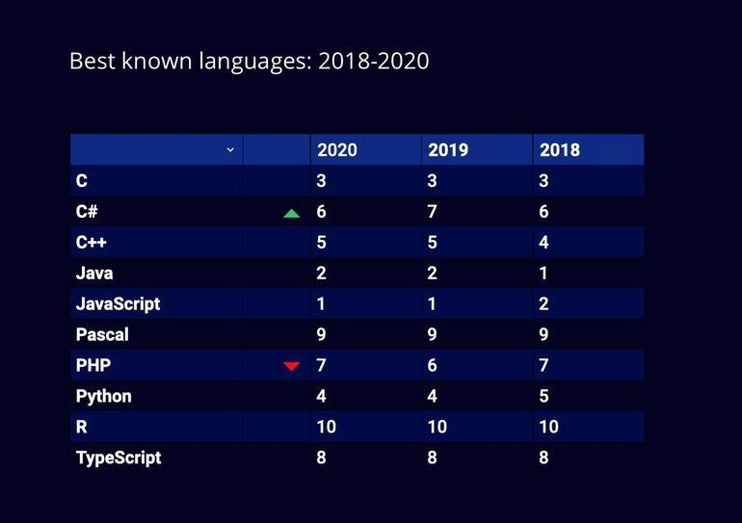
Python is becoming a more important language in the IT industry.

Slide 3
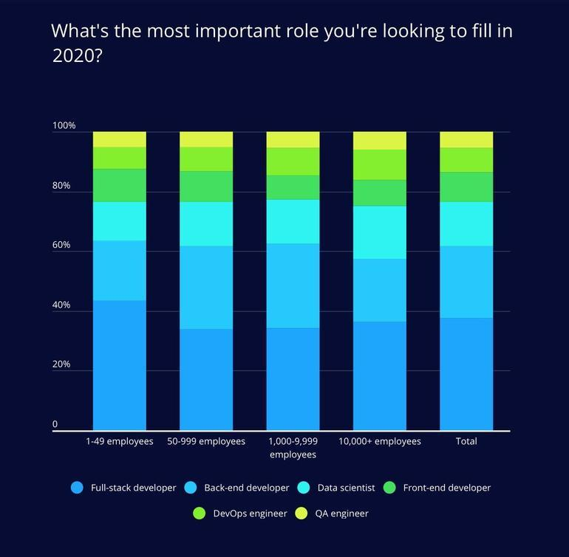
The importance of data science, which uses Python as its main language, is also becoming increasingly important in all industries.

Slide 4
Data Summary
304 Jobs
Radius 100 Miles from New York City
3 States(NY, PA, NJ)
25 Companies
Salary < $ 100,000

Slide 5
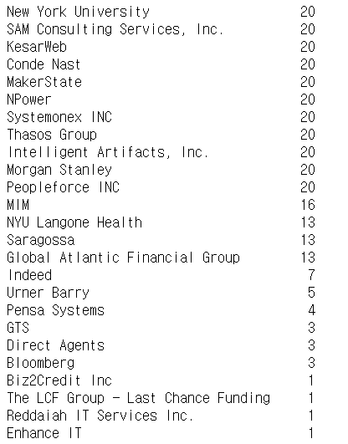
Twenty-five companies had Python under $100,000
Among them were big companies like Bloomberg, Morgan Stanley and Indeed
Other large companies expect most Python jobs to be over $100,000.

Slide 6
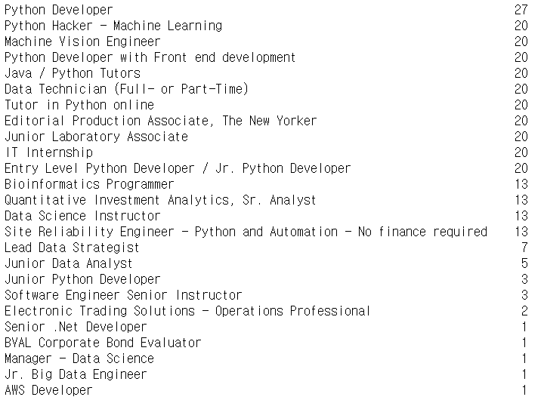

Slide 7
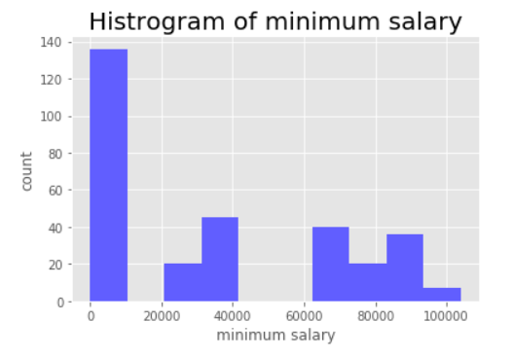
$0 is TBD salaries.
$ 20,000 - $ 40,000 are hourly wage. Calculated by multiplying the hourly wage by 2000. It could be higher if it were to be paid an annual salary. 40,000 are hourly salaries.
Most salaries are distributed over $60,000. You can see that the salary is higher than other jobs

Slide 8
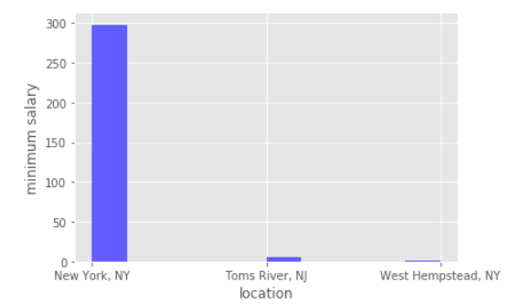
Almost all jobs are employed in New York City
Many start-ups are not on the list
And it is expected that there will be more python jobs in New York City if the jobs of start-ups are added.

