Slide 1

AI-NATIVE SDLC
PLAYBOOK
How AI changes the full software lifecycle
Xuan Zhou
Based on the Claude Academy course
Notes:
Suggested script:
Hello everyone. Today I will share the main ideas from the AI-Native SDLC Playbook. SDLC means software development lifecycle. The key message is simple: AI can write code very fast, so we also need to improve planning, testing, review, deployment, and maintenance.
Sources:
https://academy.claude.com/courses/ai-native-sdlc-playbook/introduction
Cover illustration generated for this presentation.

Slide 2
ONE MESSAGE FOR THE WHOLE COURSE
The main idea
AI writes code
The rest of the process must keep up
Minutes or hours
Planning, review, security, release, and operations still take human time.
More code can be produced in the same time.
Faster coding alone does not create faster delivery
The full lifecycle needs to change
Claude Academy course share
03
PLAN
DESIGN
BUILD
TEST
DEPLOY
MAINTAIN
Notes:
Suggested script:
This slide gives the main idea. AI makes coding much faster. However, coding is only one part of delivery. If planning, review, security, and release stay slow, the full delivery time will not improve. The course therefore looks at the whole lifecycle, not only at code generation.
Sources:
https://academy.claude.com/courses/ai-native-sdlc-playbook/introduction

Slide 3
SIX STAGES IN A LINE
The traditional SDLC
PLAN
DESIGN
BUILD
TEST
DEPLOY
MAINTAIN
Product
Architecture
Engineering
QA
Release
Operations
Many handoffs
Human-speed controls
Work moves through tickets, documents, meetings, and sign-offs.
People review each step because people created each step.
Claude Academy course share
04
PLAN
DESIGN
BUILD
TEST
DEPLOY
MAINTAIN
Notes:
Suggested script:
The traditional lifecycle has six stages. Different teams often own different stages. Work moves through documents, tickets, meetings, and approvals. This structure gave companies control, but it was designed for a time when writing code was the slowest part.
Sources:
https://academy.claude.com/courses/ai-native-sdlc-playbook/introduction

Slide 4
WHEN BUILD BECOMES VERY FAST
The bottleneck moves
BEFORE AI
PLAN
DESIGN
BUILD
TEST
DEPLOY
WITH AI
PLAN
DESIGN
BUILD
TEST
DEPLOY
The queue moves to planning, review, security, and release
These stages need new tools and new controls
Claude Academy course share
05
PLAN
DESIGN
BUILD
TEST
DEPLOY
MAINTAIN
Notes:
Suggested script:
This picture shows the change. Before AI, build was often the largest block of time. With AI, build can become much smaller. The waiting time then moves to the stages around build. Security review is a good example. If code output doubles but the security team stays the same size, the review queue grows.
Sources:
https://academy.claude.com/courses/ai-native-sdlc-playbook/introduction

Slide 5
AI WORKS IN EVERY STAGE
The AI-native lifecycle
DESIGN
Humans
PLAN
BUILD
Start the work
Give direction
Approve risk
Own the result
AI
reads and creates artifacts
TEST
MAINTAIN
DEPLOY
AI can do more work. Humans still make decisions that need judgment.
Claude Academy course share
06
PLAN
DESIGN
BUILD
TEST
DEPLOY
MAINTAIN
Notes:
Suggested script:
The AI-native lifecycle is a loop, not a one-way line. AI helps at every stage. Humans do not disappear. People start the work, give direction, approve important risk, and remain responsible for the result. Human attention moves to the places where judgment matters most.
Sources:
https://academy.claude.com/courses/ai-native-sdlc-playbook/introduction

Slide 6
EACH STAGE SAVES ITS RESULT
Artifacts connect the stages
intent.md
spec.md
plan.md
code + tests
PR
incident
What we want
What to design
How to build
Proof it works
Review record
Next improvement
Why this matters
The next stage reads the saved artifact. Git records who changed it and who approved it.
The artifact is both a handoff and an audit record.
Claude Academy course share
07
PLAN
DESIGN
BUILD
TEST
DEPLOY
MAINTAIN
Notes:
Suggested script:
The course uses committed artifacts to connect the stages. Each stage saves a clear result. The next stage reads that result. This removes some manual handoffs. It also creates an audit trail because Git records the author, the changes, and the approval.
Sources:
https://academy.claude.com/courses/ai-native-sdlc-playbook/introduction

Slide 7
CAPTURE THE IDEA AS INTENT.MD
Stage 1: Plan
Old way
AI-native way
The idea moves through backlog items, workshops, and refinement meetings.
The person with the idea explains it to Claude and creates intent.md.
PROBLEM
OUTCOME
CONSTRAINTS
QUESTIONS
What cannot be done today?
What should become better?
What rules must we follow?
What is still unknown?
A product owner reviews intent.md before the next stage
The first version can take hours instead of weeks
Claude Academy course share
08
PLAN
DESIGN
BUILD
TEST
DEPLOY
MAINTAIN
Notes:
Suggested script:
In Stage 1, the goal is to capture the original idea with less delay. The person who has the idea talks with Claude in normal language. Claude asks questions and creates intent.md. The product owner reviews and corrects the file before it moves forward. The human still owns the meaning of the request.
Sources:
https://academy.claude.com/courses/ai-native-sdlc-playbook/capture-intent

Slide 8
CREATE SPEC.MD WITH CURRENT POLICIES
Stage 2: Design
AI + skills
intent.md
spec.md
brand
security
compliance
UX
problem and constraints
requirements and design
Human review
The product owner checks that the spec solves the original problem. Policy owners answer flagged questions.
Policy problems appear before coding starts, when changes are cheaper.
Claude Academy course share
09
PLAN
DESIGN
BUILD
TEST
DEPLOY
MAINTAIN
Notes:
Suggested script:
After the team accepts intent.md, Claude creates spec.md. The agent uses the company skills for brand, security, compliance, and user experience. The product owner reviews the result. Important policy questions are resolved before engineering begins. This reduces late rework.
Sources:
https://academy.claude.com/courses/ai-native-sdlc-playbook/requirements-and-design

Slide 9
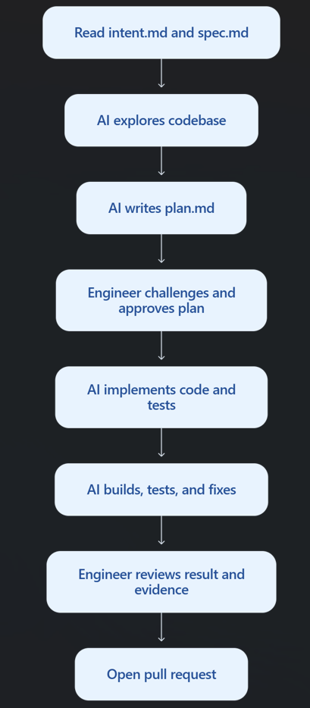
PLAN MODE COMES BEFORE CODE
Stage 3: Build
Traditional SE | AI-native SE
Reads requirements and starts coding | Reviews requirements and creates an explicit implementation plan
Keeps the implementation plan mentally | Commits the plan as plan.md
Writes most code manually | Directs AI to generate code and tests
Works mainly on one task | Can supervise multiple isolated tasks
Explains repository conventions repeatedly | Maintains shared instructions in AGENTS.md
Remembers company standards | Encodes reusable standards as Skills
Finds mistakes during final review | Gives AI feedback loops to detect mistakes earlier
Reviews individual edits | Reviews plans, evidence, architecture, and final diffs
Claude Academy course share
10
PLAN
DESIGN
BUILD
TEST
DEPLOY
MAINTAIN
Notes:
Suggested script:
software engineers spend less time typing routine code and more time defining the implementation, challenging the plan, supplying repository knowledge, supervising parallel work, and reviewing evidence. AI produces much of the implementation, but the engineer still owns every technical decision and the final result.”
Sources:
https://academy.claude.com/courses/ai-native-sdlc-playbook/plan-mode

Slide 10
CLAUDE.MD AND SKILLS
Context and company knowledge
AGENTS.md
Skills
Repo knowledge for every session.
Build and test commands
Architecture and conventions
Mistakes AI often makes
Company knowledge used for relevant tasks.
Security policy
API standards
Brand and UX rules
Simple rule
Put repo facts in AGENTS.md. Put reusable company policy in a Skill.
If a rule must always hold, add a deterministic control such as a hook.
Claude Academy course share
11
PLAN
DESIGN
BUILD
TEST
DEPLOY
MAINTAIN
Notes:
Suggested script:
CLAUDE.md gives the agent the same basic context that a new team member needs. Keep it short and current. Skills hold reusable company knowledge, for example security rules or API standards. Skills guide the agent, but they do not guarantee compliance. Important rules also need a deterministic control.
Sources:
https://academy.claude.com/courses/ai-native-sdlc-playbook/claude-md
https://academy.claude.com/courses/ai-native-sdlc-playbook/skills-as-institutional-knowledge

Slide 11
ONE ENGINEER CAN GUIDE SEVERAL SESSIONS
Parallel work
Session A
Feature work
Subagents
ENGINEER
Small helpers inside one session
Session B
Bug fix
Verifier
Runs the app and reports evidence
Researcher
Explores the codebase and reports back
Session C
Tests or docs
Start with two or three sessions. Add more only when review can keep up.
Claude Academy course share
12
PLAN
DESIGN
BUILD
TEST
DEPLOY
MAINTAIN
Notes:
Suggested script:
Parallel sessions let one engineer guide several independent tasks. Each session uses a separate Git worktree, so the files do not collide. Subagents are smaller helpers inside one session. The limit is not the number of sessions. The real limit is how much work the engineer can review carefully.
Sources:
https://academy.claude.com/courses/ai-native-sdlc-playbook/parallel-sessions-and-subagents

Slide 12
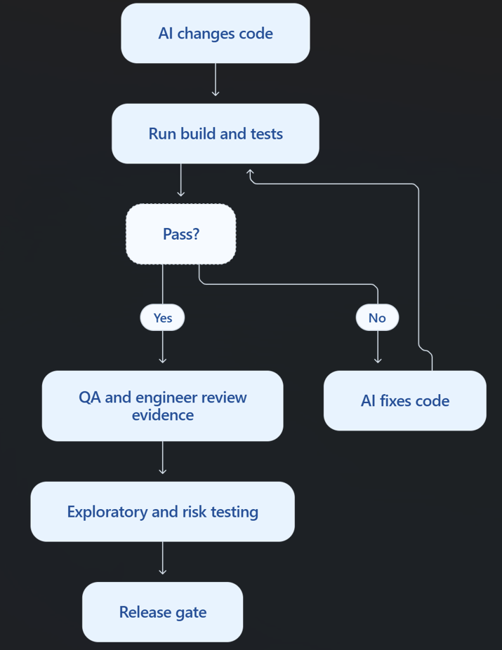
GIVE THE AGENT A FEEDBACK LOOP
Stage 4: Test
Activity | AI responsibility | QA responsibility
Requirements | Suggest test scenarios | Define acceptance criteria and quality risks
Test planning | Generate initial test cases | Select coverage and testing strategy
Test data | Generate synthetic data | Check privacy, realism, and edge cases
Execution | Run repeatable automated tests | Review failures and suspicious results
Bug fixing | Reproduce bugs and modify code | Confirm the reproduction is correct
Exploratory testing | Suggest exploration paths | Perform judgment-based exploration
Release | Produce test evidence | Decide whether quality risk is acceptable
Production | Analyze incidents | Convert escaped defects into new tests
Claude Academy course share
13
PLAN
DESIGN
BUILD
TEST
DEPLOY
MAINTAIN
Notes:
Suggested script:
A feedback loop lets Claude check its own work. The agent makes a change, runs a test, reads the result, and fixes the code. The loop continues until the check passes. The team must protect the check. For example, during a bug fix, the agent should not be allowed to edit the failing test.
Sources:
https://academy.claude.com/courses/ai-native-sdlc-playbook/give-claude-a-feedback-loop

Slide 13
Stage 4: Test
What changes for QA
QA should spend less time on:
Repeating standard regression tests
Manually collecting screenshots
Reproducing straightforward bugs
Checking formatting and simple validation
Preparing routine test reports
QA should spend more time on:
Quality strategy
Risk analysis
Acceptance criteria
Exploratory testing
Test architecture
Production quality signals
Agent evals
Deciding whether evidence is trustworthy
“In the AI-native Test stage, AI continuously tests and corrects its own work before a person reviews it. QA defines the quality criteria, protects the tests, performs risk-based exploratory testing, and decides whether the evidence is sufficient for release. QA moves from being the test executor to being the quality-system owner.”

Slide 14
TESTS FOR THE AGENT SETUP
Continuous evals
1. Collect real tasks
2. Run in CI
3. Learn from incidents
Start with 20 to 50 tasks from recent work. Save the expected result.
Run the suite when AGENTS.md, skills, hooks, prompts, or models change.
After a production incident, add a case so the same problem is tested next time.
Evals check whether the agent still works to the same standard
They are the AI-native version of regression testing
Claude Academy course share
14
PLAN
DESIGN
BUILD
TEST
DEPLOY
MAINTAIN
Notes:
Suggested script:
Evals are tests for the agent configuration. The team collects real tasks and defines what a good result looks like. CI runs these tasks when the agent setup changes. If a new prompt or skill reduces the pass rate, the team reviews the change. Production incidents should become new eval cases.
Sources:
https://academy.claude.com/courses/ai-native-sdlc-playbook/continuous-evals-in-ci

Slide 15
THE SAME REVIEW PASSES FOR EVERY PR
AI in pull request review
BUGS
Logic errors and regressions
Human reviewer
Checks intent
Judges risk
Approves or rejects
SECURITY
Authentication, injection, and data leaks
COMPLIANCE
Match spec.md, plan.md, and company rules
The agent that wrote the code cannot approve its own PR.
PR history becomes the review record.
Claude Academy course share
15
PLAN
DESIGN
BUILD
TEST
DEPLOY
MAINTAIN
Notes:
Suggested script:
Claude can review pull requests using the same review policy every time. It checks for bugs, security problems, and compliance with the plan. The human reviewer can focus on intent and risk. Separation of duties remains important. The agent that wrote the code cannot approve its own pull request.
Sources:
https://academy.claude.com/courses/ai-native-sdlc-playbook/ai-in-the-pr-review-loop

Slide 16
SAFE AUTOMATION BEFORE PRODUCTION
Hooks and CI/CD
The course recommends running Claude non-interactively inside CI/CD, sandboxing it, exposing deployment through controlled tools, and rehearsing rollback before allowing an agent to use it.
Traditional pipeline | AI-native pipeline
A script reports “test failed” | AI explains why it probably failed
Engineer investigates flaky tests | AI separates likely flaky and real failures
Engineer writes the changelog | AI drafts it from commits and PRs
Engineer follows a deployment runbook | AI calls approved deployment tools
Engineer investigates failed deployment | AI collects metrics, logs, and deployment evidence
Engineer manually runs rollback | AI can propose or invoke a pre-approved rollback
Human performs every step | Human concentrates on intent, risk, and production approval
Claude Academy course share
16
PLAN
DESIGN
BUILD
TEST
DEPLOY
MAINTAIN
Notes:
Suggested script:
Hooks can allow, ask, or block an action. They provide deterministic control. In CI and CD, start with read-only jobs, such as explaining a failed build. Later, add write actions behind existing gates. Production keeps a human authorization. Agent jobs should run in a sandbox with limited credentials.
Sources:
https://academy.claude.com/courses/ai-native-sdlc-playbook/hooks-as-approval-gates
https://academy.claude.com/courses/ai-native-sdlc-playbook/ci-cd-integration-and-deployment

Slide 17
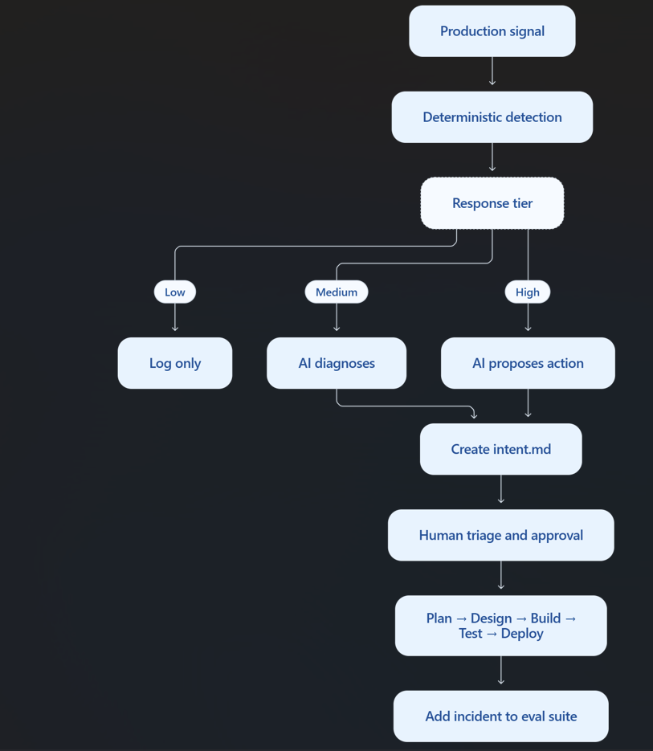
PRODUCTION SIGNALS CAN RESTART THE LOOP
Stage 6: Maintain
Maintain can run “headless”: a schedule, alert, ticket, or message starts the process without someone manually prompting AI. The resulting work still passes through independent gates and human review.
Claude Academy course share
17
PLAN
DESIGN
BUILD
TEST
DEPLOY
MAINTAIN
Notes:
Suggested script:
Maintenance can run without waiting for a person to start every step. A deterministic script watches a stable metric. A small change may only create a log. A larger change can ask Claude to diagnose the problem. A serious change can create intent.md or run an approved rollback. The normal review gates still apply.
Sources:
https://academy.claude.com/courses/ai-native-sdlc-playbook/closing-the-loop-on-metrics

Slide 18
DIFFERENT CONTROLS DO DIFFERENT JOBS
Three control layers
GUIDANCE
AGENTS.md and Skills
Help the agent follow good practice
ENFORCEMENT
Hooks, permissions, sandbox
Stop actions that must never happen
ACCOUNTABILITY
Named human approvals
Decide risk and approve important outcomes
Good governance does not mean a human checks every line
It means the right control is applied at the right point
Claude Academy course share
18
PLAN
DESIGN
BUILD
TEST
DEPLOY
MAINTAIN
Notes:
Suggested script:
The course uses three types of control. Guidance helps the agent follow good practice. Enforcement blocks actions that must not happen. Human approval remains for risk and accountability. Good governance does not require a person to check every line. It requires the correct control at the correct point.
Sources:
https://academy.claude.com/courses/ai-native-sdlc-playbook/skills-as-institutional-knowledge
https://academy.claude.com/courses/ai-native-sdlc-playbook/hooks-as-approval-gates
https://academy.claude.com/courses/ai-native-sdlc-playbook/ci-cd-integration-and-deployment

Slide 19
SUMMARY AND DISCUSSION
Three points to remember
1. Faster code moves the bottleneck
2. Artifacts connect the work
3. Controls enable autonomy
Planning, review, release, and operations also need to change.
Saved files provide the handoff, the trigger, and the audit record.
Guidance, enforcement, and human approval work together.
Discussion question
What are our bottlenecks today? How to improve?
Claude Academy course share
21
PLAN
DESIGN
BUILD
TEST
DEPLOY
MAINTAIN
Notes:
Suggested script:
To finish, I want to repeat three points. Faster coding moves the bottleneck to other stages. Committed artifacts connect the lifecycle and create an audit record. Layered controls allow more autonomy without removing human accountability. My question for the team is: if our code output doubled, which part of our current process would become the bottleneck?
Sources:
https://academy.claude.com/courses/ai-native-sdlc-playbook/introduction
https://academy.claude.com/courses/ai-native-sdlc-playbook/closing-thoughts-and-resources

