Slide 1
Relational Reinforcement Learning in POMDPs
Harsha Kokel and Kaushik Roy

Slide 2
Domain
Logistics
Objects: trucks, boxes, cities
Objective: Deliver box to destination city
Actions: Move, Unload
Observation: Current city of a truck
Assumption: Trucks already have box loaded

Slide 3


Domain
Our experiment
One truck
Destination city is 3
Truck only moves in sequential order
Move action in destination city will keep the truck in destination city

Slide 4
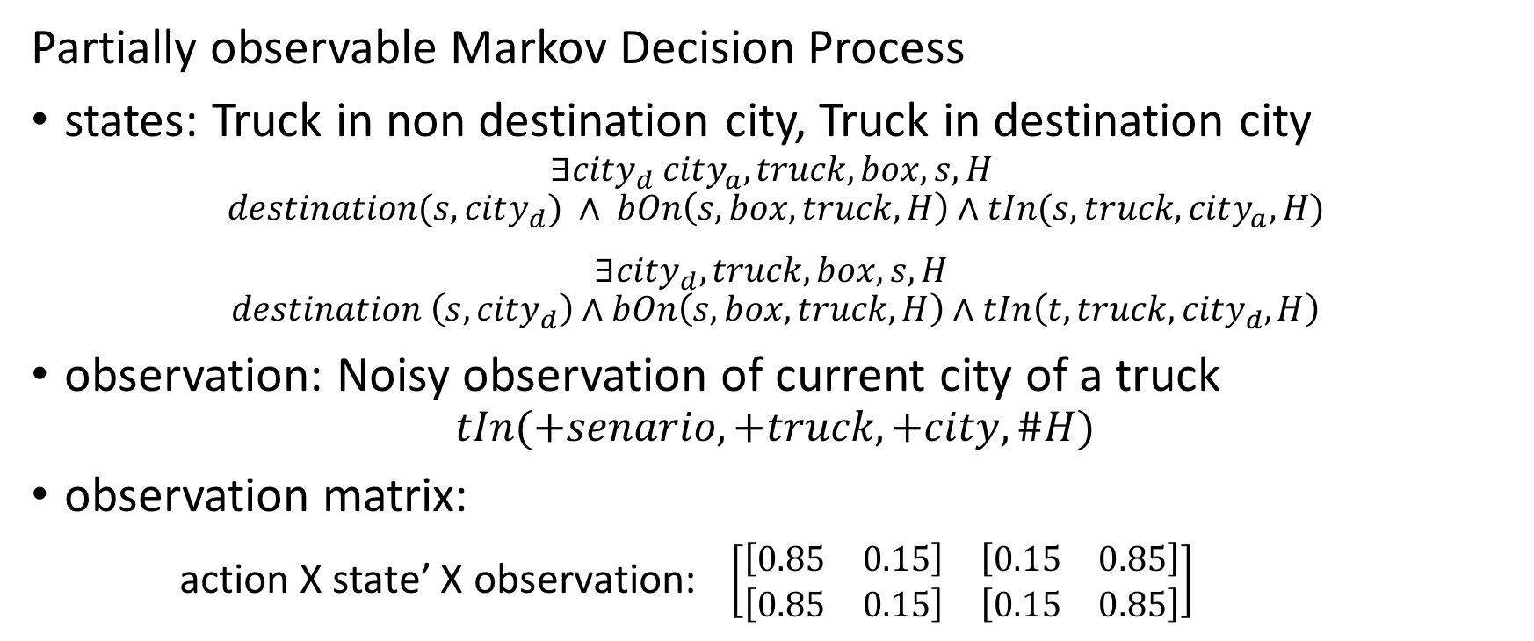
POMDP
Partially observable Markov Decision Process
states: Truck in non destination city, Truck in destination city
$$∃city_{d} city_{a},truck, box,s, H$$
$$destination(s,city_{d}) ∧ bOn\left(s,box, truck,H\right)∧tIn(s, truck, city_{a}, H)$$
$$∃city_{d}, truck,box, s, H$$
$$destination \left(s,{city}_{d}\right)∧bOn\left(s,box,truck, H\right)∧tIn\left(t,{truck, city}_{d},H\right)$$
observation: Noisy observation of current city of a truck
$$tIn(+senario,+truck,+city,\#H)$$
observation matrix:
action X state’ X observation: $\left[\begin{matrix}[\begin{matrix}0.85 & 0.15\end{matrix}] & [\begin{matrix}0.15 & 0.85\end{matrix}] \\ [\begin{matrix}0.85 & 0.15\end{matrix}] & [\begin{matrix}0.15 & 0.85\end{matrix}]\end{matrix}\right]$

Slide 5
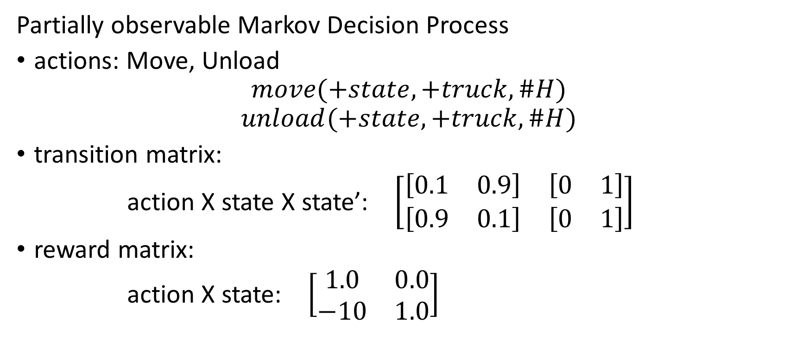
POMDP
Partially observable Markov Decision Process
actions: Move, Unload
$$move(+state,+truck,\#H)$$
$$unload(+state,+truck, \#H)$$
transition matrix:
action X state X state’: $\left[\begin{matrix}[\begin{matrix}0.1 & 0.9\end{matrix}] & [\begin{matrix}0 & 1\end{matrix}] \\ [\begin{matrix}0.9 & 0.1\end{matrix}] & [\begin{matrix}0 & 1\end{matrix}]\end{matrix}\right]$
reward matrix:
action X state: $\left[\begin{matrix}1.0 & 0.0 \\ −10 & 1.0\end{matrix}\right]$

Slide 6
POMDP
Value Iteration
Bellman equation for optimal value function
Greedy policy

Slide 7
Value Iteration
for belief state
x
y
z
move
observation
unload
x’
y’
z’
x’’’
y’’’
z’’’
move
move
observation
observation
x’’
y’’
z’’

Slide 8
Value Iteration
Approximate value iteration for observation
Learn RRT on value iteration for sampled belief states and observations and test it against observations.

Slide 9
Related work
Thrun, Sebastian. "Monte carlo pomdps." NIPS 2000
Wang, Chenggang, and Roni Khardon. "Relational Partially Observable MDPs." AAAI 2010
Sanner, Scott, and Kristian Kersting. "Symbolic dynamic programming for first-order POMDPs." AAAI 2010
Khot, Tushar, Sriraam Natarajan, and Jude W. Shavlik. "Relational One-Class Classification: A Non-Parametric Approach." AAAI. 2014
Hausknecht, Matthew, and Peter Stone. "Deep recurrent q-learning for partially observable mdps." CoRR, abs/1507.06527 (2015)
Code adapted from
Emami, Patrick, Alan J. Hamlet, and Carl D. Crane. "POMDPy: An Extensible Framework for Implementing Partially-Observable Markov Decision Processes in Python.”

Slide 10
Results (preliminary)

Slide 11
Results (preliminary)

Slide 12
Questions?

