Slide 1
Relational Reinforcement Learning in POMDPs
Harsha Kokel and Kaushik Roy

Slide 2
Domain
Logistics
Objects: trucks, boxes, cities
Objective: Deliver box to destination city
Actions: Move, Unload
Observation: Current city of a truck
Assumption: Trucks already have box loaded

Slide 3


Domain
Our experiment
One truck
Destination city is 3
Truck only moves in sequential order
Move action in destination city will keep the truck in destination city

Slide 4
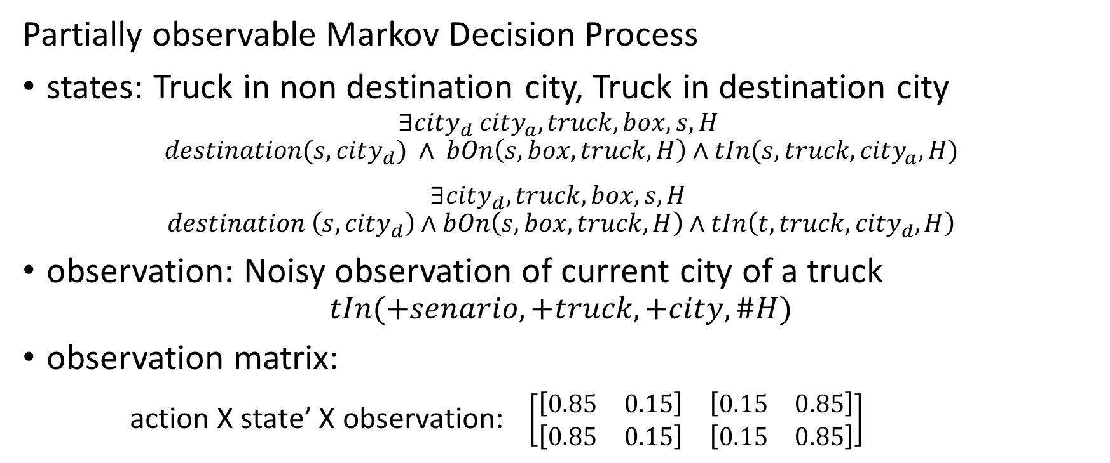
POMDP
Partially observable Markov Decision Process
states: Truck in non destination city, Truck in destination city
$$∃city_{d} city_{a},truck, box,s, H$$
$$destination(s,city_{d}) ∧ bOn\left(s,box, truck,H\right)∧tIn(s, truck, city_{a}, H)$$
$$∃city_{d}, truck,box, s, H$$
$$destination \left(s,{city}_{d}\right)∧bOn\left(s,box,truck, H\right)∧tIn\left(t,{truck, city}_{d},H\right)$$
observation: Noisy observation of current city of a truck
$$tIn(+senario,+truck,+city,\#H)$$
observation matrix:
action X state’ X observation: $\left[\begin{matrix}[\begin{matrix}0.85 & 0.15\end{matrix}] & [\begin{matrix}0.15 & 0.85\end{matrix}] \\ [\begin{matrix}0.85 & 0.15\end{matrix}] & [\begin{matrix}0.15 & 0.85\end{matrix}]\end{matrix}\right]$

Slide 5
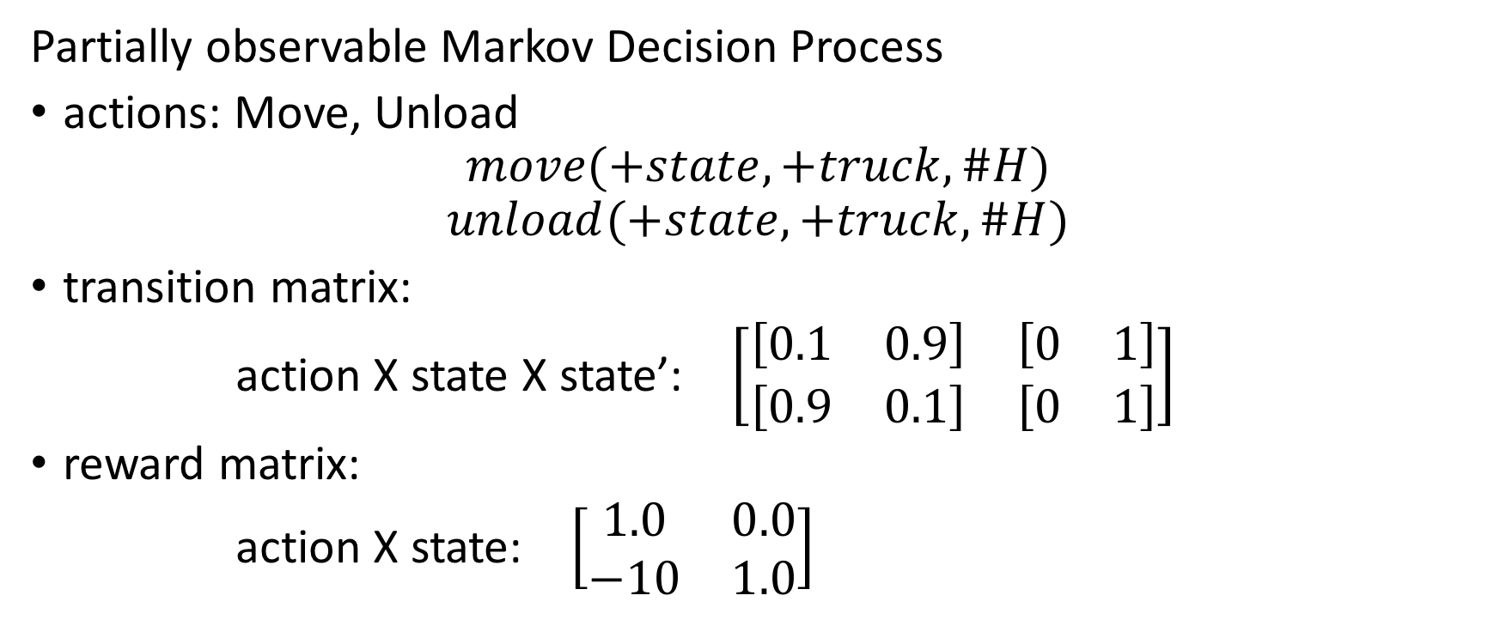
POMDP
Partially observable Markov Decision Process
actions: Move, Unload
$$move(+state,+truck,\#H)$$
$$unload(+state,+truck, \#H)$$
transition matrix:
action X state X state’: $\left[\begin{matrix}[\begin{matrix}0.1 & 0.9\end{matrix}] & [\begin{matrix}0 & 1\end{matrix}] \\ [\begin{matrix}0.9 & 0.1\end{matrix}] & [\begin{matrix}0 & 1\end{matrix}]\end{matrix}\right]$
reward matrix:
action X state: $\left[\begin{matrix}1.0 & 0.0 \\ −10 & 1.0\end{matrix}\right]$

Slide 6
What we want to do?
Value approximation for observation history using RRTs

Slide 7
Approach
Domain
VI
Create Facts & Examples
Generate Data
Generate Data
Query POMDP for random initial belief states
<belief state>,<action>,<alpha vector>,<observation>
Sample s0:
[0.8 0.2],0,[0.95 0. ],0
[0.33009709 0.66990291],0,[0.95 0. ],1
[0.00598802 0.99401198],1,[-9.5 0.95],None
belief state: [non-destination destination-city]
action: 0-Moving/1-unloading
alpha-vector: 2D array
Observation: 0-non-destination/1-destination-city
Fact:
'destination(s0,cd)',
'bOn(s0,b1,t1,h0)', 'tIn(s0,t1,ncd,h0)', 'move(s0,t1,h0)', 'bOn(s0,b1,t1,h1)', 'tIn(s0,t1,cd,h1)', 'move(s0,t1,h1)', 'bOn(s0,b1,t1,h2)', 'tIn(s0,t1,cd,h2)', 'unload(s0,t1,h2)',
Example:
'value(s0) 0.887425191'

Slide 8
Approach
Create Facts & Examples
Learn RRT at each horizon
Test
Split
...
Clauses learnt for horizon 3
value(S):- move(S,T,h1),move(S,T,h0),destination(S,C),move(S,T,h2) 0.1190010641
value(S):- move(S,T,h1),move(S,T,h0),destination(S,C) 0.903633211608

Slide 9
Results (preliminary)
Create Facts & Examples
Learn RRT at each horizon
Test
Split
...

Slide 10
Related work
Thrun, Sebastian. "Monte carlo pomdps." NIPS 2000
Wang, Chenggang, and Roni Khardon. "Relational Partially Observable MDPs." AAAI 2010
Sanner, Scott, and Kristian Kersting. "Symbolic dynamic programming for first-order POMDPs." AAAI 2010
Khot, Tushar, Sriraam Natarajan, and Jude W. Shavlik. "Relational One-Class Classification: A Non-Parametric Approach." AAAI. 2014
Hausknecht, Matthew, and Peter Stone. "Deep recurrent q-learning for partially observable mdps." CoRR, abs/1507.06527 (2015)
Code adapted from
Emami, Patrick, Alan J. Hamlet, and Carl D. Crane. "POMDPy: An Extensible Framework for Implementing Partially-Observable Markov Decision Processes in Python.”

Slide 11
Questions?

