Slide 1
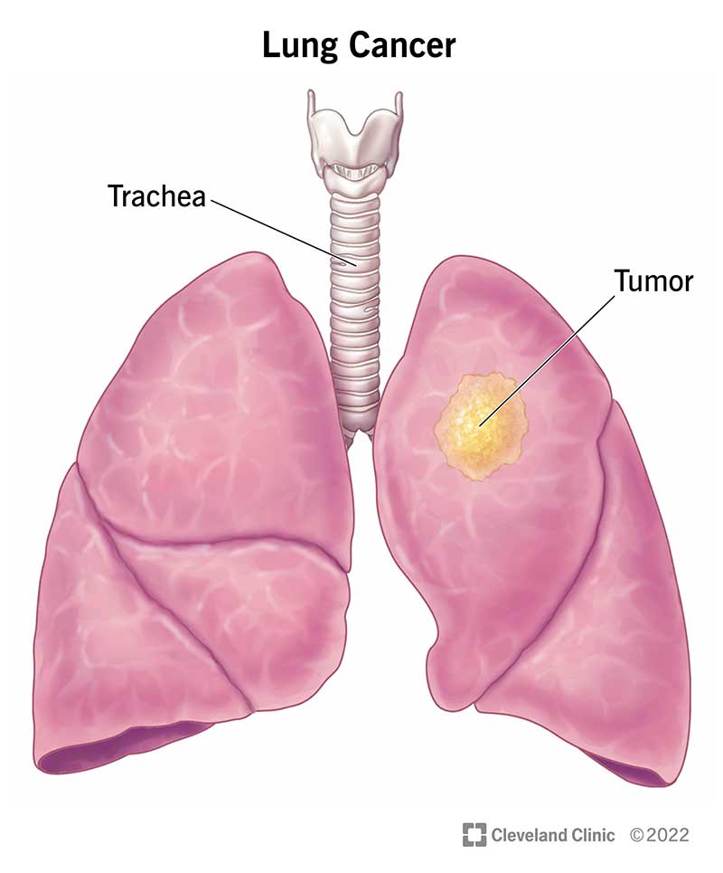
LUNG CANCER DETECTION AND ANALYSIS USING MACHINE LEARNING
Presented By:
Name
Under the Guidance of

Slide 2
AGENDA
Abstract
Introduction
System Requirements and Specifications
System Design
Implementation
Conclusion

Slide 3
INTODUCTION
Lung cancer remains a predominant cause of cancer-related deaths, with early and accurate prediction being crucial for improving survival rates.
Traditional methods of lung cancer diagnosis often involve invasive procedures or rely heavily on manual assessments, which can lead to delayed or inaccurate diagnosis.
This study presents a machine learning-based approach for predicting the likelihood of lung cancer in patients using clinical and demographic data.

Slide 4
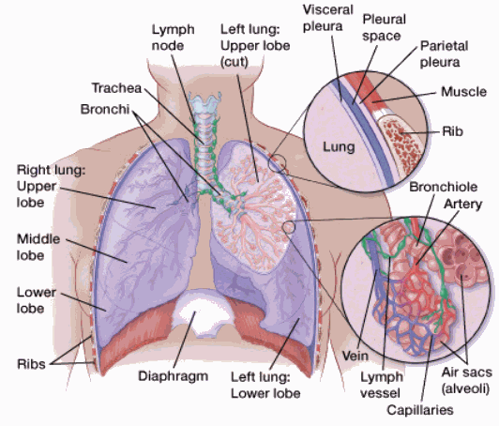
What Is Lung Cancer?
Your lungs are 2 sponge-like organs in your chest that are separated into sections called lobes. Your right lung has 3 lobes. Your left lung has 2 lobes. The left lung is smaller because the heart takes up more room on that side of the body.
When you inhale (breathe in), air enters through your mouth or nose and goes into your lungs through the trachea (windpipe). The trachea divides into tubes called bronchi, which enter the lungs and divide into smaller bronchi. These divide to form smaller branches called bronchioles. At the end of the bronchioles are tiny air sacs known as alveoli.

Slide 5
Lung cancer staging
Stage 0 (in-situ): Cancer is in the top lining of the lung or bronchus. It hasn’t spread to other parts of the lung or outside of the lung.
Stage I: Cancer hasn’t spread outside the lung.
Stage II: Cancer is larger than Stage I, has spread to lymph nodes inside the lung, or there’s more than one tumor in the same lobe of the lung.
Stage III: Cancer is larger than Stage II, has spread to nearby lymph nodes or structures or there’s more than one tumor in a different lobe of the same lung.
Stage IV: Cancer has spread to the other lung, the fluid around the lung, the fluid around the heart or distant organs.

Slide 6
Symptoms and Causes
A cough that doesn’t go away or gets worse over time.
Trouble breathing or shortness of breath (dyspnea).
Chest pain or discomfort.
Wheezing.
Coughing up blood (hemoptysis).
Hoarseness.
Loss of appetite.
Unexplained weight loss.

Slide 7
System Requirements and Specifications
Software Requirements
Scripting language : Python Programming
Scripting Tool : Anaconda Navigator (Jupiter Notebook) & Google Collab
Operating System : Microsoft Windows 11
Dataset : Lung Cancer dataset
Packages : NumPy, Pandas, Matplotlib, Seaborn , Sklearn etc.

Slide 8
System Requirements and Specifications
Hardware Requirements
Processor : 3.20 GHz
Output Devices : Monitor (LCD)
Input Devices : Keyboard
Hard Disk : 512 GB SSD
RAM : 16 GB

Slide 9
System Design
Machine Learning Algorithms
Lung Cancer Dataset
Data
Train
Test
Data Preprocessing
Model Deployment
Random Forest, SVM , SVM, Decision Tree and LR
Feature
Extraction
Missing Data Handling
Model Evaluation
Prediction of Lung Cancer
Yes
NO

Slide 10
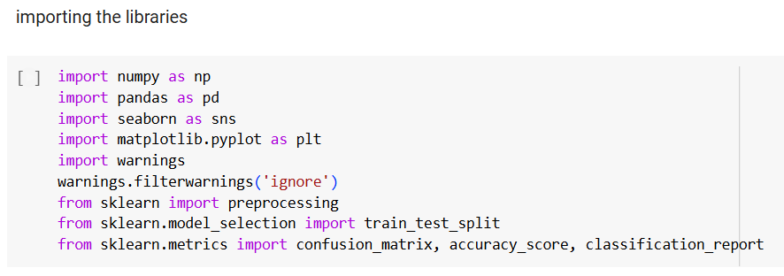
SYSTEM IMPLEMENTATION
Importing the Libraries

Slide 11
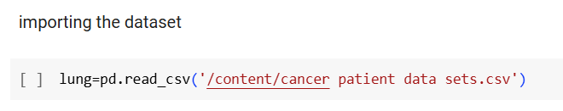
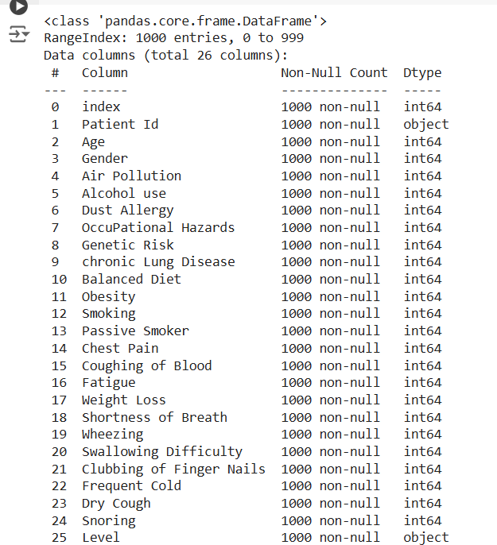

Slide 12
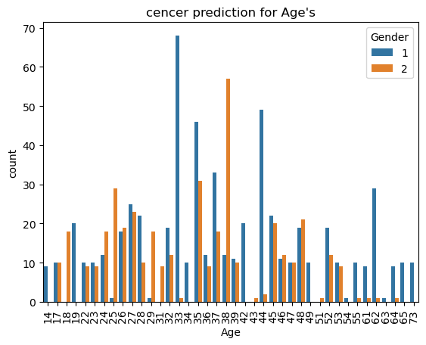
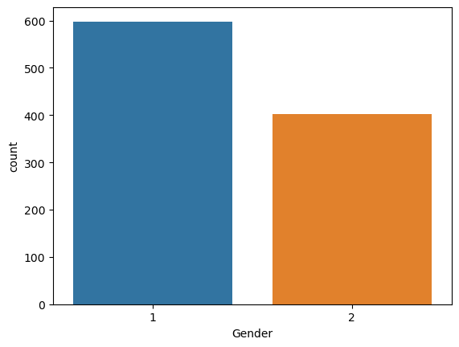
DATA ANALYSIS

Slide 13
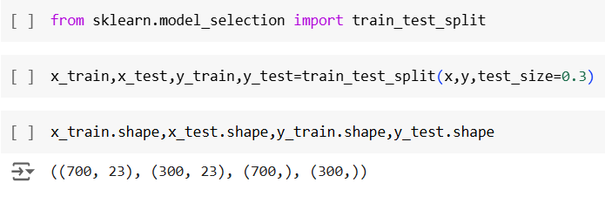
Training and splitting the data

Slide 14
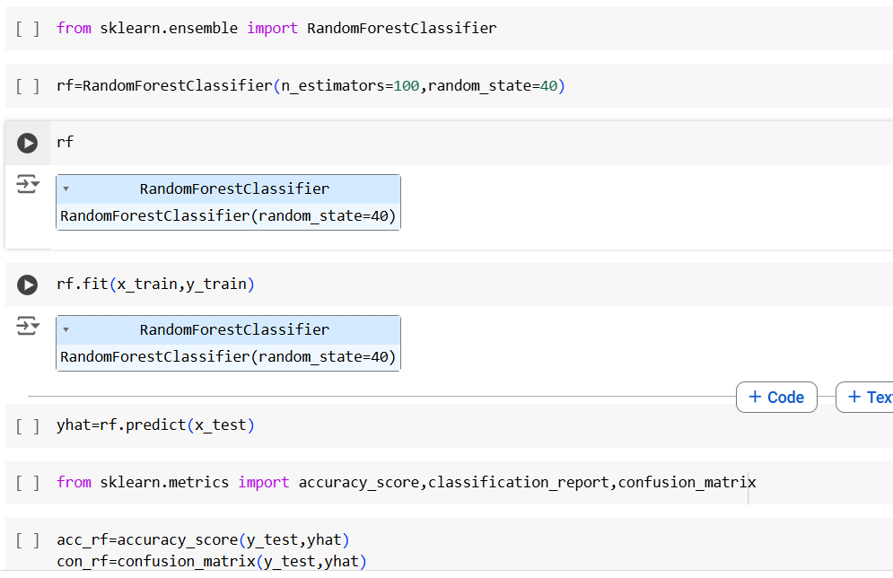
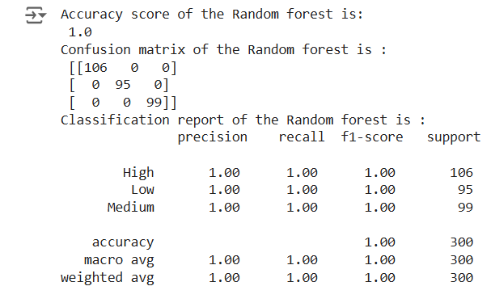
Random Forest Classifier

Slide 15
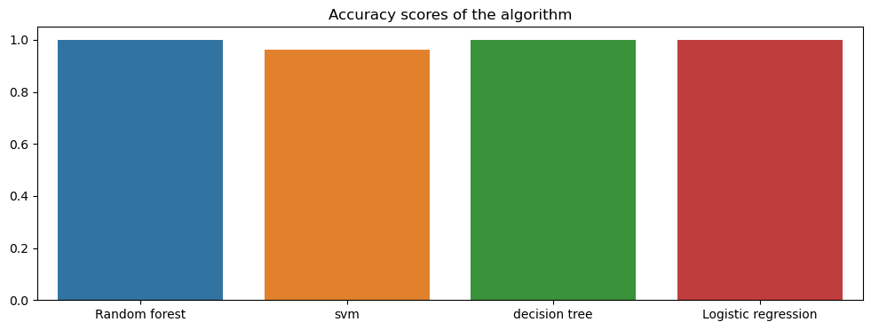
ACCURACY COMPARISON

Slide 16
CONCLUSION
The study successfully developed and evaluated a machine learning-based approach for predicting lung cancer risk using clinical, demographic, and imaging data. By exploring various machine learning models, including Logistic Regression, Decision Trees, Random Forest, Support Vector Machines techniques, this research demonstrated the potential of these methods in identifying high-risk individuals.
The results indicate that ensemble methods exhibit superior accuracy in predicting lung cancer when trained on large, well-labeled datasets. Furthermore, feature selection and engineering techniques played a critical role in improving model performance by identifying the most relevant predictors of lung cancer.

