Slide 1

Finite Element Modelling using PLAXIS 2D
Krishna Kumar
Email: kks32@cam.ac.uk
Lent Term 2017

Slide 2

What is PLAXIS?
A finite element program that simulates the behaviour of soil and its interaction with structures
Introduction to Plaxis 2D
Running a simulation
  Plaxis Input
  Plaxis Calculations
  Plaxis Output
  Plaxis Curves
Discussion of Homework #2

Slide 3
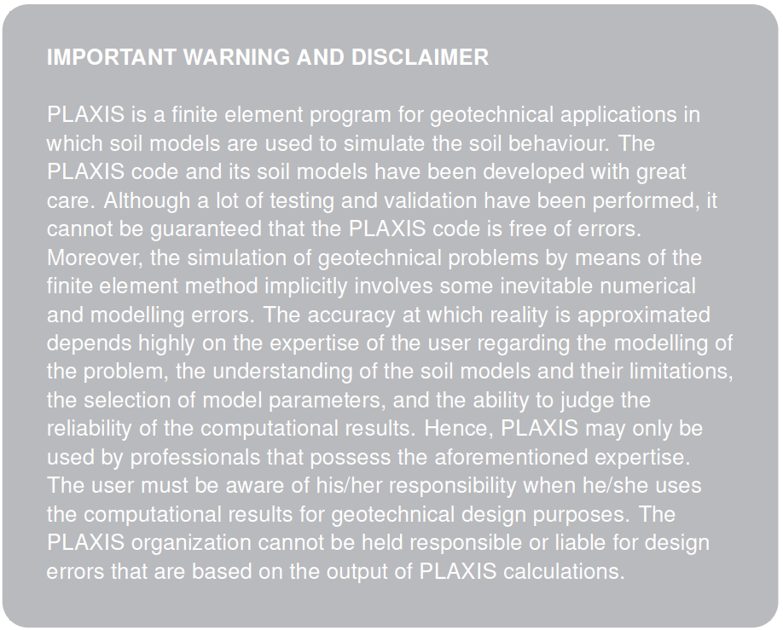

Slide 4
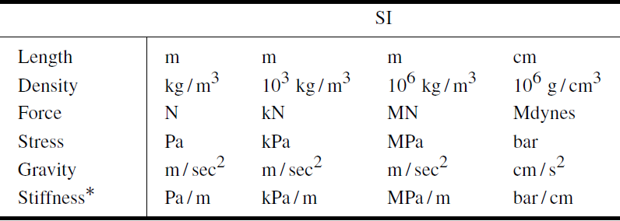
Consistent System of Units

Slide 5
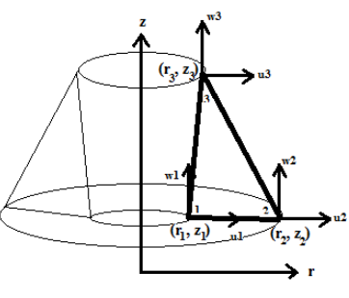
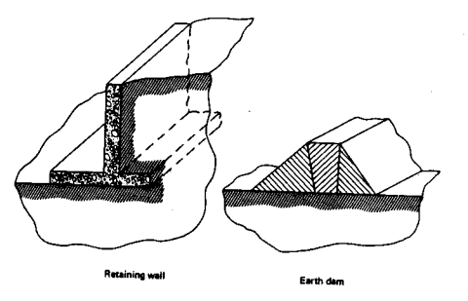
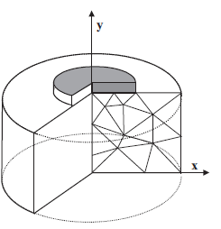
General Settings
Plane Strain: Strain normal to x-y plane is zero ε_{z} = 0 and shear strains γ_{zy} and γ_{zx}
Axisymmetric:

Slide 6
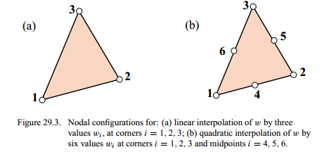
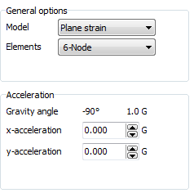
General Settings (cont…)

Slide 7
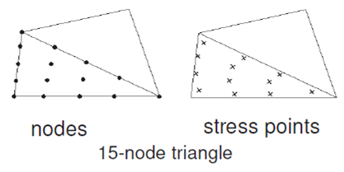
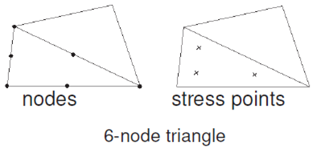
6 and 15 Node Elements
12 Gauss points
4th order interpolation
Most accurate in PLAXIS 2D
Better than four 6-noded triangle elements
3 Gauss points
2nd order interpolation
Care should be taken while using for Axisymmetric and Failure problems

Slide 8
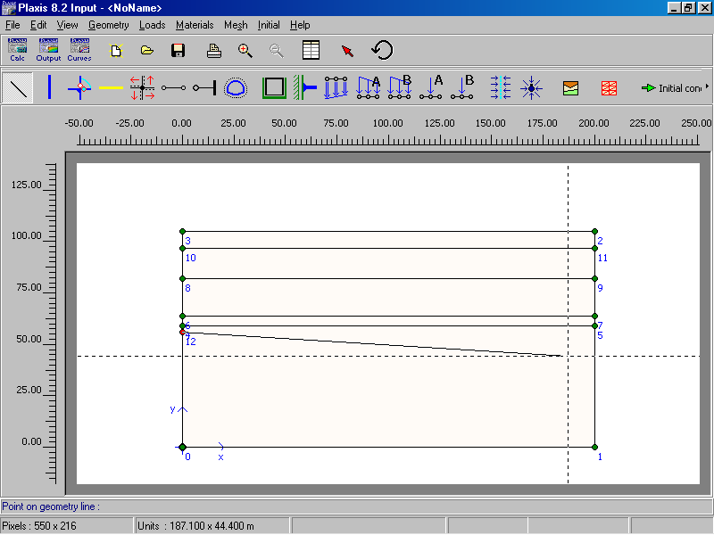
Setting up the geometry

Slide 9
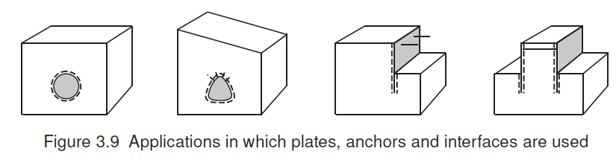
Plate Elements
Plates are structural Objects used to model slender structures in the ground with a significant flexural rigidity (or bending stiffness) and a normal stiffness.
Plates can be used to simulate influence of walls, plates, shells or linings extending in z-direction
3-node and 5-node plate element, with 4 and 16 stress points.

Slide 10
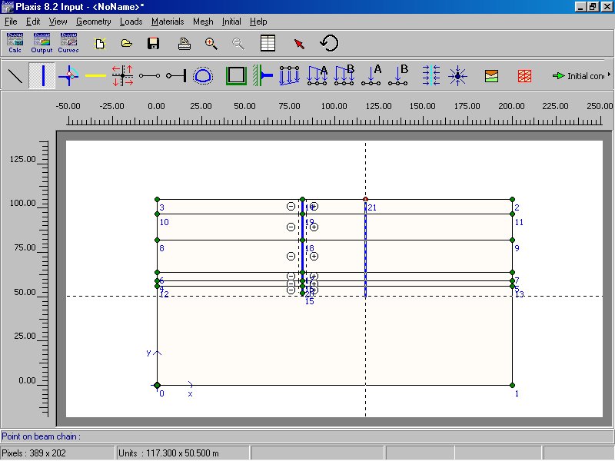
Modelling walls
Use plate elements AND interface elements

Slide 11
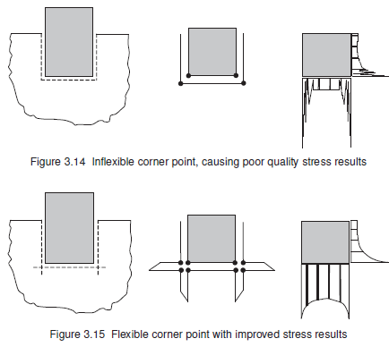
Interface Elements
Problems involving Soil-Structure Interaction

Slide 12
Interface Elements (cont…)
Properties of interface are associated with material data set.
Virtual thickness of interface element is 0.1, depends on the coarseness of the mesh.
Rigid and Strength reduction (Rinter) interfaces.
In a consolidation analysis or groundwater flow analysis, interface elements can be used to block the flow perpendicular to the interface as an impermeable screen.
Should not be used to create unrealistic strength loss in soil.

Slide 13
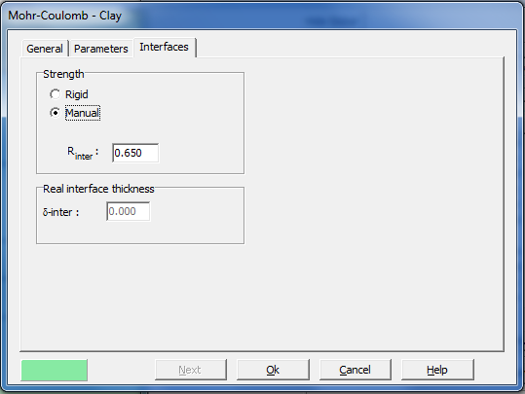
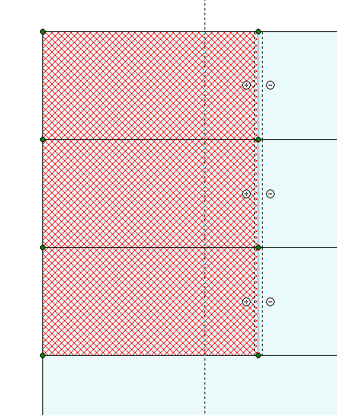
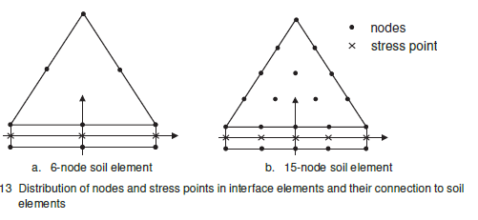
Interface Elements

Slide 14
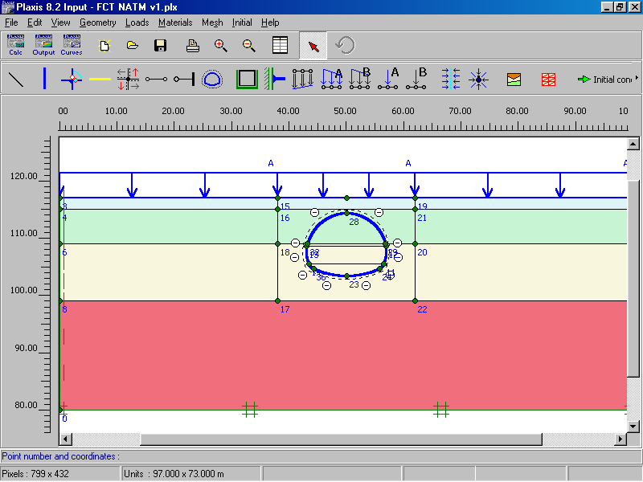
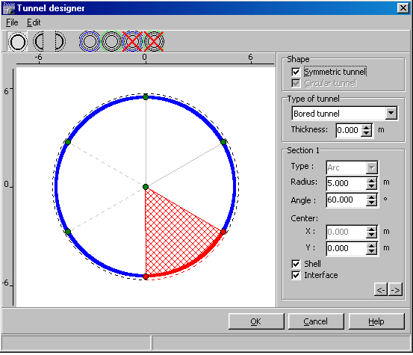
Modelling tunnels

Slide 15
Anchors
Node to Node: are sprints that are used to model ties between two points.
It’s not recommended to draw geometry line at position where node-to-node anchor is to be placed.
It’s a 2 node elastic spring element with normal stiffness (Spring constant)
Element can sustain both tensile forces (anchors) as well as compressive forces (struts).
Fixed-End anchors: Modelling of struts or props to sheet pile walls.

Slide 16
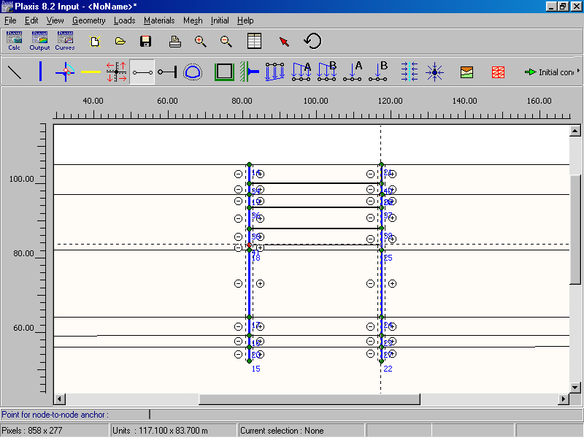
Modelling struts
Use node to node anchors OR fixed end anchors

Slide 17
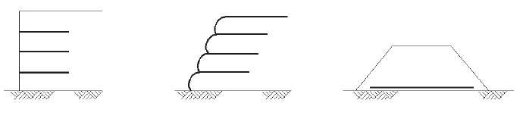
Geogrids
Geogrids are slender structures with a normal stiffness but no bending stifness.
Geogrids can only sustain *Tensile forces* and no compression!
Structures involving geotextiles.

Slide 18
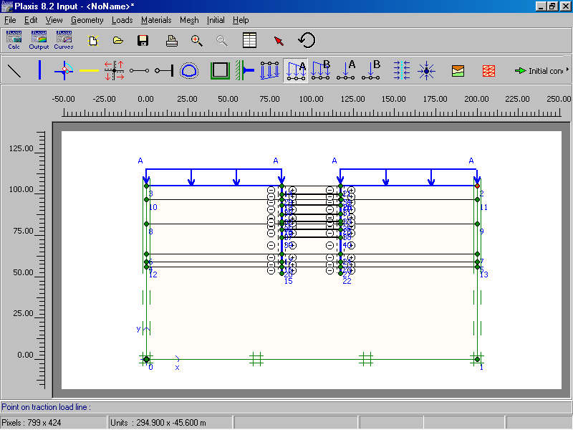
Defining load & boundary conditions
Standard and
rotation fixities
Prescribed displacements, distributed loads & point loads

Slide 19
Other modelling capabilities
Hinges and rotation springs
Geogrids
Drains
Wells
Drains – lines that set pore pressures to zero
Wells – points where a specific discharge is subtracted from or added to the soil

Slide 20
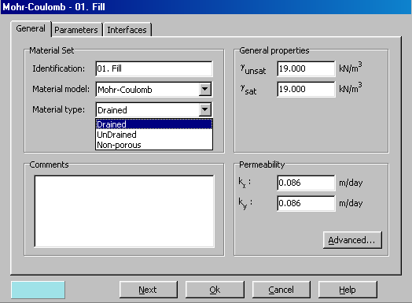
Defining material properties - soil

Slide 21
Material models
1. Linear elastic – primarily used for stiff structures
2. Mohr-coulomb – very simple and popular model with 5 parameters: E, ν, c, ϕ and ψ
3. Soft-soil – a Cam Clay model for NC clays and peat
4. Hardening soil – an advanced elastoplastic hyperbolic model
5. Soft soil creep – similar to the soft-soil model, but can consider secondary compression
6. Jointed-rock – used for stratified or jointed rock.
7. User-defined– it is possible to use your own model.

Slide 22
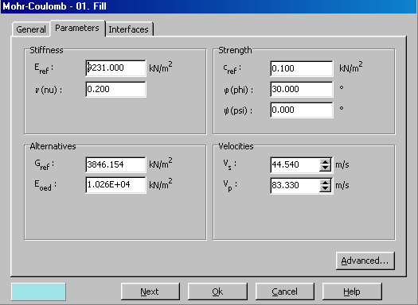
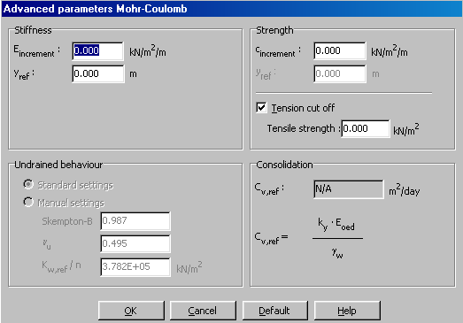
The Mohr Coulomb model
Stiffness & strength parameters
Variation of stiffness and strength with depth

Slide 23
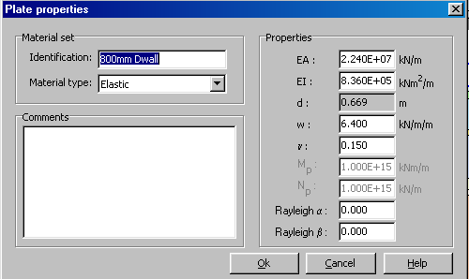
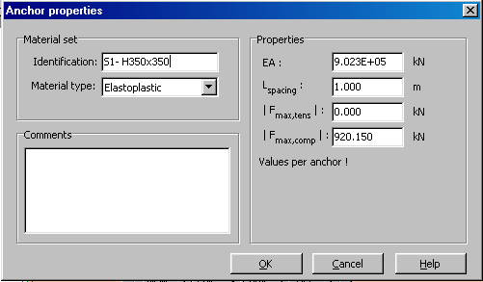
Defining material properties – plates and anchors
Plates
Anchors

Slide 24
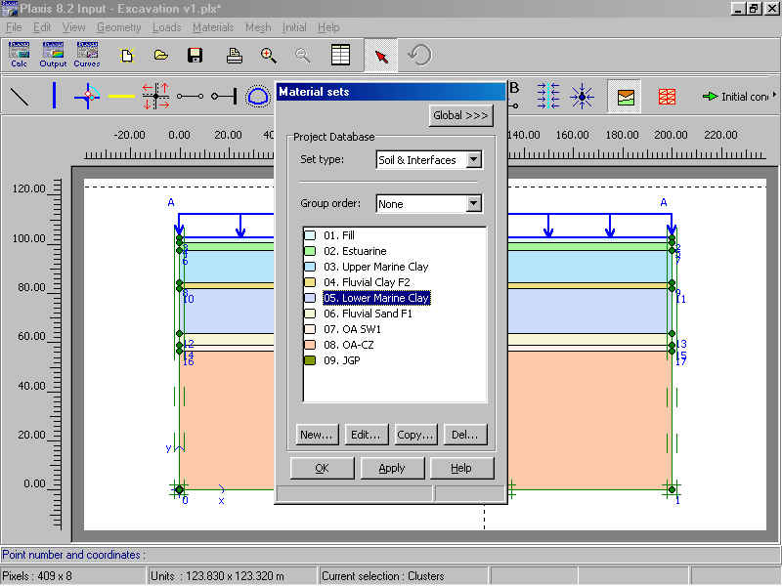
Assigning materials

Slide 25

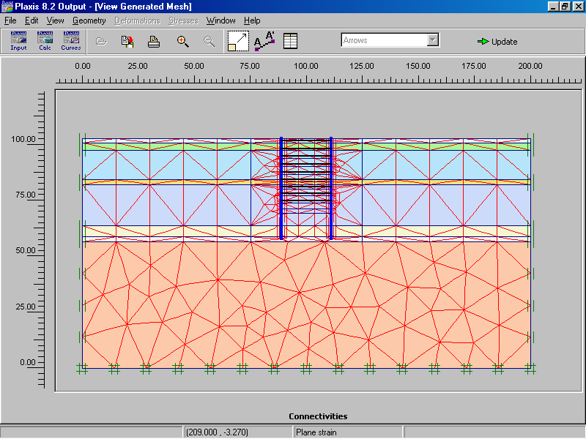
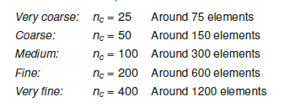
Generating the mesh
Specify global coarseness and local refinement: Element size:
Local element size is 1.0 at all geometries and to reduce the element size by half set the local size factor to 0.5. Values between 0.05 to 5.0 is acceptable for local refinement

Slide 26
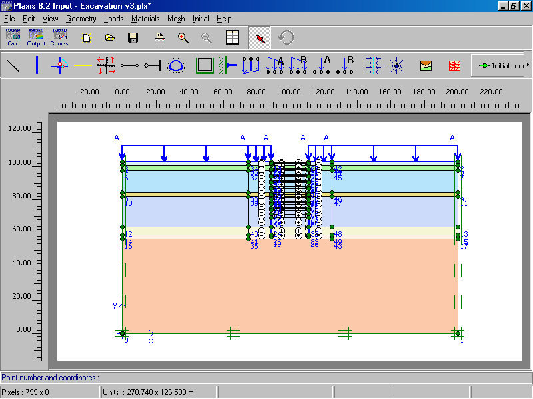
Defining initial conditions

Slide 27
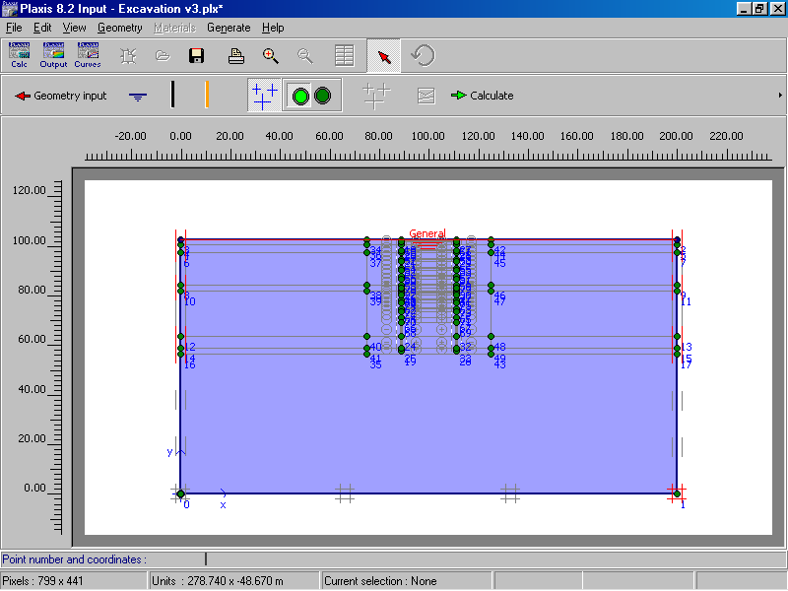
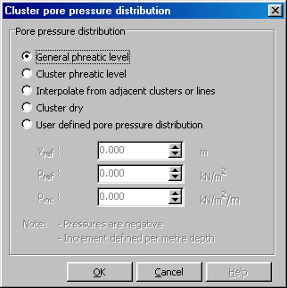
Defining initial pore pressures

Slide 28
Defining initial pore pressures
Can specify closed flow and/or closed consolidation boundaries if necessary

Slide 29
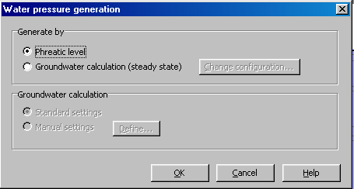
Calculating pore pressures

Slide 30
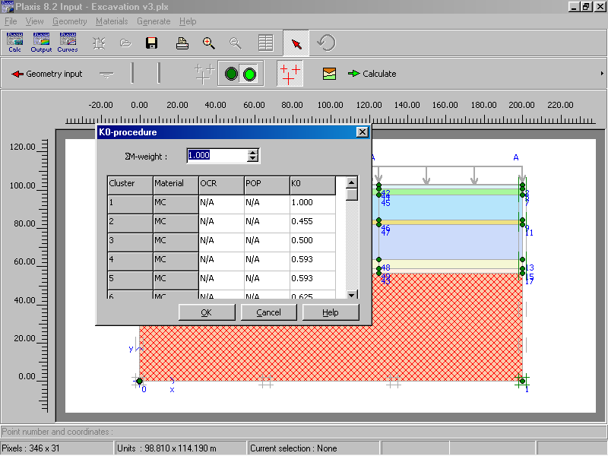
Generate initial soil stresses
Note: default K₀ value is 1 - sin φ in Plaxis
Can also use gravity loading method

Slide 31
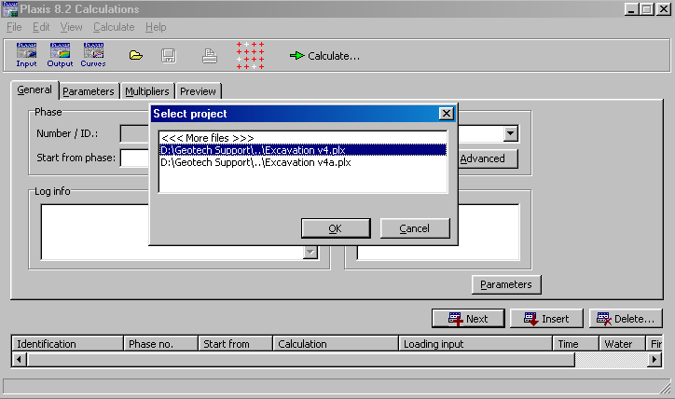
PLAXIS CALCULATIONS

Slide 32
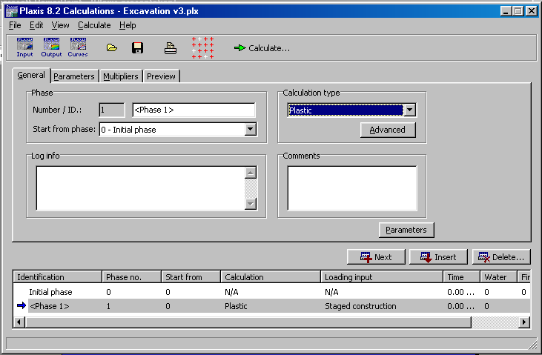
Type of Calculations
Plastic calculations
Consolidation analysis
Phi-c reduction

Slide 33
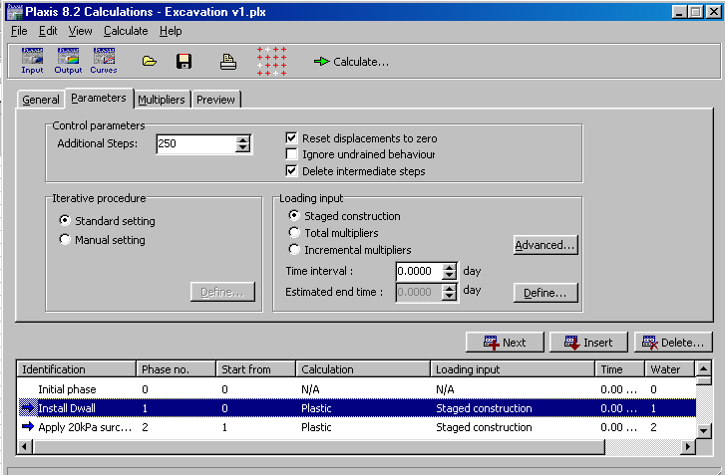
Defining construction stages
Define modelling phase, Insert next phase

Slide 34
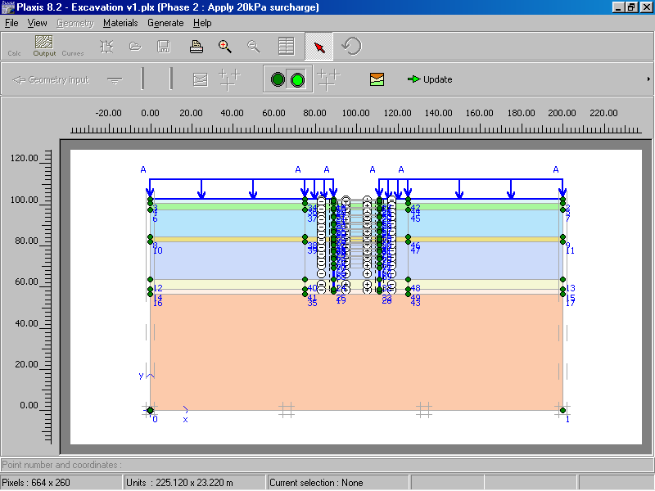
Activating elements for calculation
Default: all soil layers activated
Click on a cluster or item to activate (or deactivate) it
Double click on a cluster or item to change its properties

Slide 35
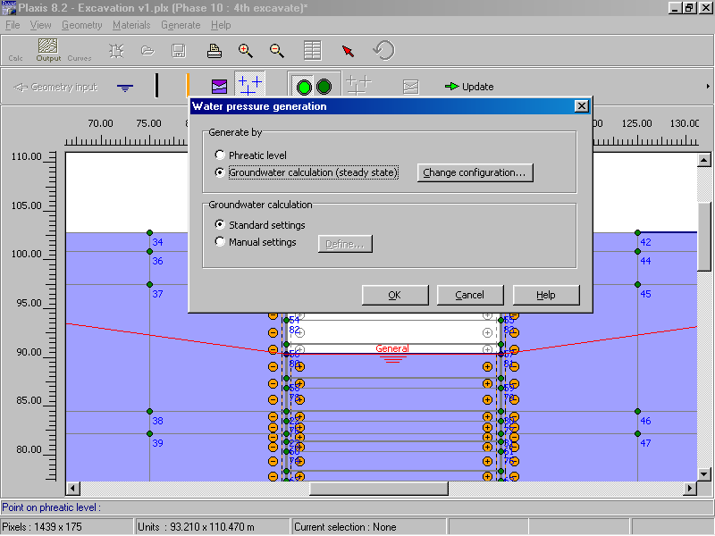
Changing groundwater conditions
To de-water, redefine water conditions

Slide 36
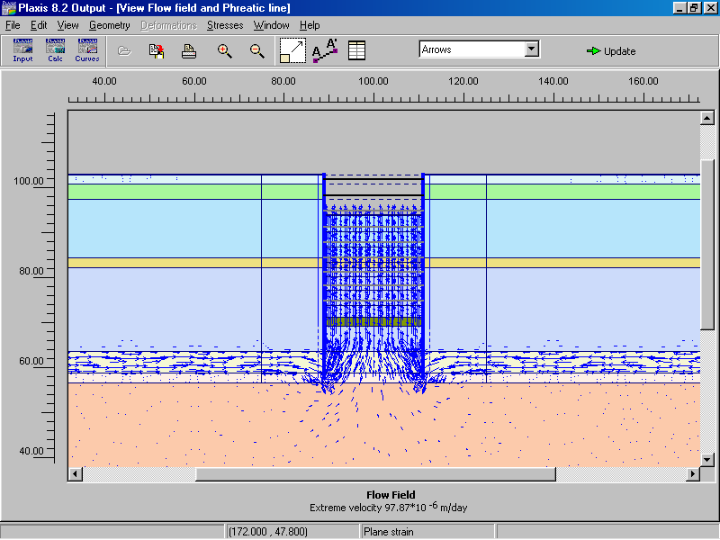
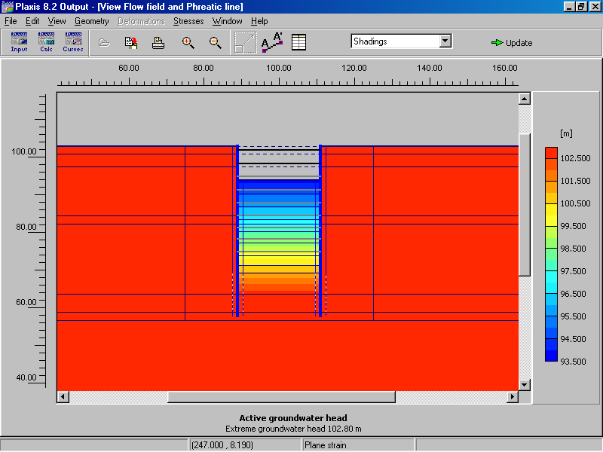
Groundwater calculations
Flow field arrows
Active groundwater level contours

Slide 37
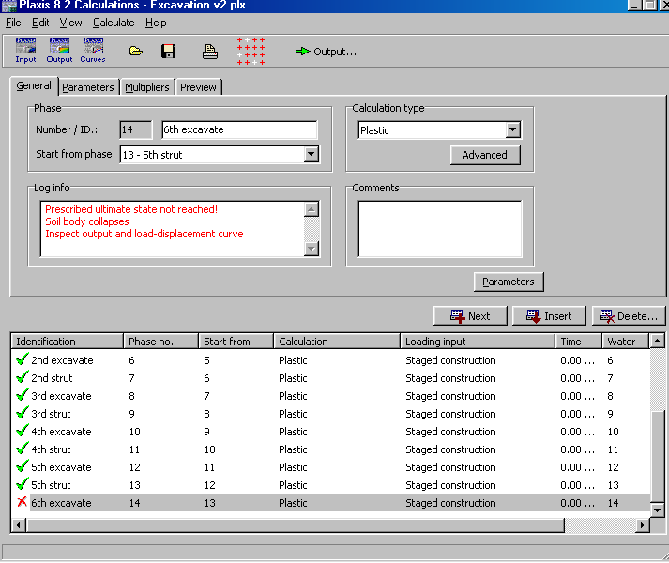
Selecting calculation phase
Arrow -- Check -- Cross

Slide 38
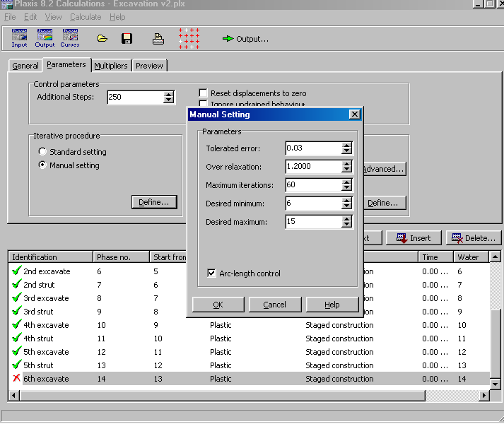
Achieving convergence

Slide 39
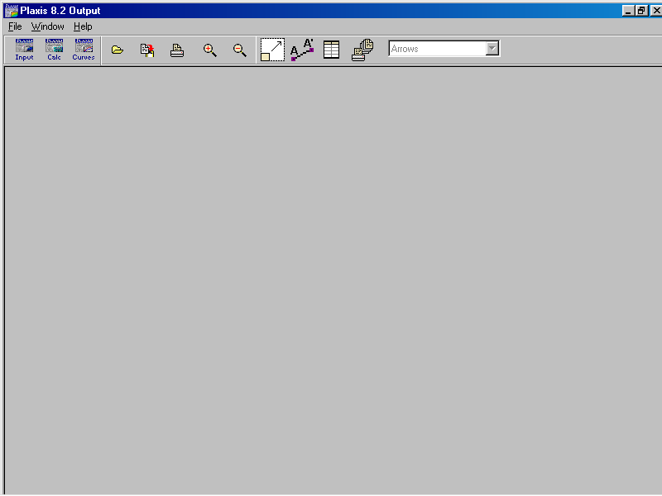
PLAXIS OUTPUT

Slide 40
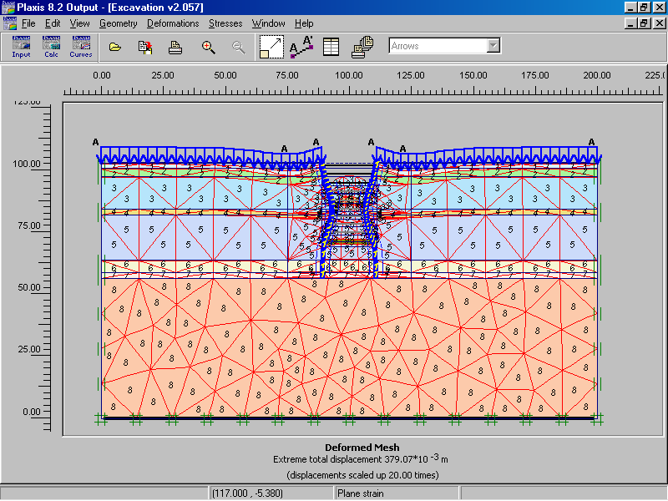
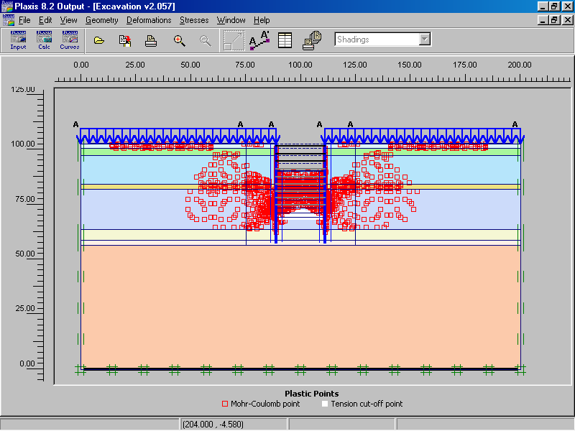
Deformed mesh & plastic points
Deformed mesh
Red - Yielded Points
White - Tension cut-off

Slide 41
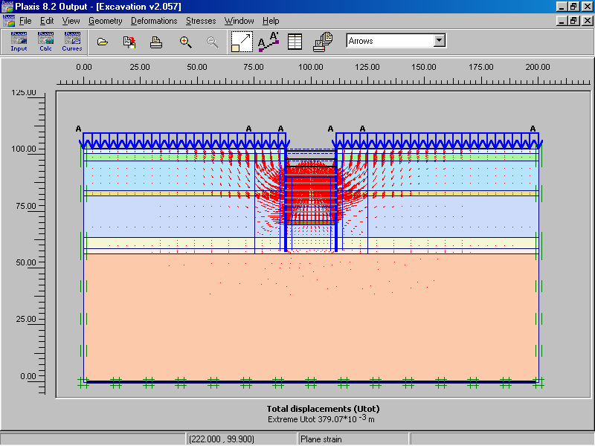
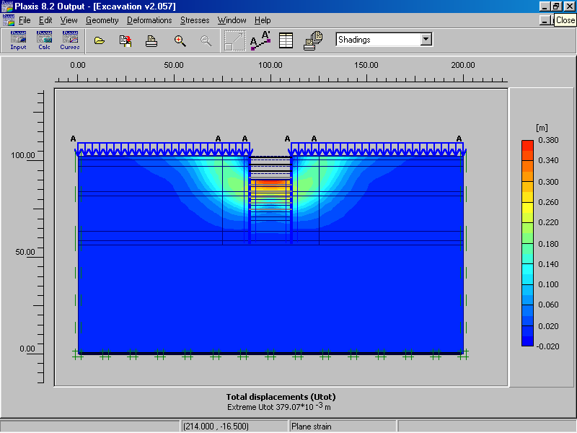
Soil Displacement Plots
Arrows
Contours

Slide 42
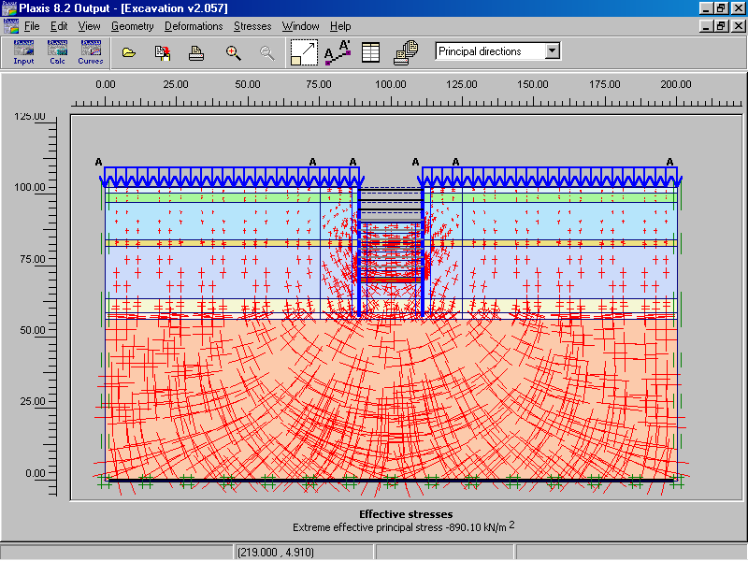
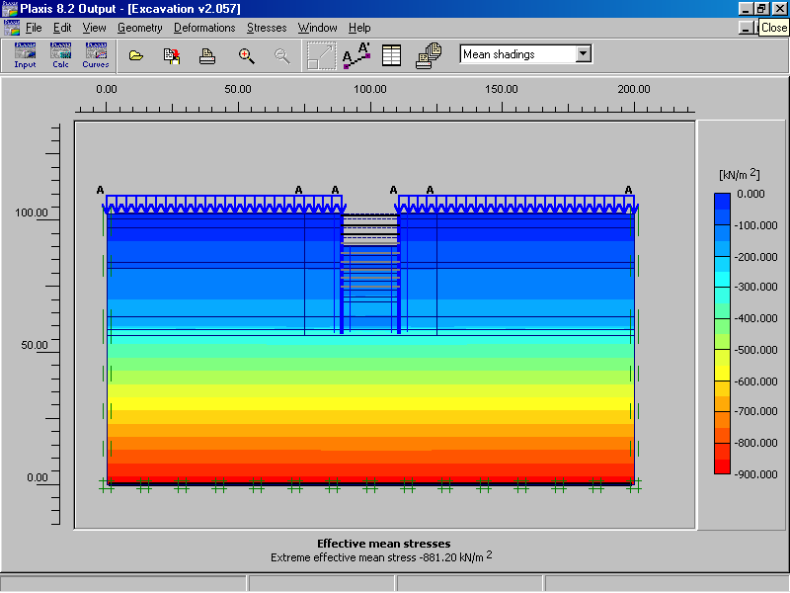
Soil Stress Plots
Principal directions
Contours

Slide 43


Pore Water Pressures
Active pore Pressures
Excess pore pressures

Slide 44

Strut loads

Slide 45

Plate element plots

Slide 46


Plate element plots
Total displacements
Bending moments

Slide 47
Interface element plots

Slide 48


Interface element plots
Active pore Pressures
Excess pore pressures

Slide 49

PLAXIS CURVES

Slide 50

Selecting Nodes & Stress Points
Select nodes to compute phi/C factor of safety
Select stress points for stress paths & stress-strain curves

Slide 51

Plaxis Curves - Stress-Strain plots

Slide 52

Plaxis Curves - Stress Path plots

Slide 53

Homework #2–FE Modelling of a Tie-Back
Excavation in Clay

Slide 54
Total Stress Approach
Stiffness is modelled using an undrained Young’s modulus Eu and Poisson ratio.
Pore pressures are not generated
Undrained shear strength Su is an input parameter.
Consolidation analysis has no effect and should not be performed.
C_{u} (S_{u}) and undrained friction ϕ_{u}=0
Drained simulation, with Poisson ratio of 0.495 (0.5 can’t be used as it results in singularity).

Slide 55
Effective Stress Approach or
Undrained (A)
Effective stiffness and effective strength parameters are used.
Pore pressures are generated, but may be inaccurate, depending on model.
Undrained shear strength is not an input parameter but an outcome of the constitutive model . The resulting shear strength must be checked against known data.
Consolidation analysis can be performed after the undrained calculation, which affect the shear strength

Slide 56
Equivalent Effective Stress or
Undrained (B)
Effective stiffness parameters and undrained strength parameters are used.
Pore pressures are generated, but may be highly inaccurate.
Undrained shear strength S_{u} is an input parameter.
Consolidation analysis should not be performed after undrained calculation. Su must be updated, if consolidation is performed anyway.

Slide 57
Methods of undrained analysis for Mohr-Coulomb clay
Methods of Undrained Analysis | Material Type | Deformation Parameters | Strength Parameters | Initial Conditions
Total Stress | Non-porous/ Drained | E_{u}, ν_{u} | c_{u}, ϕ_{u}=0 | K_{0,u}
Effective Stress (triaxial parameters) | Undrained | E’, ν’ | c', ϕ’ | K₀
Effective stress (strength profile) | Undrained | E’, ν’ | c’, ϕ’ | K₀

Slide 58
Hints
Total Stress Method
  Use v_{u}= 0.495 because 0.5 won’t compute
  K_{0,u} may not be uniform throughout the clay
  There should be no water in the clay
Effective Stress Methods
  Use Mohr’s circles to determine s_{u} from c’ and ϕ’ and vice versa
  Remember to dewater the excavation
General:
  Assume no dilation (i.e. ψ=0)
  Excavate in stages
  Design the mesh carefully

Slide 59
Total Stress Approach
Use V = 0.495
K₀ Varies with depth
ϕ’=0
Depth | σ_{v} | u | σ_{v}' | k₀σ_{v}'=σ_{h}' | σ_{h} | K₀ | K₀ Layer
0 | 82.5 | 0 | 82.5 | 49.5 | 49.5 | 0.6
6.5 | 202.75 | 65 | 137.75 | 82.65 | 147.65 | 0.728 | 0.664
11.5 | 295.25 | 115 | 180.25 | 108.15 | 223.15 | 0.756 | 0.742
16.5 | 387.75 | 165 | 222.75 | 133.65 | 298.65 | 0.77 | 0.763

Slide 60

Undrained analysis using Effective stress method
Effective stress A
Define strength c’-φ’ in terms of the real effective stress parameters, assuming zero dilation
v’= 0.2
E and Ko should be ‘effective stress’ based
τ
Mohr-Coulomb failure criteria
τ = c’ + σ’tanφ’
c’
Su
(1+Ko)/2 * σ_{v}’
σ’
φ’
S_{u} = c' cosφ + (1+K_{o}) sinφ' / 2 * σ_{vo}'
Thus when z = 0, Su = c’

Slide 61
Undrained analysis using Effective stress method
Effective stress B
Define strength c’-φ’ in terms of the “equivalent” effective stress parameters, with zero dilation
v’= 0.2
E and Ko should be ‘effective stress’ based
τ
c’
S_{u2}
S_{u1}
φ’
(1+Ko)/2*σ_{v1}’
(1+Ko)/2*σ_{v2}’
σ’

Slide 62
Simulations are believed by no one except those who conducted them.
Experimental results are believed by everyone except those who conducted them.
Thank You!

