Slide 1


AI IN GEOTECHNICAL ENGINEERING – MODULE 5
Temporal Predictions with NN
RNN and LSTM
Krishna Kumar, PhD
J. Neils Thompson Centennial Teaching Fellow
Associate Professor
Department of Civil, Architectural, and Environmental Eng.
Oden Institute of Computational Engineering and Sciences
The University of Texas at Austin

Slide 2
Learning Objectives
Understand the need for temporal predictions
Why MLPs can’t work for temporal predictions (need for history)
Implement RNN/LSTM models for geotechnical time-series prediction (settlement, pore pressure, displacement)

Slide 3
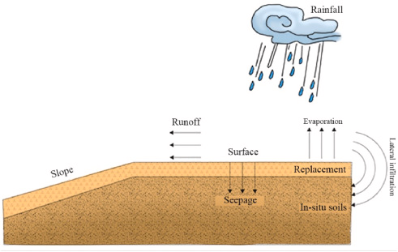
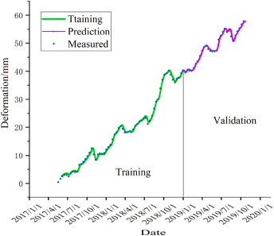
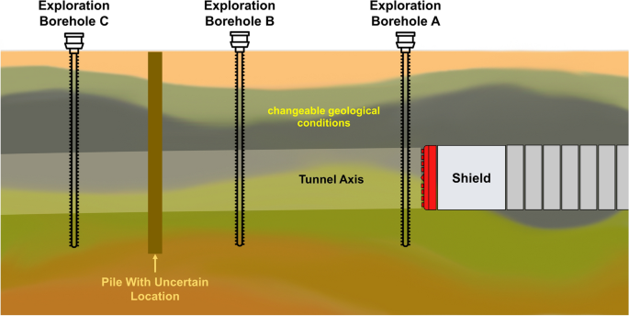
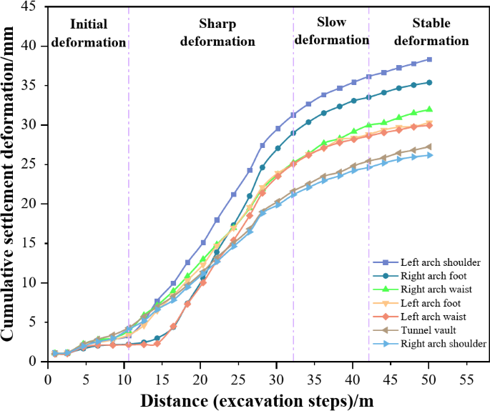
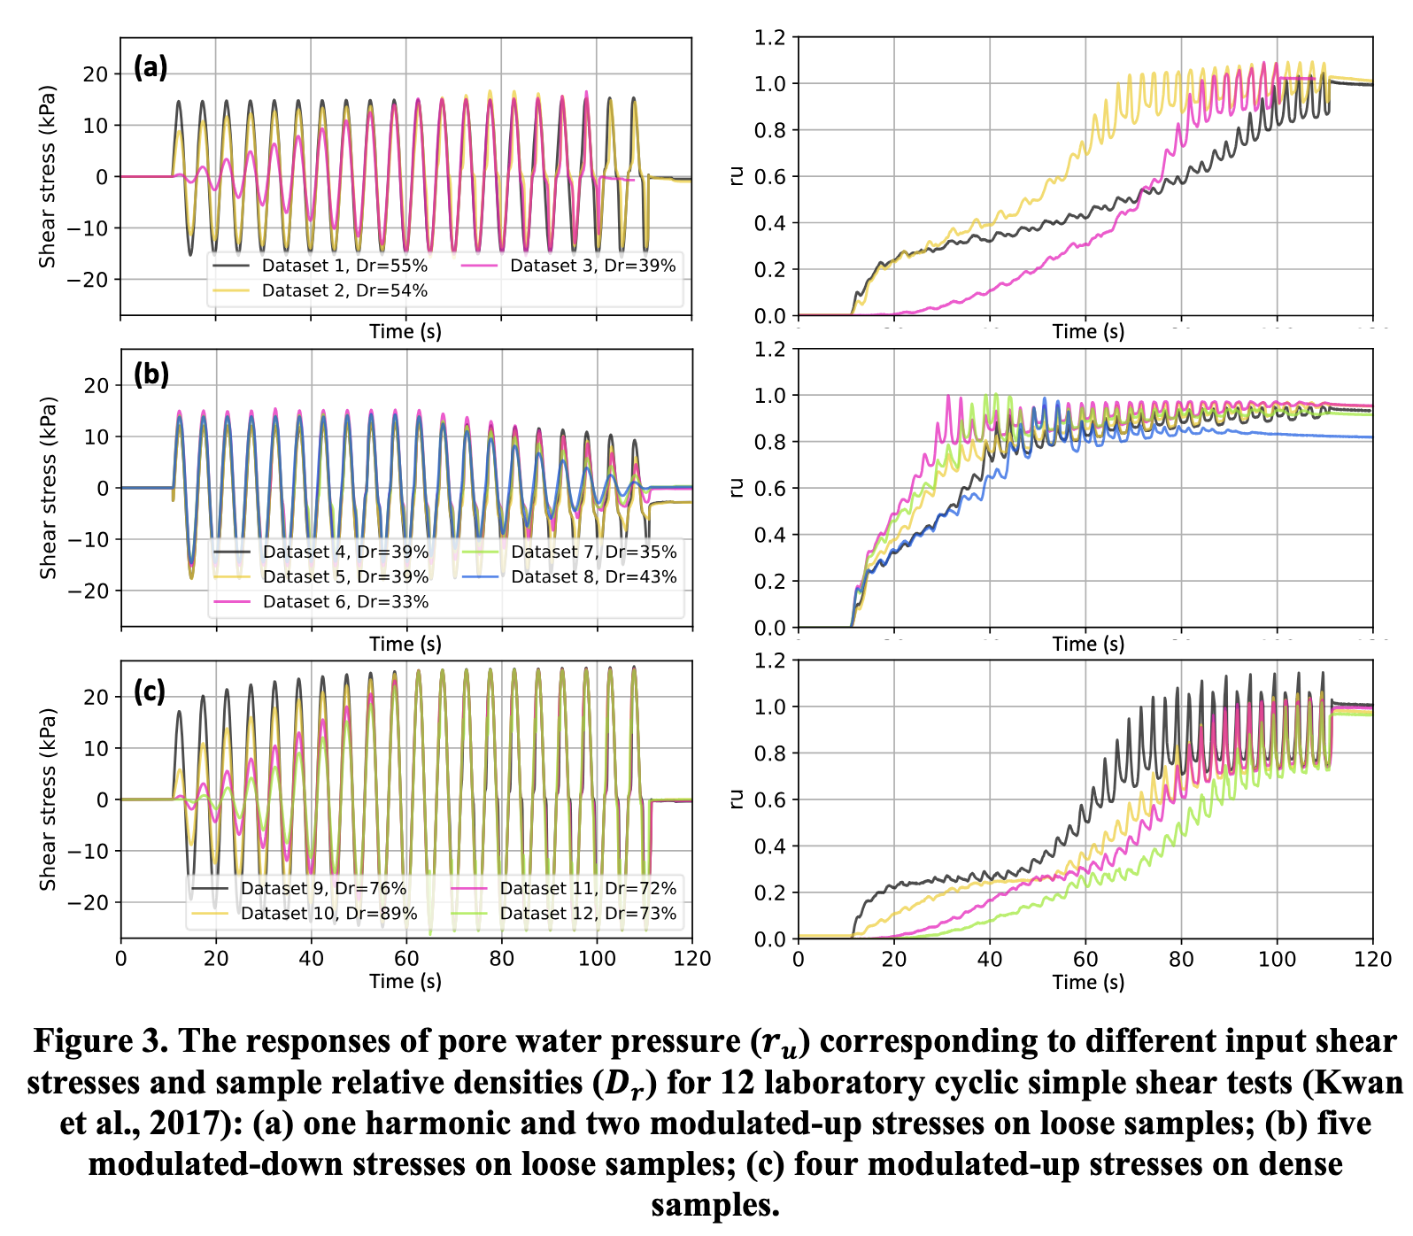
Temporal Predictions
https://www.nature.com/articles/
s41598-024-79059-x
https://doi.org/10.1016/j.heliyon.2024.e26301
https://doi.org/10.1061/9780784484692.021

Slide 4
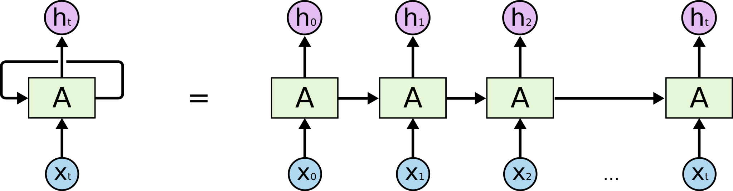
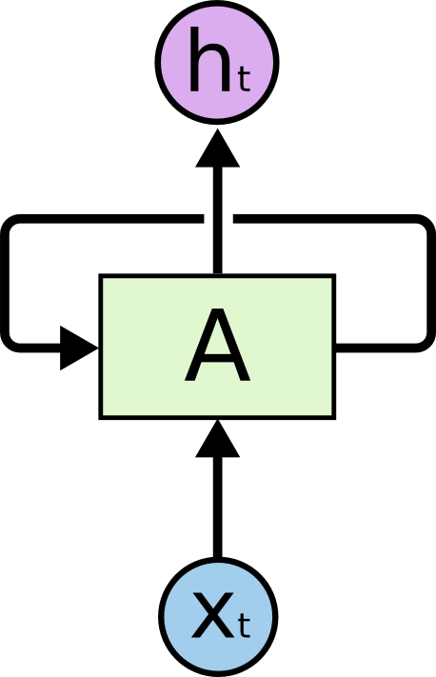
Remembering the past…Recurrent Networks
Recurrent Neural Networks
https://colah.github.io/posts/2015-08-Understanding-LSTMs/

Slide 5
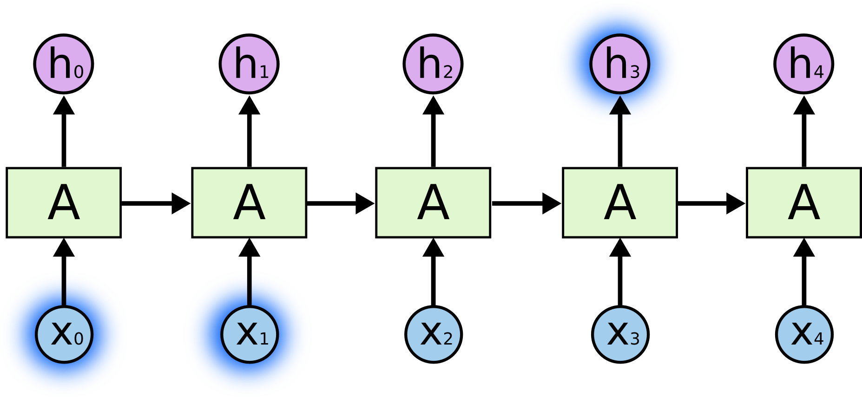
Predicting based on the past…
the clouds are in the
sky

Slide 6
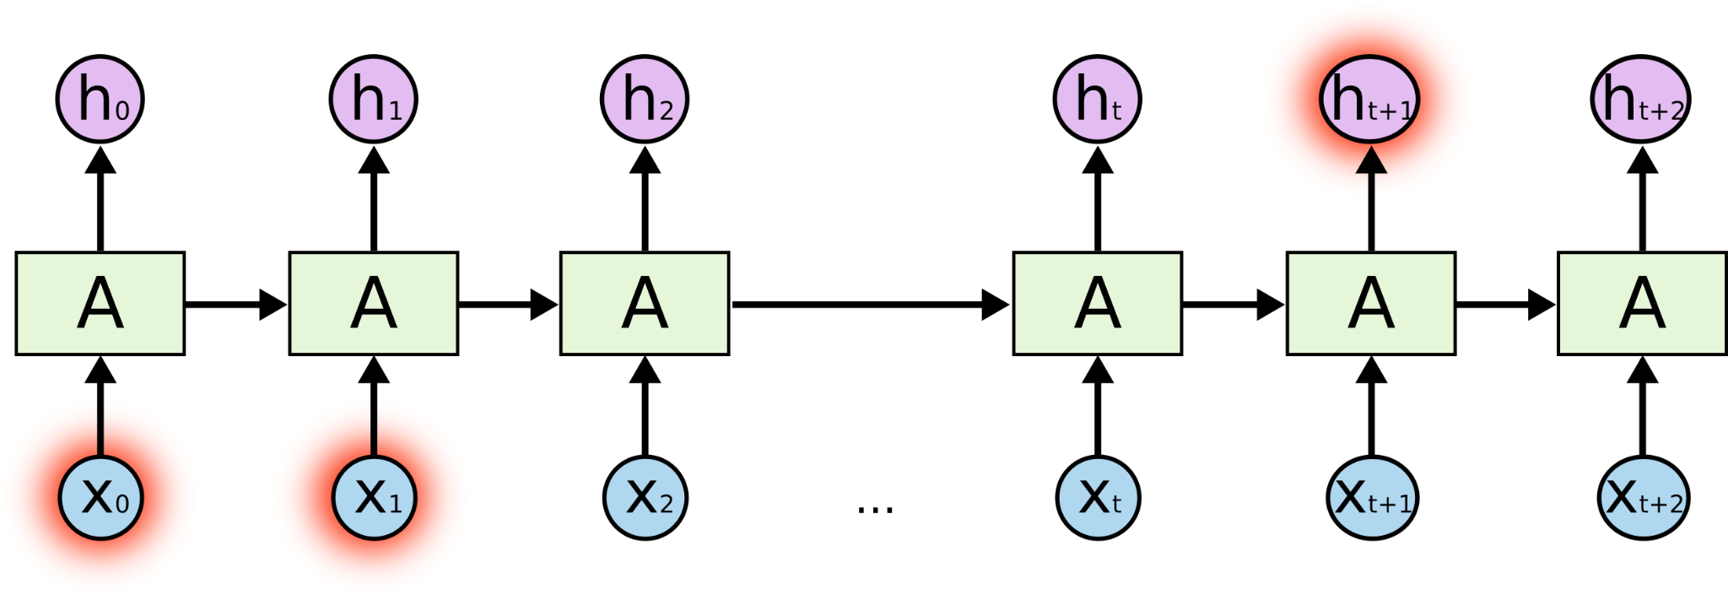
The problem of long dependencies
I grew up in France… Although I live in the US, now, I speak fluent
French

Slide 7
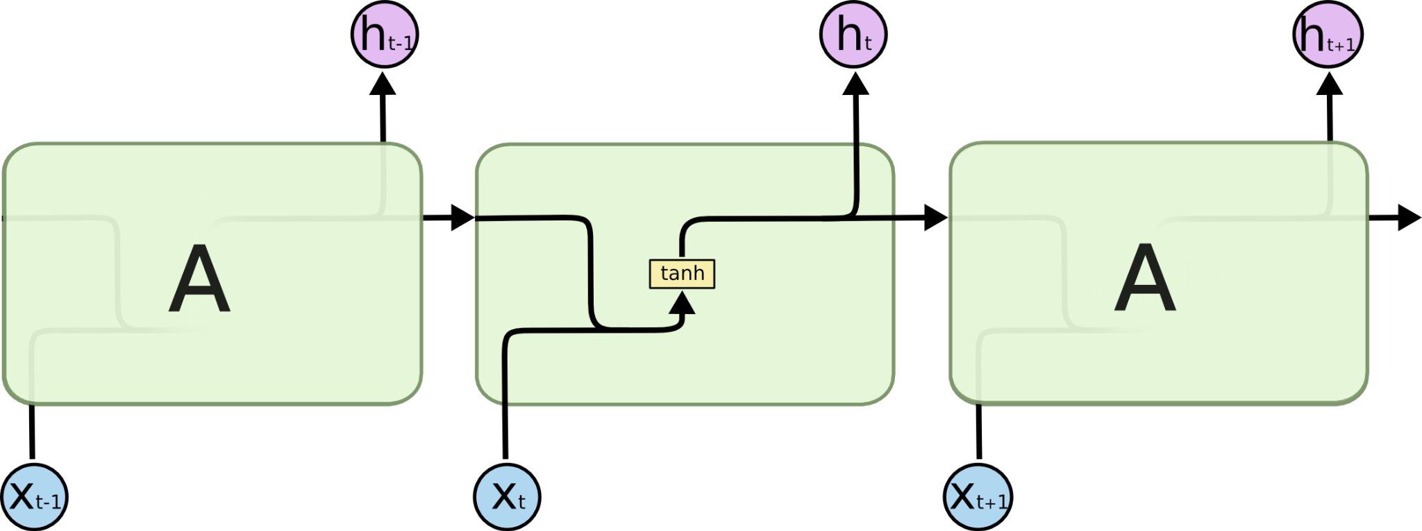
Long Short Term Memory (LSTM)

Slide 8
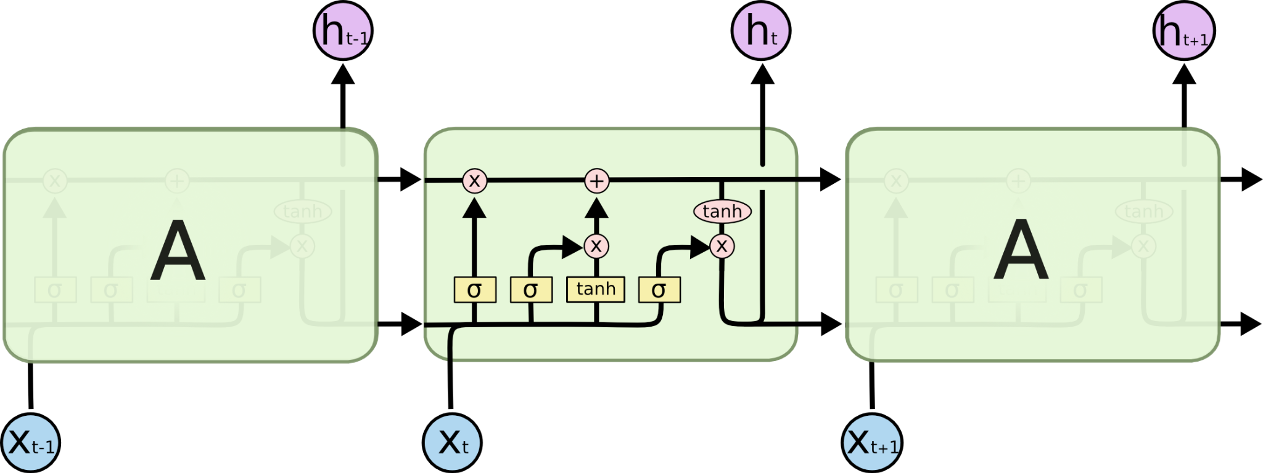
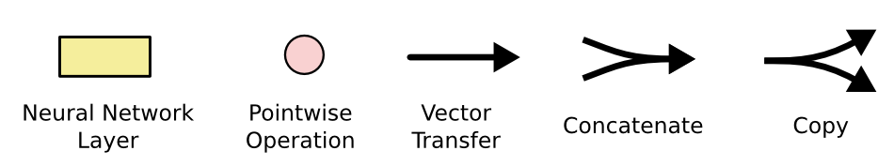
LSTM components

Slide 9
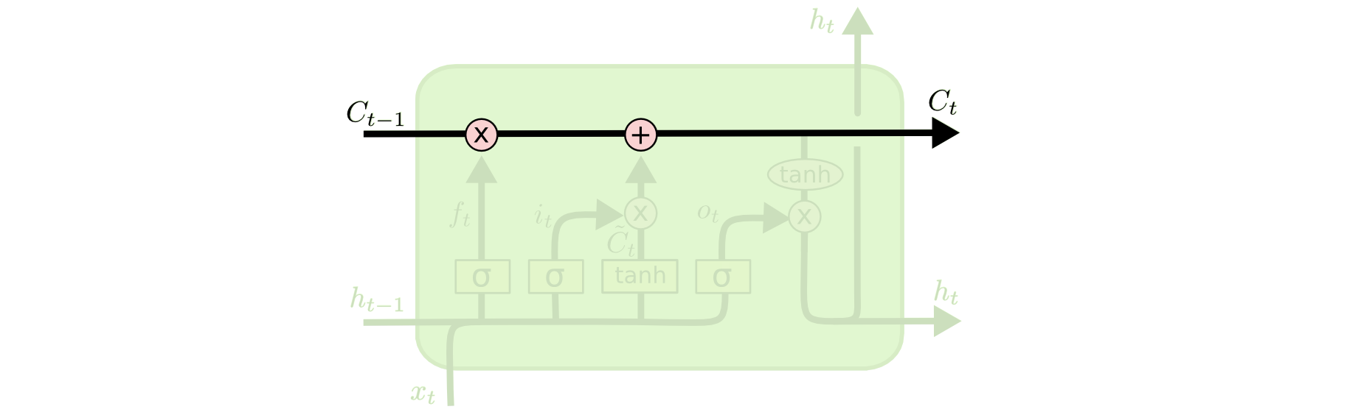
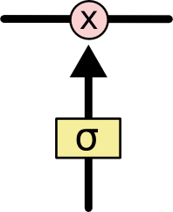
Core Idea: LSTM – Cell State
The cell state is kind of like a conveyor belt. Runs straight down the entire chain, with only some minor linear interactions. LSTM does have the ability to remove or add information to the cell state, carefully regulated by structures called gates
Gates are a way to optionally let information through. They are composed out of a sigmoid neural net layer and a pointwise multiplication operation.
Notes:
Sigmoid layer outputs numbers between zero and one, describing how much of each component should be let through. A value of zero means “let nothing through,” while a value of one means “let everything through!”

Slide 10
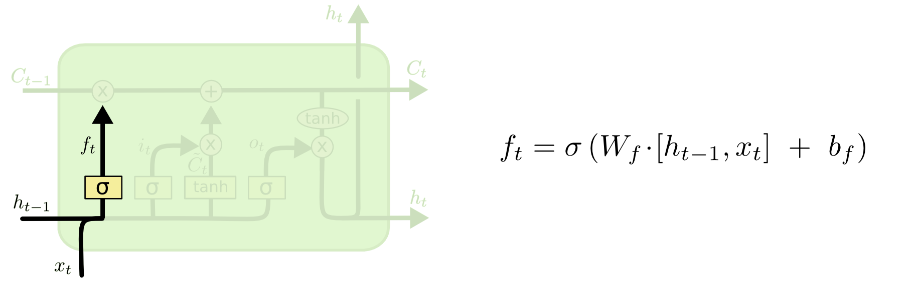
LSTM – Step-by-Step (Forget Gate)
what information we’re going to throw away from the cell state

Slide 11
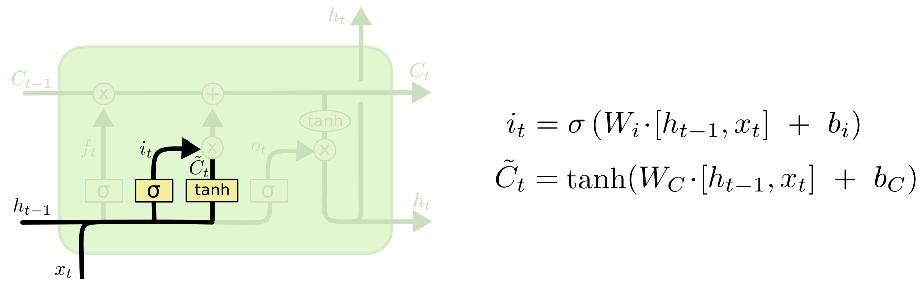
LSTM – Step-by-Step (Input Gate)
what new information we’re going to store in the cell state… a sigmoid layer called the “input gate layer” decides which values we’ll update. Next, a tanh layer creates a vector of new candidate values, that could be added to the state

Slide 12
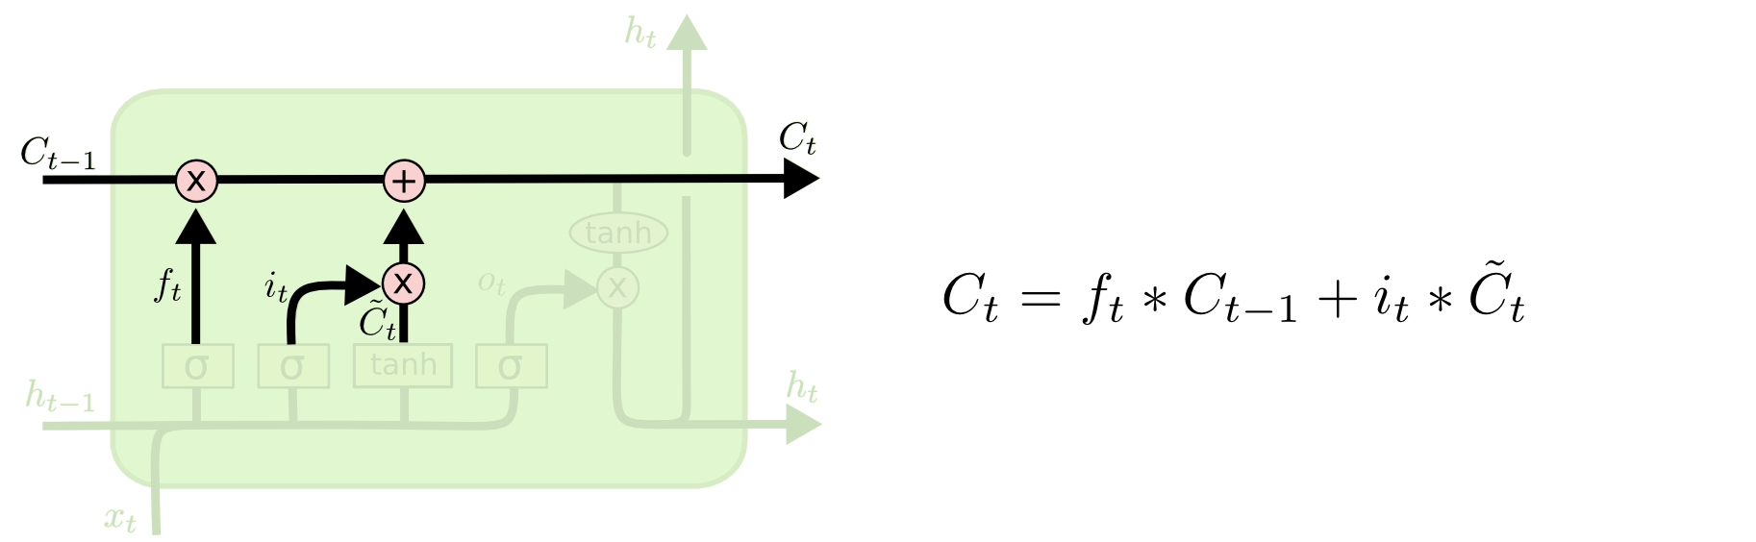
LSTM – Step-by-Step (Update Old Cell State)
Update old cell state C_{t} to C_{t+1}

Slide 13
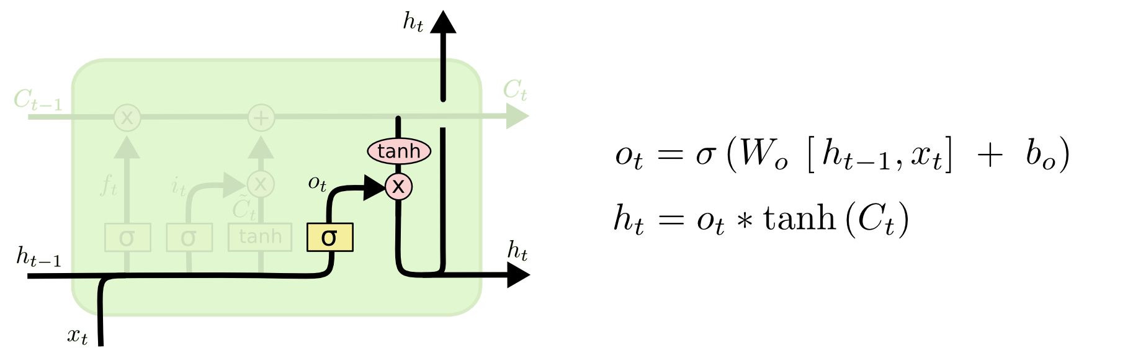
LSTM – Step-by-Step (Output)
what we’re going to output. This output will be based on our cell state, but will be a filtered version

Slide 14
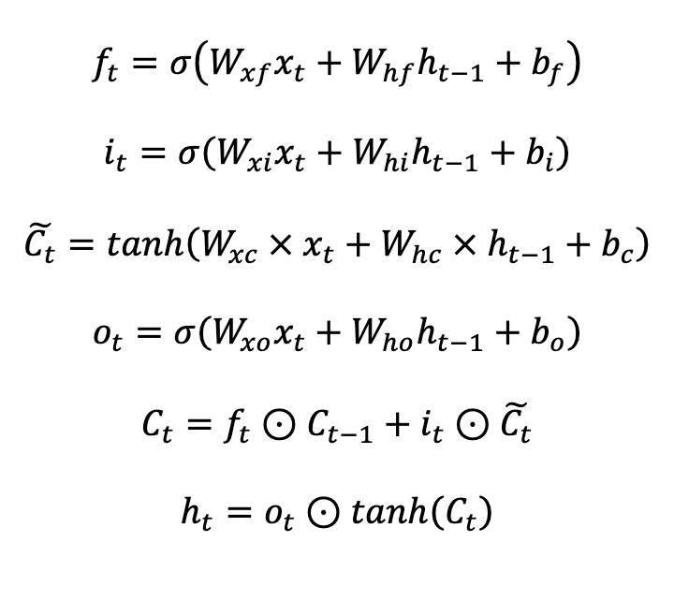
LSTM Network

Slide 15
LSTM Prediction of Liquefaction
Choi and Kumar (2022)
https://arxiv.org/pdf/2206.07780

Slide 16
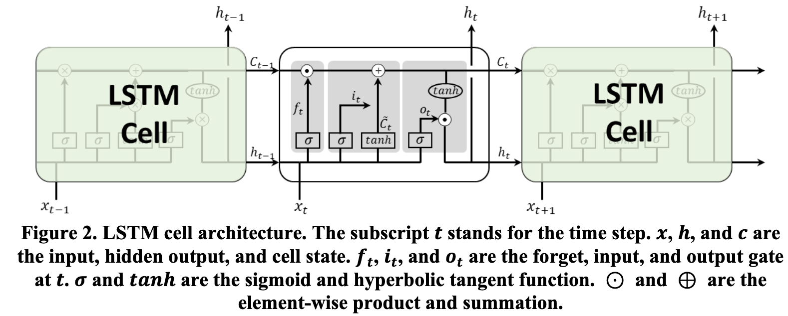
LSTM Cell

Slide 17
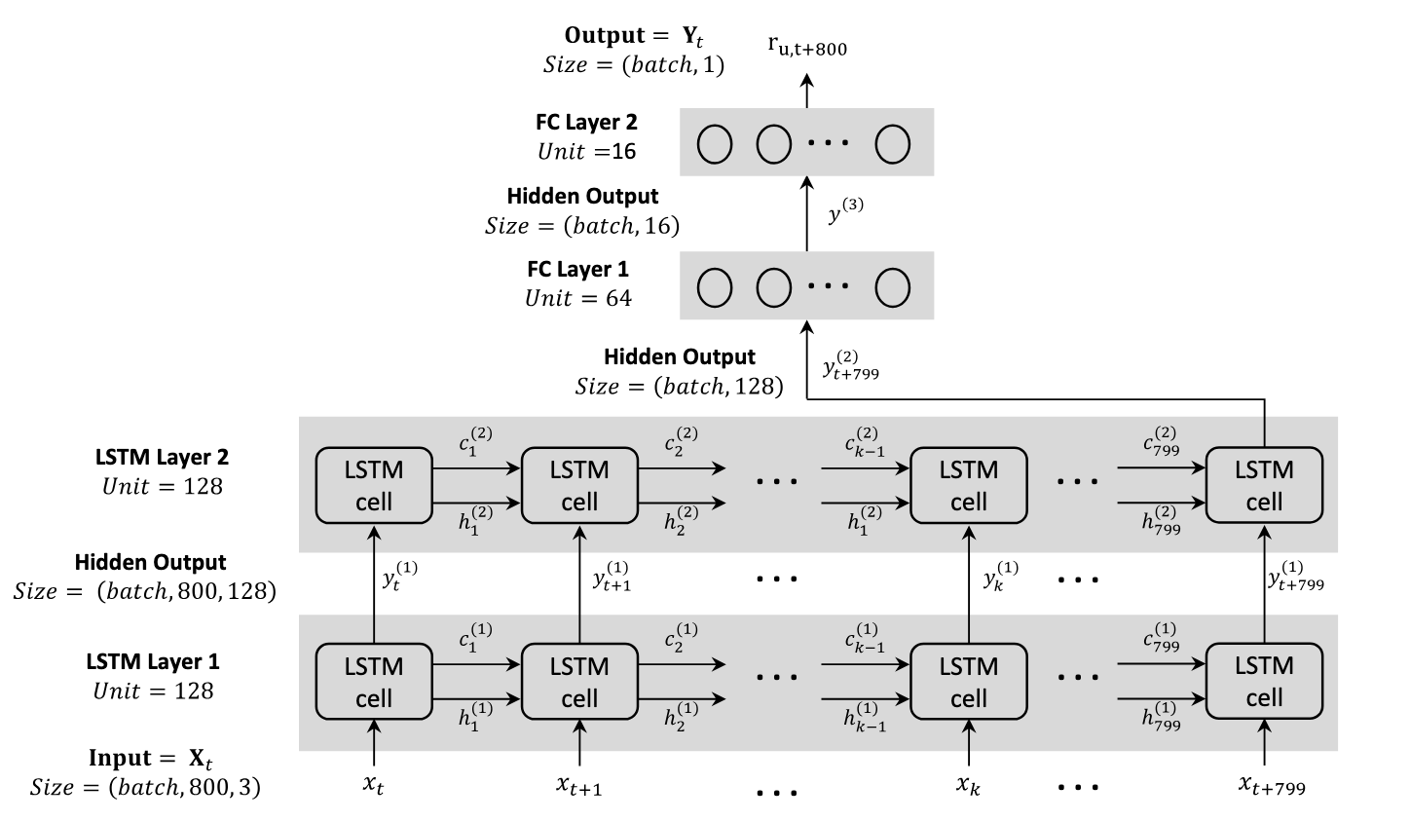
LSTM Network

Slide 18
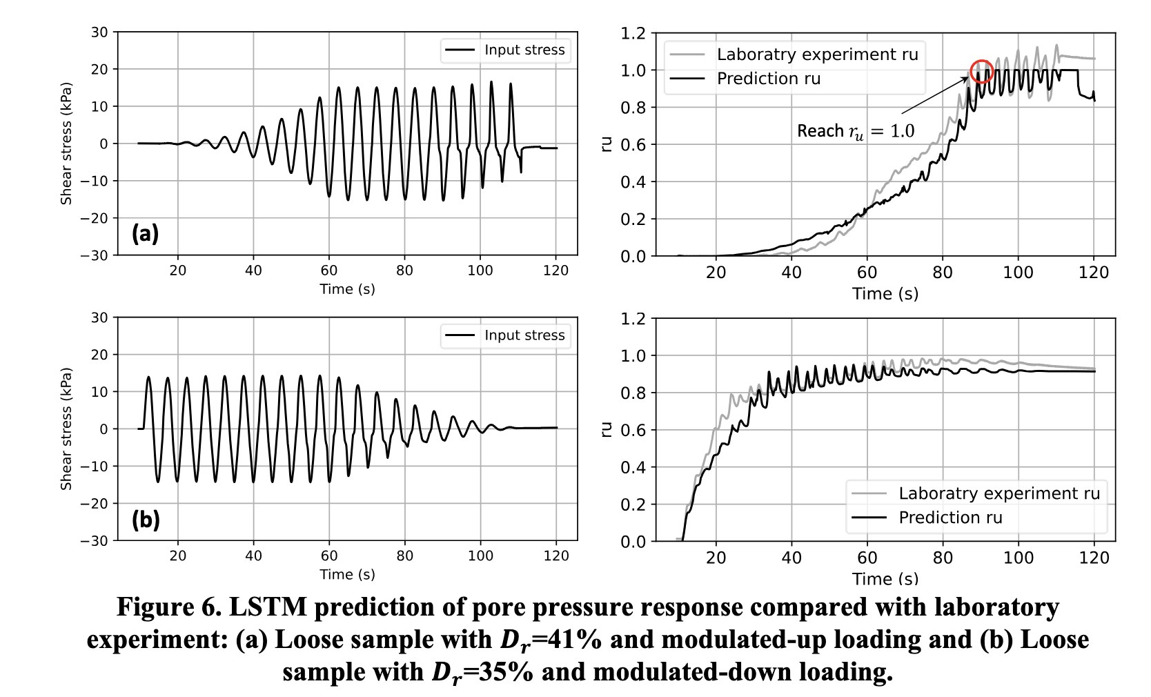
LSTM Network predictions

