Slide 1


AI IN GEOTECHNICAL ENGINEERING – MODULE 6
Convolutional Neural Networks
PROF. KRISHNA KUMAR, PHD
J. Neils Thompson Centennial Teaching Fellow
Department of Civil, Architectural, and Environmental Eng.
The University of Texas at Austin

Slide 2
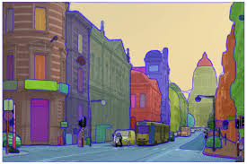
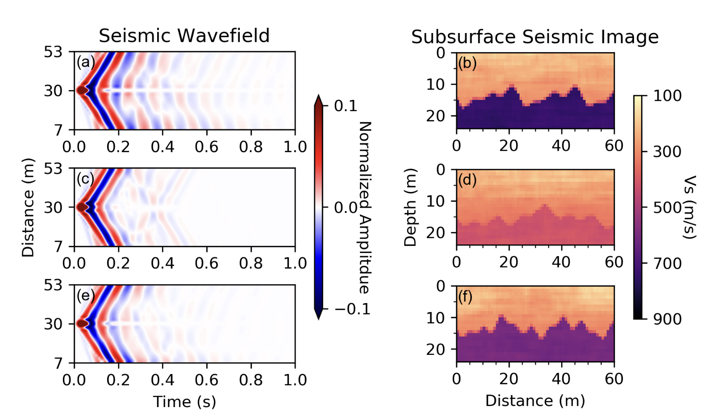
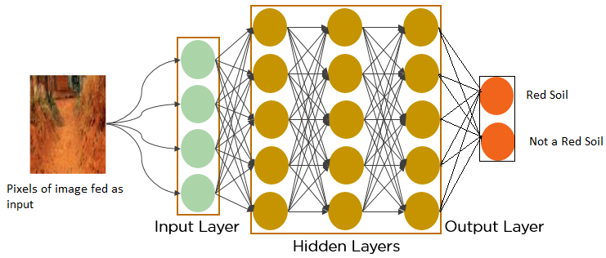
Learning Objectives
What is a Convolutional Neural Networks (Image-based data)
CNN Architecture
Uses of CNN:
  Image classification (Soil Classification/Crack detection)
  Image segmentation (Mapping cracks/Soil layer separation)
  Image generation (Generate soil profile based on measurements)

Slide 3
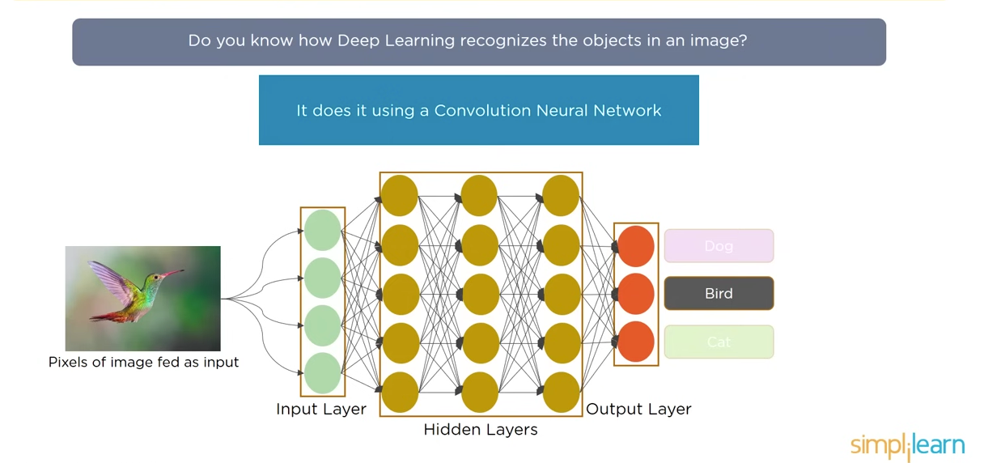
Why do we need CNN?
Multi- Layer Perceptron

Slide 4
Why do we need CNN? (MLP Failure)
Dog
Bird
Multi- Layer Perceptron

Slide 5
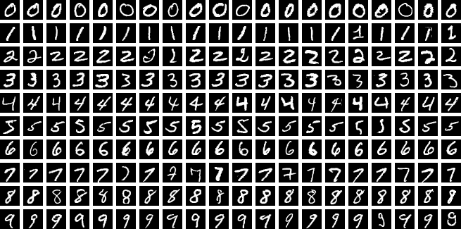
MNIST dataset

Slide 6
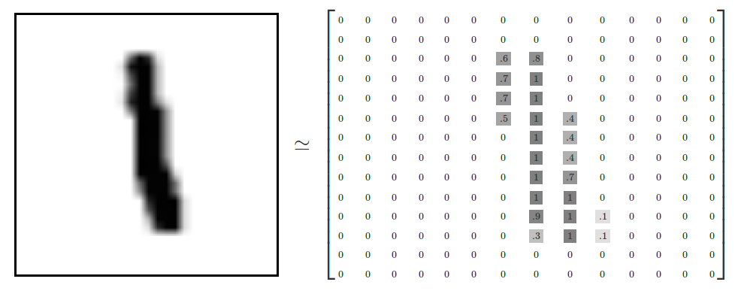
Encoding Images using MLP
this pixel gets weight 0.6
this pixel gets weight 0.1
this pixel gets weight 0.9

Slide 7
Is this still a 1? with the shift?
this pixel gets weight 0.6
this pixel gets weight 0.1
this pixel gets weight 0.9

Slide 8
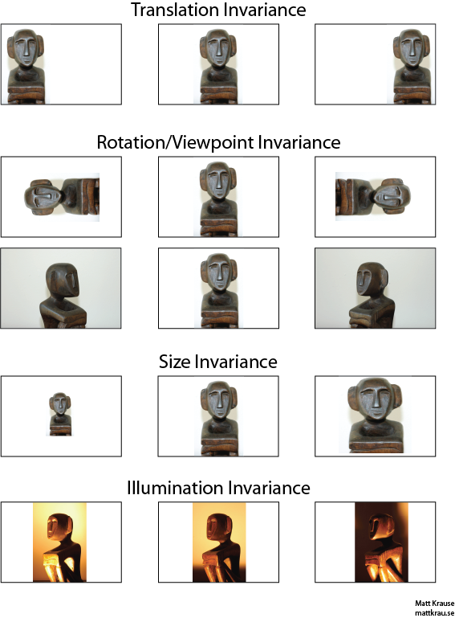
Translational Invariance

Slide 9
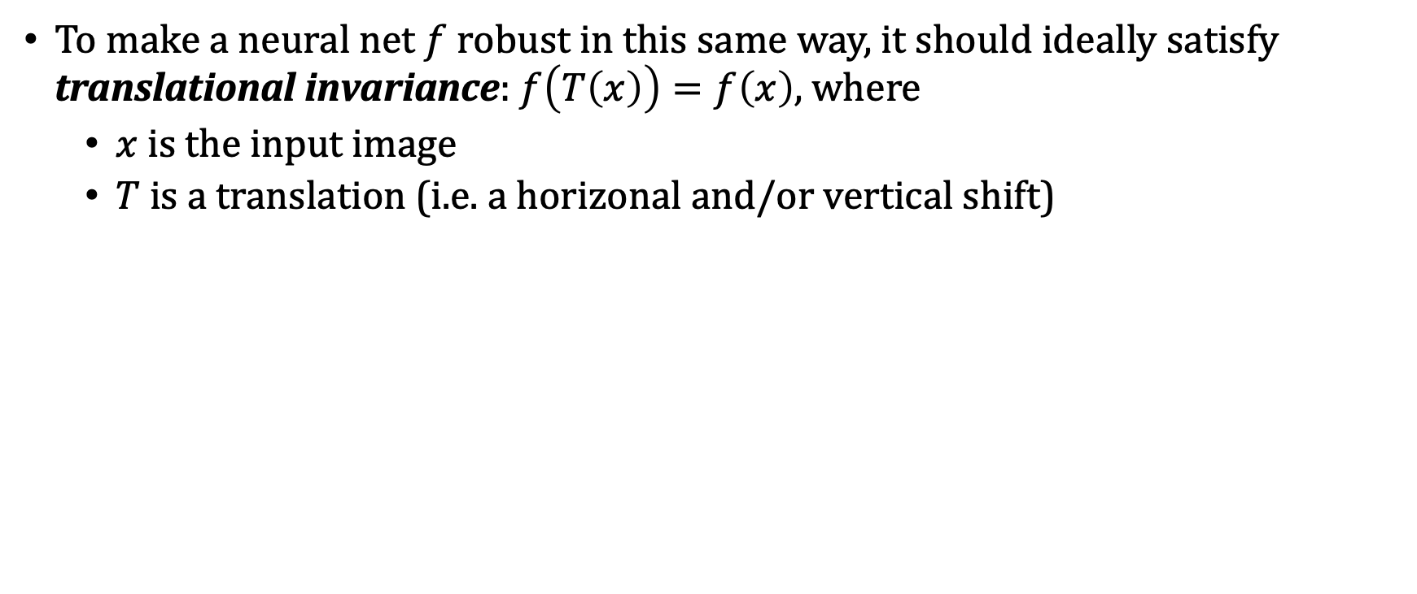
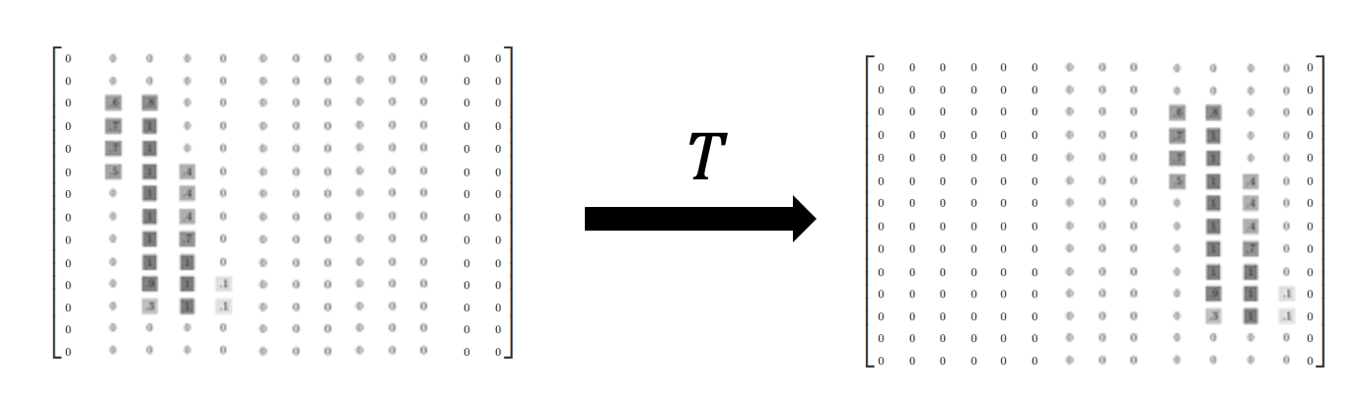
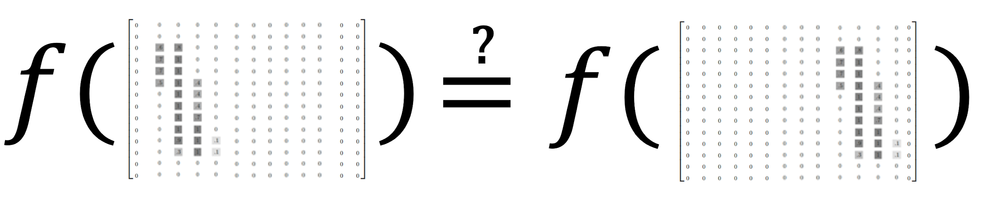
Translational Invariance

Slide 10


FCNN are not Translationally Invariant
How to make the network translationally invariant?
Focus on local differences/patterns

Slide 11
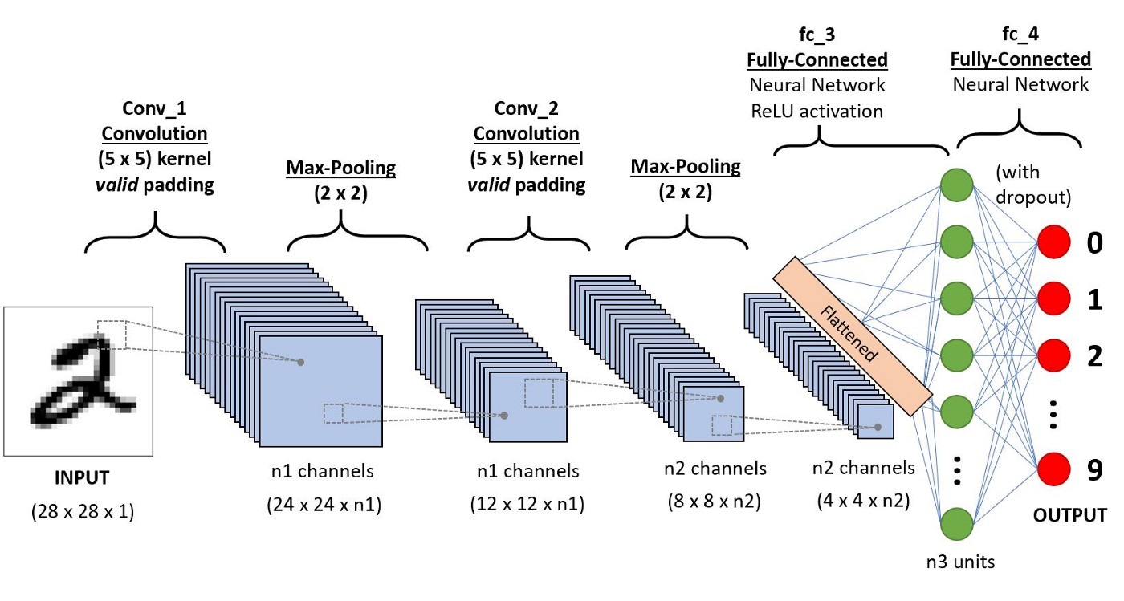
Convolutional Neural Network

Slide 12
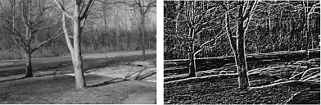
What is a Convolution?
Convolution is an operation that takes two inputs:
(1) An greyscale image (2D – B/W)
(2) A filter (also called a kernel)
1 | 1 | 1
0 | 0 | 0
-1 | -1 | -1
2D array of numbers; could be any values

Slide 13

Convolution Operation
image
filter/kernel
2 | 0 | 1 | 3
7 | 1 | 1 | 0
0 | 2 | 5 | 0
0 | 5 | 1 | 4
1 | 0 | 1
0 | 1 | 0
1 | 0 | 1
(We use this symbol for convolution)
(The verb form is “convolve”)

Slide 14

Convolution Operation

Slide 15


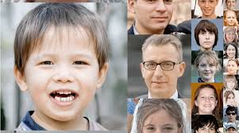
CNN: Different Kernels
Blur
Sharpen Kernel
Shift
1/9 | 1/9 | 1/9
1/9 | 1/9 | 1/9
1/9 | 1/9 | 1/9
0 | -1 | 0
-1 | 5 | -1
0 | -1 | 0
0 | 0 | 0
1 | 0 | 0
0 | 0 | 0

Slide 16

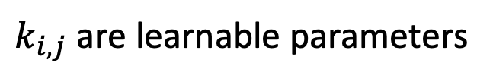
CNN Kernel is learnable
image
filter/kernel
output
2 | 0 | 1 | 3
7 | 1 | 1 | 0
0 | 2 | 5 | 0
0 | 5 | 1 | 4
1 | 1 | 1
0 | 0 | 0
-1 | -1 | -1
? | ?
? | ?
-4 | -3
3 | -8

Slide 17
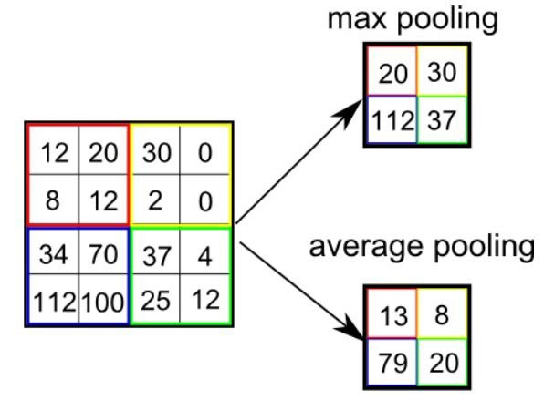
CNN: Pooling Layer

Slide 18
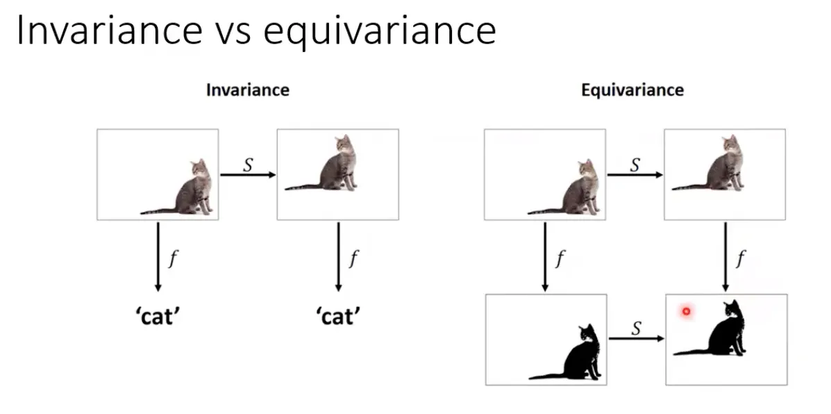
Pooling and Invariance

Slide 19
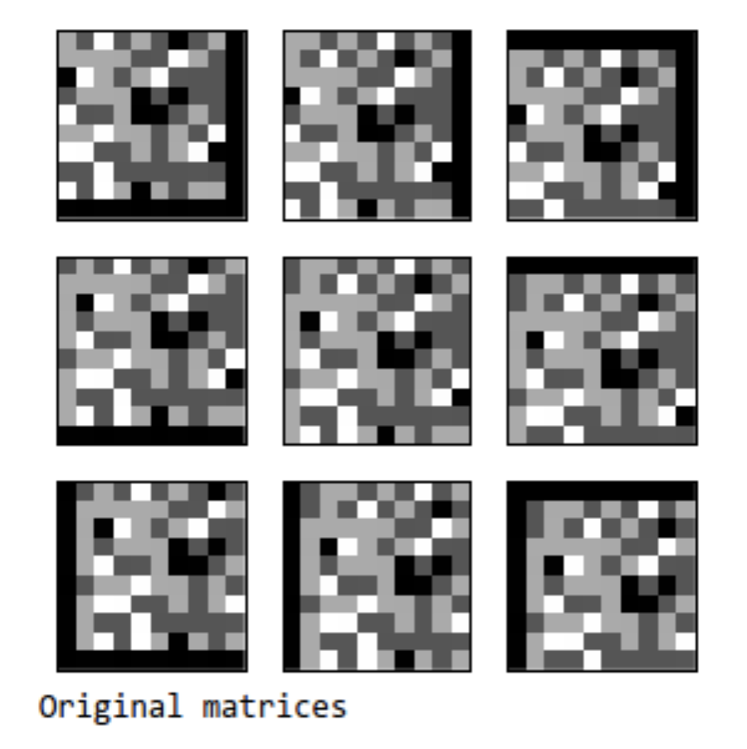
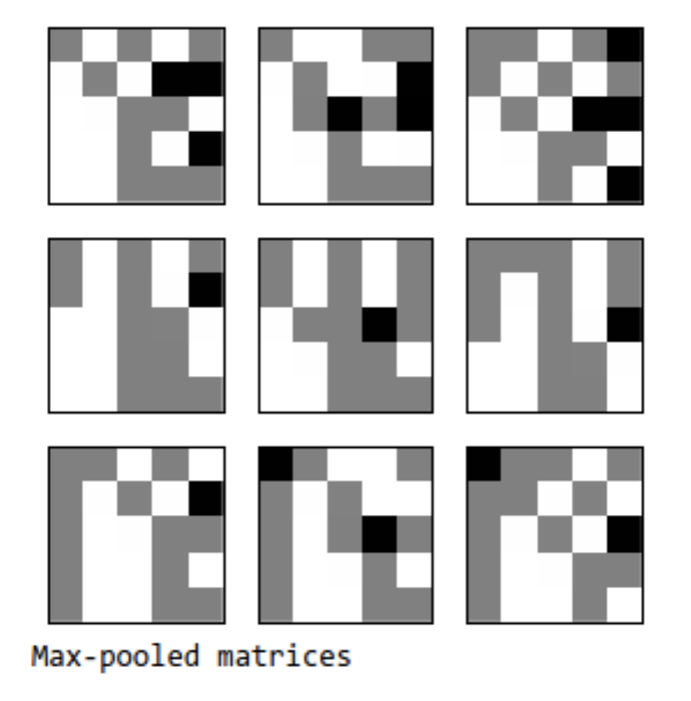
Are CNN translational invariant?
These are not all the same!
Max Pool
https://dsp.stackexchange.com/questions/24900/translation-invariance-in-max-pooling-and-cascading-with-convolutional-layer
Answer: CNNs are “sort of” translation invariant
  Shifting the content of the image around tends not to drastically effect the output classification probabilities...
  It is a local operator. Achieves partial invariance to small translations.
  ...but they are not, strictly speaking, translation invariant

Slide 20
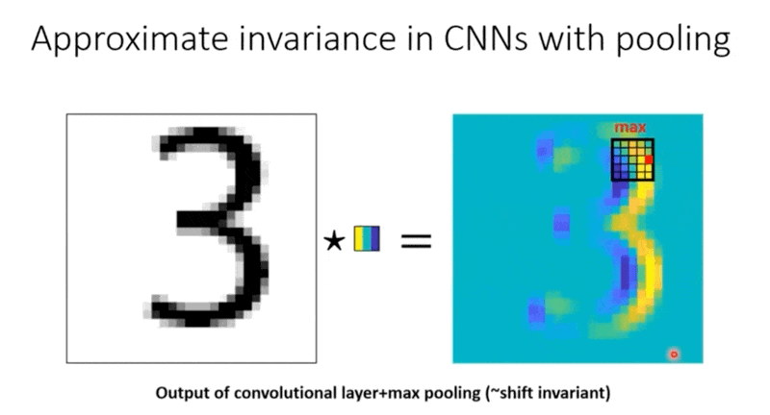
Shift Invariance in CNN

Slide 21
CNN: Kernel & Filter
Convolutional Layer
Pooling Layer

Slide 22
Stride
We don’t just have to slide the filter by one pixel every time
The distance we slide a filter by is called stride
  All the examples we’ve seen thus far have been stride = 1
2 | 0 | 1 | 3
7 | 1 | 1 | 0
0 | 2 | 5 | 0
0 | 5 | 1 | 4
2 | 0 | 1 | 3
7 | 1 | 1 | 0
0 | 2 | 5 | 0
0 | 5 | 1 | 4
1 | 1 | 1
0 | 0 | 0
-1 | -1 | -1
1 | 1 | 1
0 | 0 | 0
-1 | -1 | -1
stride = 1

Slide 23
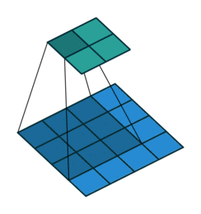
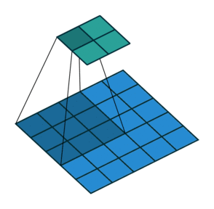
Stride
Stride: 1
Output size: 2x2
Stride: 2
Output size: 2x2
Input size: 4x4
Input size: 5x5
Larger stride turns a bigger input into the same size output
Corollary: Larger stride turns the same size input into a smaller output
Use this to (controllably) decrease image resolution!

Slide 24
CNN Architecture

Slide 25
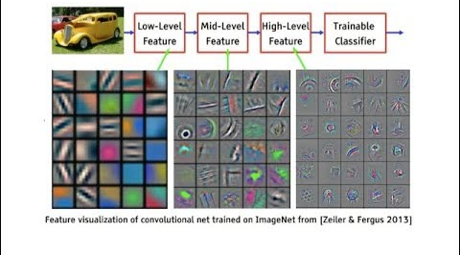
CNN layers and features

Slide 26
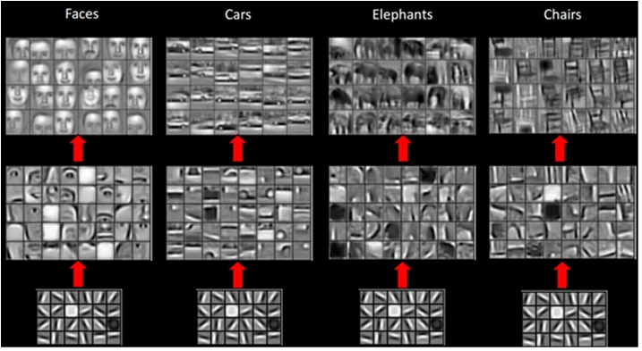
CNN: Learning features

Slide 27
Padding
Same
Filter slides over the bounds of the data, ensuring output size is the “Same” as input size (when stride = 1)
Valid
Filter only slides over “Valid” regions of the data
0 | 0 | 0 | 0 | 0 | 0
0 | 2 | 0 | 1 | 3 | 0
0 | 1 | 1 | 2 | 3 | 0
0 | 4 | 3 | 2 | 1 | 0
0 | 8 | 3 | 1 | 3 | 0
0 | 0 | 0 | 0 | 0 | 0
2 | 0 | 1 | 3
0 | 1 | 1 | 0
0 | 0 | 2 | 0
0 | 1 | 1 | 1

Slide 28
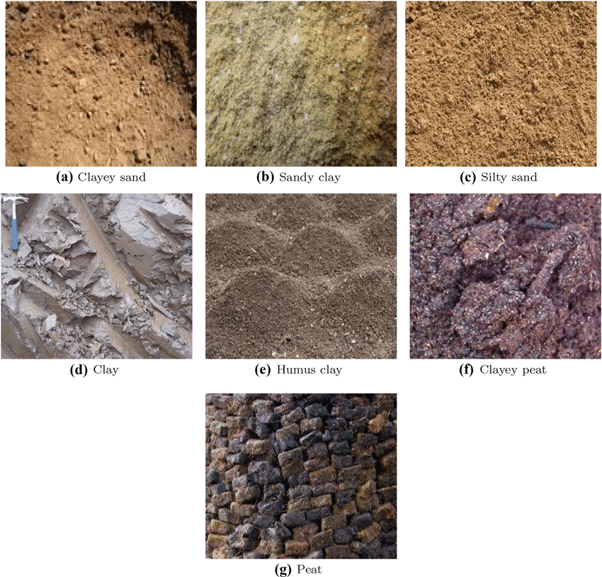
Hands on: Image Classification

Slide 29
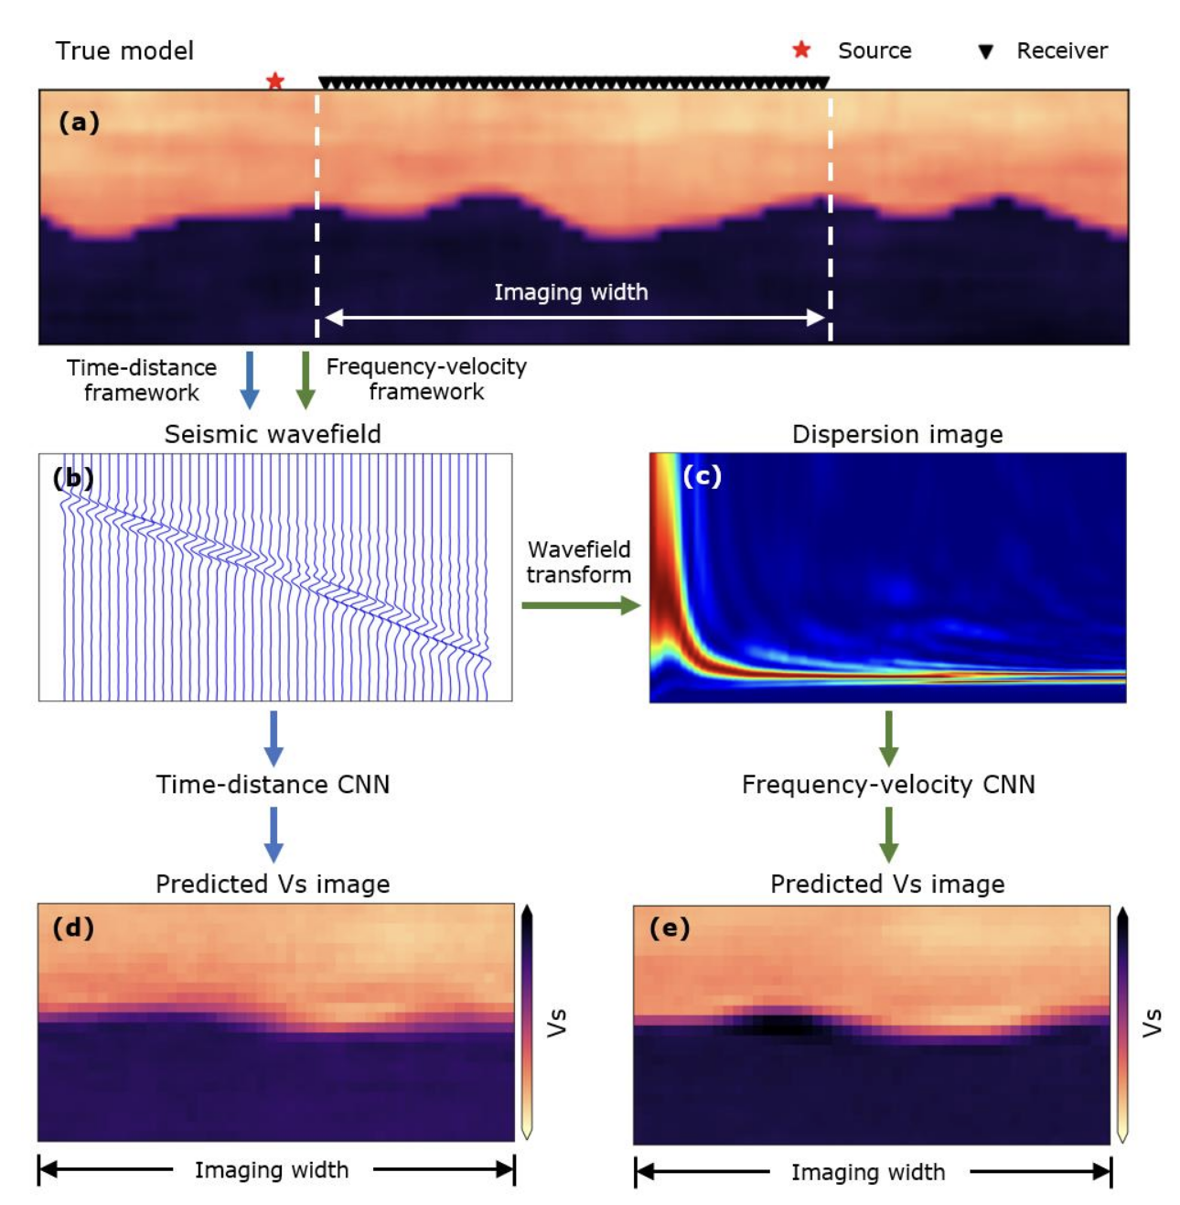
CNN: Seismic Image to Soil Profile
Abbas et al., (2022)

Slide 30
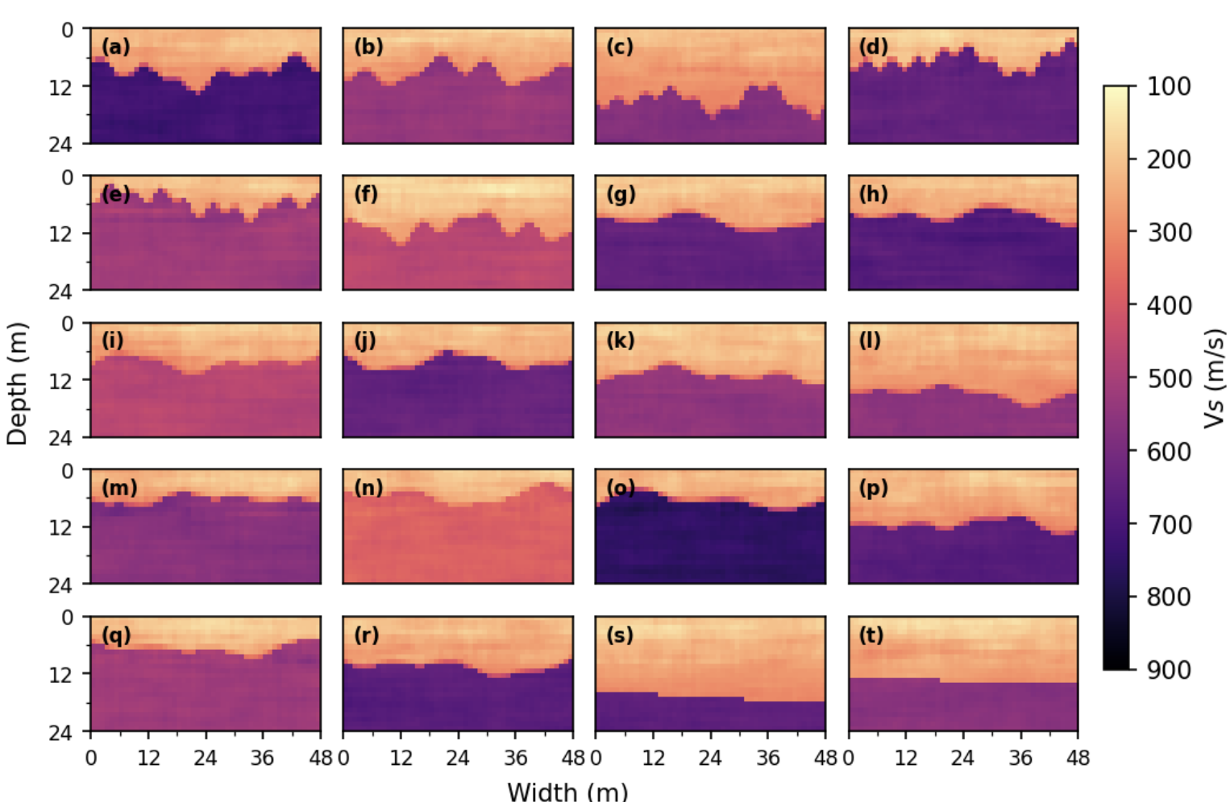
CNN: FWI

Slide 31
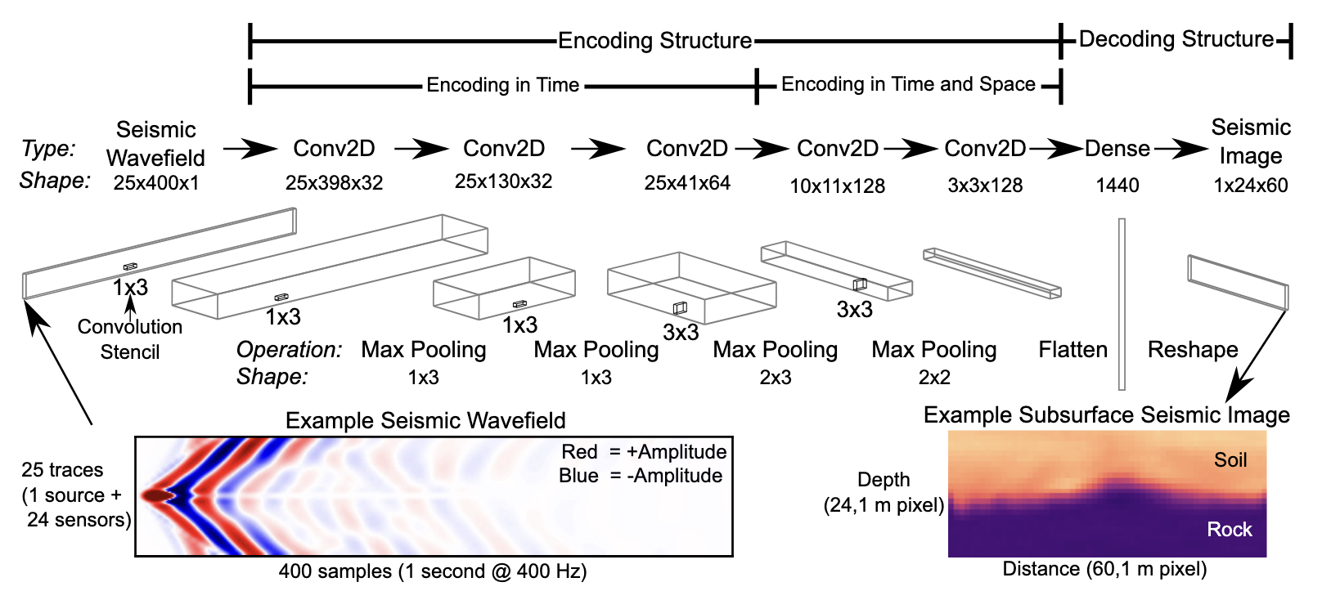
CNN Architecture

Slide 32
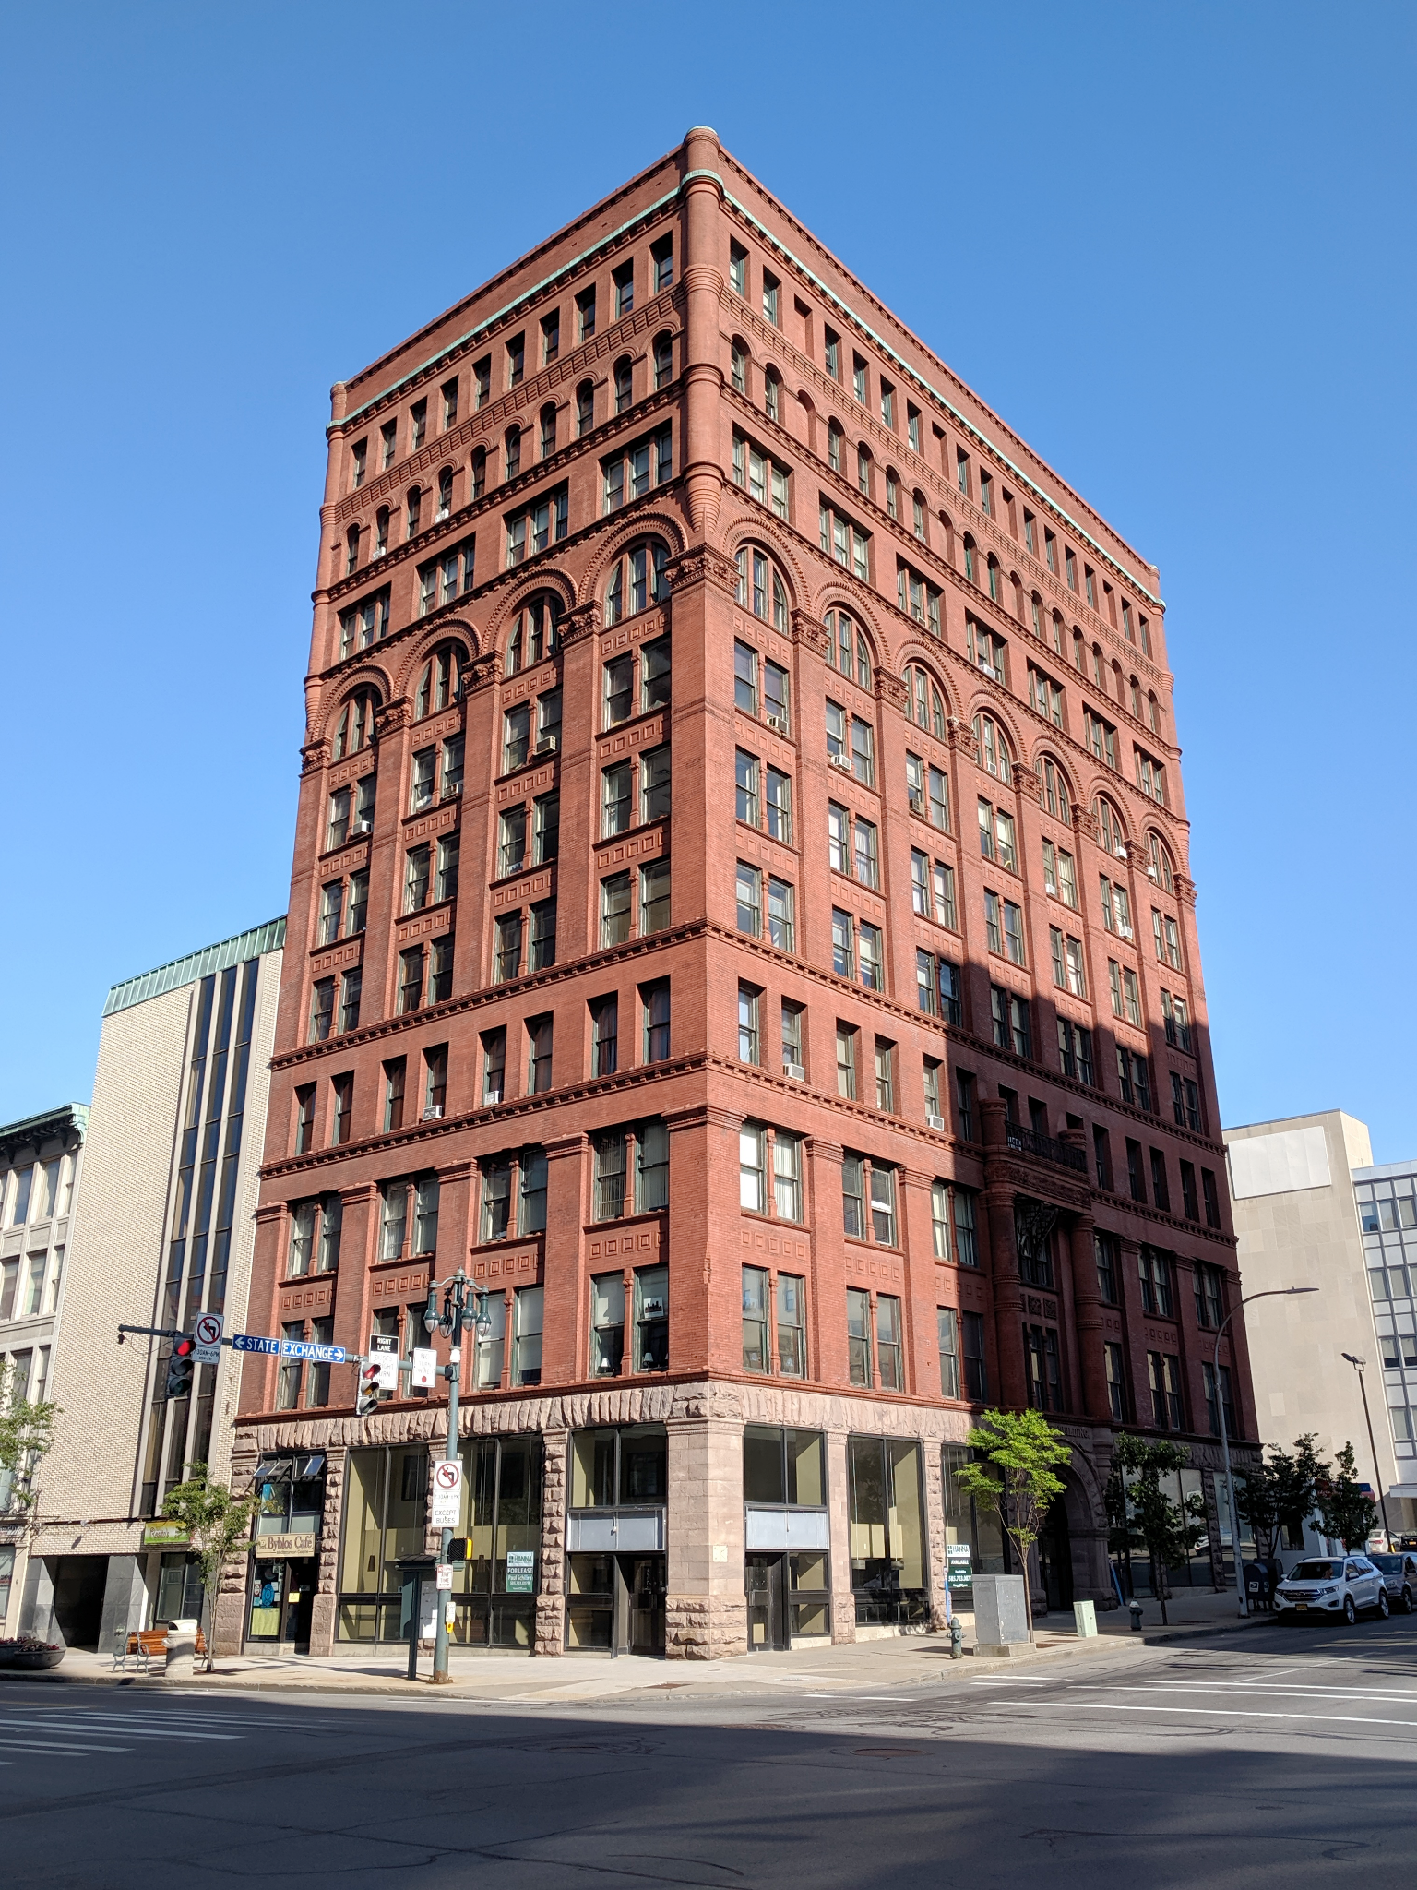
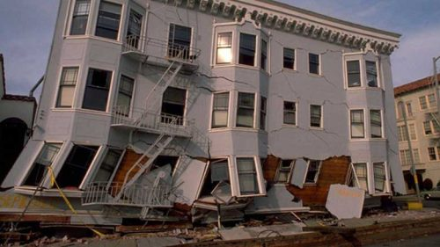
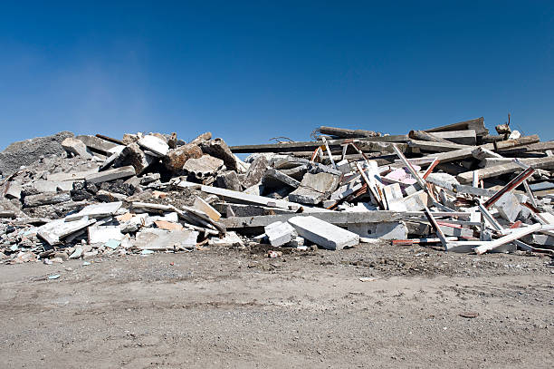
Building damage classifier - an explanation
Undamaged
Partially-damaged
Completely-destroyed

Slide 33
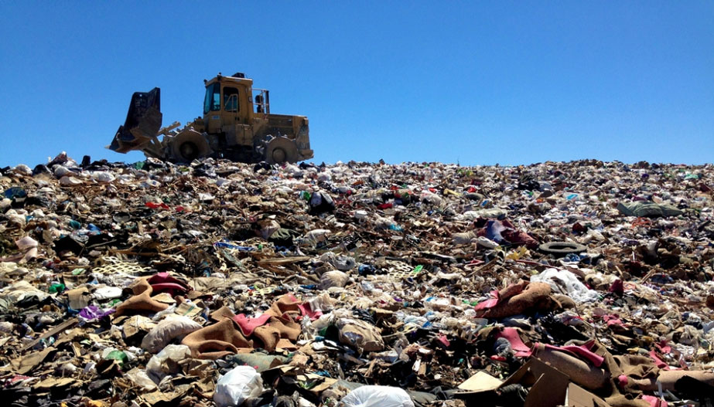
Explaining a building image classifier
Sky
Predicted class: General Collapse
rubble
Transfer learning prediction: Ants

Slide 34
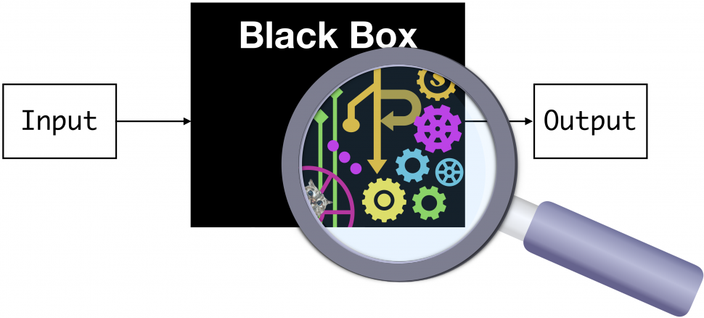
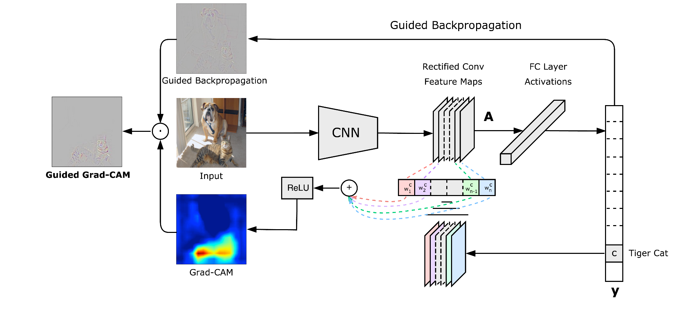
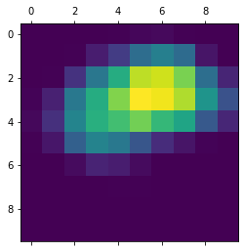
GradCAM Explanation
GC
http://gradcam.cloudcv.org/

Slide 35
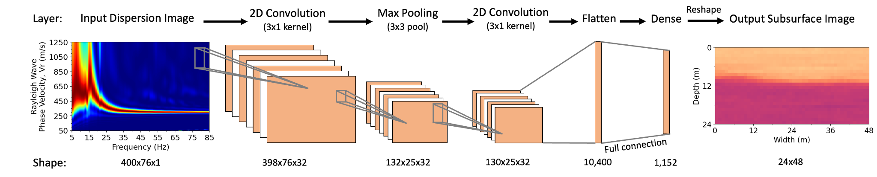
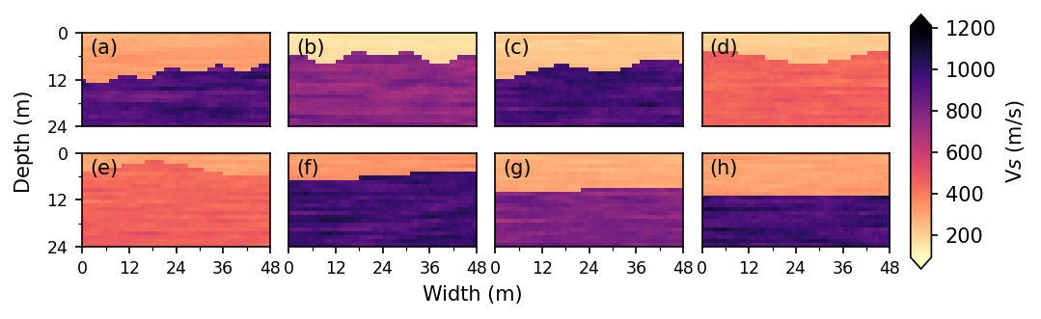
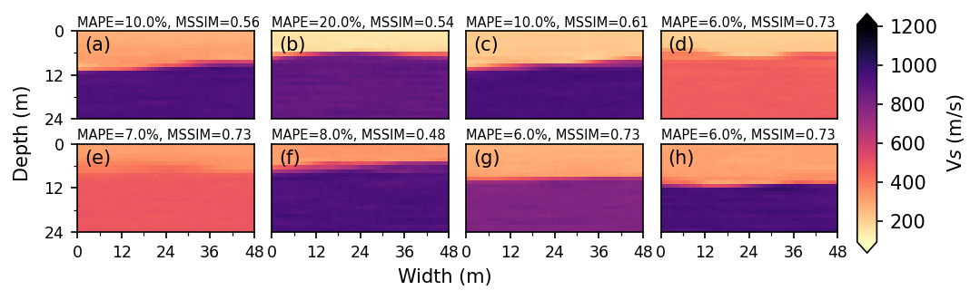
Convolutional Neural Network for inverse problem
True Model
Predictions

Slide 36
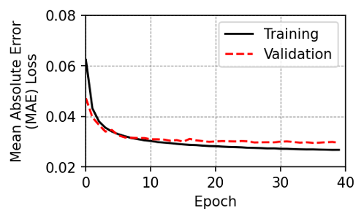
How to design a CNN
MAPE | Kernel Size: 3x1 | Kernel Size: 3x3
Deep (5) | 11.3 % | 8.5 %
Shallow (3) | 12.1 % | 11.2 %

Slide 37
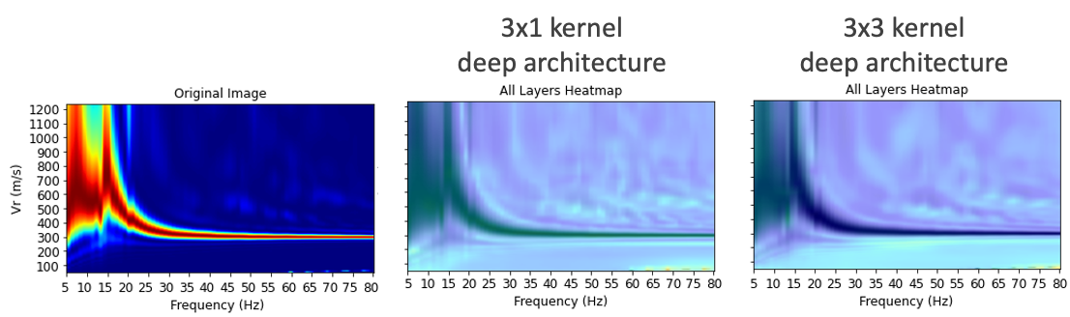
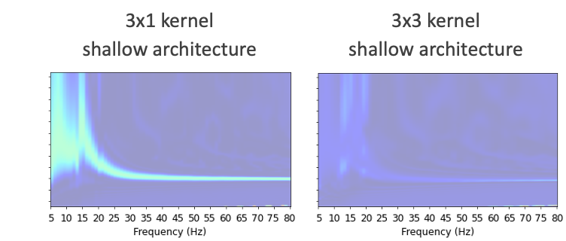
Designing a neural network with explainability

