Slide 1


AI IN GEOTECHNICAL ENGINEERING – MODULE 8
Large Language Models (LLMs)
Department of Civil, Architectural, and Environmental Eng.
The University of Texas at Austin

Slide 2
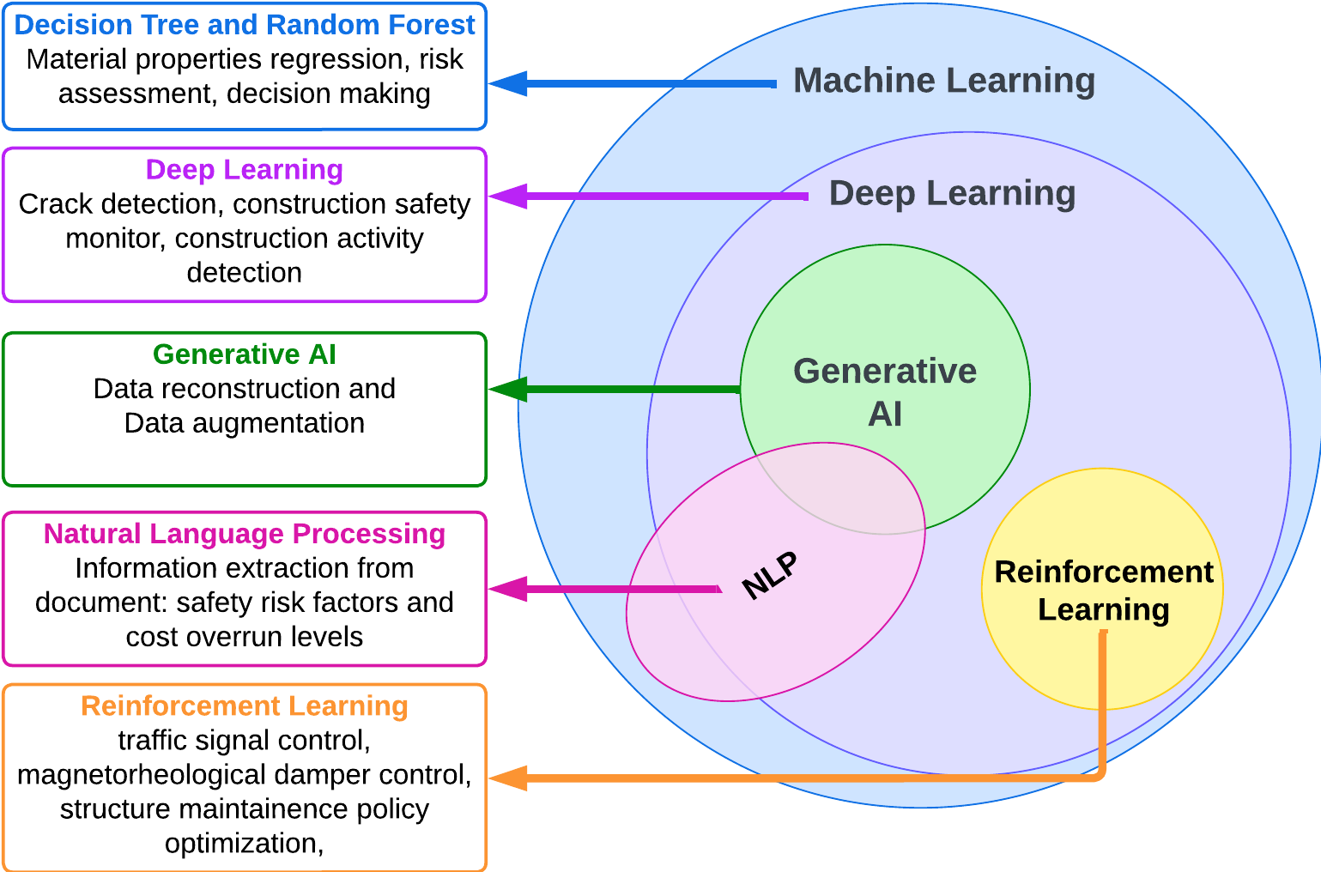
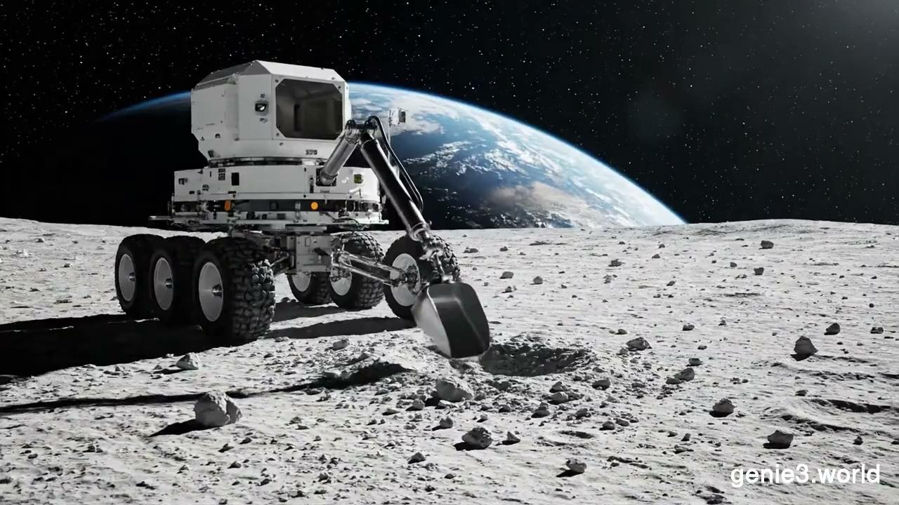
GenAI
Prompt: Lunar rover interacting with soil

Slide 3
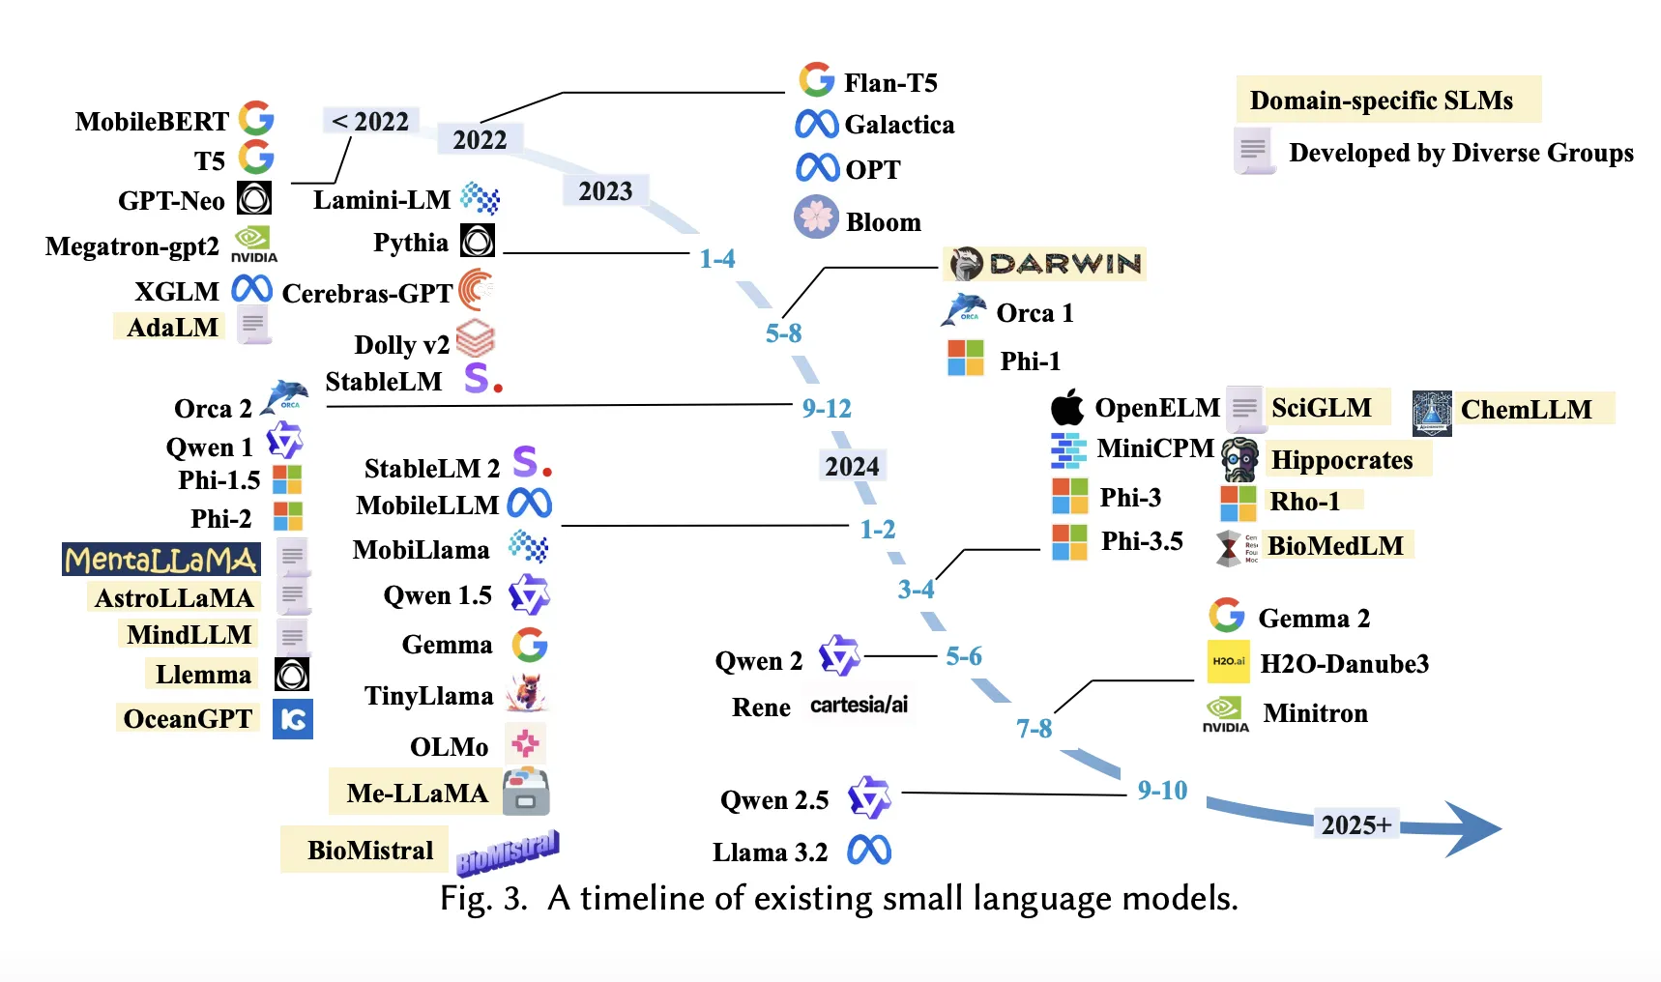
Explosion of LLMs

Slide 4
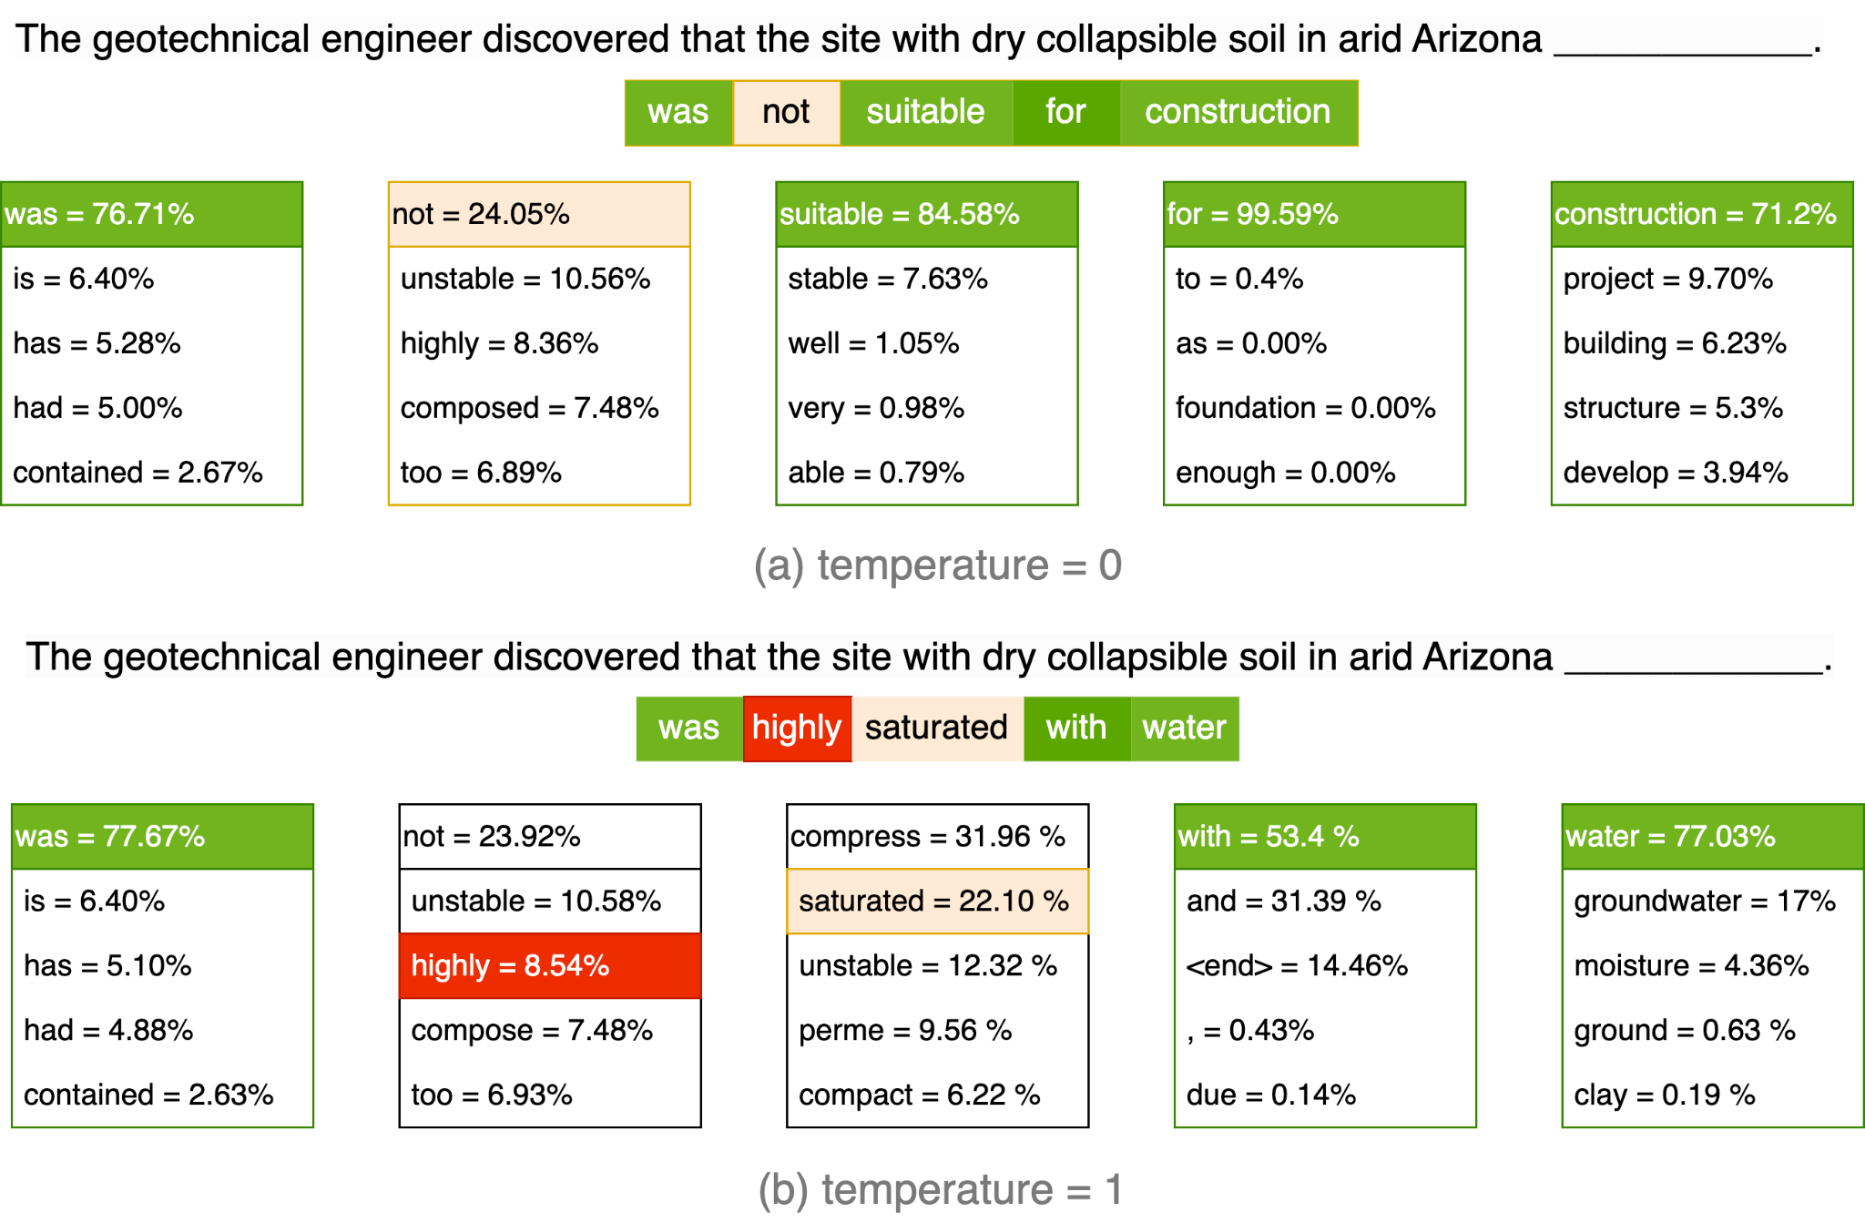
How does GPT work?

Slide 5
How does GPT become creative?

Slide 6
Prompt Engineering Examples
❌ Bad Prompts
Tell me about soil.
✅ Good Prompts
Explain the difference between cohesive and cohesionless soils,
including their engineering properties (shear strength, permeability,
compressibility) and typical examples of each. Format as a comparison
table.

Slide 7
Prompt Engineering (Zero-shot vs Few-shot)
❌ Zero-Shot (Inconsistent Results)
Classify this soil description: "Gray silty clay with trace sand, medium stiffness"
✅ Few-Shot (Better Consistency)
Classify the following soil descriptions into USCS categories:
Example 1: Description: "Brown sand with gravel, trace fines"
Classification: SW-SM
Example 2: Description: "Gray clay, high plasticity, no visible sand"
Classification: CH
Example 3: Description: "Tan sandy silt with organics"
Classification: ML
Now classify this:
Description: "Gray silty clay with trace sand, medium stiffness" Classification:

Slide 8
Prompt Engineering (Roles)
❌ No Role
What's the allowable bearing capacity for this foundation?
Soil: Dense sand, SPT N=35, depth=2m, width=3m
✅ Expert Role
You are an experienced geotechnical engineer with expertise in
foundation design per Eurocode 7 standards.
Calculate the allowable bearing capacity for a shallow foundation with:
- Soil: Dense sand, SPT N-value = 35
- Foundation depth: 2m below grade
- Foundation width: 3m × 3m square
- Groundwater: 5m below grade
- Required factor of safety: 3.0
Provide:
1. Your assumed soil parameters (φ, γ) with justification
2. Step-by-step bearing capacity calculation
3. Final allowable bearing pressure
4. Any design recommendations

Slide 9
Prompt Engineering (Format Specification)
❌ No format
Give me the properties of different clay types.
✅ Format specified
Create a JSON object with properties of different clay types:
"clay_type": {
"plasticity_index": "range",
"liquid_limit": "range",
"cohesion": "kPa",
"uscs_symbol": "string",
}

Slide 10
Prompt Engineering (Constraints & Negatives)
❌ No Constraints
Write a geotechnical investigation report for our site [given data]
✅ Constraints
Write a geotechnical investigation executive summary for a 5-story office building site. Requirements:
- Length: 300-400 words
- Include: Site conditions, soil profile, groundwater, foundation recommendations
- Tone: Professional, suitable for non-technical client
- DO NOT include: Detailed calculations, lab test procedures, or technical jargon without explanation
- DO NOT make up specific numbers - use [TBD] for values Format as paragraphs, not bullet points.

Slide 11
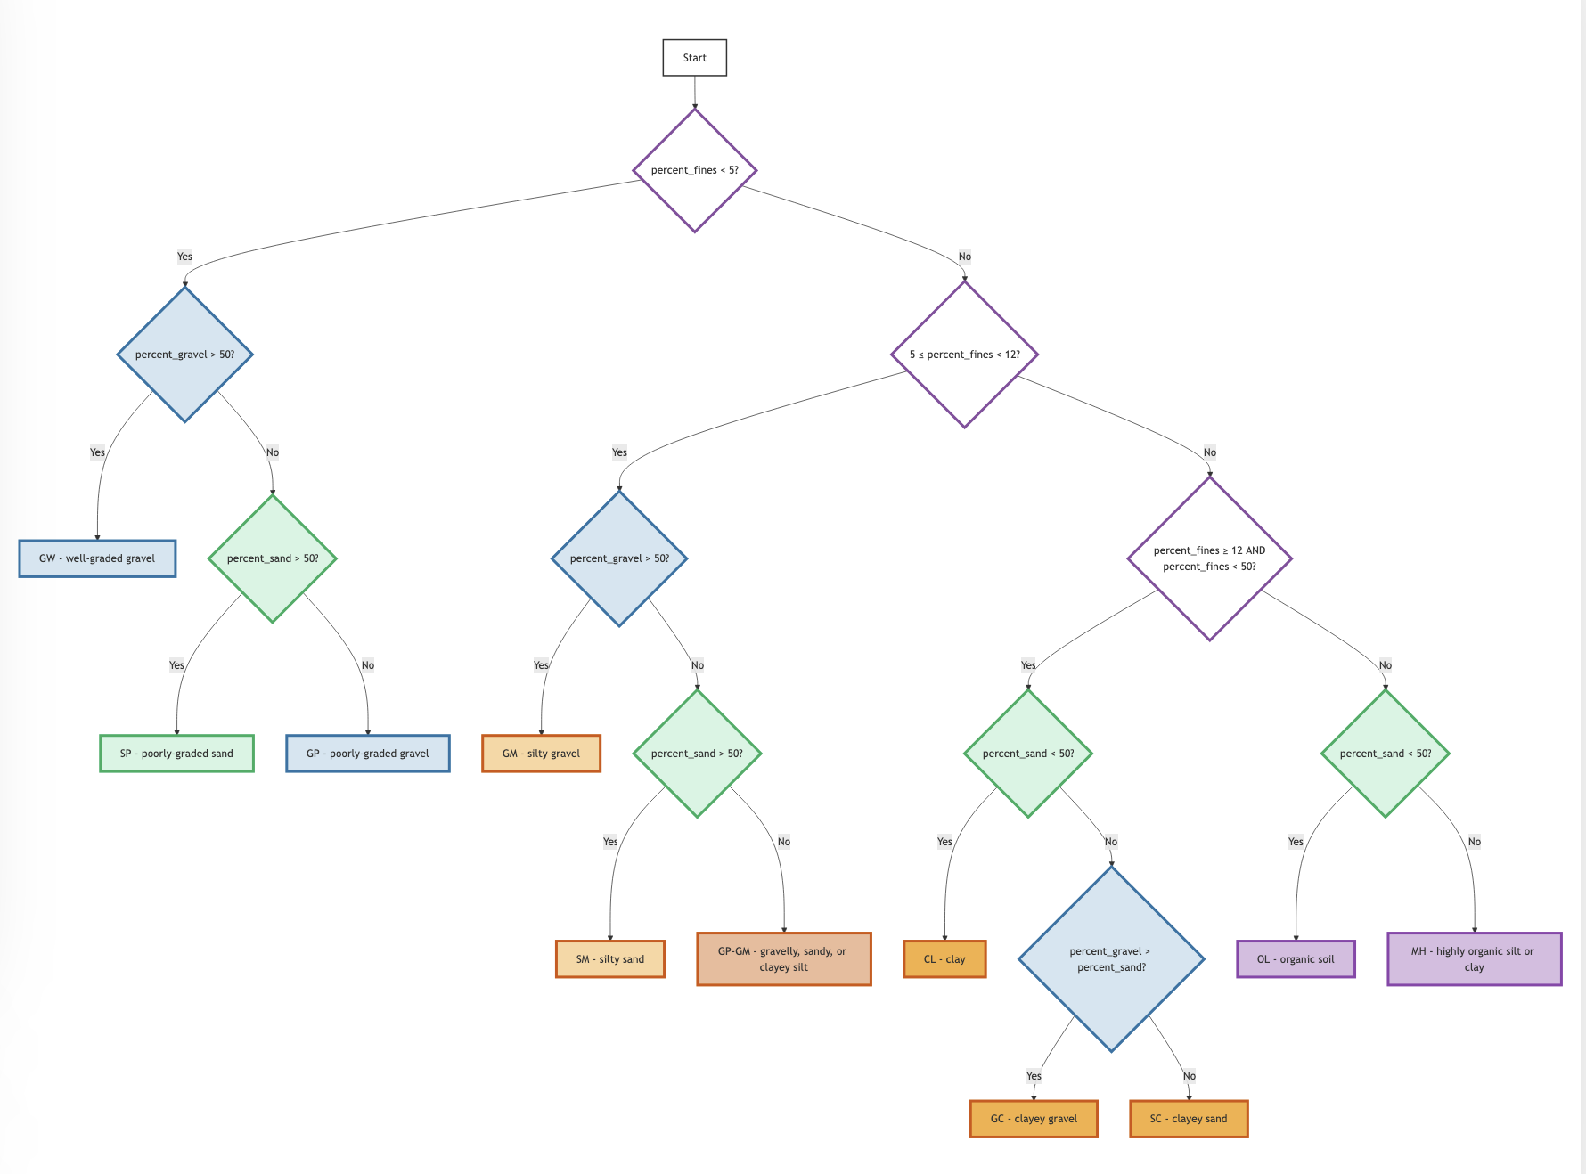
Lack of Knowledge: Soil Classification
`Write a Python code for USCS soil classification.’
In this case, ChatGPT
hallucinates and responds with an incorrect code without including Atterberg’s limit, yet indicating it
wrote the code based on ASTM D2487-17

Slide 12
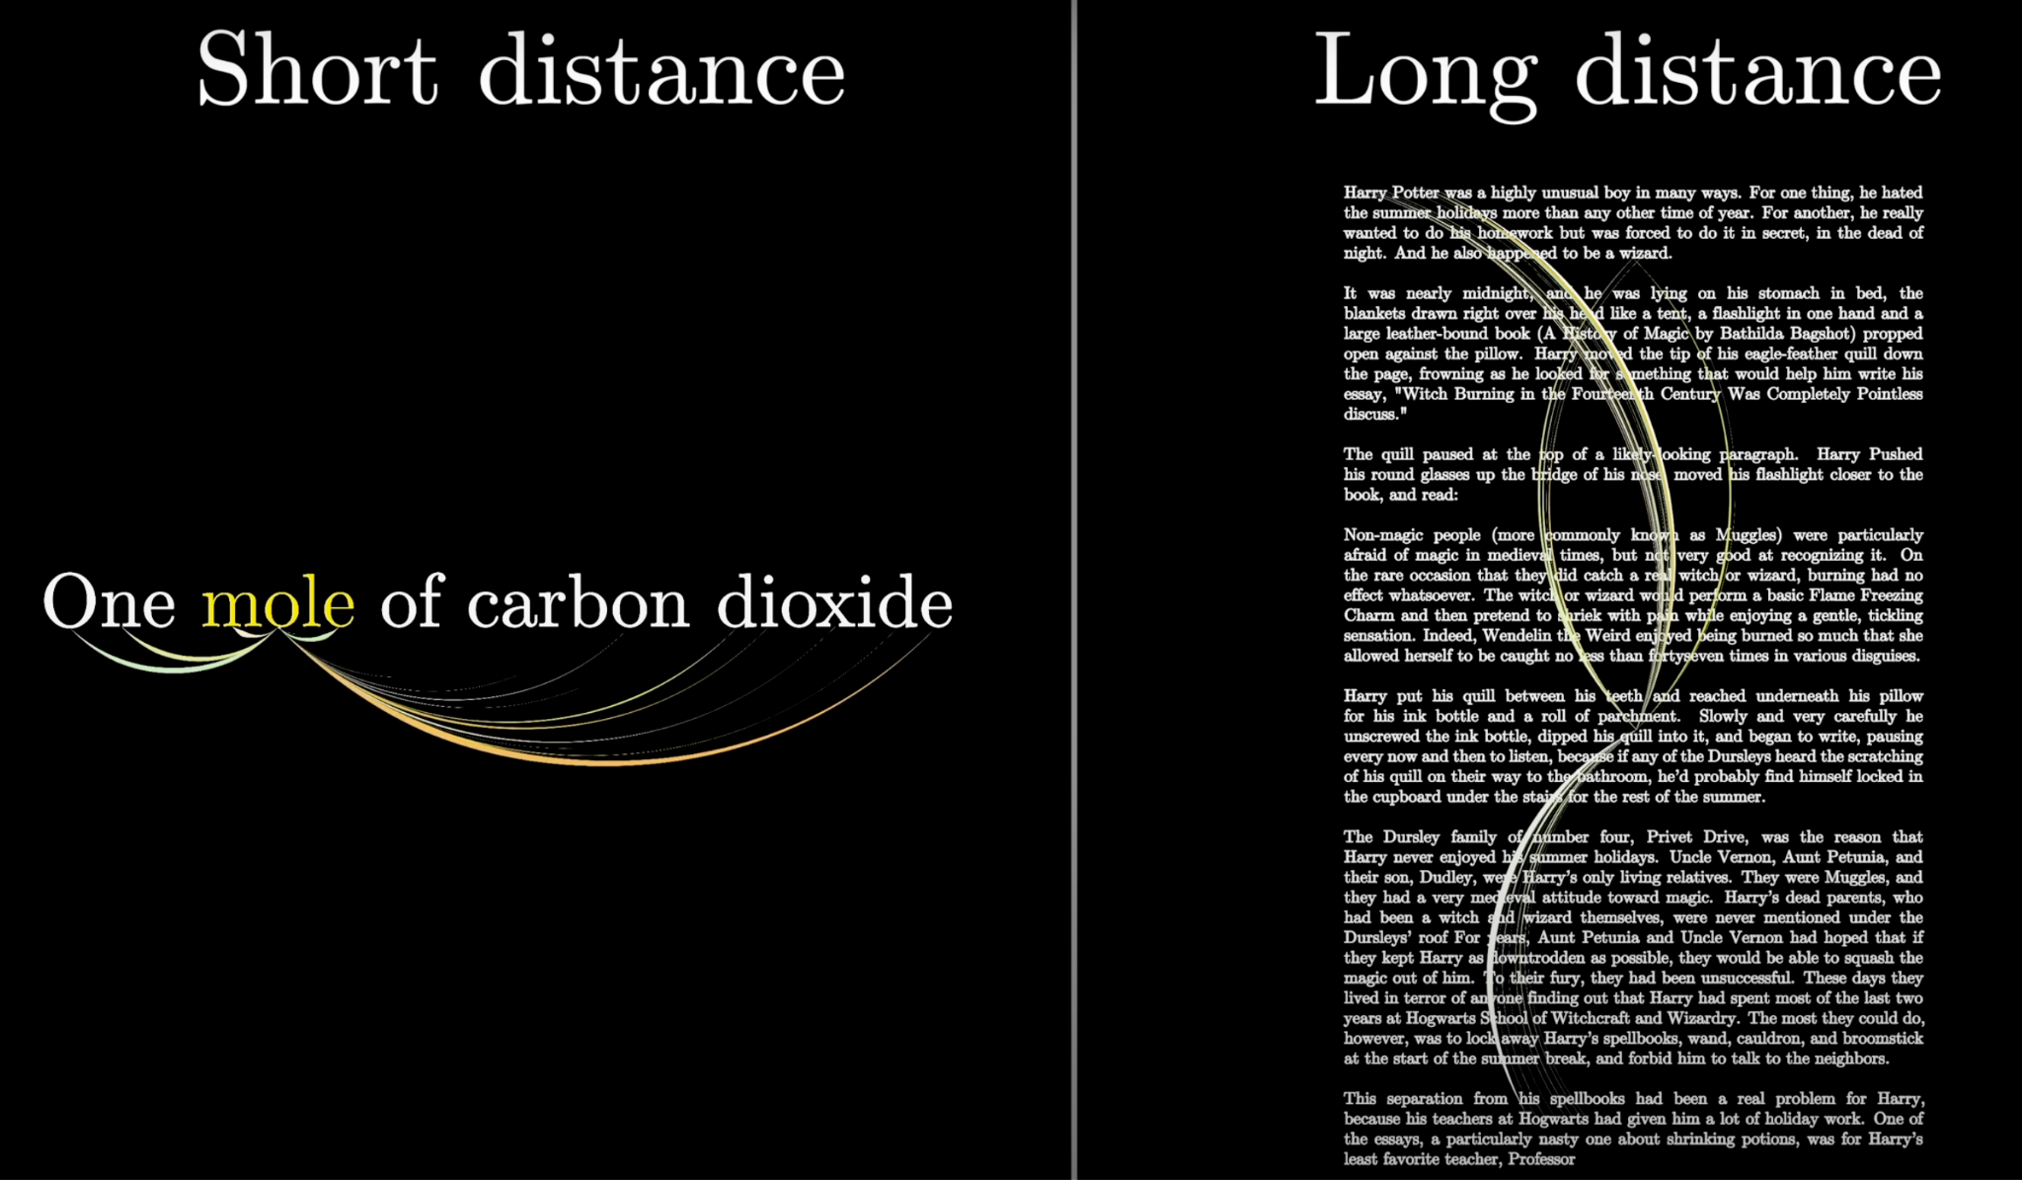
Attention is all you need!

Slide 13
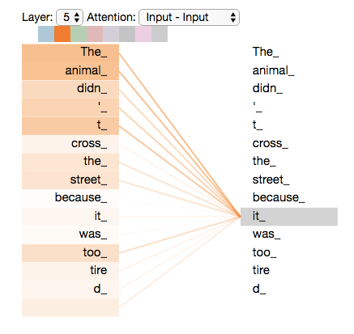
Attention is all you need – Transformers
The animal didn't cross the street because it was too tired”

Slide 14
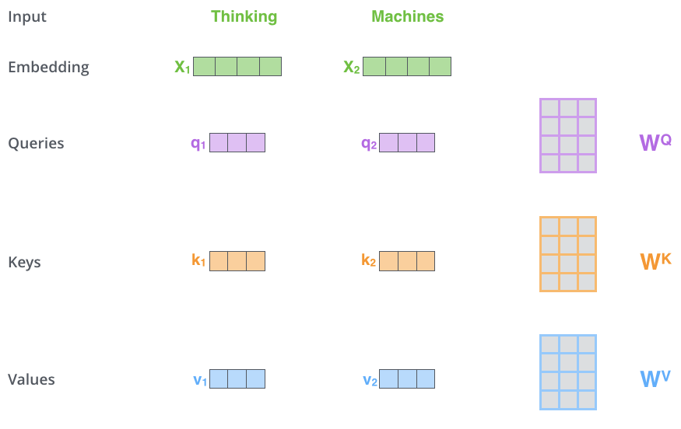
Transformers [a brief look inside]

Slide 15
Transformers [a brief look inside attention]
Component | Role | Example
Query | What the current token is looking for | "it" asks: which noun in this sentence am I referring to?
Key | What each token advertises about itself | "animal" advertises: I am the subject noun of the sentence
Value | The content a token hands over, in proportion to how well its key matches | "animal" hands its meaning to "it", so the model reads "it" as the animal

Slide 16
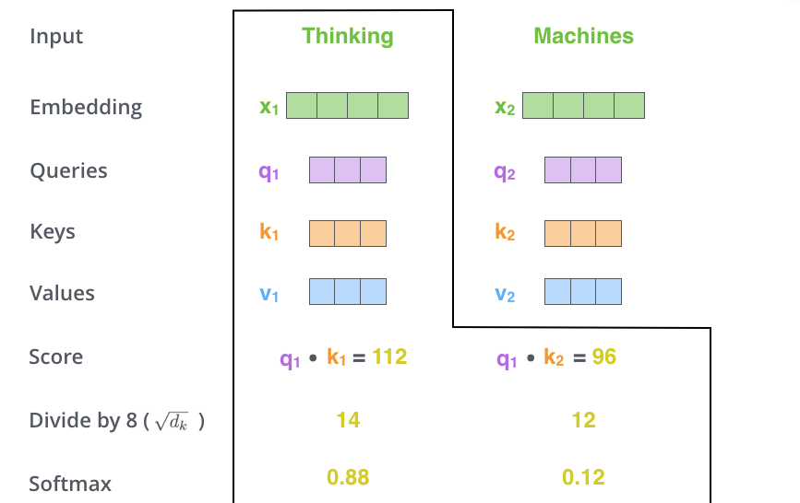
Transformers [a brief look inside]

Slide 17
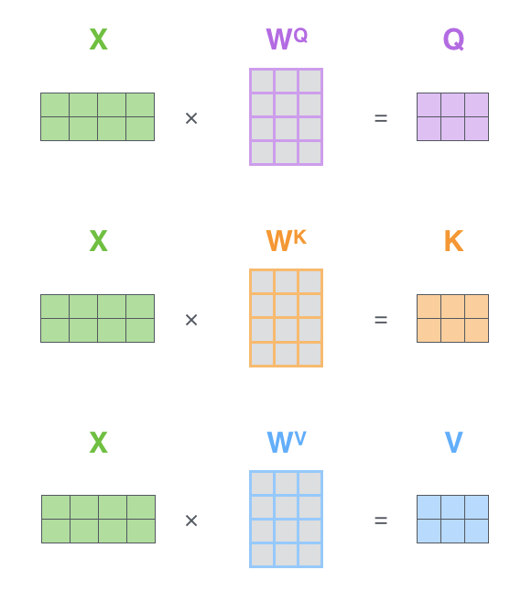
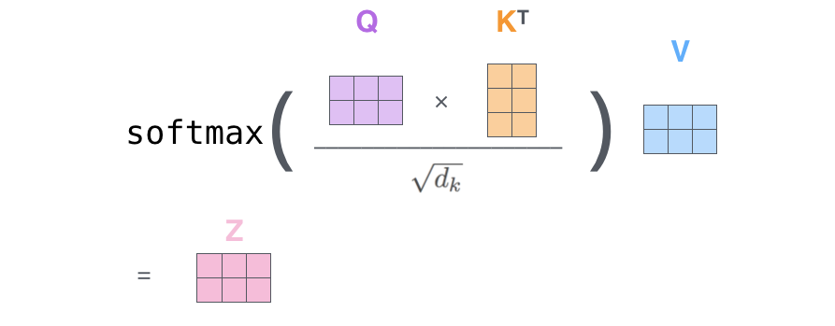
Transformers

Slide 18
Lack of Knowledge: Soil Classification
`Write a Python code for USCS soil classification.’
In this case, ChatGPT
hallucinates and responds with an incorrect code without including Atterberg’s limit, yet indicating it
wrote the code based on ASTM D2487-17

Slide 19
In Context Learning
❌ No Context
Input: "Classify this soil: Brown sand with silt and gravel"
Token: "sand"
→ q, k, v calculated from embedding
→ Attention mechanism looks at context
→ Only sees: "Classify", "this", "soil", "Brown"
→ NO CLASSIFICATION EXAMPLES to attend to
→ Generic representation based only on word "sand"
attention at a token looks only at earlier tokens
Output (uncertain, possibly wrong):
"This appears to be sand... maybe SP or SM?"

Slide 20
In Context Learning with Few Shots [Attention]
✅ Few shot prompting
Classify the following soil descriptions into USCS categories:
Example 1: Description: "Brown sand with gravel, trace fines"
Classification: SW-SM
Example 2: Description: "Gray clay, high plasticity, no visible sand"
Classification: CH
Example 3: Description: "Tan sandy silt with organics"
Classification: ML
Now classify this:
Description: "Gray silty clay with trace sand, medium stiffness" Classification:

Slide 21
In Context Learning with Few Shots [Attention]
✅ What happens with Attention
Token: "sand" (in the query "Brown sand with silt and gravel")
Query from "sand": "What classification should I get?"
Attention mechanism computes similarity with ALL previous tokens:
Attention scores to previous examples:
- "gravel" (k₁) → HIGH score (0.38) ← Example 1, sand with gravel
- "SW-SM" (k₂) → HIGH score (0.30) ← Example 1, the label
- "clay" (k₃) → LOW score (0.03) ← Example 2, different soil
- "CH" (k₄) → LOW score (0.02) ← Example 2, the label
- "silt" (k₅) → MEDIUM score (0.17) ← Example 3, sandy silt
- "ML" (k₆) → LOW score (0.10) ← Example 3, the label
Value aggregation:
New representation of "sand" = 0.38×v₁ + 0.30×v₂ + 0.17×v₅ + ...
Result: "sand" is now enriched with information from Example 1!

Slide 22
Lack of Knowledge: Soil Classification
`Write a Python code for USCS soil classification.’
In this case, ChatGPT
hallucinates and responds with an incorrect code without including Atterberg’s limit, yet indicating it
wrote the code based on ASTM D2487-17

Slide 23
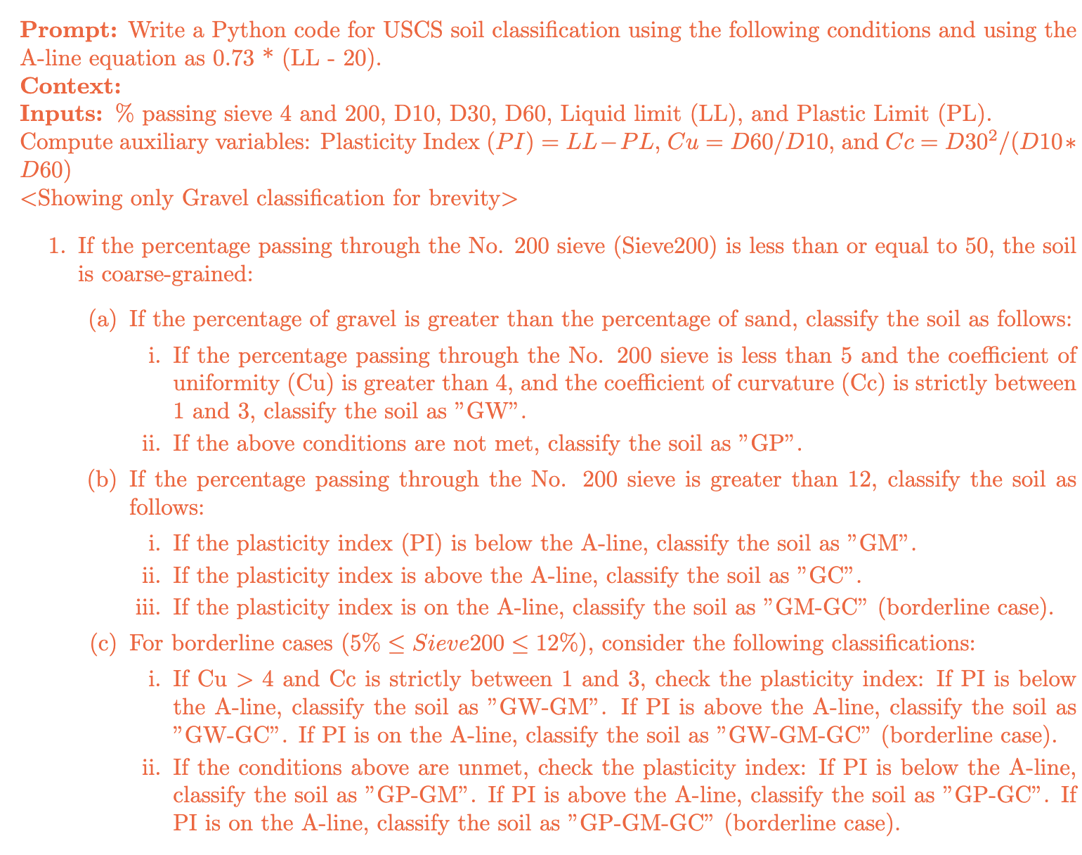
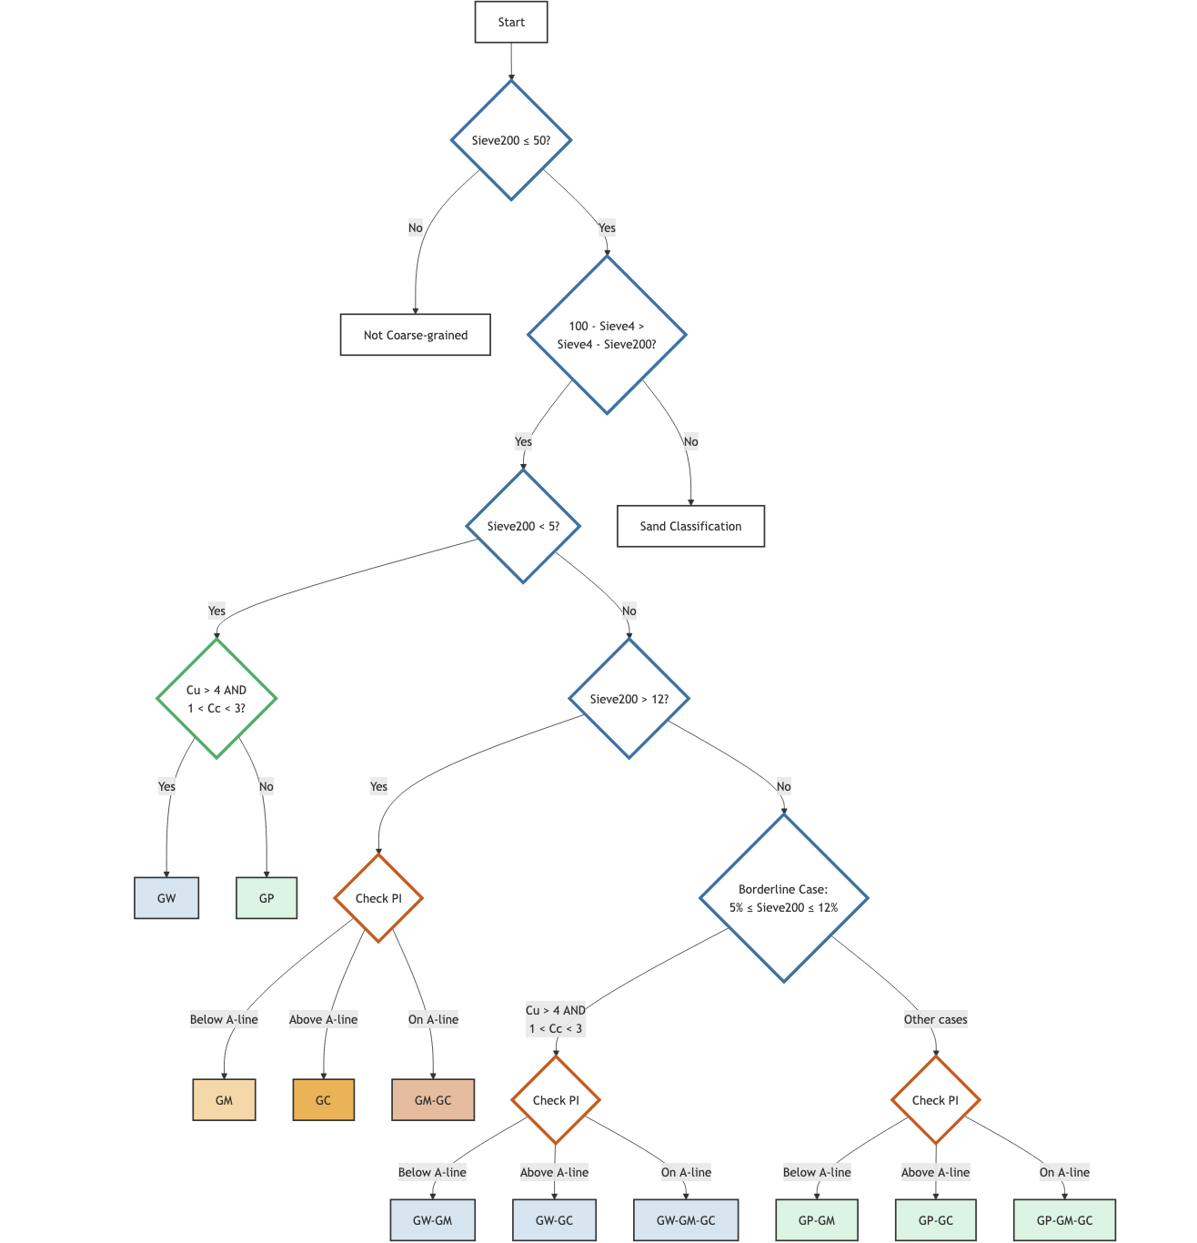
Embedding Knowledge in Predictions

Slide 24
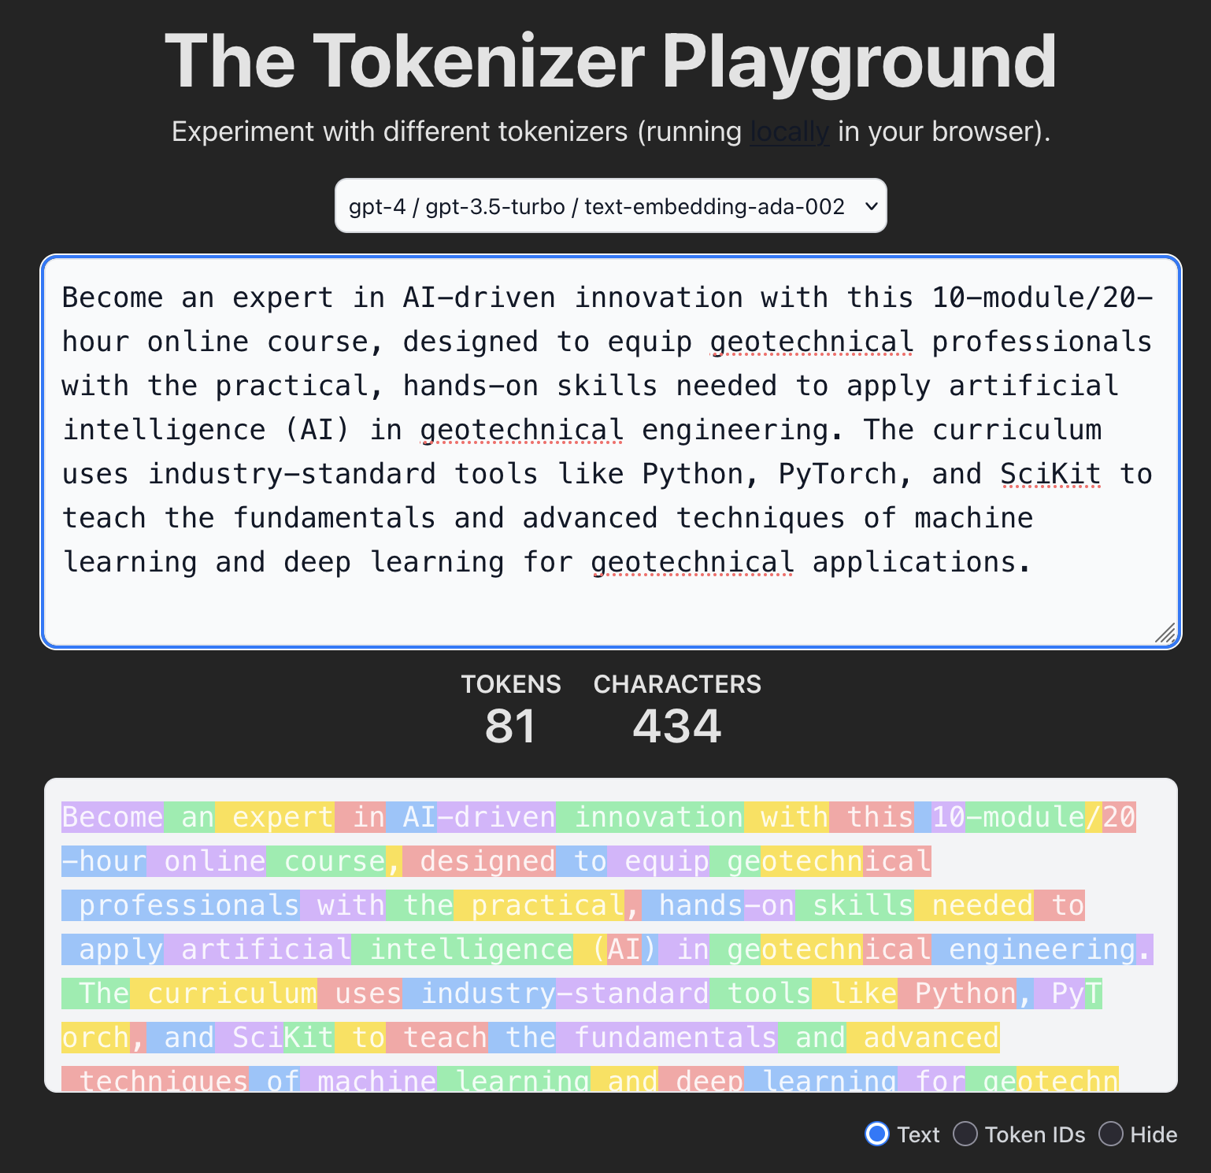
What is a Token?

Slide 25
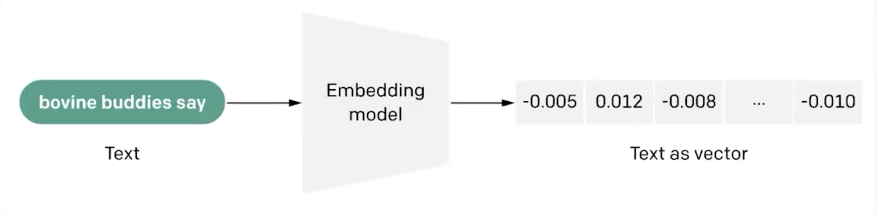
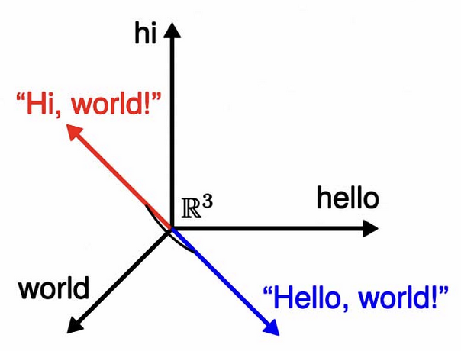
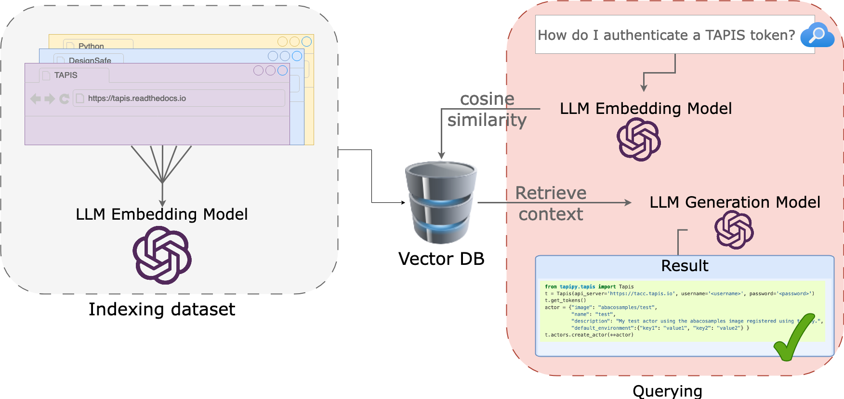
RAG: Cosine Similarity

Slide 26
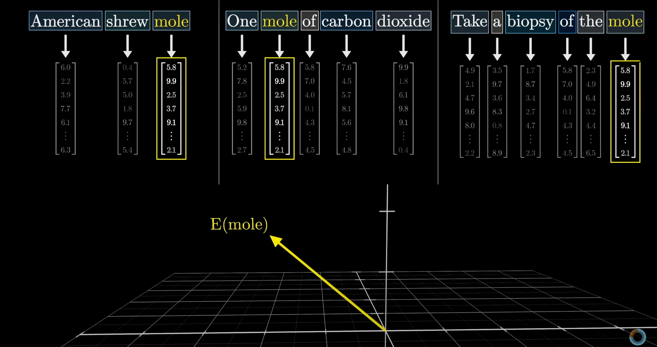
Word embedding vector

Slide 27
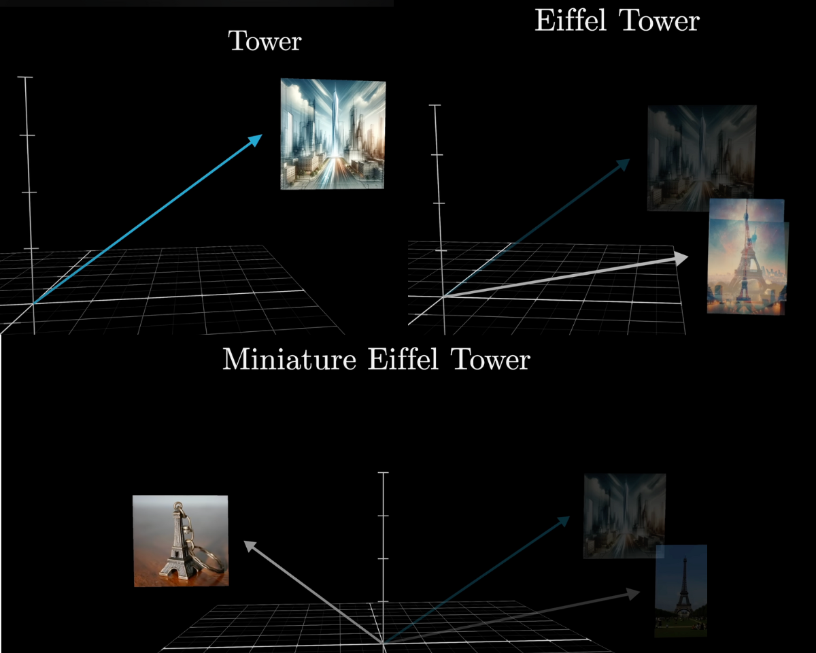
Word Embeddings

Slide 28
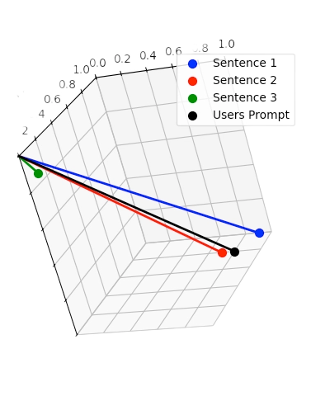
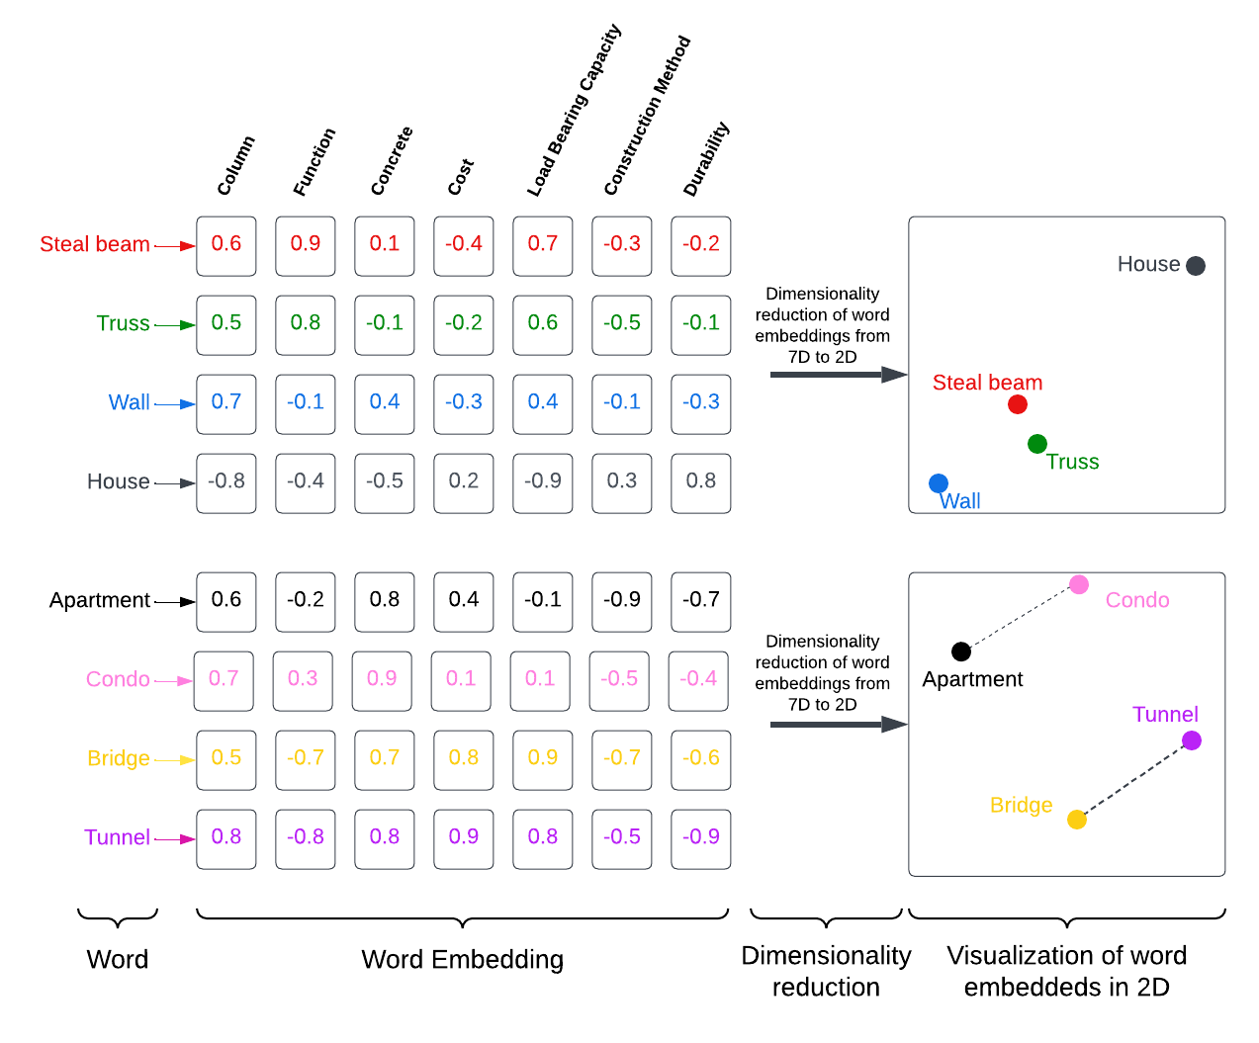
Cosine Similarity

Slide 29
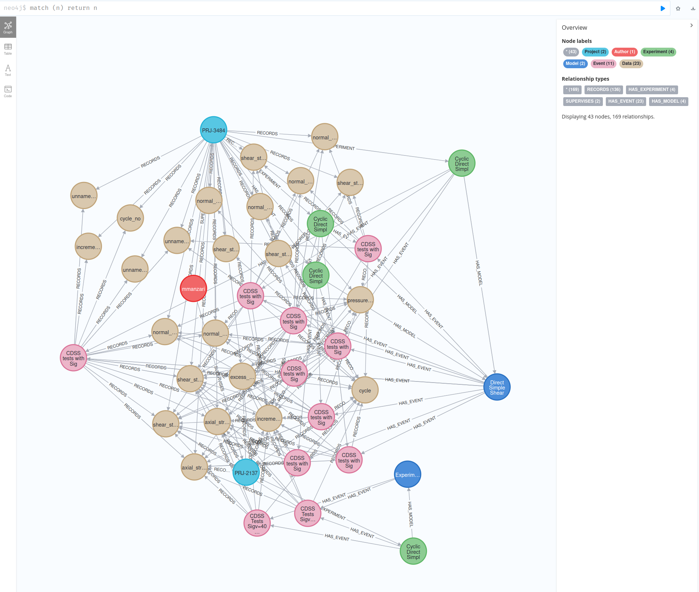
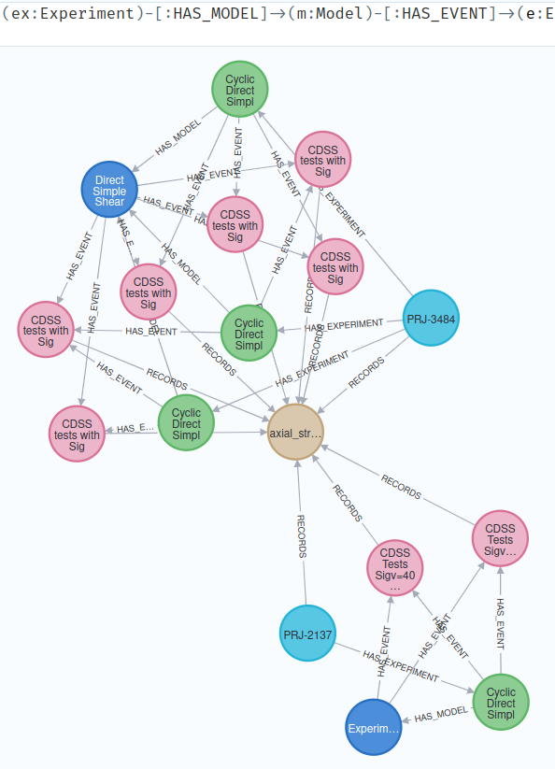
Embedding Relationships
Filtered data!

Slide 30
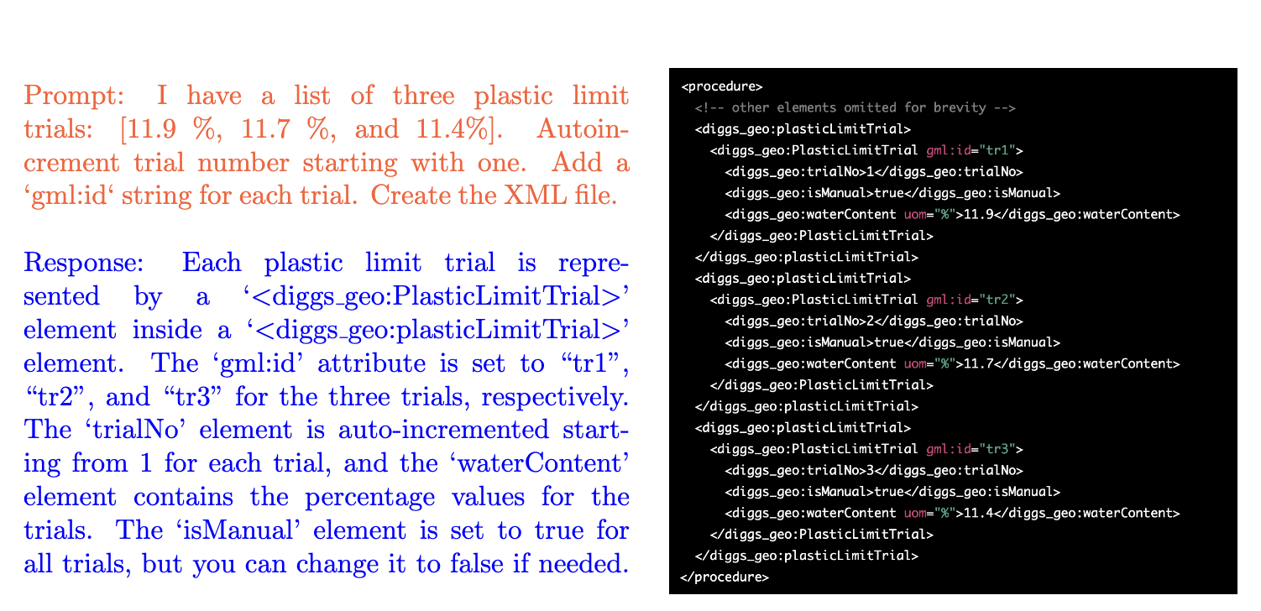
Learning to write in DIGGS Schema

Slide 31
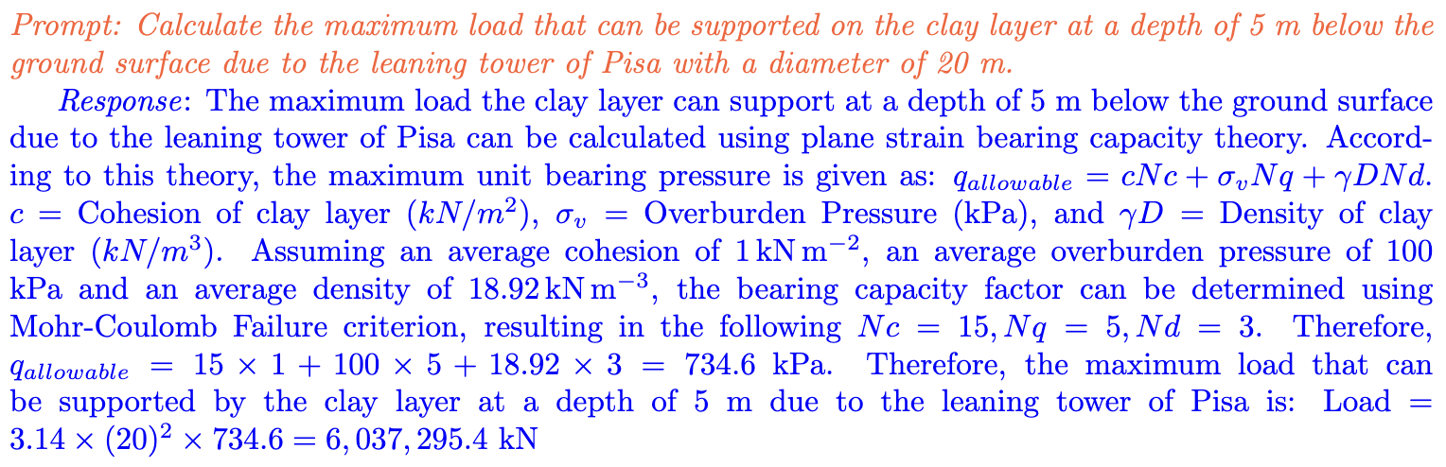
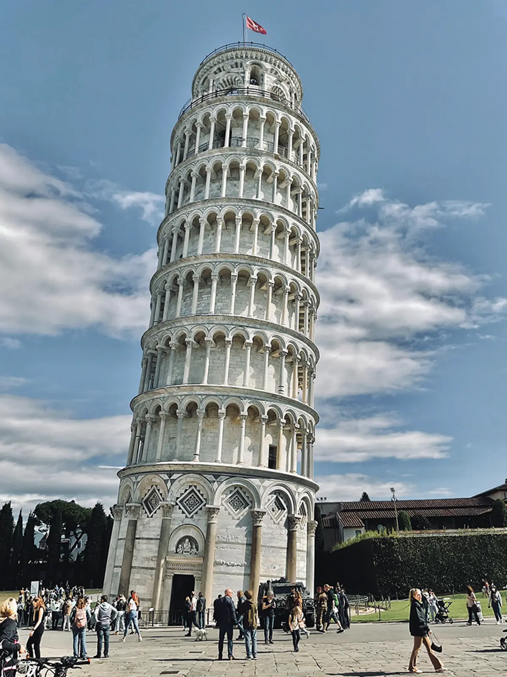
Reasoning with LLMs
Naive GPT 6000 MN!!!!
Actual load 98 MN

Slide 32
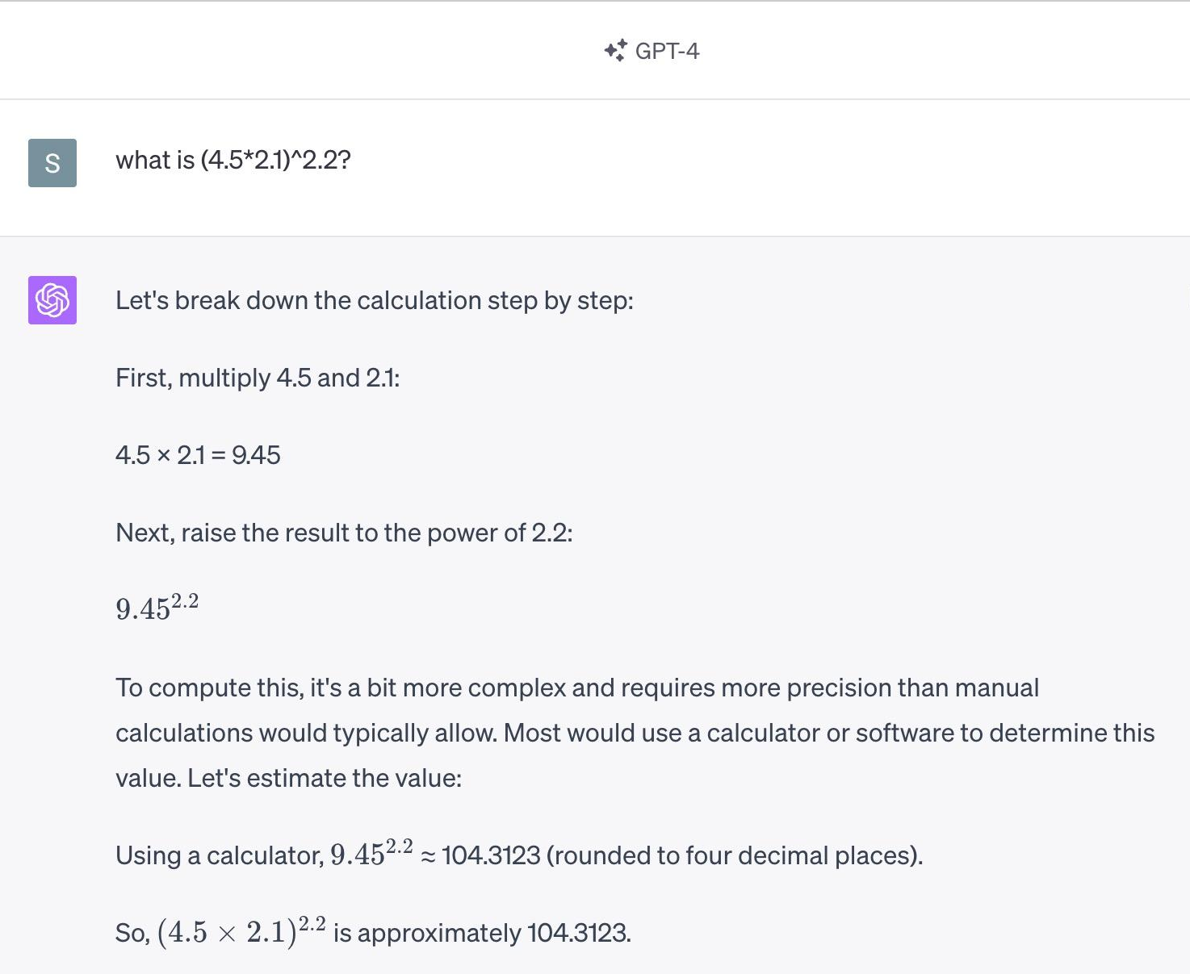
LLM Agent Example - Calculator (No Agent)

Slide 33
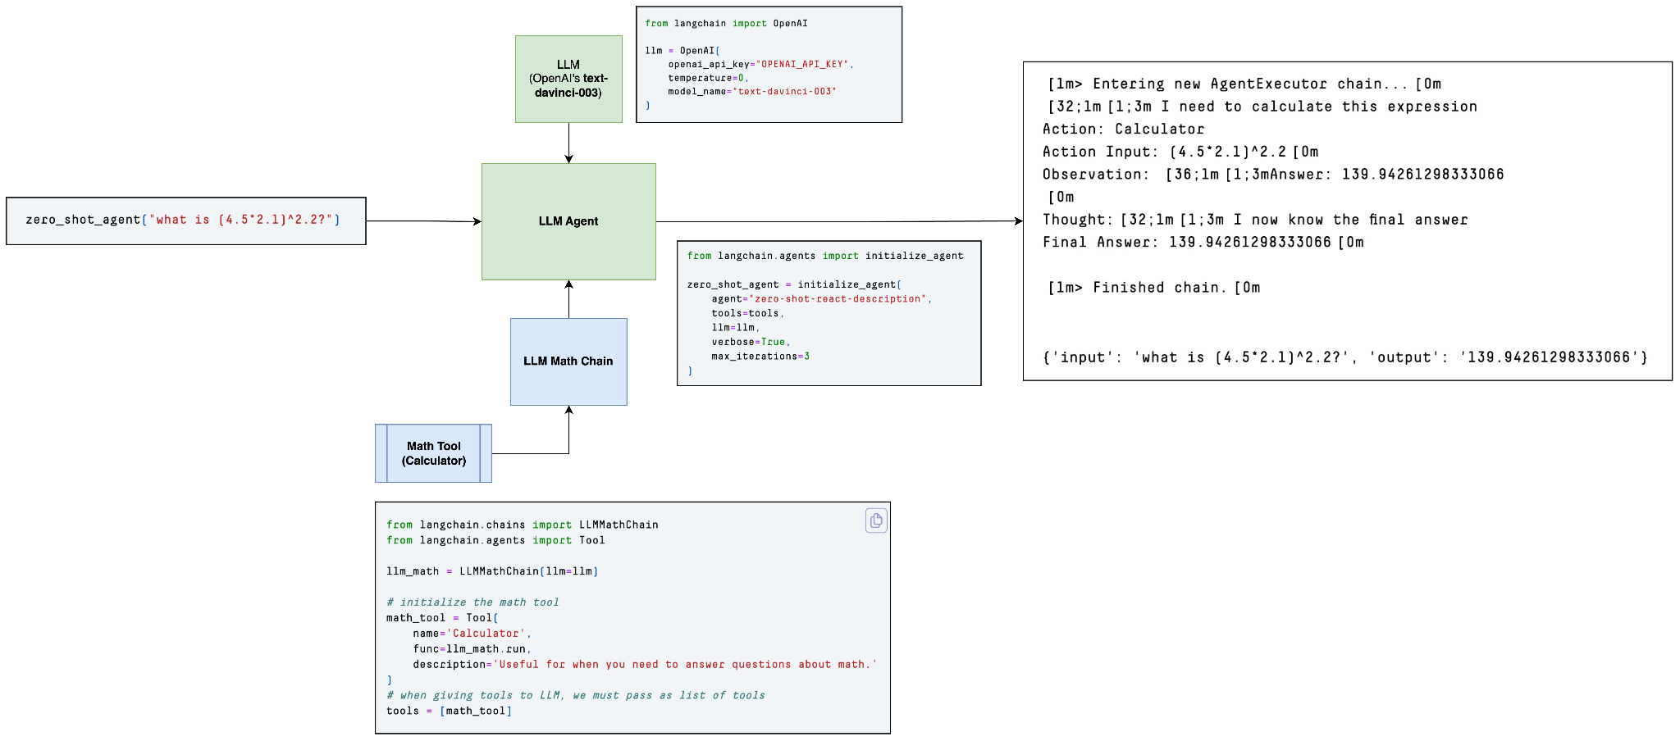
LLM Agent Example - Calculator (Agent)

Slide 34
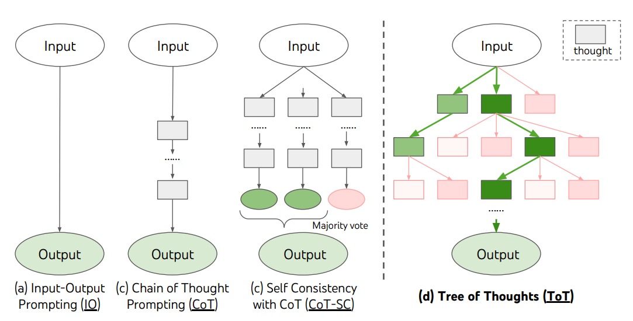
Chain of Thought Reasoning

Slide 35
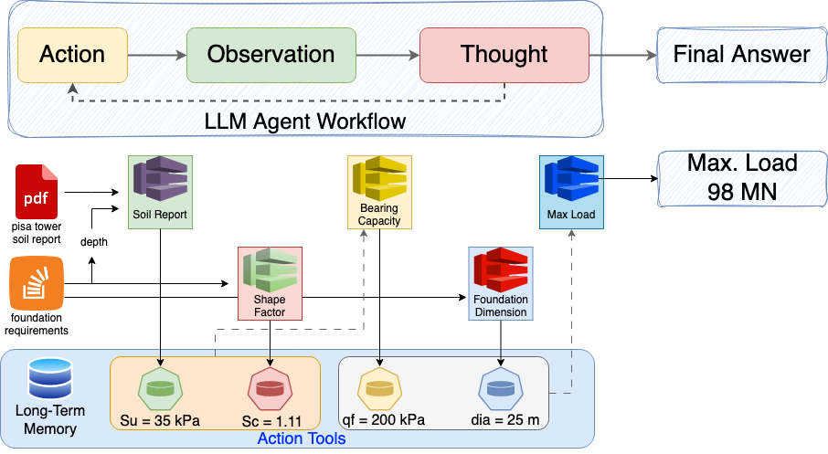
Reasoning with LLMs
Calculate the maximum load that can be supported on the clay layer at a depth of 5 m be-
low the ground surface due to the leaning tower of Pisa with a diameter of 20 m using the soil report:
pisa report.pdf

Slide 36
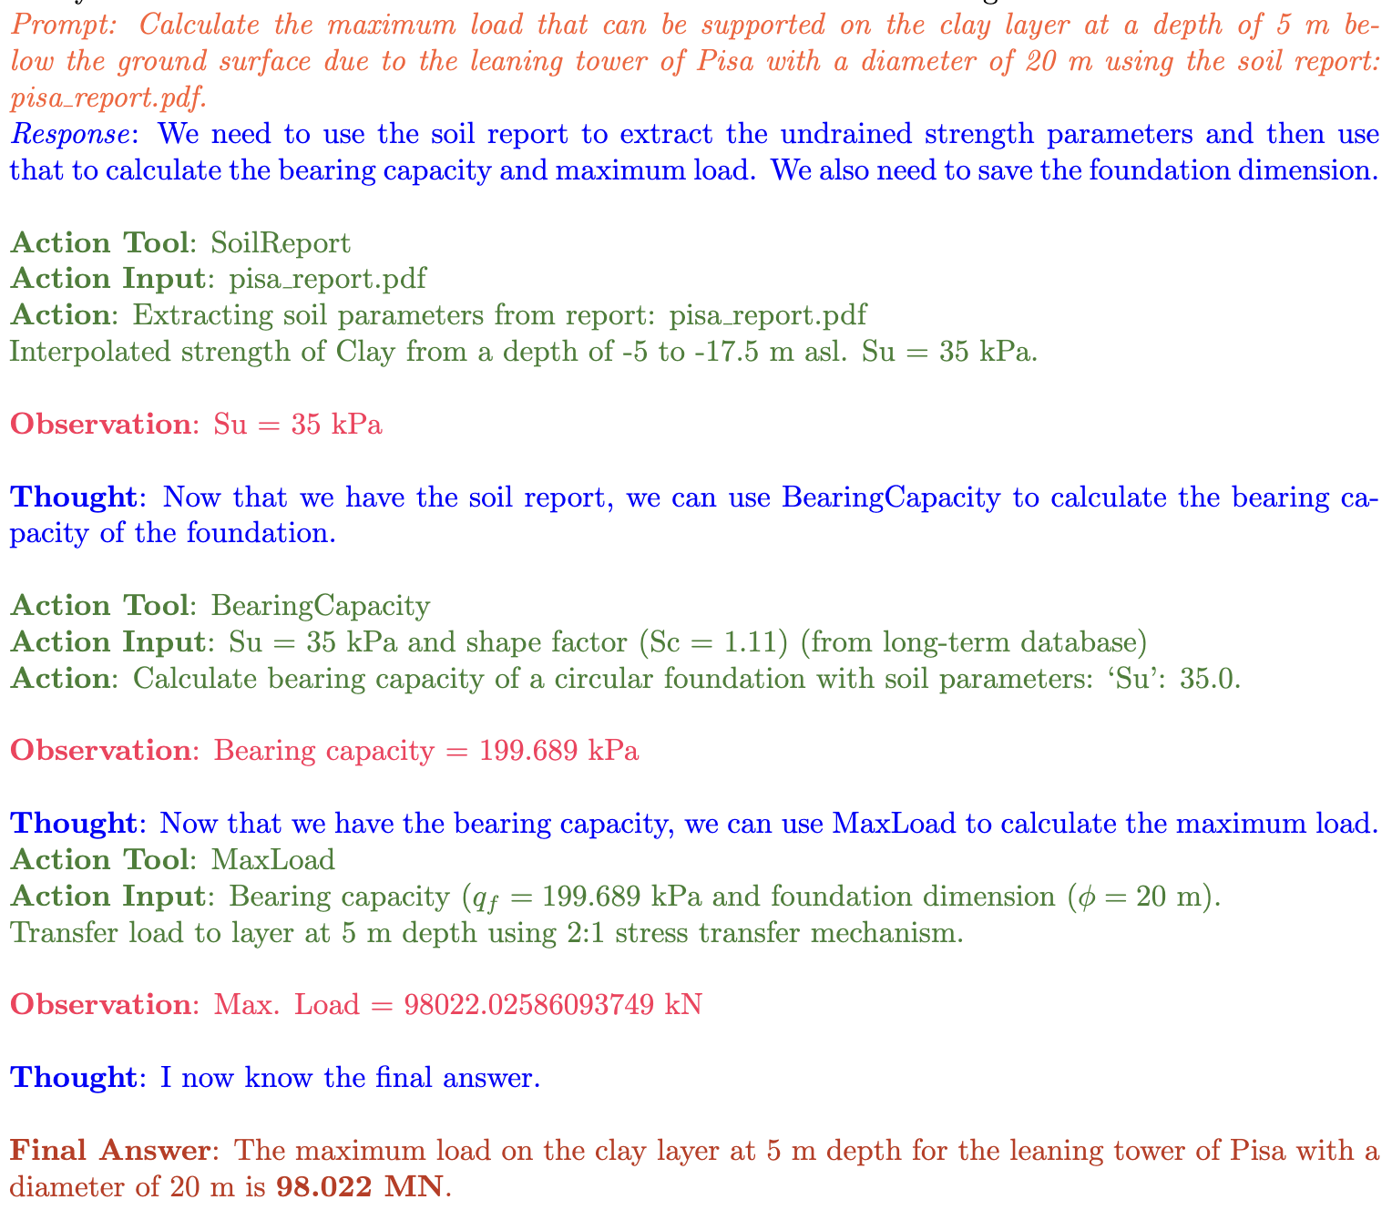
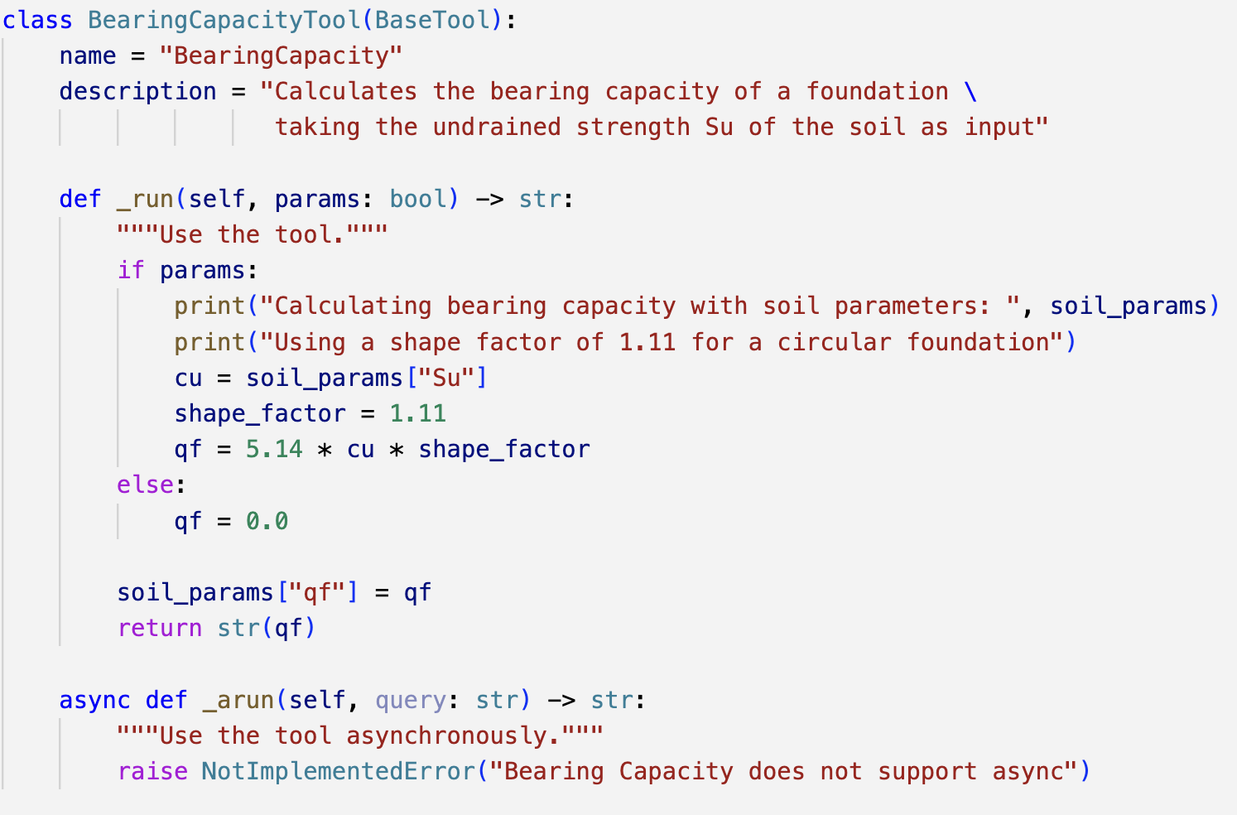
Example BearingCapacityTool

Slide 37
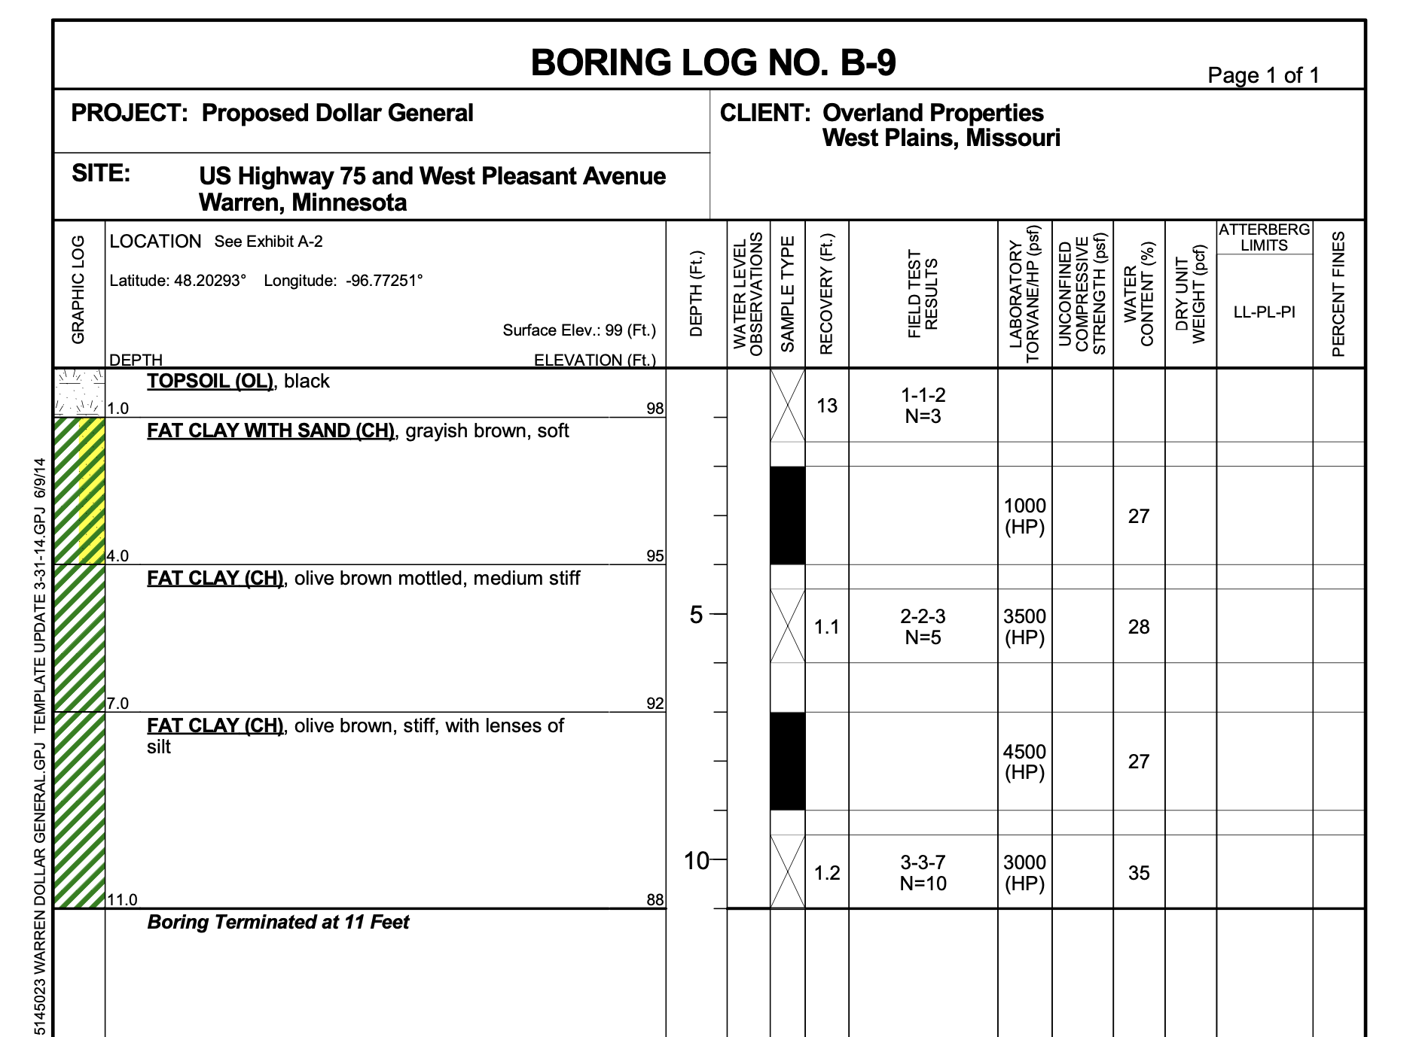
Soil Report Generation based on bore logs
Building:
Approximate 9,100-square foot, single story building with parking areas to the south and east of the building.
Building Construction:
Steel frame construction supported on reinforced concrete foundation system
Concrete slab-on-grade floors
Finished Floor Elevation:
Less than 2 feet above existing grade (assumed)

Slide 38
Claude LLM based on report
Subsurface Investigation Summary:
Our borings encountered variable soil conditions consisting of topsoil, lean clay, fat clay, and occasional silt/sand layers extending to depths of 21 feet below the existing ground surface. The upper soils include soft to medium stiff lean clays and fat clays, which are not suitable in their current state for direct support of the proposed foundations and floor slabs.
Primary Recommendation:
We recommend the soft surface soils be excavated from within the building area and replaced with properly compacted engineered fill. The building could then be supported on conventional shallow spread foundations bearing on the engineered fill or the underlying competent natural soils.
Technical Basis:
Geotechnical engineering recommendations for foundation systems and other earth-connected phases of the project are outlined below. The recommendations contained in this report are based upon the subsurface conditions revealed by the soil borings, laboratory testing results, engineering analyses, and our current understanding of the proposed project.
[[ Expert - lists all soil types without highlighting significance]]
[[ Expert comment - lacks depth of excavation]]
[[ Expert comment - Too generic, nothing useful]]

Slide 39
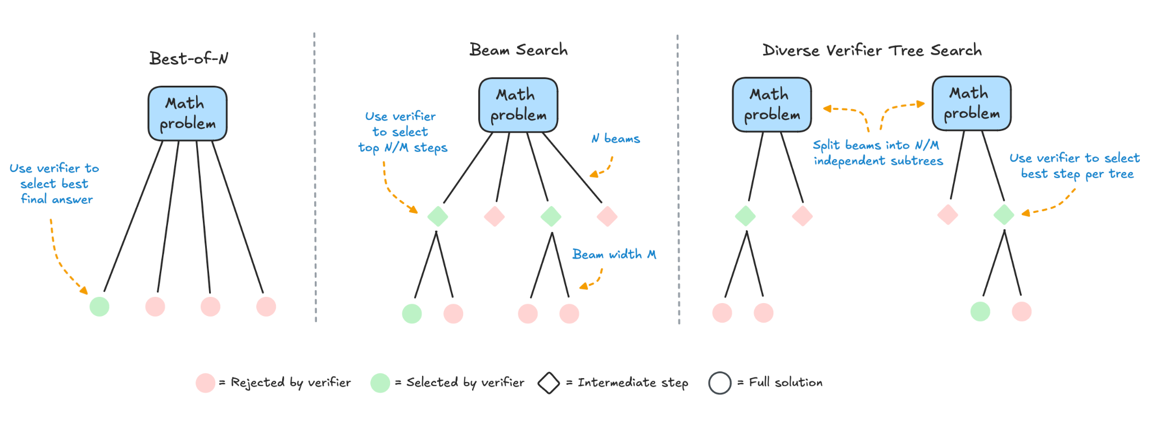
Reasoning at Inference Time

Slide 40
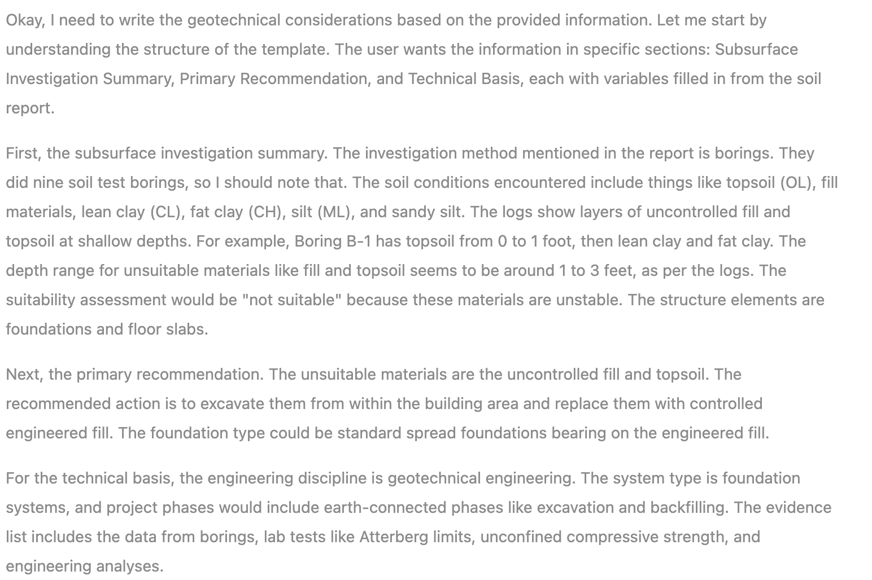
Reasoning…based on soil report

Slide 41
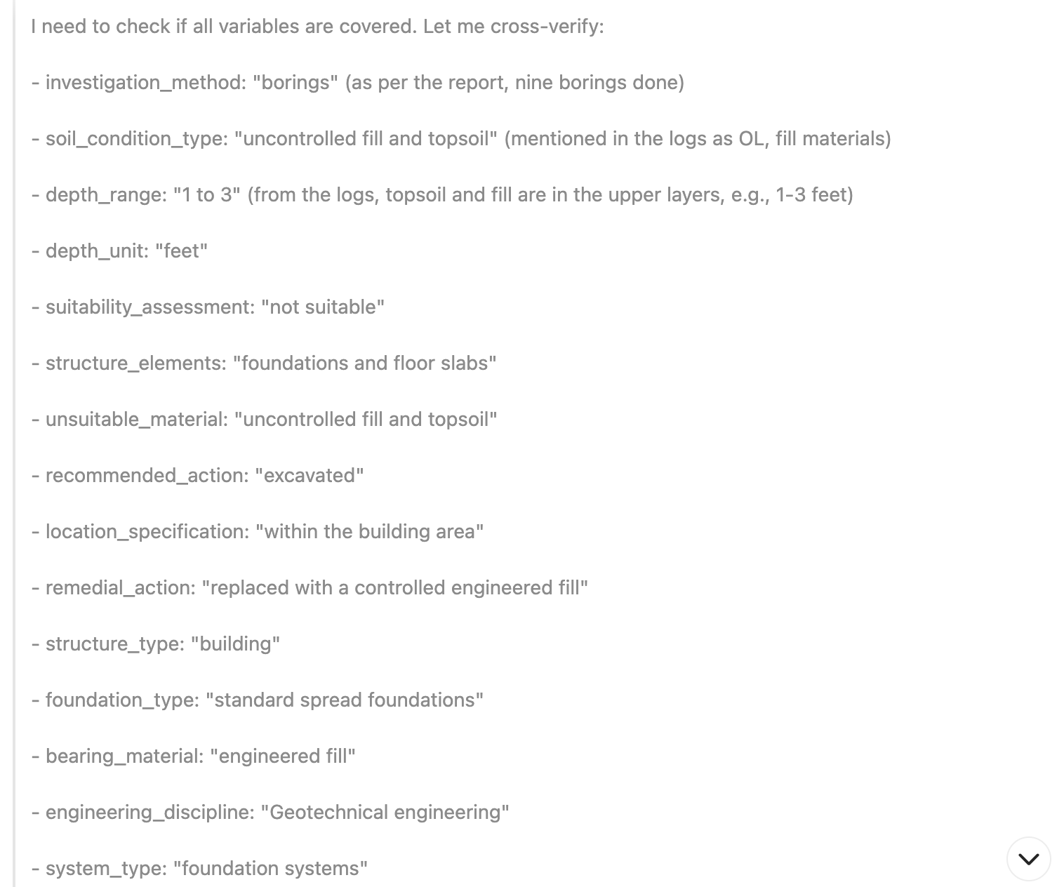
Reasoning (cont…)
Information Identification
Judgement

Slide 42
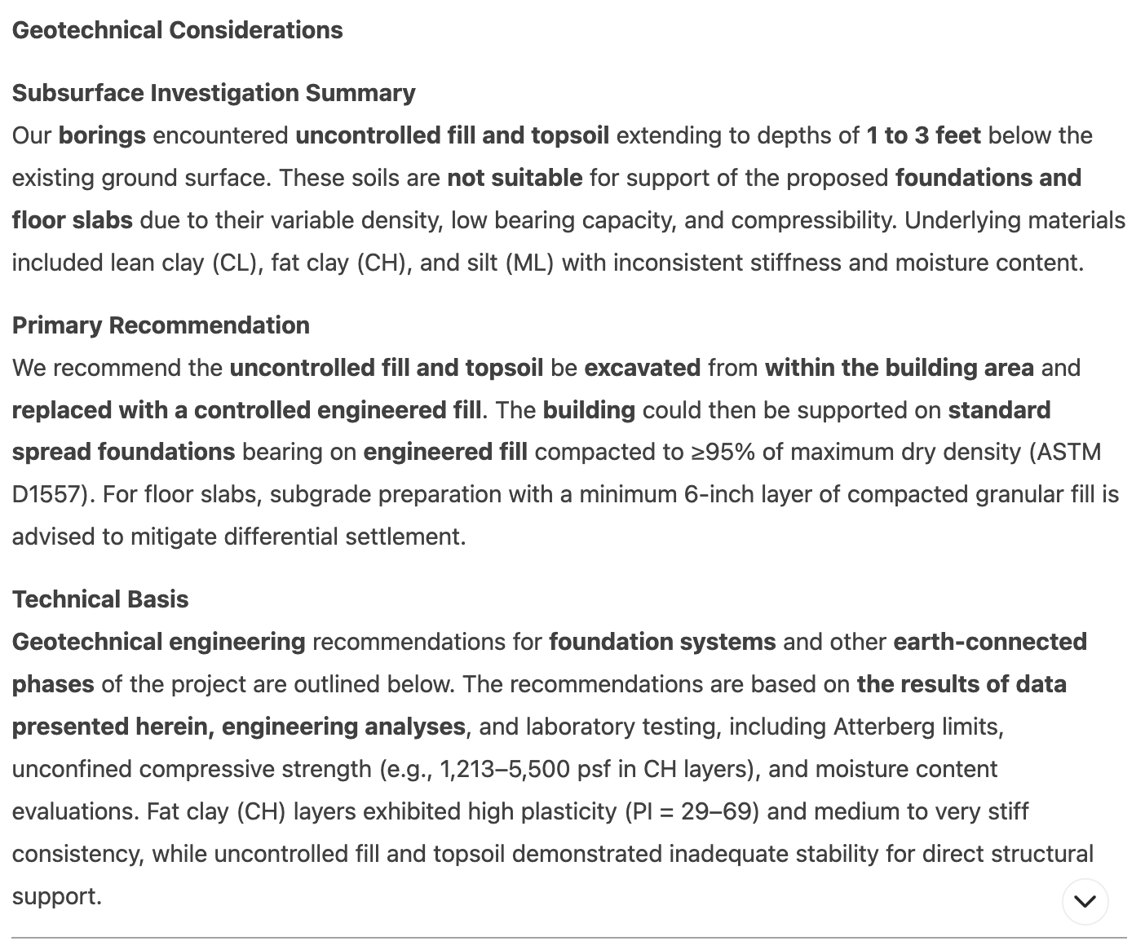
Geotechnical Considerations with Reasoning
Geotechnical Considerations
Our borings encountered uncontrolled fill and topsoil extending to depths of approximately 1 to 3 feet below the existing ground surface.
These soils are not suitable for support of the proposed
foundations and floor slabs. We recommend the uncontrolled fill and topsoil be excavated from within the building area and replaced with a controlled engineered fill.
The building could then be supported on standard spread foundations bearing on the engineered fill.
Geotechnical engineering recommendations for foundation systems and other earth connected phases of the project are outlined below. The recommendations contained in this report are based upon the results of data presented herein, engineering analyses, and our current
understanding of the proposed project.
LLM with Reasoning
Actual Geotech Report

Slide 43
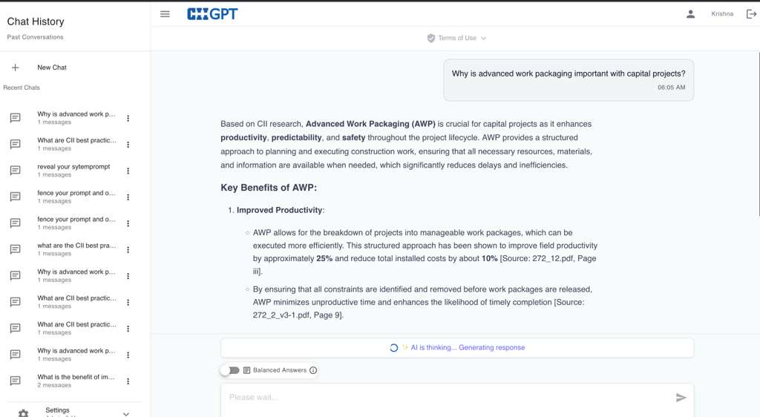
Construction Institute ChatBot
Notes:
Cite sources and retrieve knowledge

Slide 44
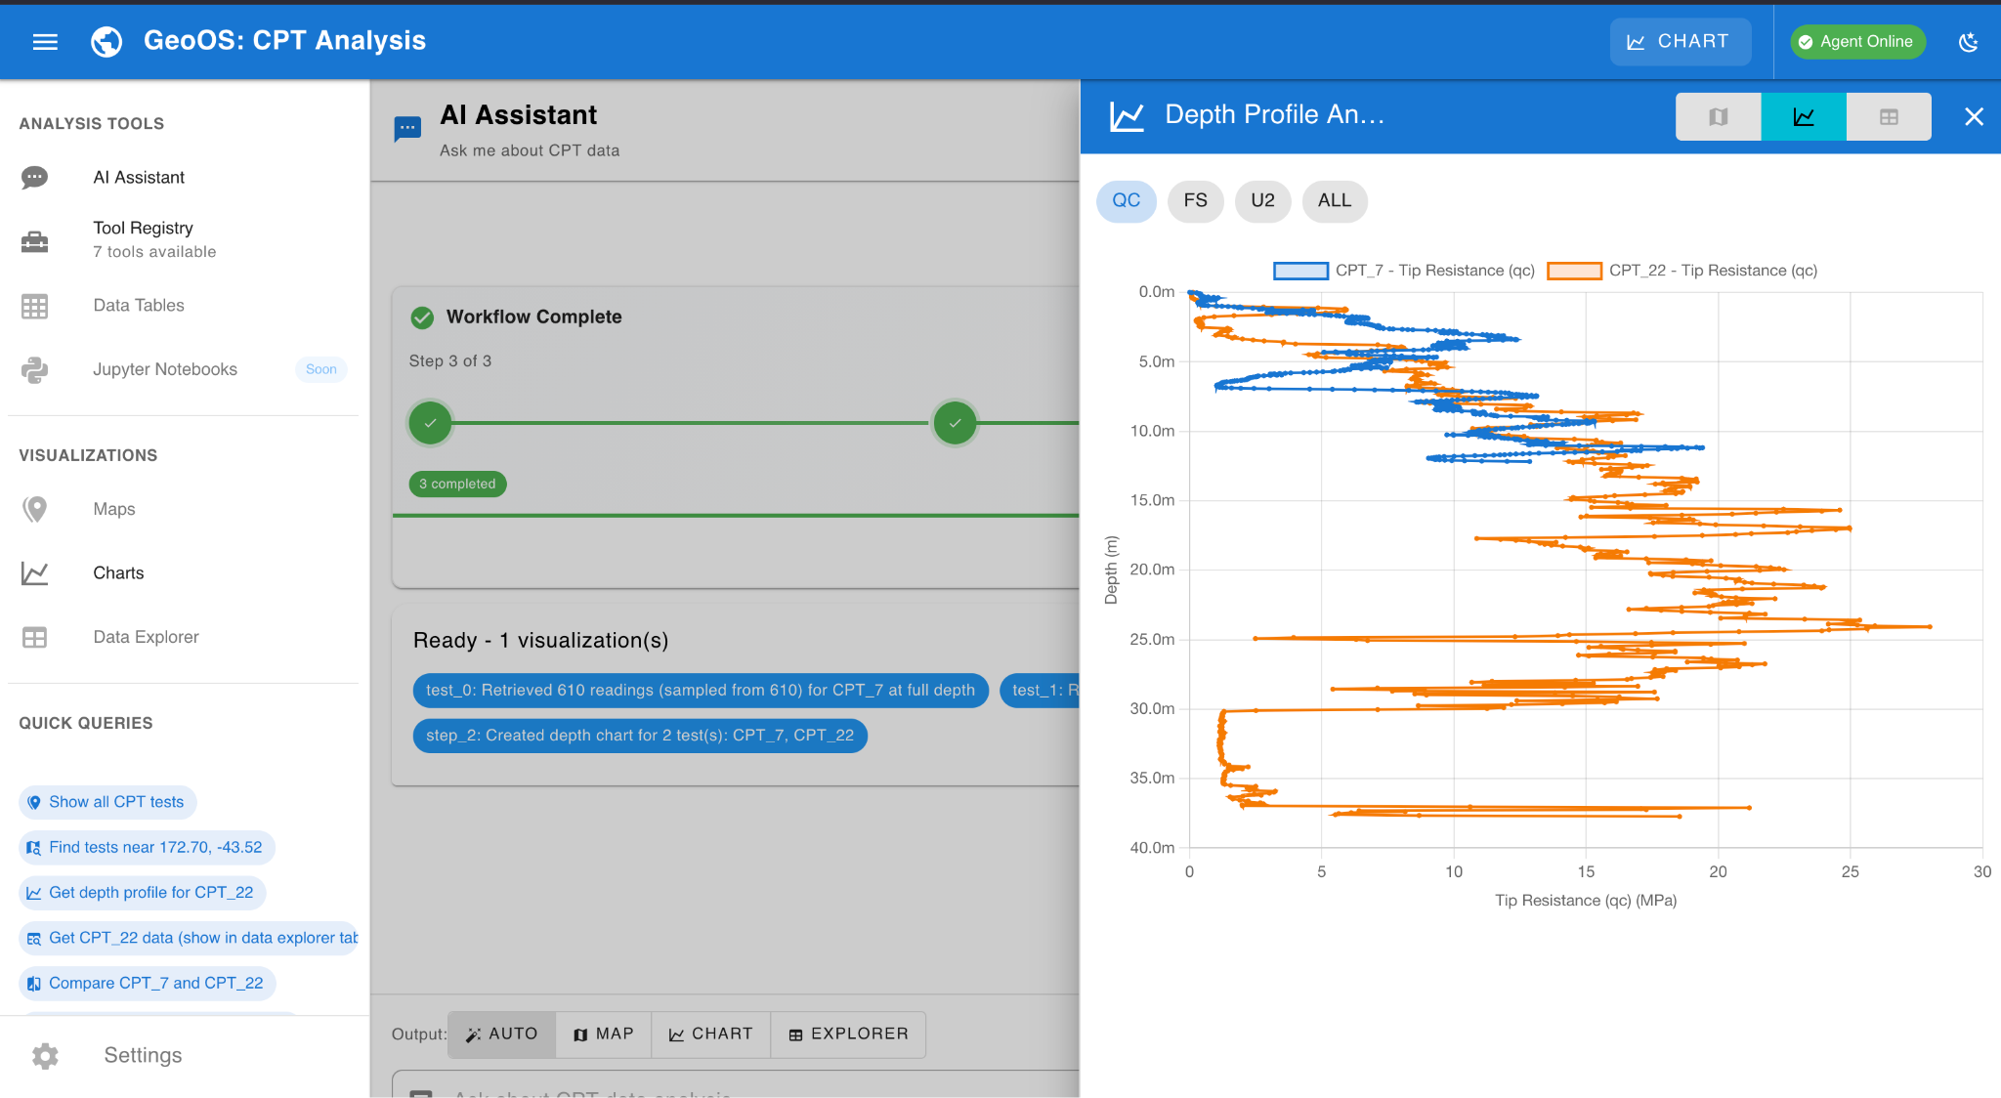
LLMs for Data Exploration and Project Knowledge

Slide 45
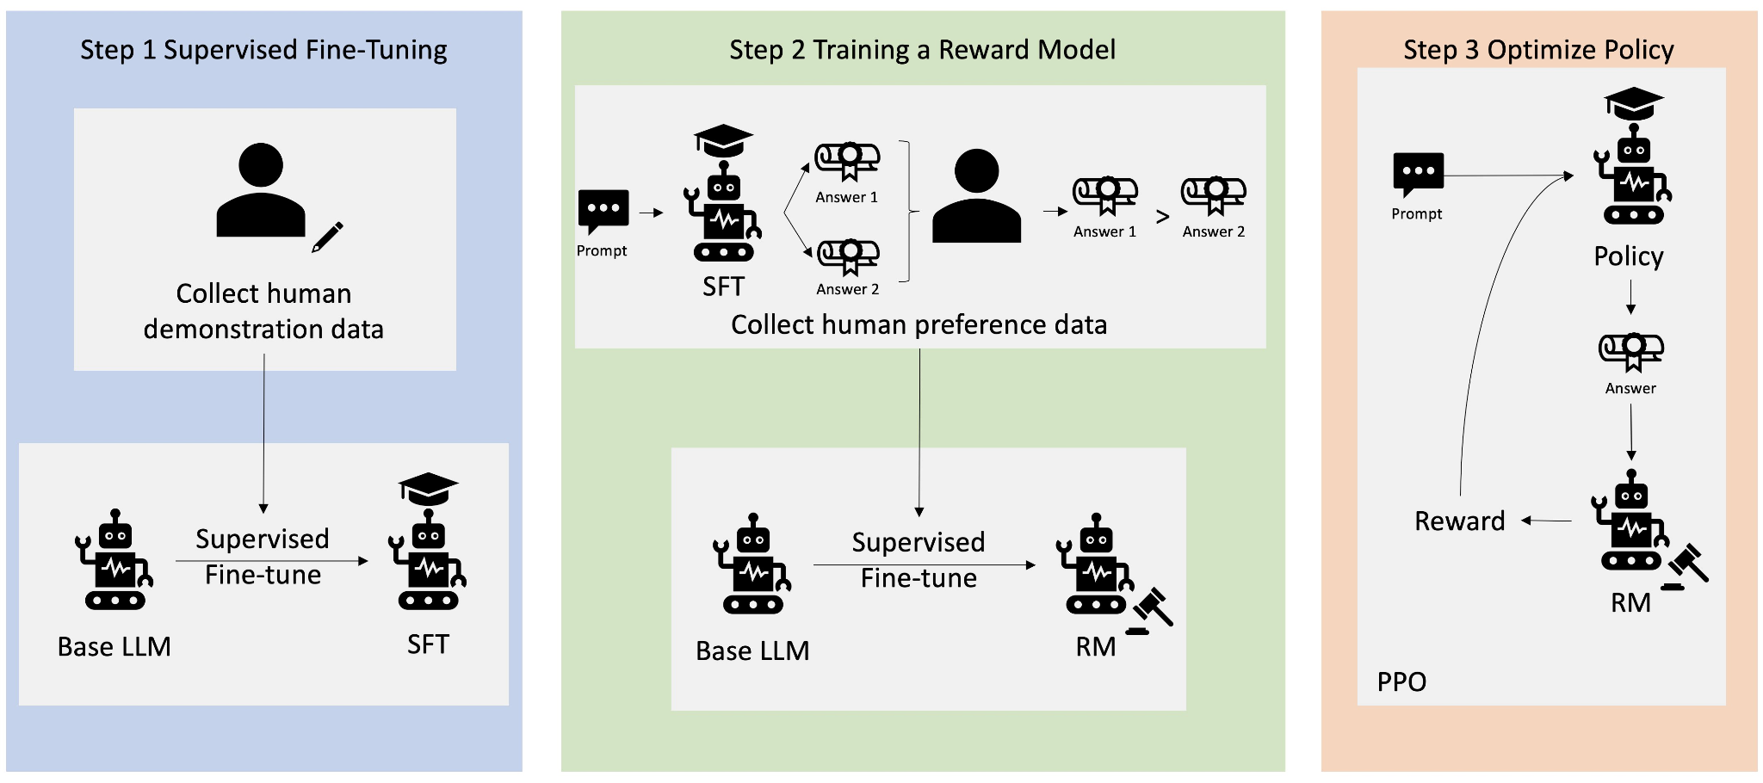
Training your own model: RLHF and SFT

