Slide 1
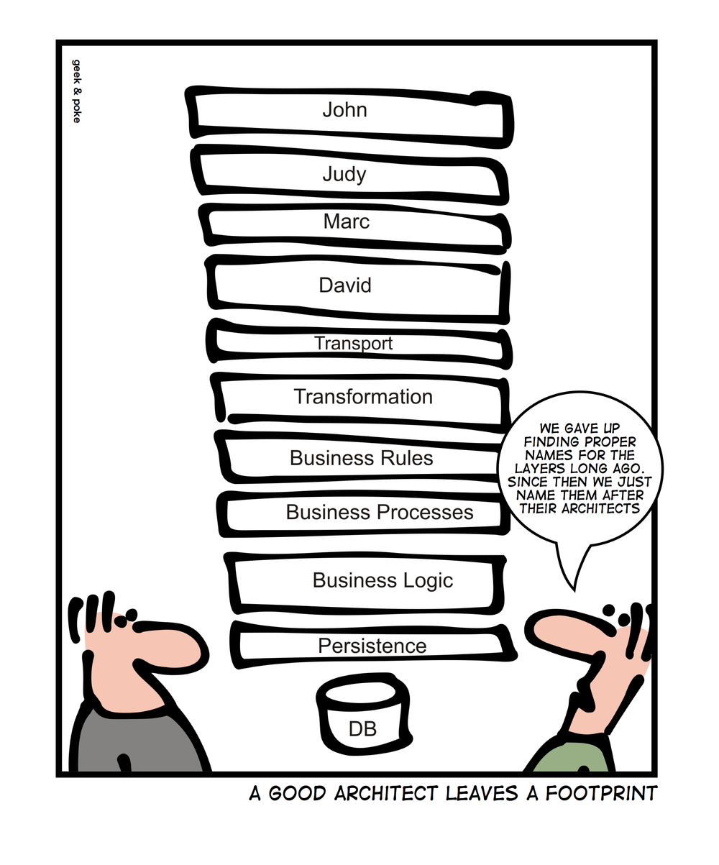
Metaclasses and Reflection
Krishna Kumar

Slide 2
Reflection
Reflection makes it possible to inspect classes, interfaces, fields and methods at runtime, without knowing the names of the classes, methods etc. at compile time.
Given some object we first should ask for its type. As a result we are given class descriptor, which provides information about class methods and fields. We can use these field descriptors to fetch/store object fields and can use method descriptors to lookup and invoke methods.
Unfortunately C++ doesn't support reflection:
  RTTI support was added to the language. But RTTI provides only very restricted subset of reflection: it allows to get object compile-time and runtime type (it is possible to get object runtime type only if object class contains virtual functions).
  You can compare types and you can get type name - and that is all you can do with RTTI.

Slide 3
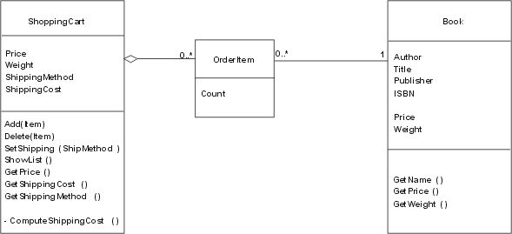
Online bookstore
Let's look at a simple example: Susan, the manager of a local bookstore, wants to expand into the Internet. So she asks you to write a simple program for an Internet bookshop.

Slide 4
Online book store
class Book {
public:
Book(const string & author_, const string & title_, const string & publisher_,
double price_, double weight_);
string getName() {
string name = author + ": " + title;
return name.substr(0, 40);
}
double getPrice();
double getWeight();
private:
string author, title, publisher;
double price, weight;
};

Slide 5
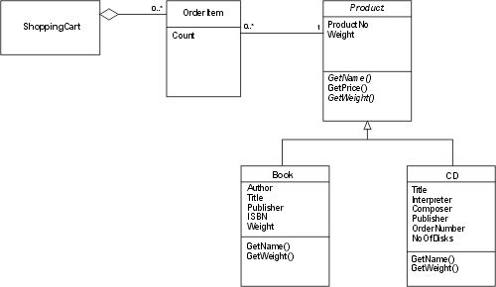
Online book store – Sell CDs
Susan decides to sell CDs as well. So you have to change your program. With object orientation, you can do this quite easily and your modified class model will look like

Slide 6
Massive online retail store
Now it is clear that it is not acceptable to modify. We need to provide different interfaces for the Product class: A simple interface for ShoppingCart providing getName(), getPrice(), and getWeight(). Then you need a different interface for a general search machine, which must provide information like:
  what is the actual class of the object
  what attributes does that class have
  what are the actual values of these attributes for the object.
This is a classic reflection interface that gives you information about the properties of classes and objects.
But you also need a third interface for product maintenance that allows you to define new product classes, specify the attributes for them, create instances of these classes, and set the attribute values of these instances. Such an interface is called a "Meta-Object Protocol (MOP)". The reflection protocol is a subset of such a MOP.

Slide 7
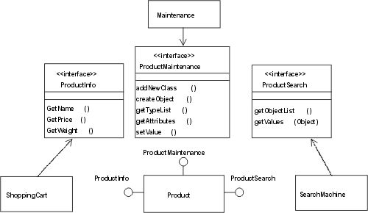
Online retail store – Better Model

Slide 8
Meta Classes for C++
What is the meaning of "Meta-Object Protocol"? Well, meta information is information about something else seen from a level beyond -- a meta level.
So, information about the attribute values of an object, say someBook.author, is information on the object level. But information about the properties of the object itself, about its attributes, its structure, etc. is meta information.
In C++, this information is captured in the class definition for the object, so the class is a meta-object. And in C++, you have all the functionality of a MOP at class level -- which is at development time. But that level is not available at runtime: You cannot manipulate classes like objects, you cannot add new classes at runtime.
The idea of a MOP is to collapse the meta-level (classes) and the object level (objects); i.e. make the class definitions normal objects and the object properties are normal attribute values of the class definitions that can be manipulated at runtime.

Slide 9
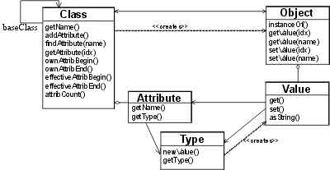
MOP Overview
  definition of new classes
  adding attributes to classes
  querying attributes of classes
  creating objects
  querying the class of an object
  setting attribute values of an object
  querying attribute values of an object
  deleting objects
For our example with the Internet shop and a product hierarchy this would probably quite useful.

Slide 10
MOP Class: Type
The main purpose of Type is to distinguish different kind of Attributes. For this, a simple enum would suffice. But the idea of types is to have different kind of Values for different Types, so the Type should create new Values. So we put the enum inside the Type class, provide the newValue() method.
Though we don't look closer at Value for now, if we have different kind of values we probably need some base class for them. Let's call it "BaseValue", and newValue() can just return a pointer to BaseValue.
Now we know what to create, but how? While there are several patterns to implement polymorphic creation, the simplest one for our purpose is probably the Prototype, which can be easily implemented with a simple static vector.

Slide 11
MOP Class: Type
class Type {
public:
enum TypeT {stringT, intT, doubleT, unknownT};
explicit Type(TypeT typeId_) : typeId(typeId_) {} // Explicit constructor
BaseValue * newValue() const { return prototypes[typeId]->clone(); }
TypeT getType() const {return typeId; }
static void init(); {
prototypes[stringT] = new Value<string>("");
prototypes[intT] = new Value<int>(0);
prototypes[doubleT] = new Value<double>(0);
}
private:
TypeT typeId;
static vector<BaseValue *> prototypes;
};
vector<BaseValue *> Type::prototypes(Type::unknownT);

Slide 12
MOP Class: Attribute
As we have decided to create new Values through Type, Attribute contains only a name and type, so here is its implementation:
class Attribute {
  public:
    Attribute(const string & name_, Type::TypeT typeId) : name(name_),
          type_(typeId) {}
    const string & getName() const { return name; }
    Type getType() const { return type_; }
  private:
    string name;
    Type type_;
};

Slide 13
MOP Class: Class
We can now finish the class (meta-) level of our model by looking at Class itself. As multiple inheritance is probably not an issue for our purposes, we have just one pointer to a base class (which can be null). The more important question is the attribute list: Should it hold only the attributes defined for this class or should it include all inherited attributes? While for the actual object value access a complete list is more useful (and much faster), for class maintenance it might be important to know which attribute was defined in which class. So we just keep both.
What happens if the name of an attribute is the same as the name of an inherited attribute? in this case we must guarantee that on lookup of an attribute by name we get the most derived attribute. So, findAttribute() must do a reverse search. So findAttribute() returns an index and getAttribute() takes an index and returns an Attribute. So the Attribute lists need to be an indexed containers, so we choose vectors for them.

Slide 14
MOP Class: Class (cont...)
A major purpose of Class is to create Objects from it, so it has a method newObject() which returns a pointer to an Object. Do we need to keep a repository with references to all created objects? For a full reflection interface we should do this. But for actual applications this is nearly never useful, as objects of the same class are created for completely different purposes.
What do we do with already existing objects if we add a new attribute to a class?
  add this attribute to all existing objects and assign it a default value.
  leave these existing objects and add the new attribute only to new objects. This leads to differently structured objects of the same class at the same time, and then we must add some version information to the objects.
  To forbid the modification of a class definition once an instance of that class was created. This is the easiest option, so we adopt it for our MOP and add a flag definitionFix. With that flag, we can skip the object repository.
A last design question is when to add the attributes: At creation time of a class definition (through the constructor) or later (with a member function)? For different applications both options might be useful, so we'll provide two constructors and addAttribute().

Slide 15
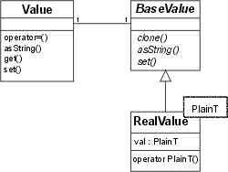
MOP Class: Values
Base value
The whole idea of Value is to store values,
so we need a set() function.
What parameter?
  The only thing we have is BaseValue, so that's the parameter type. Pass by value, by reference, or by pointer? Definitely not by value, as BaseValue is only an interface. On the other hand, what you pass is a value, so the parameter passing should be by value to let you pass temporaries. So one option would be to pass by const reference. But though this helps for the problem at hand, it doesn't cure the fundamental problem: you should have a value, but all you have is a polymorphic interface. The real solution here is the pimpl idiom or more generally Handle/Body. So we add a handle class, name it Value, and look at it later again. For now we're still at BaseValue.

Slide 16
References
http://www.vollmann.com/en/pubs/meta/meta/meta.html
http://www.garret.ru/cppreflection/docs/reflect.html
http://www.garret.ru/cppreflection/docs/reflect.html

