Slide 1
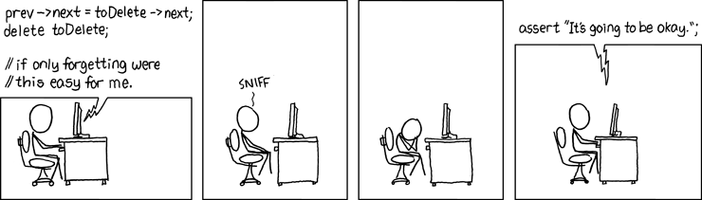
C++ Pointers (Part II), Arrays
&References
(https://xkcd.com/379/)
Krishna Kumar

Slide 2
Pointers (recap)
Pointer values are memory addresses
A pointer does not know the number of elements that it's pointing to.
A pointer does know the type of the object that it's pointing to
Stack: Stores local data, return addresses, used for parameter passing
      Local variables
      Cleared when out of scope
Heap:You would use the heap if you don't know exactly how much data you will need at runtime or if you need to allocate a lot of data
      Accessed using new and delete
      Memory leaks – manual delete of used memory

Slide 3
Void*
void* means “pointer to some memory that the compiler doesn't know the type of”
We use void* when we want to transmit an address between pieces of code that really don't know each other's types – so the programmer has to know
The primary use for void* is for passing pointers to functions that are not allowed to make assumptions about the type of the object and for returning untyped objects from functions
There are no objects of type void
  void v; // error
  void f(); // f() returns nothing – f() does not return an object of type void
Any pointer to object can be assigned to a void*
  int* pi = new int;
  double* pd = new double[10];
  void* pv1 = pi;
  void* pv2 = pd;

Slide 4
void* (cont...)
To use a void* we must tell the compiler what it points to
  void f(void* pv) {
  void* pv2 = pv; // copying is ok (copying is what void*s are for)
  double* pd = pv; // error: can’t implicitly convert void* to double*
  *pv = 7; // error: you can’t dereference a void*
  ++pv; // error: can't increment void*
  // (the size of the object pointed to is unknown)
  pv[2] = 9; // error: you can’t subscript a void*
  int* pi = static_cast<int*>(pv); // ok: explicit conversion
                // Unsafe!!
  // …
}
A static_cast can be used to explicitly convert to a pointer to object type
  "static_cast" is a deliberately ugly name for an ugly (and dangerous) operation – use it only when absolutely necessary

Slide 5
Warnings
There are some serious gotchas when using casts on pointers, so try to avoid them
  There is precisely one safe use, to get back to the type you started with – and a compiler can't check you got it right
  myclass object();
  myclass* myptr = object.addr();
  void* rawptr = myptr;
  . . .
  myclass* newptr = static_cast<myclass*>(rawptr);
You will often see C-style casts in C++ code derived from C – or by C programmers writing “C++”
  They look like (newtype)expression
But don't write them
  They are extremely hard to spot in non-trivial code
  They are even less safe than reinterpret_cast

Slide 6
void*
void* is the closest C++ has to a plain machine address
Functions using void* pointers typically exist at the very lowest level of the system, where real hardware resources are manipulated.
void* my_alloc(size_t n); // allocate n bytes
  //from my special heap
Avoid using it if you possibly can
  It bypasses essentially all type checks
  Occurrences of void*s at higher levels of the system should be viewed with great suspicion because they are likely indicators of design errors.
Pointers to functions and pointers to members cannot be assigned to void*s.

Slide 7
nullptr
A pointer that does not point to an object.
It can be assigned to any pointer type, but not to other built-in types:
  int* pi = nullptr;
  double* pd = nullptr;
  int i = nullptr; // error: i is not a pointer
  int* x = 0; // x gets the value nullptr
  int* p = NULL; // error: can't assign a void* to an int*
  // Macro NULL is typically (void*)0,
  // which makes it illegal in C++

Slide 8
Arrays
For a type T, T[size] is the type “array of size elements of type T.” indexed from 0 to size–1.
float v[3]; // an array of three floats: v[0], v[1], v[2]
char* a[32]; // an array of 32 pointers to char: a[0] .. a[31]
Arrays don’t have to be on the free store
  char ac[7]; // global array – “lives” forever –
  // “in static storage” -AVOID!
  int max = 100;
  int ai[max];
  int f(int n) {
    char lc[20]; // local array – “lives” until the end of
            // scope – on stack
    int li[60];
    double lx[n]; // error: a local array size must be known
    // at compile time
    std::vector<double> lx(n); would work
  // …
  }

Slide 9
Initialization syntax
char ac[ ] = "Hello, world"; // array of 13 chars, not 12 (the compiler
// counts them and then adds a null
// character at the end
char* pc = "Howdy"; // pc points to an array of 6 chars
char* pp = {'H', 'o', 'w', 'd', 'y', 0 }; // another way of saying the same
int ai[ ] = { 1, 2, 3, 4, 5, 6 }; // array of 6 ints
// not 7 – the “add a null character at the end”
// rule is for literal character strings only
int ai2[100] = { 0,1,2,3,4,5,6,7,8,9 }; // the last 90 elements are initialized to 0
double ad3[100] = { }; // all elements initialized to 0.0

Slide 10
Address of: &
You can get a pointer to any object
  not just to objects on the free store
  int a;
  char ac[20];
  void f(int n)
  {
  int b;
  int* p = &b; // pointer to individual variable
  p = &a;
  char* pc = ac; // the name of an array names a pointer to its first element
  pc = &ac[0]; // equivalent to pc = ac
  pc = &ac[n]; // pointer to ac’s n^{th} element (starting at 0th)
  // warning: range is not checked
  // …
  }
pc:
p:
a:
ac:

Slide 11
Arrays (often) convert to pointers
void f(int pi[ ]) // equivalent to void f(int* pi)
{
int a[ ] = { 1, 2, 3, 4 };
int b[ ] = a; // error: copy isn’t defined for arrays
b = pi; // error: copy isn’t defined for arrays. Think of a
// (non-argument) array name as an immutable pointer
pi = a; // ok: but it doesn’t copy: pi now points to a’s first element
// Is this a memory leak? (maybe)
int* p = a; // p points to the first element of a
int* q = pi; // q points to the first element of a
}
1st
pi:
2nd
a:
1
2
3
4
p:
q:

Slide 12

Arrays into pointers
int v[] = { 1, 2, 3, 4 };
int* p1 = v; // pointer to initial element (implicit
// conversion)
int* p2 = &v[0]; // pointer to initial element
int* p3 = v+4; // pointer to one-beyond-last element
int* p4 = v–1; // before the beginning, undefined: don't do it
int* p5 = v+7; // beyond the end, undefined: don't do it

Slide 13
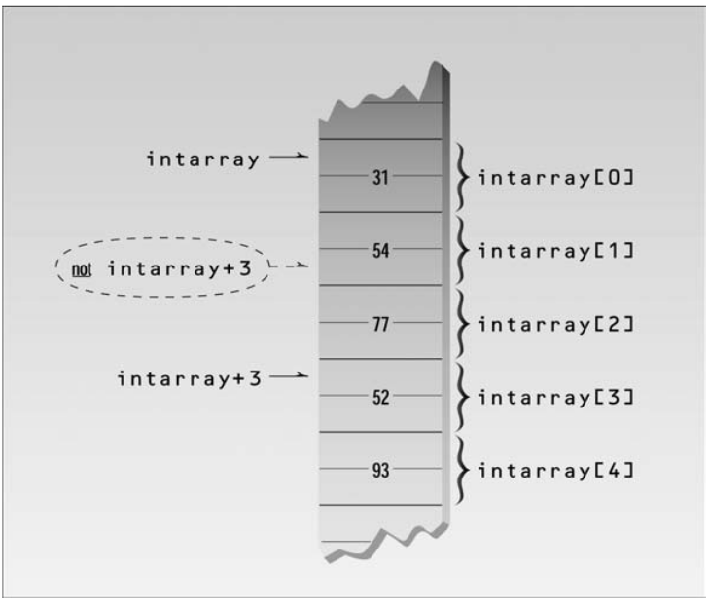
Accessing Array Elements
void fi(char v[]) {
for (int i = 0; v[i]!=0; ++i)
use(v[i]);
}
void fp(char v[]) { //Using Pointers
for (char* p = v; *p!=0; ++p)
use(*p);
}
Subscripting a built-in array a[j]:
a[j] == *(&a[0]+j) == *(a+j) == *(j+a) == j[a]
3["Texas"]=="Texas"[3]=='a' (But, don't do it!)

Slide 14
Multidimensional Arrays
are represented as arrays of arrays.
a 3-by-5 array is declared like this:
int ma[3][5]; // 3 arrays with 5 ints each
We can initialize ma like this:
void init_ma() {
for (int i = 0; i!=3; i++)
for (int j = 0; j!=5; j++)
ma[i][j] = 10*i+j;
}
The array ma is simply 15 ints that we access as if it were 3 arrays of 5 ints. In particular, there is no single object in memory that is the matrix ma – only the elements are stored. The dimensions 3 and 5 exist in the compiler source only.

Slide 15
Be careful with arrays and pointers
char* f() {
  char ch[20];
  char* p = &ch[90];
  // …
  *p = 'a'; // we don’t know what this’ll overwrite
  char* q; // forgot to initialize
  *q = 'b'; // we don’t know what this’ll overwrite
  return &ch[10]; // oops: ch disappear upon return from f()
            // (an infamous “dangling pointer”)
}
void g() {
  char* pp = f();
  *pp = 'c'; // we don’t know what this’ll overwrite
  // (f’s ch are gone for good after the return from f)
}

Slide 16
Passing Arrays
Arrays cannot directly be passed by value
void comp(double arg[10]) { // arg is a double*
for (int i=0; i!=10; ++i)
arg[i]+=99;
}
// writes to arg[i] are writes directly to the elements of comp()’s argument, rather than to a copy
void f() {
double a1[10];
double a2[5];
double a3[100];
comp(a1);
comp(a2); // disaster!
comp(a3); // uses only the first 10 elements
};

Slide 17
Arrays don’t know their own size
void f(int pi[ ], int n, char pc[ ]) {
    // equivalent to void f(int* pi, int n, char* pc)
    // warning: very dangerous code, for illustration only,
// never “hope” that sizes will always be correct
char buf1[200];
strcpy(buf1,pc); // copy characters from pc into buf1
// strcpy terminates when a '\0' character is found
// hope that pc holds less than 200 characters
strncpy(buf1,pc,200); // copy 200 characters from pc to buf1
// padded if necessary, but final '\0' not guaranteed
int buf2[300]; // you can’t say char buf2[n]; n is a variable
if (300 < n) error("not enough space");
for (int i=0; i<n; ++i) buf2[i] = pi[i]; // hope that pi really has space for // n ints; it might have less
}

Slide 18
Pointers and Consts
constexpr: Evaluate at compile time
const: Do not modify in this scope
const int model = 90; // model is a const
const int v[] = { 1, 2, 3, 4 }; // v[i] is a const
const int x; // error: no initializer
// Declaring something const ensures that its value will not change within its scope:
void f() {
model = 200; // error
v[2] = 3; // error
}

Slide 19
Pointers and const
void f1(char* p) {
char s[] = "Gorm";
const char* pc = s; // pointer to constant
pc[3] = 'g'; // error: pc points to constant
pc = p; // OK
char* const cp = s; // constant pointer
cp[3] = 'a'; // OK
cp = p; // error: cp is constant
const char *const cpc = s; // const pointer to const
cpc[3] = 'a'; // error: cpc points to constant
cpc = p; // error: cpc is constant
}

Slide 20
Pointers and references
Think of a reference as an automatically dereferenced pointer
  Or as “an alternative name for an object”
  A reference must be initialized
  The value of a reference cannot be changed after initialization
    int x = 7;
    int y = 8;
    int* p = &x;
    *p = 9;
    p = &y; // ok
    int& r = x;
    x = 10;
    r = 11;
    r = &y; // error (and so is all other attempts to change what r refers to)

Slide 21
Vectors and Arrays (C++11)
Vectors are sequence containers, that are dynamic and they know their size
vector<int> vi; // create a zero-size vector of int
array<int, 5> ai;
// create array object of 5 ints
array<double, 4> ad = {1.2, 2.1, 3.43. 4.3}

Slide 22
Iterating through vectors
// Normal way of iteration
for(int i=0; i < vector.size(); i++){
std::cout << vector[i] << std::endl;
}
// Safe way to iterate – will never go over the size! Exception handling
for(int i=0; i < vector.size(); i++){
std::cout << vector.at(i) << std::endl;
}

Slide 23
Iterating through vectors
// Normal
for(std::vector<T>::size_type i = 0; i != v.size(); i++)
v[i].doSomething();
// Iterators
for(std::vector<T>::iterator it = v.begin(); it != v.end(); ++it)
it->doSomething();
// auto
for (auto it = v.begin(); it != v.end(); ++it)
it->doSomething ();
// elements
for (auto & element : v) {
element.doSomething ();
}
// for_each
std::for_each(v.begin(), v.end(), doSomething());

Slide 24
References
Bjarne Stroustrup C++
C++ Primer Plus
Object Oriented Programming in C++
http://people.ds.cam.ac.uk/nmm1/C++/index.html
(exercise 17&18)

