Slide 1
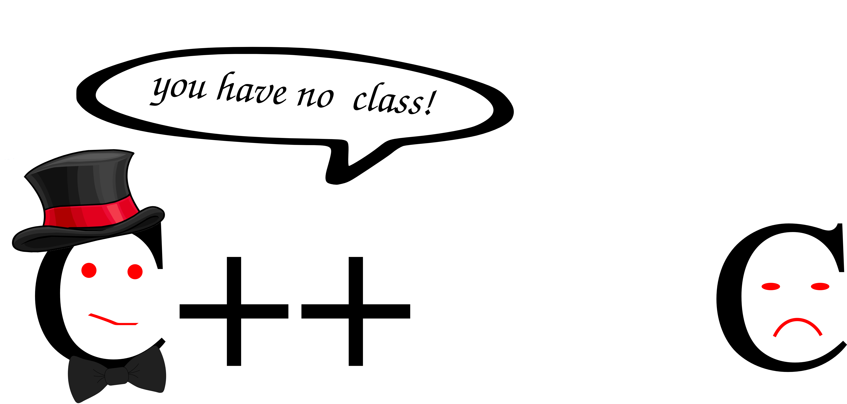
C++ Classes (Part I)
Krishna Kumar

Slide 2
Class Basics
A class is a user-defined type.
A class consists of a set of members. The most common kinds of members are data members and member functions.
Member functions can define the meaning of initialization (creation), copy, move, and cleanup (destruction).
Members are accessed using . (dot) for objects and –> (arrow) for pointers.
Operators, such as +, !, and [], can be defined for a class.
A class is a namespace containing its members.
The public members provide the class’s interface and the private members provide implementation details

Slide 3
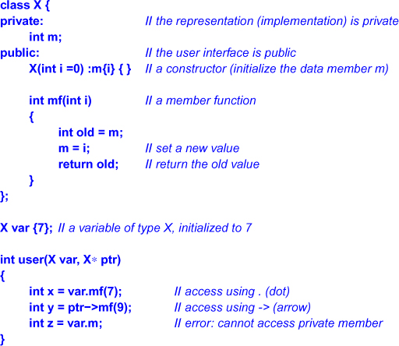
Class basics

Slide 4
Initialization function ()
class Rectangle {
int width, height;
public:
void set_values (int,int) {
width = x; height =y; } ;
int area () {return width*height;}
};
int main () {
Rectangle rect, rectb;
rect.set_values (3,4);
rectb.set_values (5,6);
cout << "rect area: " << rect.area() ;
cout << "rectb area: " << rectb.area();
}
Output
  rect area: 12
  rectb area: 30
What happens if the programmer forgets to call set_values() before calling area()?
  An undetermined result

Slide 5
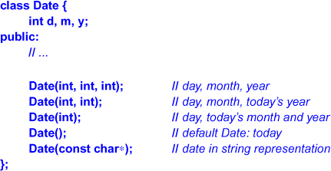

Constructor
declare a function with the explicit purpose of initializing objects.
Such a function constructs values of a given type, it is called a constructor.
A constructor is recognized by having the same name as the class itself.
Use {} to represent intialisation over ().
By guaranteeing proper initialization of objects, the constructors greatly simplify the implementation of member functions

Slide 6
Explicit vs Implicit Constructor
By default, a constructor invoked by a single argument acts as an implicit conversion from its argument type to its type.
complex<double> d {1}; // d == {1.0, 0}
Such implicit conversions can be useful.
However in many cases, such conversions can be significan source of confusion and errors.
An initialization with an = is considered copy initialization. Initializer is placed into the initialized object.
Leaving out the = makes the initialization explicit. It is known as direct initialization.

Slide 7
Member initialization in constructors
class Rectangle {
int width, height;
public:
Rectangle(int,int);
int area() {
return width*height;
}
};
Rectangle::Rectangle (int x, int y) { width=x; height=y; }
member initialization as:
Rectangle::Rectangle (int x, int y) : width(x) { height=y; }
Or even:
Rectangle::Rectangle (int x, int y) : width(x), height(y) { }

Slide 8
Delegating constructors
class Foo
{
Public:
Foo() { // code to do A }
Foo(int nvalue) {
// code to do A
// code to do B
}
};
In C++, it would be useful for one constructor to call another constructor in the same class.
This is disallowed in C++0X
This results in dublicate code.
Here the “code to do A” is defined twice.

Slide 9
Delegating constructor (cont...)
Use init() non-ctor function
class Foo {
Public:
Foo() { initA(); }
Foo(int nvalue) {
initA();
// code to do B
}
void initA() { // code to do A}
};
It is quite readable, but:
  Adds a new function and several function calls.
  initA() is not a constructor, it can be called during the normal program flow, where member variables and dynamic memory are set and allocated

Slide 10
Delegating constructors (cont...)
C++11
class Foo {
Public:
Foo() { // code to do A }
Foo(int nvalue) : Foo ()
// use Foo() default ctor to do A
{
// code to do B
}
};
It is much cleaner!
Use the initialization syntax when delegating ctor. Compilers which do not support delegating ctor will flag this as error.
If you call one ctor from the body of another ctor, the compiler will not complain and your code may misbehave.

Slide 11
Class Mechanics (Error 1)
Complex( double real, double imaginary = 0 )
: _real(real), _imaginary(imaginary)
{
}
Guideline:
Watch out for hidden temporaries created by implicit conversions. One good way to avoid this is to make constructors explicit when possible, and avoid writing conversion operators.
Constructor allows implicit conversion!
Because the second parameter has a default value, this function can be used as a single parameter constructor and, hence, as an implicit conversion from double to complex

Slide 12
Error 2: operator+ is probably slightly inefficient.
void operator+ ( ( Complex other )
{
_real = _real + other._real;
_imaginary = _imaginary + other._imaginary;
}
Guide:
Prefer passing objects by const& instead of passing by value
Also, in both cases, "a=a+b" should be rewritten "a+=b". This improve efficiency when adding class types.
For efficiency, the parameter should be passed by reference to const
Prefer writing "a op= b;" instead of "a = a op b;" (where op stands for any operator). It's clearer, and it's often more efficient.

Slide 13
Error 3: operator+ should not be a member function.
void operator+ Complex other
{
_real = _real + other._real;
_imaginary = _imaginary + other._imaginary;
Guide:
If you supply a standalone version of an operator (for example, operator+), always supply an assignment version of the same operator (for example, operator+=) and prefer implementing the former in terms of the latter
If operator+ is made a member function, as it is here, then it won't work as naturally as your users may expect when you do decide to allow implicit conversions from other types. Specifically, when adding Complex objects to numeric values, you can write "a = b + 1.0" but not
"a = 1.0 + b" because a member operator+ requires a Complex (and not a const double) as its left-hand argument.
It may make sense to provide the overloaded functions operator+(const Complex&, double) and operator+(double, const Complex&) too.

Slide 14
Error 4:
void operator+ ( Complex other )
{
_real = _real + other._real;
_imaginary= _imaginary + other._imaginary;
}
operator+ should not modify this object's value, and it should return a temporary object containing the sum.
Note that the return type for the temporary should be "const Complex" (not just "Complex") in order to prevent usage like "a+b=c".

Slide 15
Error 5: operator<< should not be a member function
void operator<< ( ostream os )
{
os << "(" << _real << "," << _imaginary << ")";
}
Also, the parameters should be "(ostream&, const Complex&)". Note that the nonmember operator<< should normally be implemented in terms of a(n often virtual) member function that does the work, usually named something like Print().

Slide 16
Error 6:
Further, operator<< should have a return type of "ostream&" and should return a reference to the stream in order to permit chaining. That way, users can use your operator<< naturally in code like "std::cout << a << b;".

Slide 17
Error 7: The preincrement operator's return type is incorrect.
Complex operator++()
{
++_real;
return *this;
}
Preincrement should return a reference to non-const—in this case, Complex&. This lets client code operate more intuitively and avoids needless inefficiency.

Slide 18
Error 8: The postincrement operator's return type is incorrect.
Complex operator++( int )
{
Complex temp = *this;
++_real;
return temp;
}
Postincrement should return a const value—in this case, const Complex. By not allowing changes to the returned object, we prevent questionable code like "a++++", which doesn't do what a naïve user might think it does.

Slide 19
References
Exceptional C++ - Herb Sutter

